Slide 1
Event Management System
Online Event management system was web-based application that enhanced project management to the creation and development of large scale events such as festivals, ceremonies, weddings, blood donation etc.

Slide 2
The process of planning and coordinating the event is usually referred to as event planning and it included budgeting, scheduling, site selection, acquiring necessary permits, coordinating Transportation and parking, arranging for speakers or entertainers, arranging decor, event security, catering, coordinating with third party vendors, and emergency plans.

Slide 3
UI For EMS

Slide 4
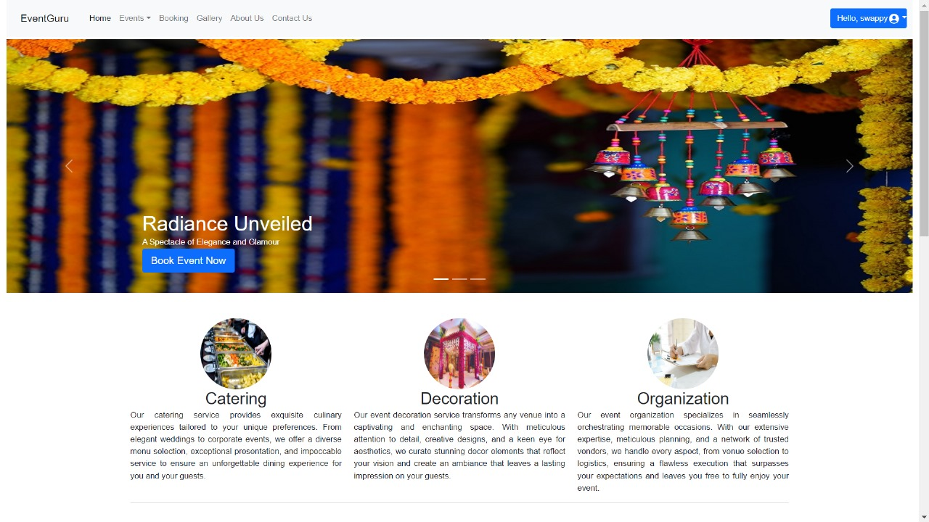
Home

Slide 5
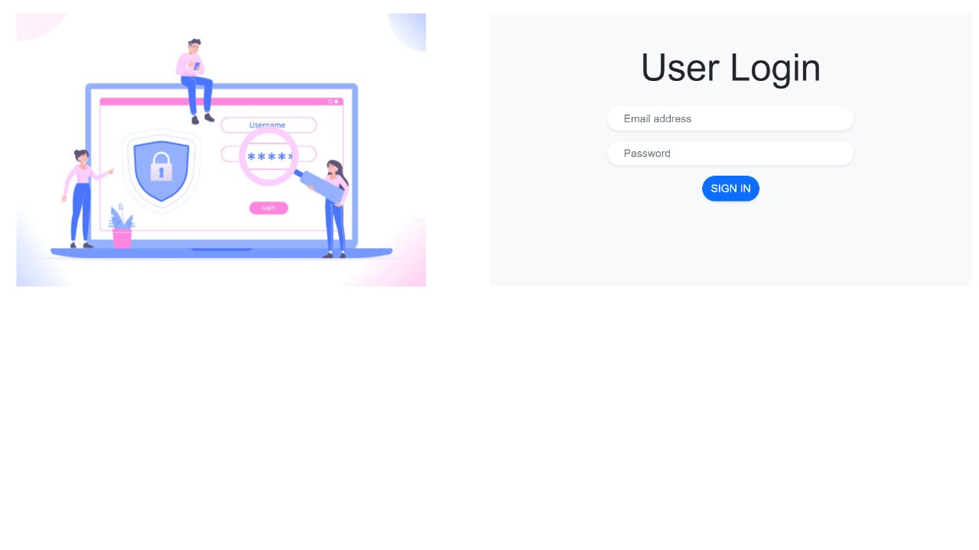
Login

Slide 6
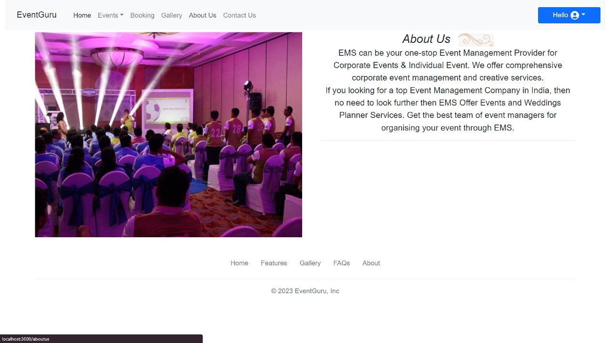
AboutUs

Slide 7
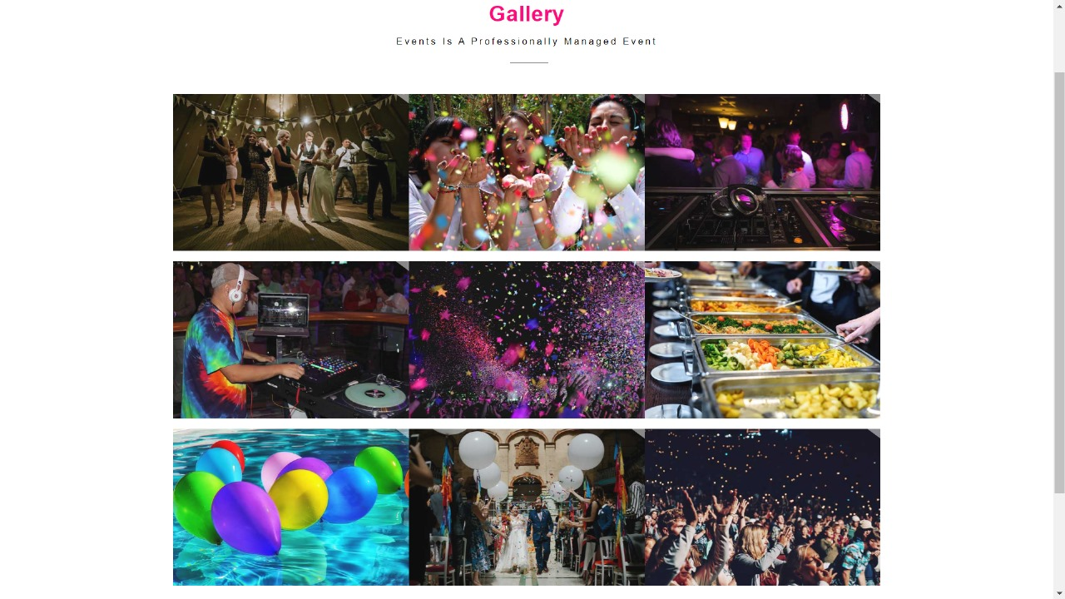
Gallary

Slide 8
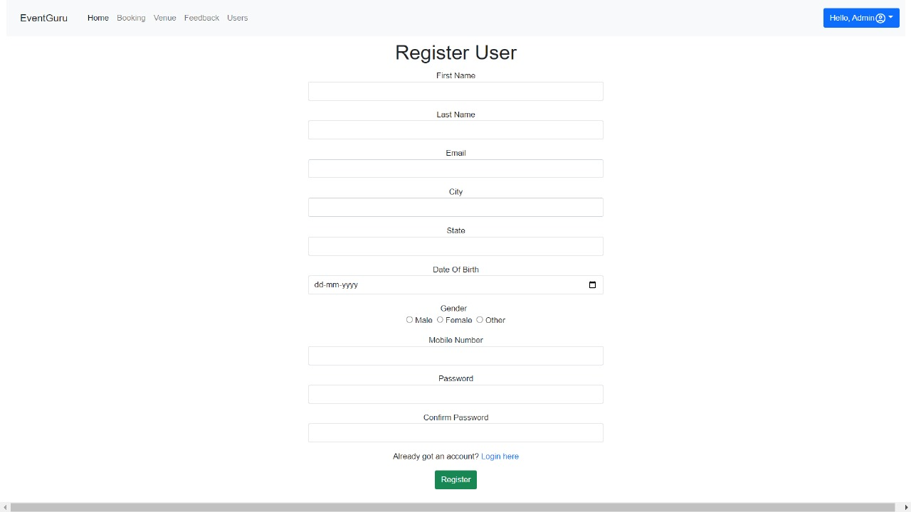
Registration

Slide 9
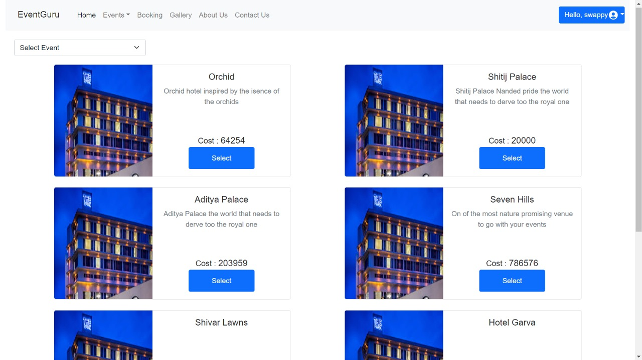
Hotel Details

Slide 10
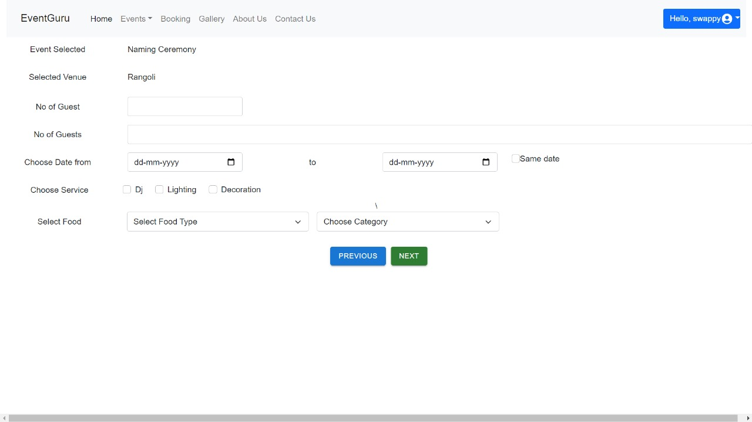
Booking Page

Slide 11
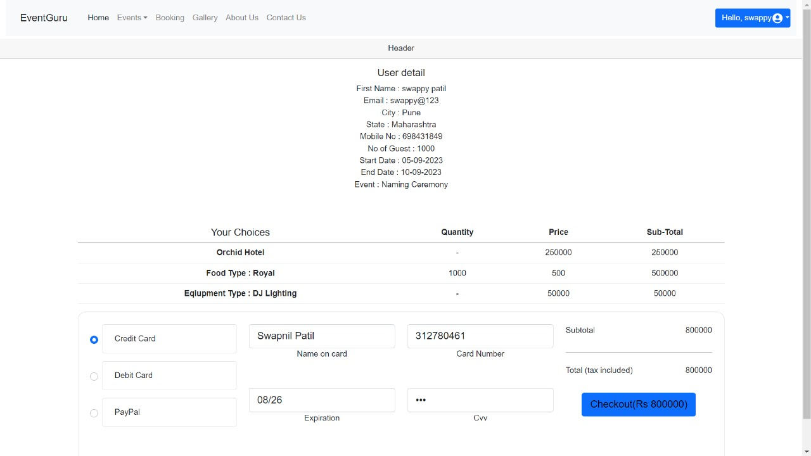
Billing Page

Slide 12
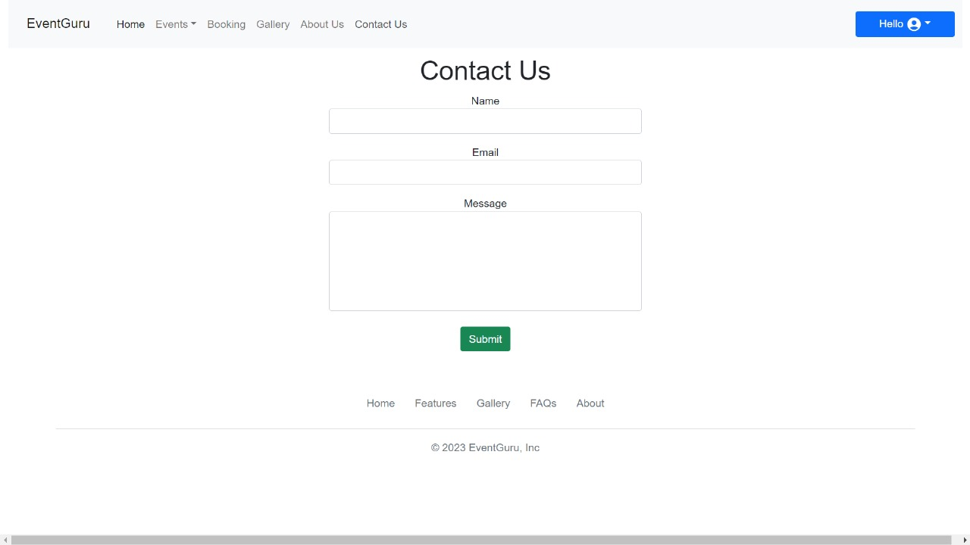
Contact Us

Slide 13
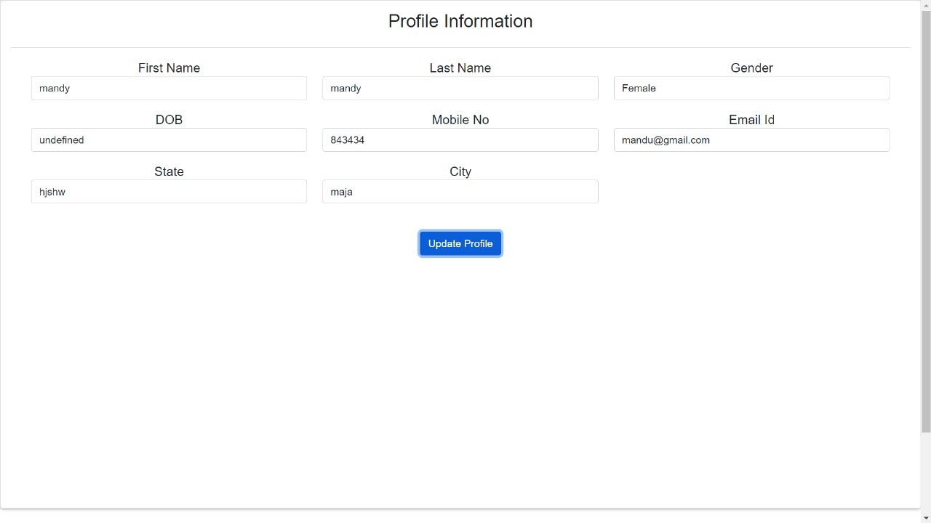
User Profile Update

Slide 14
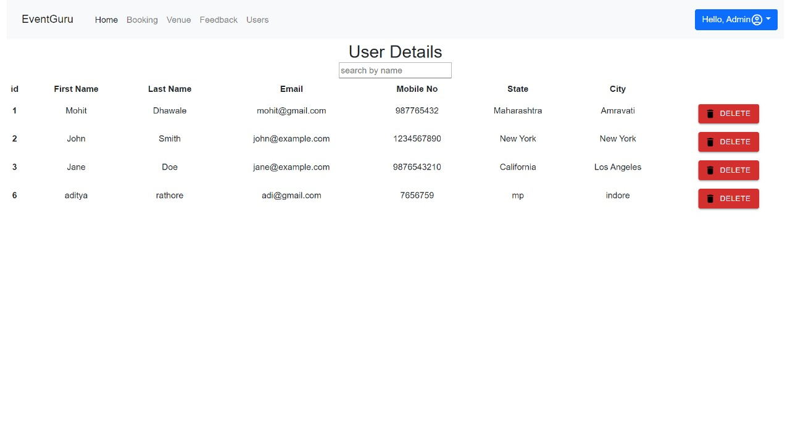
Delete User by Admin

Slide 15
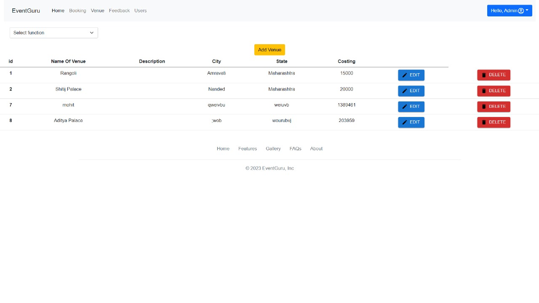
Add/Delete Venue by Admin

Slide 16
Thank you!!

