Slide 1
AI for Embedded Systems

Slide 2
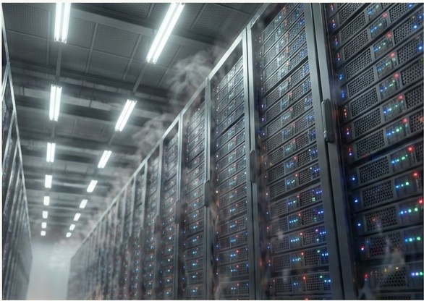
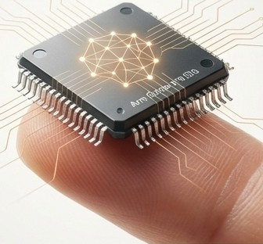
Intelligence Everywhere, No Cloud Required.
GPU vs TPU Intro
The next wave of AI isn't in massive data centres. It's in tiny, battery-powered devices that can run for years, making sense of their surroundings on their own. This is TinyML.
"Imagine 'peel-and-stick sensors'-devices that require no battery changes, can be applied anywhere in an environment, and forgotten."

Slide 3
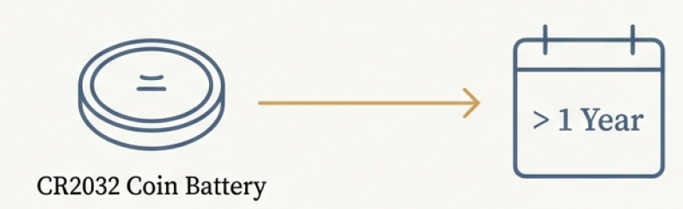

The 1 Milliwatt Revolution
I
I
--
I
I
> 1 Year
CR2032 Coin Battery
< 1 mW Power Consumption
~1 Year Battery Life
Device Class
TinyML Device
(e.g., Arm Cortex-M)
SBC
(e.g., Raspberry Pi Zero)
High-End Edge
(e.g., NVIDIAJetson)
Power
Memory
Cost
This isn't about shrinking desktop AI; it's about enabling a new class of intelligent, untethered devices.
<lmW
Tens of KB
< £1
~lOOs of mW
Hundreds of
MB
~£5-£10
Up to 12 Watts
Gigabytes
> £100

Slide 4
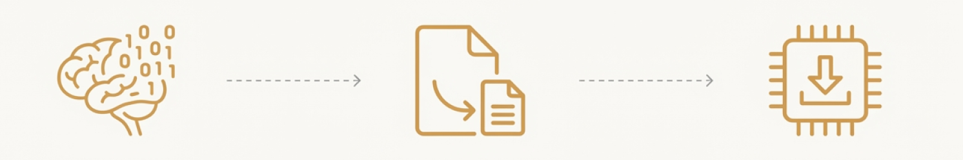
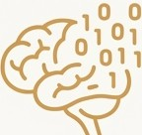



A Clear Path from Idea to Device.
-------------➔
₋--
2. CONVERT
-------------➔
1. TRAIN
3. DEPLOY
Load the converted model onto a microcontroller. Write C++ code to run inference locally using the TensorFlow Lite for Microcontrollers library.
Design and train a neural network using standard tools like TensorFlow and Keras, typically in a powerful environment like
a desktop or the cloud (e.g.,
Google Colab).
Use the TensorFlow Lite Converter to transform the trained model into a highly efficient, space-optimised format.
This step includes crucial optimisations like quantization.

Slide 5
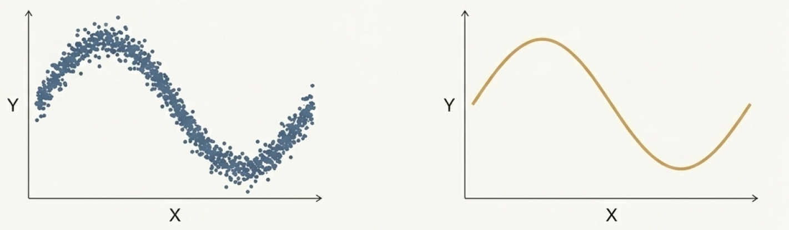
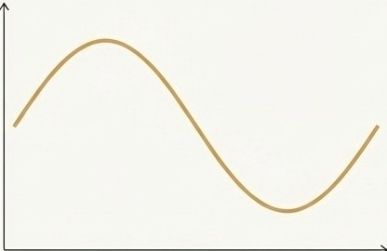
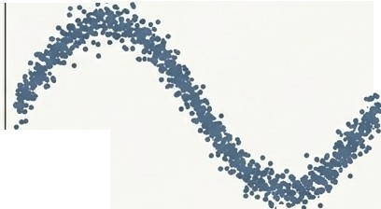
Project 1: Teaching a Microcontroller Trigonometry.
Train a model to approximate a simple mathematical function: a sine wave. This serves as the 'Hello World' of TinyML.
Training Data
• • •
Model's Goal
•
y
y
••• •
X
We start with imperfect, noisy data, just like in the real world.
X
The model's task is to learn the underlying pattern, ignoring the noise.
By training a model to approximate a known result, we can demonstrate the fundamental principles of machine learning on a microcontroller.

Slide 6
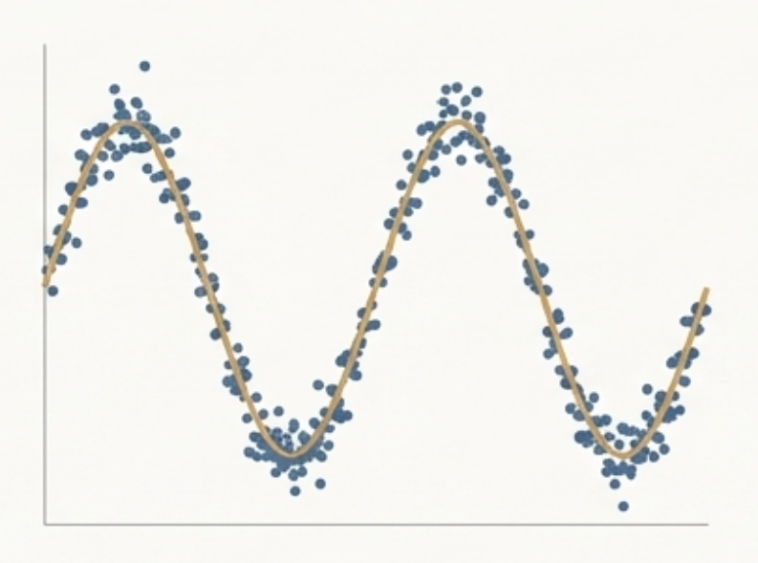
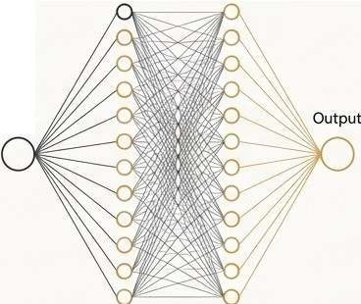


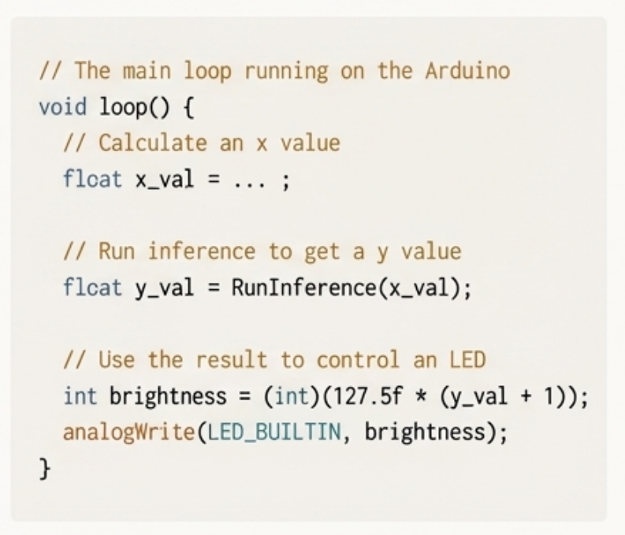


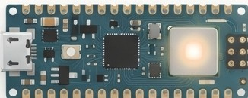
From Data to a Blinking Light.
The Model
Dense (16) Dense (16)
The Result
The Deployment
•
Quantized Model Size: 2,512 bytes
•
•
II The main loop running on the Arduino void loop() {
II Calculate an x value float x_val = ...;
Input
•
II Run inference to get a y value flcat y_val = Runinference(x_val);
II Use the result to control an LED
int brightness= (int)(127.5f*(y_val + 1)); analogWrite(LED_BUILTIN, brightness);
Dense (16)
Dense (16)
}
Total Parameters: 321

Slide 7
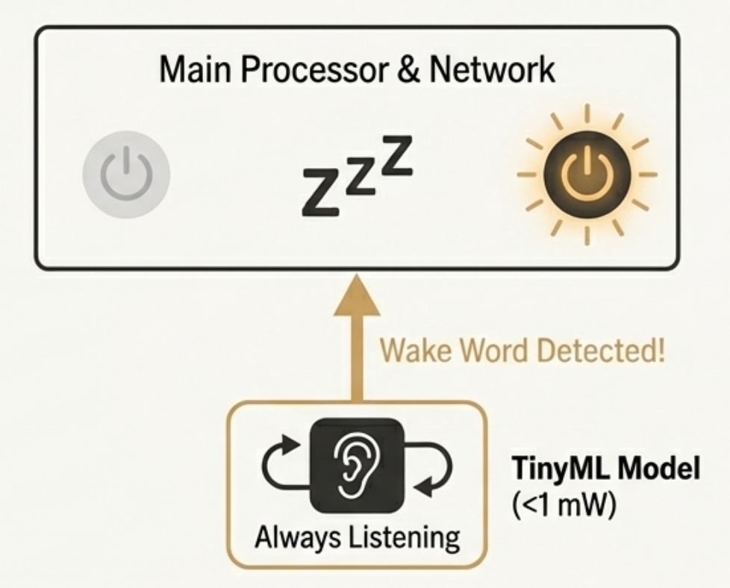

Project 2: Always-On Voice, Without Sacrificing Privacy.
The TinyML Solution
Main Processor & Network
\
I /
The Problem
- -
How do devices like 'OK Google' or 'Alexa' listen constantly without sending all audio to the cloud?
Wake Word Detected!
Privacy: Streaming all audio is unacceptable.
TinyML Model
(<1mW)
Bandwidth: Constant streaming is impractical and costly.
Always Listening
A tiny, ultra-low-power model runs locally, listening for just the wake word. It only 'wakes up' the main processor and network when a match is found.
D
Battery: Network communication would drain a mobile device in hours.
The pretrained wake-word model is just 18 KB.

Slide 8
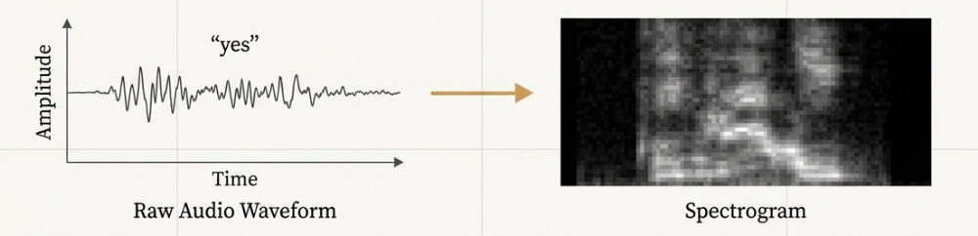
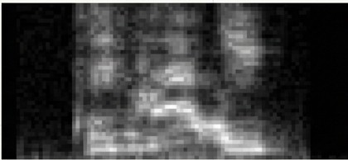

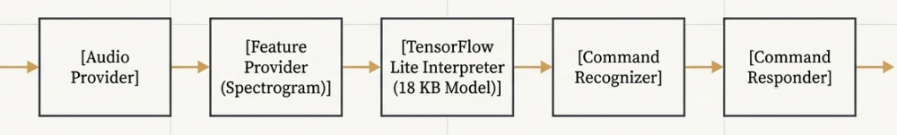


Turning Sound into a Picture
The model doesn't process raw audio waveforms. Instead, one second of audio is converted into a
spectrogram-a 2D representation of frequency intensity over time.
Q)
"_{.a}O
((yes"
Time
Raw Audio Waveform Spectrogram
The model learns to recognise the visual patterns in the spectrogram, which are more distinct than raw audio.
[Audio Provider] | � | [Feature Provider (Spectrogram)] | � | [TensorFlow Lite Interpreter (18 KB Model)]
 | ,
[Command Recognizer] | � | [Command Responder] | �
 |  |  | ,
►
►

Slide 9
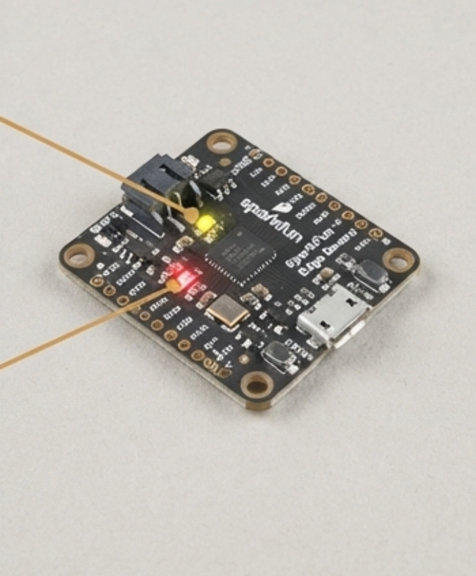
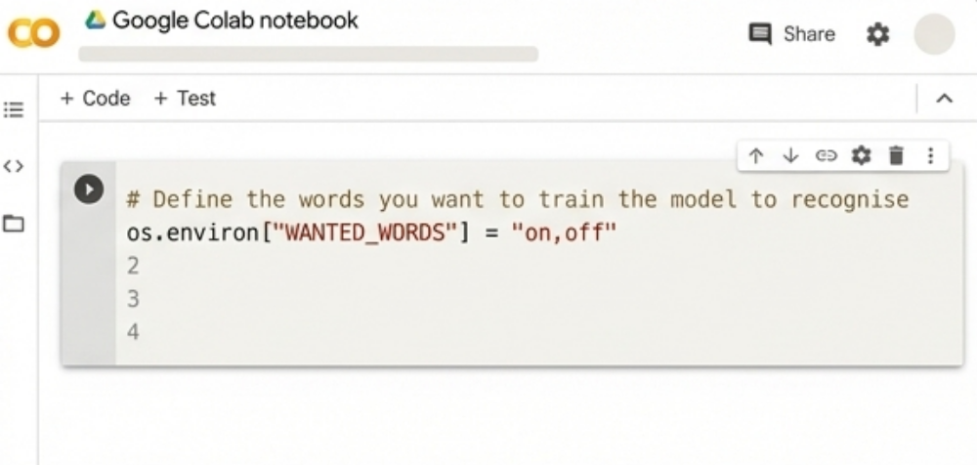
A Customisable Voice Interface
In Action
Training Your Own Words
The device responds to 'yes' (Yellow LED)
and 'no' (Red LED) by running inference on
a continuous stream
of audio.
The provided training scripts and Colab notebook allow you to easily train a new model on different words from the Speech Commands dataset, or even your own custom audio.

Slide 10
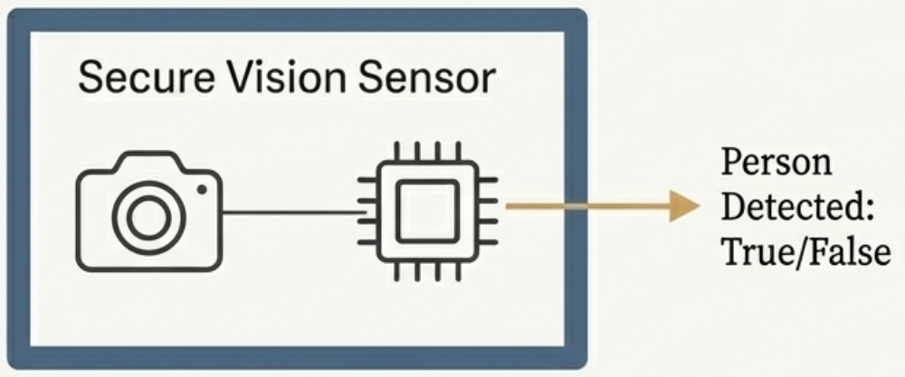
Project 3: On-Device Vision that Respects Privacy.
The Problem:
Smart cameras are useful but create significant privacy risks. How can we build devices that see without streaming or storing images?
The TinyML Solution:
A self-contained vision sensor.
A microcontroller and camera module run a model that detects the presence of a person. The raw image data never leaves the device.
Use Cases
Smart appliances that power down when a room is empty.
Security systems that alert without sending video to
the cloud.
Wildlife counters that operate for years in remote locations.

Slide 11
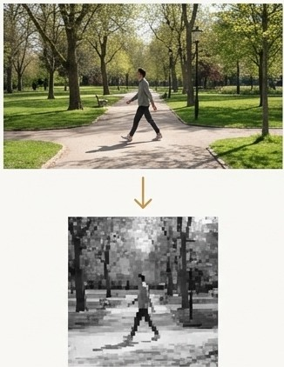
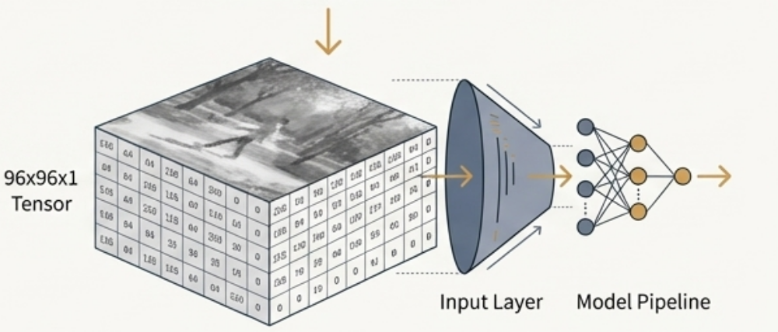
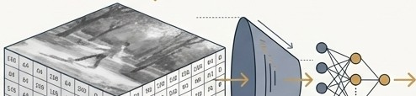

A Simple Pipeline for a Complex Sense
The Model
Based on the efficient MobileNet architecture.
Trained on the Visual Wake Words dataset dataset.
Model Size: 250 KB
t
The Input
Unlike audio, the model works directly with pixel data, requiring minimal preprocessing.
Input Spec: 96 x 96 pixel, 8-bit grayscale images.
96x96xl
Tensor
0
0
0
0
Input Layer
Model Pipeline
0 0

Slide 12
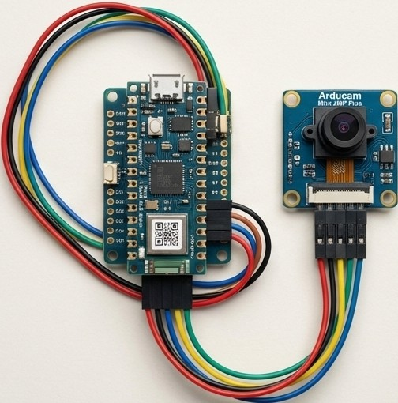
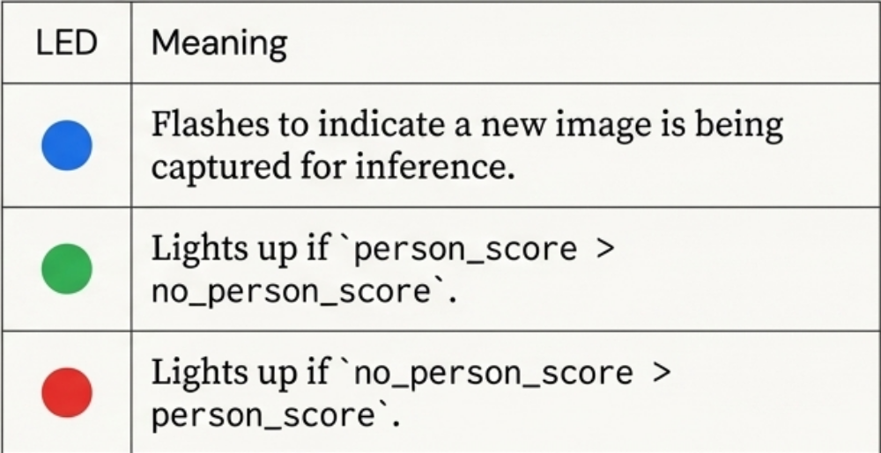



Person Detection, Live on an Arduino
The Output Logic
LED | Meaning
 | Flashes to indicate a new image is being captured for inference.
 | Lights up if' person_score > no_person_score' .
 | Lights up if' no_person_score > person_score' .
Inference on this model takes several seconds on the microcontroller, highlighting the trade-off between model complexity and latency on tiny hardware.

Slide 13
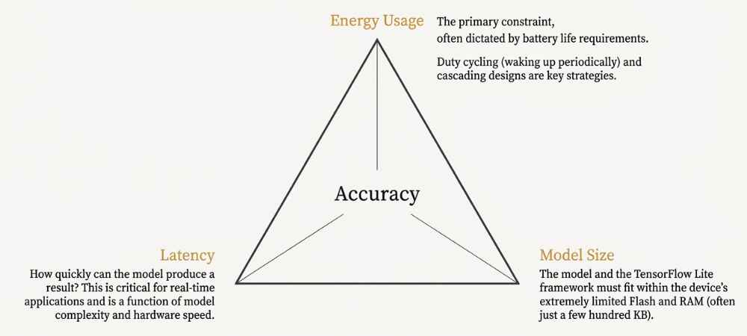
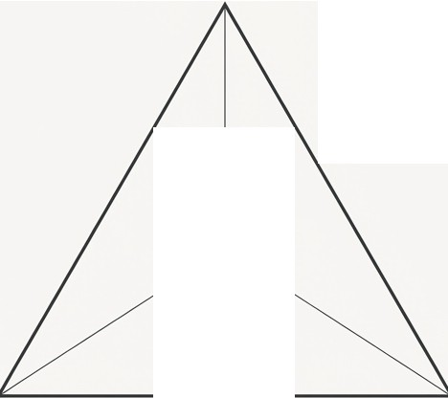
The Three-Way Trade-Off of TinyML Design
Every TinyML application requires balancing three critical, often competing, constraints.
Energy Usage
The primary constraint,
often dictated by battery life requirements.
Dutycycling (waking up periodically) and cascading designs are keystrategies.
Accuracy
Latency
How quickly can the model produce a result? This is critical for real-time applications and is a function of model complexity and hardware speed.
Model Size
The model and the TensorFlow Lite framework must fit within the device's extremely limited Flash and RAM (often just a few hundred KB).
Optimising one area, such as reducing latency with a larger model, often negatively impacts another, like energy use or memory footprint.

Slide 14

Model Size vs. Problem Complexity
The size of a neural network is a primary driver of its memory usage and latency. Here are typical sizes for common TinyML tasks.
Speech Wake-Word
Detection
A small convolutional model designed for high efficiency. Can classify a few keywords from spectrogram input.
20KB
Accelerometer
Gesture Recognition
A model that analyses time-series data from an accelerometer to recognise simple gestures like a 'wing' or 'ring' shape.
20KB
A much larger MobileNet-based vision model. Pushes the limits of many microcontrollers but provides powerful visual capabilities.
Person Presence Detection (Vision)
250 KB
Model Size (KB)

Slide 15

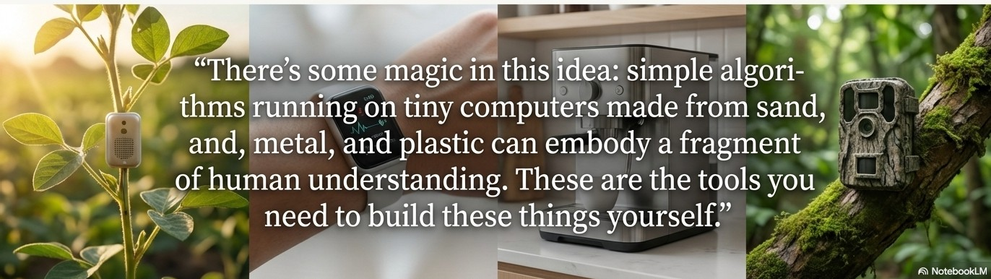
0
The Tools to Build a Smarter, More Private World.
TinyML provides a complete, open-source toolkit to embed machine learning into billions of
low-cost, low-power devices.
Run on a Coin Battery for a Year: Unlocks 'fire-and-forget' deployments.
@
0
Process Sensor Data Locally: Enables fast, responsive, and offline operation.
Preserve User Privacy by Design: Processes sensitive data (voice, images) on-device, never sending it to the cloud.

Slide 16
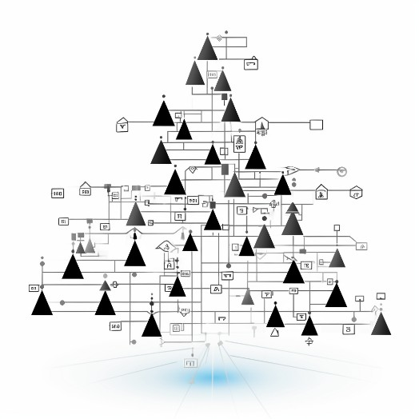
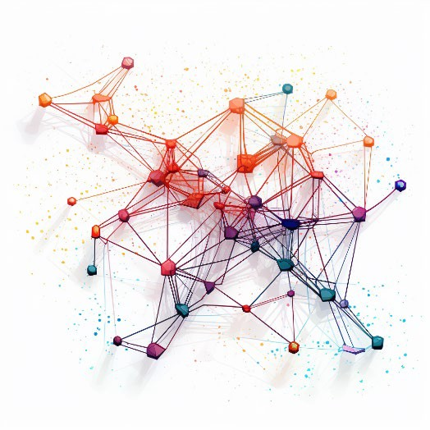

What is artificial intelligence
Embedded artificial intelligence
The ability of machines to perform tasks that typically require human intelligence
From a technical perspective, AI is another way to program a machine.
Perception Reasoning Learning Decision-making

Slide 17
The AI Hierarchy – AI → ML → DL → GenAI
1. Artificial Intelligence (AI) – The Big Umbrella
Broadest field enabling machines to perform tasks requiring human intelligence
Focus: reasoning, decision-making, language understanding, perception
Examples: Voice assistants (Siri, Alexa), route navigation, game bots (chess, FIFA)
2. Machine Learning (ML) – Learning from Data
Subset of AI
Systems learn patterns from data instead of being explicitly programmed
Improves automatically with experience
Examples: Spam filters, Netflix/Amazon recommendations, fraud detection

Slide 18
Deep Learning & Generative AI
3. Deep Learning (DL) – Neural Networks
Subset of ML
Uses multi-layer neural networks inspired by the human brain
Excels in processing unstructured data: images, audio, video
Examples: Face ID, speech-to-text, Google Photos auto-tagging, self-driving car vision
4. Generative AI (GenAI) – Creating New Content
Subset of Deep Learning
Goes beyond recognizing patterns — it creates new text, images, music, and code
Examples: ChatGPT (text/code), DALL-E & Midjourney (image generation), GitHub Copilot (code assistance)
Transforming content creation across design, marketing, music & education

Slide 19
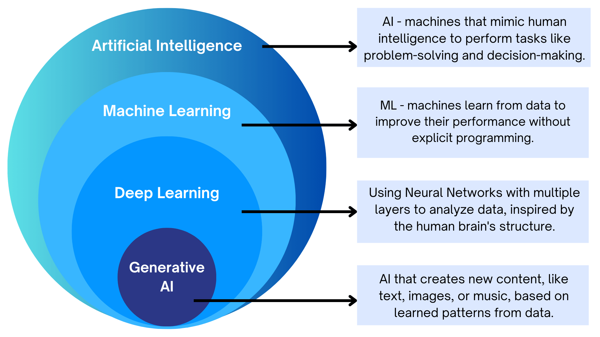
The AI Hierarchy

Slide 20
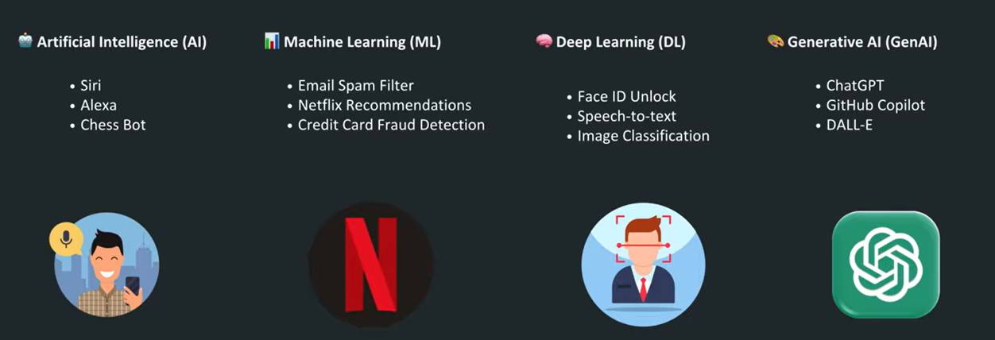
Use Cases

Slide 21
Machine Learning — A Simple Summary
Machines produce data during operation (e.g., vibration, temperature, speed).
By collecting this data over time, we can predict failures before they happen, reducing downtime and repair cost.
Machine Learning (ML) is the technique that allows computers to learn patterns from past data and predict future behavior.
Instead of manually defining rules, programmers feed data into ML algorithms that automatically discover patterns and relationships.
The algorithm uses this data to build a model through a process called training.
Once trained, the model processes new incoming data to make predictions — this stage is called inference.
ML enables systems to make complex decisions without requiring developers to understand every internal detail of the system.

Slide 22
Deep Learning – A Popular Approach to Machine Learning
What Is Deep Learning?
A leading machine learning approach inspired by how the human brain works
Uses networks of simulated neurons (arrays of numbers) to learn patterns
Models relationships between inputs and outputs through training
Why Different Architectures?
Deep learning networks come in various designs, each specialized for a type of task
Image understanding: Convolutional Neural Networks (CNNs) extract features like edges, shapes, objects
Sequence prediction: Recurrent Neural Networks (RNNs), LSTMs, and Transformers predict future values in time-series or text
Key Idea
Deep learning becomes powerful by automatically discovering complex patterns suited to the problem—whether it’s images, speech, text, or sensor data.

Slide 23
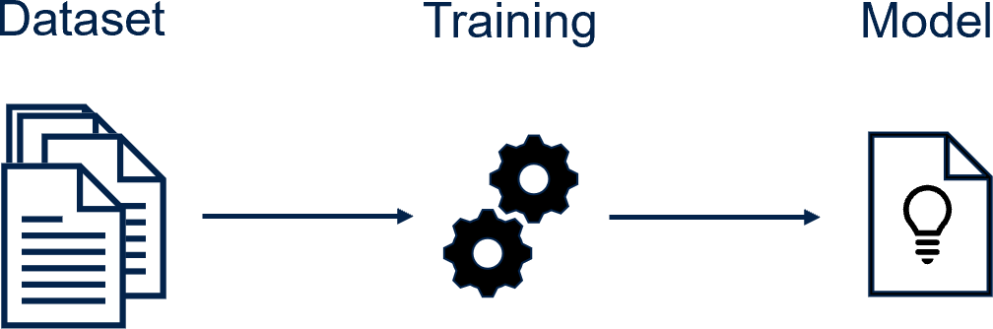
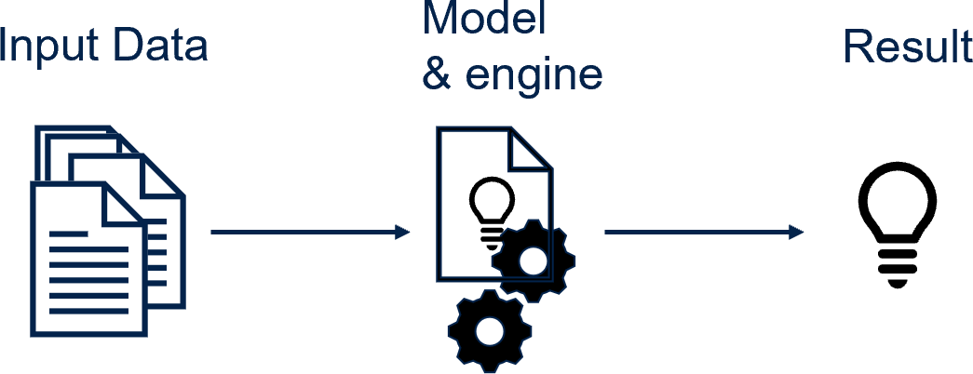
Using AI algorithms implies two phases
Training
Inference
Using datasets (like examples)
and a training engine/framework we are producing a model.
Then during the second phase, we can use this model. This is the inference phase.
ST Sensor

Slide 24
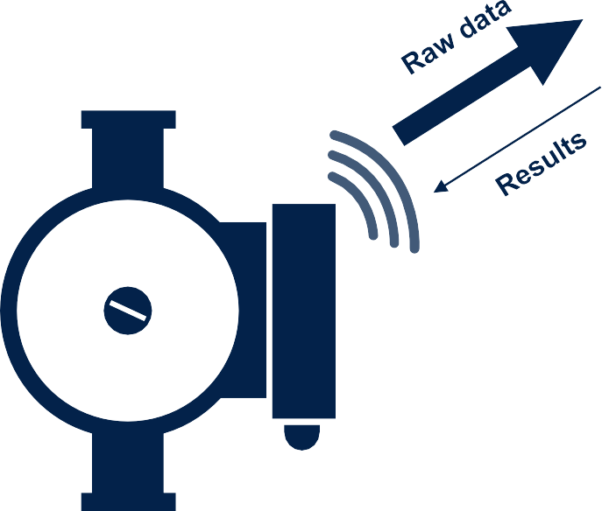
The next leap for intelligent products
Technology is moving beyond simple connectivity to on-device autonomy, where products can infer locally
Cloud-based AI (IoT devices)
Edge AI
Cloud AI
Cloud
AI inference storage & dashboarding
Optional storage & dashboarding
AI

Slide 25
Where should your intelligence live?
For products that need to be reliable, fast, and secure, edge AI is not an option: it's a necessity.
 | Cloud-based AI | Edge AI (on-device)
Decision speed | Slow (seconds) due to network latency. | Instant (milliseconds) for real-time action.
Connectivity | Required: Fails without an internet connection. | Not required: Fully autonomous and reliable.
Privacy & security | Vulnerable: data is transmitted externally. | Secure by design: Data never leaves the device.
Operational cost | High cloud computing fees for data server usage | Minimal: No data transmission costs. No cloud services cost
Power efficiency | High computational bandwidth to process the data collected by local devices | Minimal: local data processing reduces transmission loads
Important to note

Slide 26
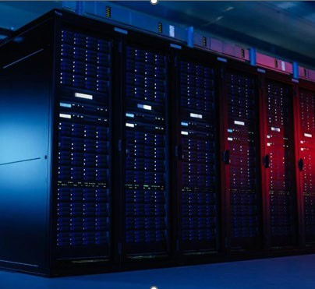
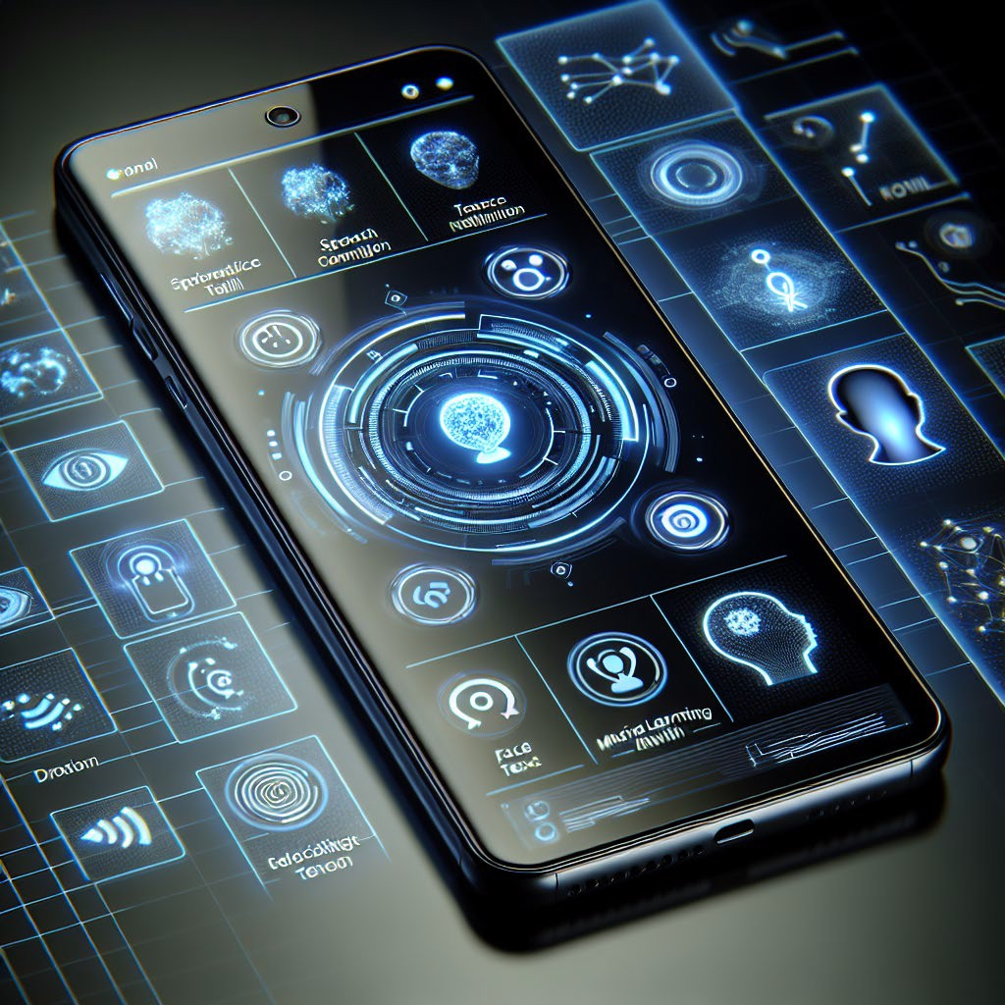
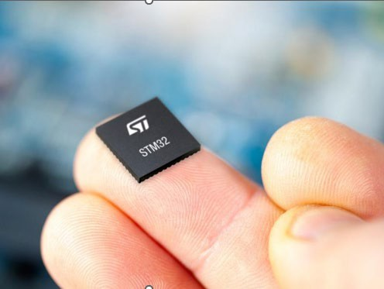
The explosion of AI-enabled devices is accelerating the inference shift from the cloud to the tiny edge
Inference
Cloud-centric
On device-centric
Tiny edge-centric
Enabled by a different class of hardware and software

Slide 27
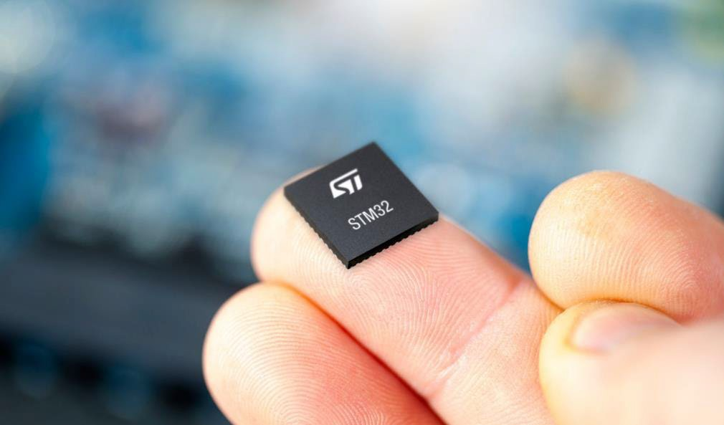
Inferring at the edge brings substantial benefits
Ultra-low latency
Real-time applications
Tiny edge-centric
01
10
Reduced data transmission
Generate meaningful information
01
10
Enhanced privacy and security
No data sharing in the cloud
Enhanced privacy and security
No data sharing in the cloud
Sustainable on energy
Low data, low power
Lower cost of inference to enable a new class of operations

Slide 28


Opening a new range of embedded AI applications
Upgrade existing devices with AI-based services
Reduce BoM by shifting from MPUs to MCUs
Offer advanced services without cloud costs
Arc Fault Detection
Object Classification
People Detection
Predictive Maintenance
Pose Estimation
Sound Analysis
Battery Management
Object Segmentation
Speech Recognition
A few KOPS
Tens of TOPS

Slide 29
AI addresses a wide variety of projects
ST Examples Link
Smart city
Smart buildings
Smart home
Energy
Industry 4.0
Healthcare
Energy optimization Traffic management Public safety
Public transportation
Energy optimization Access control Safety
Predictive maintenance
Outdoor cameras Babycams
Smart doorbells Home appliances Energy management Lawn mowers Vacuum robots
Solar panels Breaker's control EV chargers Smart meters Fraud detection
Predictive maintenance Tools safety Environment monitoring
Wearables Patient monitoring Fall detection
Predictive maintenance
Battery management
Arc fault detection
Face / object recognition
Anomaly detection

Slide 30
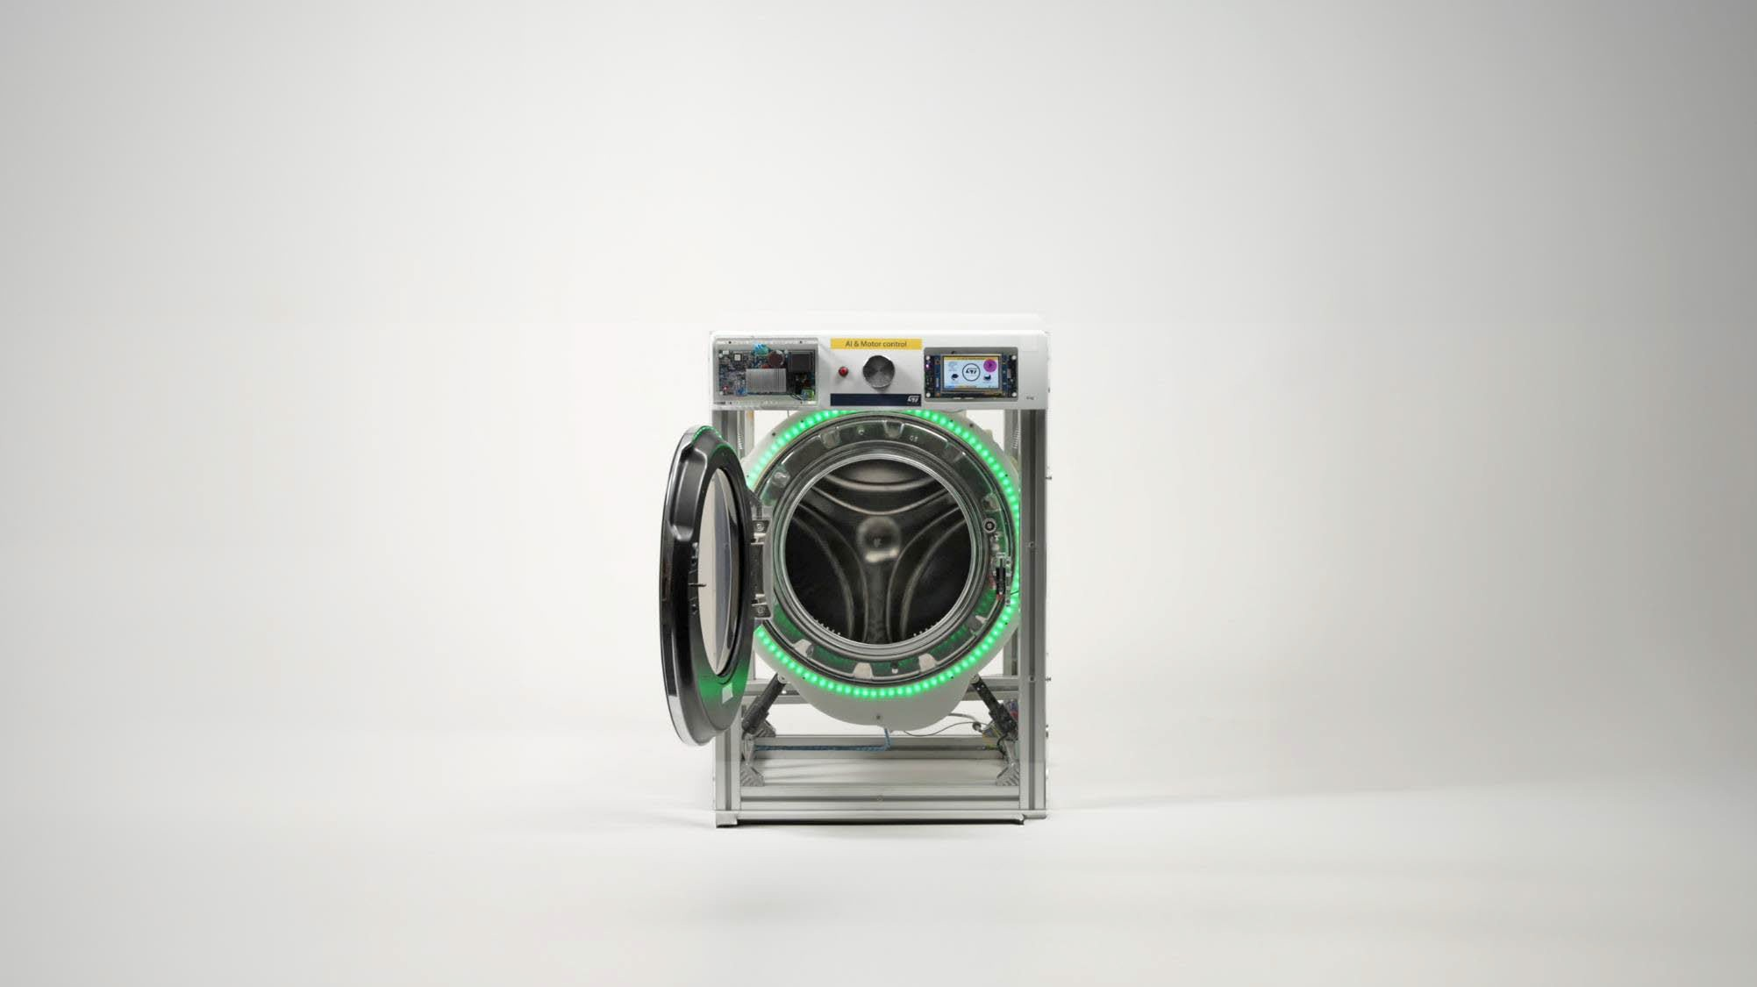
A washing machine uses advanced motor control algorithms to weigh clothes and optimize water, detergent, and energy used
~15-40%
Energy saving per washing cycle
Leader in white-goods
Production starting in 2024 for millions units

Slide 31
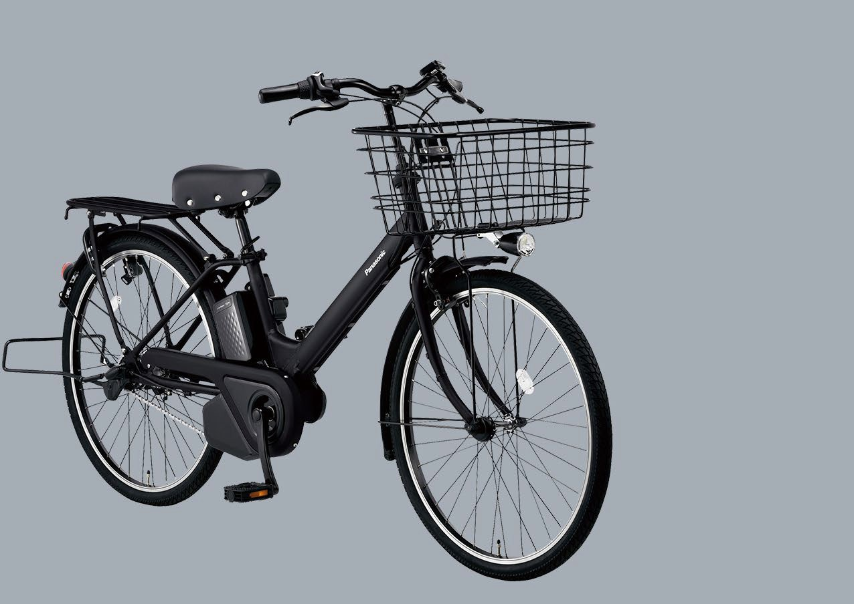

Adding tire pressure detection capability to e-bikes
without adding any new hardware
Virtual sensor
Tire pressure measured through the e-motor current consumption
Panasonic e-bike
Hundreds of thousands of units annually, starting in 2024

Slide 32
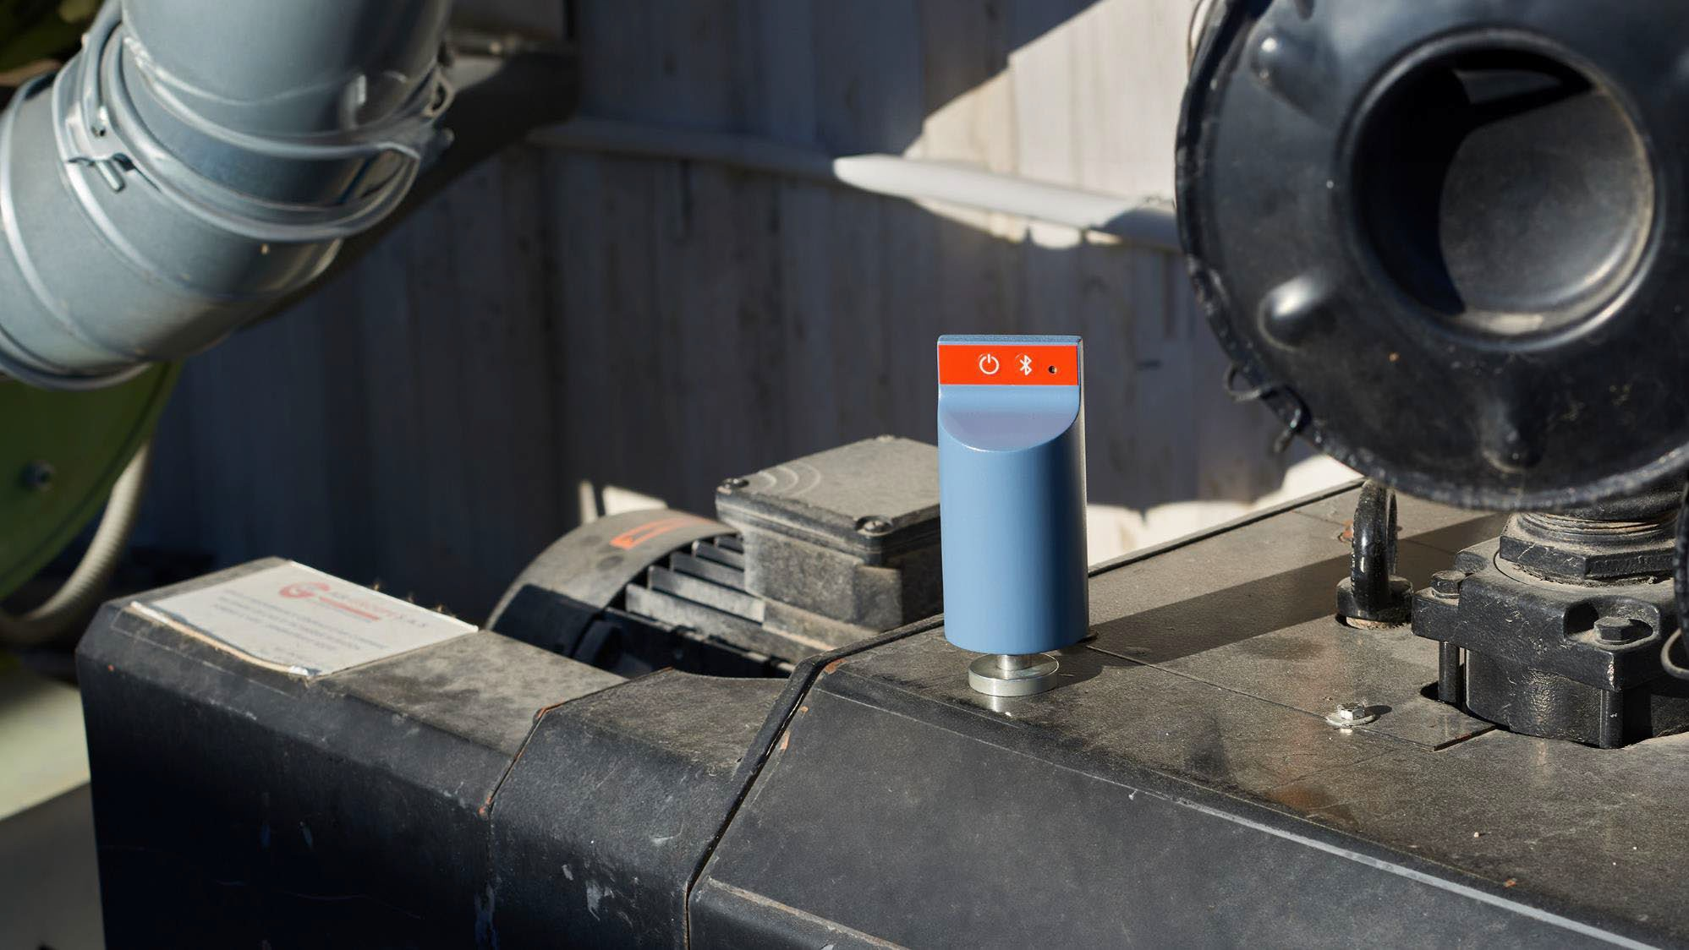


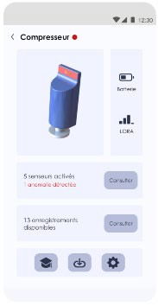
After-market predictive maintenance
intelligent sensor with wireless connectivity
Predictive maintenance
Multisensors and learning on device
EMEA company Deployed at Volvo Trucks
manufacturing plant

Slide 33
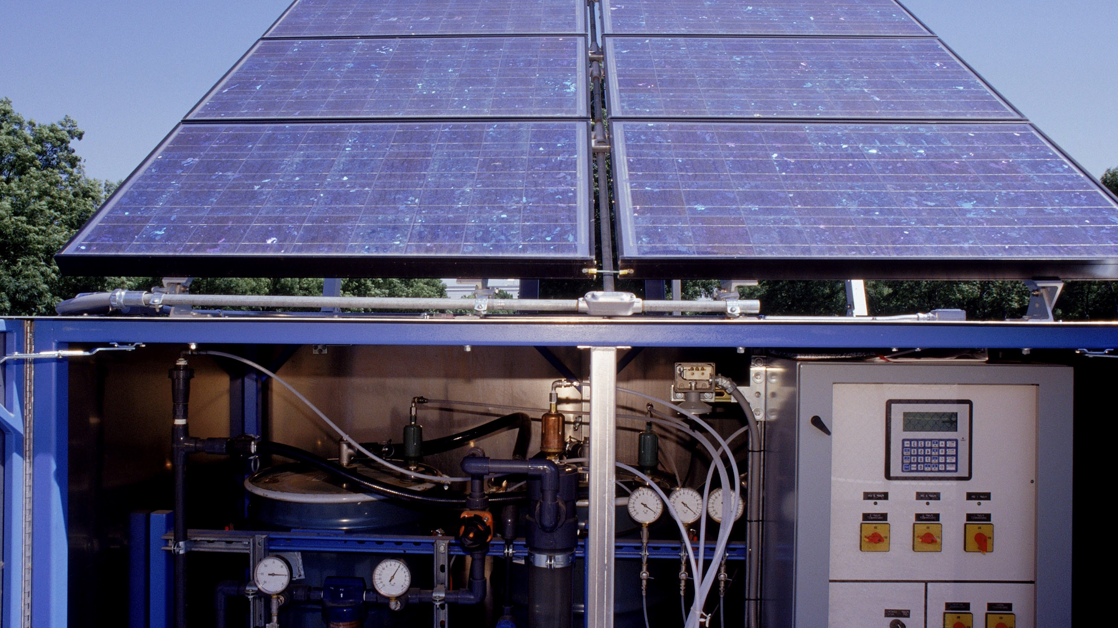

Adapt your arc fault algorithm to multiple scenarios: cable length, noise, weather, charges, and more.
Create a versatile solution to detect electrical arc faults.
Electrical arc detection
Enhanced accuracy to avoid false detection

Slide 34







Industrial pumps learn their own optimal mode of operation and detect anomalies by themselves
Predictive maintenance
Simplified large-scale deployment with the device learning feature

Slide 35






Vibration sensors – Condition monitoring
Machine conditions
Vibration
Power / current
Magnetic field
Air pressure
Conditions start to change
Noise
Temperature
Imbalance
Looseness
Output shaft
Gear Mesh
Smoke
Failure
Time
Mechanical vibration
Displacement
Speed
Acceleration
Angular speed
Torque
Acoustic noise
t
Minutes
Days
Weeks
Months

Slide 36
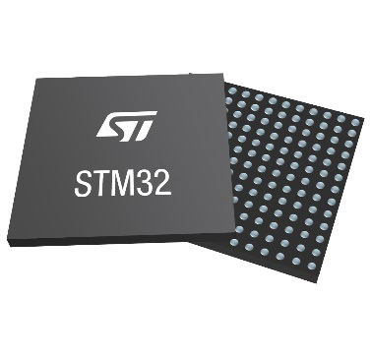
The challenge of deploying embedded AI
Memory footprint
AI expertise
Inference time
eSW development
Data
Power consumption
Deploying embedding AI on MCUs is NOT a walk in the park

Slide 37
Taking up the edge AI developer’s challenge
Performance
Create, deploy & maintain ML models
Security
Power efficiency

Slide 38



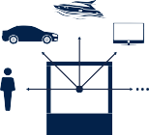
Types of AI Processing
STM32Cube Monitor
Time-series
Simple computer-vision Audio processing
Advanced computer-vision
Predictive Maintenance
Sound Analysis
Pose Estimation
Arc Fault Detection
People Detection
Object Classification
Battery Management
Speech Recognition
Object Segmentation

Slide 39
STM32Cube Monitor is tuned to Visualize time-series data
A time series data is a sequence of data points collected or recorded over time, usually at regular intervals.
Simple Definition
Time series data = data + timestamp
Every value is associated with a specific point in time.
Examples
Temperature readings recorded every hour
Stock prices captured every second or every day
Heart rate signals recorded every millisecond
Sensor data from machines (vibration, pressure, speed)
Sales numbers logged daily, weekly, or monthly
Key Characteristics
Time-ordered: The sequence matters
Patterns evolve over time: Trends, seasonality, bursts
Used for prediction: “What happens next?”
Why It’s Important in ML
Time series data helps models learn from the past to forecast the future—used in anomaly detection, finance, IoT, predictive maintenance, etc.

Slide 40
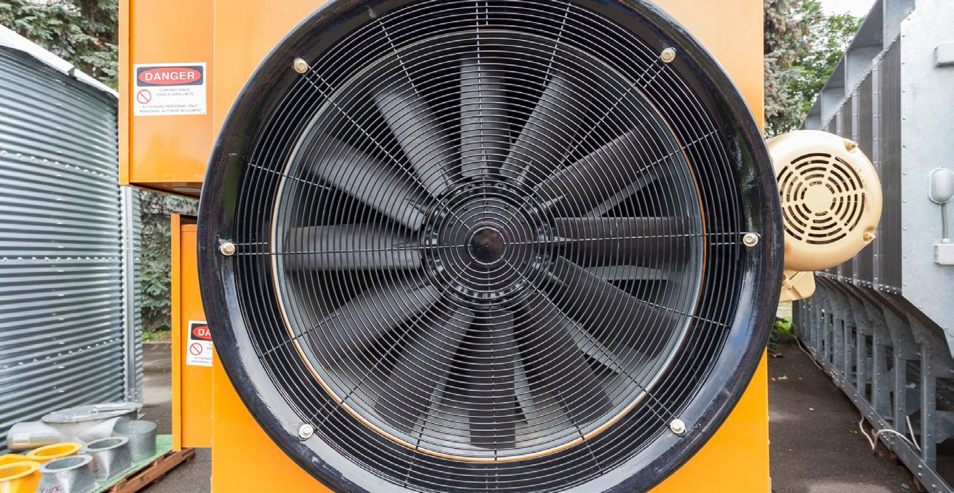
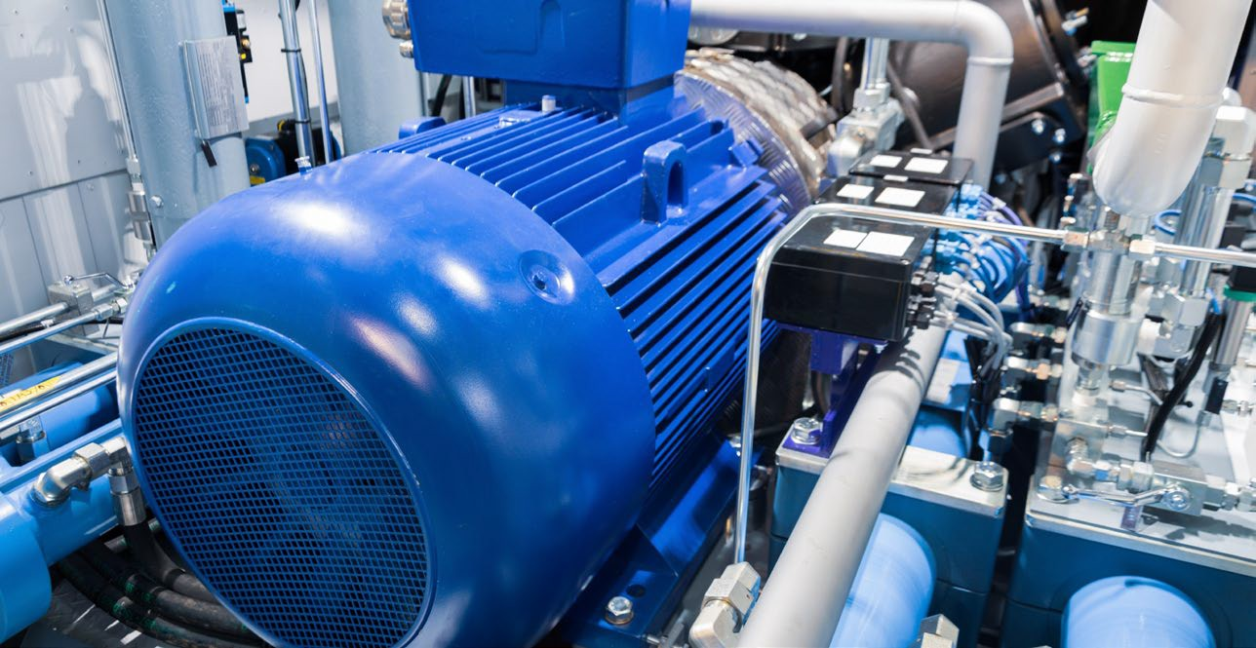
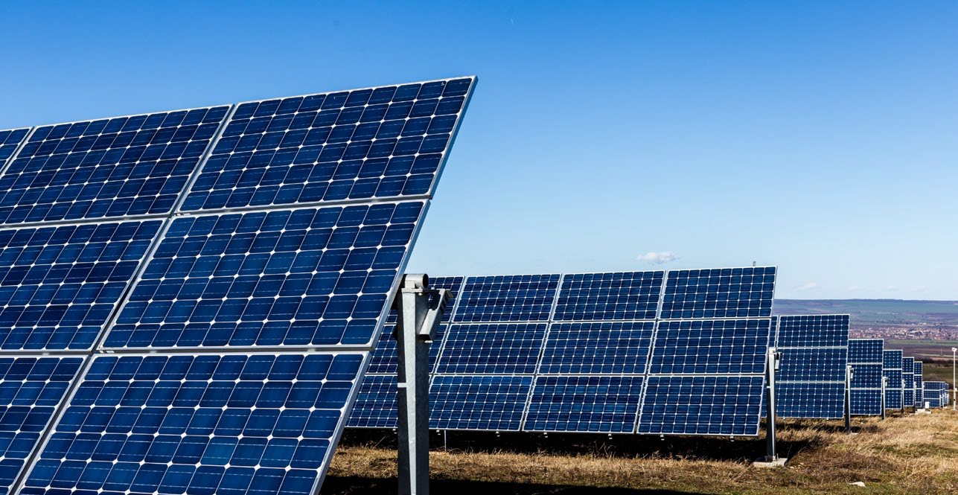
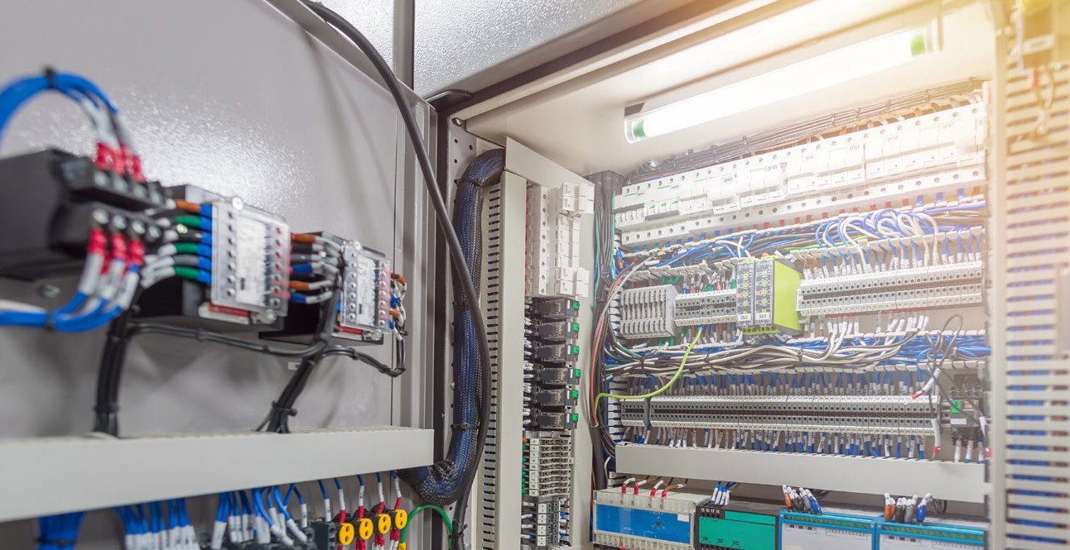

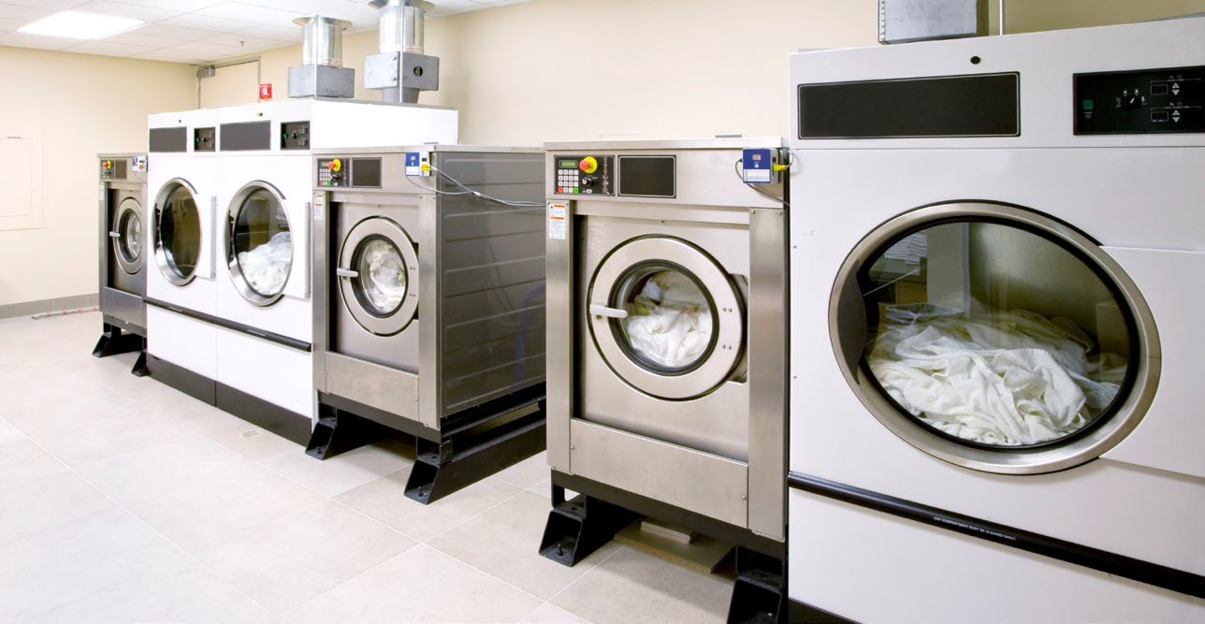
Where do time-series data matter?
Industrial motors
Industrial pumps
Solar panels
Breakers
Power tools
White goods
40

Slide 41


Unlock the hidden value in your sensors
Motion sensors
Current sensors
Time-of-Flight (ToF) sensors
Vibration analysis, predictive maintenance, appliance monitoring, anomaly detection
Power monitoring, battery management, motor control, arc-fault detection, anomaly detection
Distance ranging, multitarget detection, gesture recognition
Temperature sensors
MEMS microphones
Biosensors
Asset tracking, virtual sensor
Ultrasound analysis
Heart rate, ECG, EEG

Slide 42



Steps to deploy AI on MCU’s
DATA
Bring your own data (BYOD)
MODEL
MODEL ZOO
ML
ML
Bring your own model (BYOM)
ML
ML
ML
AI for OpenSTLinux
Neural network model optimizer & app examples
ST Edge AI Core AI framework for OpenSTLinux
Neural network model optimizer
STM32Cube.AI for desktop
MPU Offline compiler
X-LINUX-AI
STM32Cube ecosystem
Command Line Interface
Microcontrollers (MCU) Microprocessors (MPU)
Desktop tools

Slide 43











One tool – two versions to deploy AI on STM32
ST Edge AI model zoo
Optimize your NN model
Generate optimized code
OR
Bring your own model
Optimized model code for STM32
via
via
STM32Cube.AI for desktop
STM32Cube ecosystem
Command-line interface
ST Edge AI Developer Cloud
Online platform
REST API
Benchmarking tool

Slide 44


The 3 pillars of STM32Cube.AI
Graph optimizer
Quantized model support
Memory optimizer
Automatically improve performance through graph simplifications & optimizations that benefit STM32 target hardware architectures
Import your quantized ANN to be compatible with STM32 embedded architectures while keeping their performance
Optimize memory allocation to get the best performance while respecting the constraints of your embedded design
Auto graphs rewrite
Node/operator fusion
Layout optimization
Constant-folding…
Operator-level info to fine-tune memory footprint and computation
From FP32 to Int8 or mixed-precision
Minimum loss of accuracy
Code validation on target
  Latency
  Accuracy
  Memory footprint
Memory allocation
Internal/external memory repartition
Model-only update option
STM32Cube.AI is free of charge, available both in graphical interface and in command line.

Slide 45






Three machine learning algorithm families for Embedded AI
I want to anticipate product failures
Industrial pumps learn their own optimal mode of operation and detect anomalies by themselves
Clustering →
I want to identify the activity, the environment, the usage
Smart watches classify human activity recognition without using connectivity features
Classification
→
I need to predict future states
A virtual sensor for tire pressure in an eBike estimates pressure based on motor current measurements
Extrapolation/Regression
→

