Slide 1
RTOS Concepts for
Embedded Systems

Slide 2
Syllabus
What are Real-Time Systems?
Characteristics of Real-Time Systems: Timing Constraints, Determinism, Predictability
Types of Real-Time Systems: Hard Real-Time, Soft Real-Time
Challenges in Real-Time System Design
Overview of Real-Time Operating System (RTOS) Components
Task Management: Task States, Task Scheduling, Context Switching
Memory Management and Resource Allocation
Task Partitioning and Priority Assignment
Deadline Analysis and Task Timing Requirements
Resource Management and Allocation
Fault Tolerance and Error Handling
Preemptive vs Non-Preemptive Scheduling
Scheduling Policies: Rate Monotonic (RM), Earliest Deadline First (EDF), Fixed Priority, Dynamic Priority
Analysis of Scheduling Algorithms: Response Time Analysis, Worst-Case Execution Time (WCET)
Introduction to Interrupts in Real-Time Systems
Priority-Based Interrupt Handling
Interrupt Latency and Response Time Analysis
Interrupt Service Routines (ISRs) and Deferred Interrupt Handling
Inter-Task Communication and Synchronization
Message Passing: Queues
Shared Memory and Memory-Mapped I/O
Semaphores, Mutexes, and Critical Sections

Slide 3
What is a Real Time System ?
Any system that has a deterministic response to a given event can be considered “ real-time.
It is extremely important to realize that real-time requirements can vary widely, both in the speed of the timing requirement and also the severity of consequences if the required Realtime deadlines are not met.

Slide 4
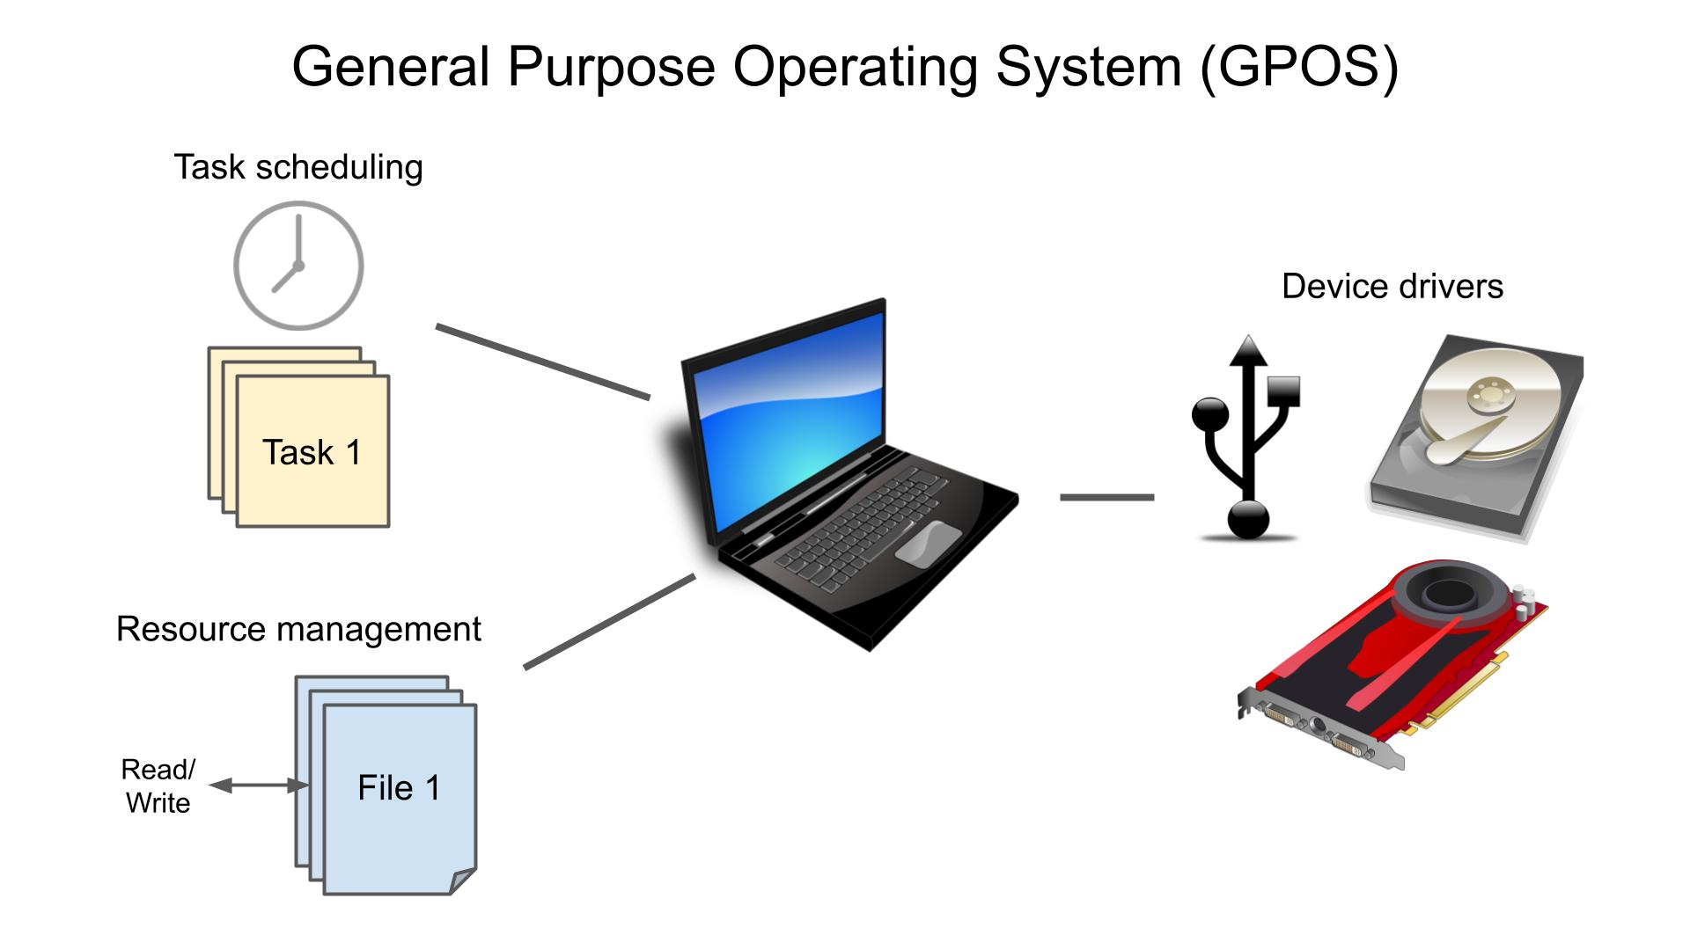
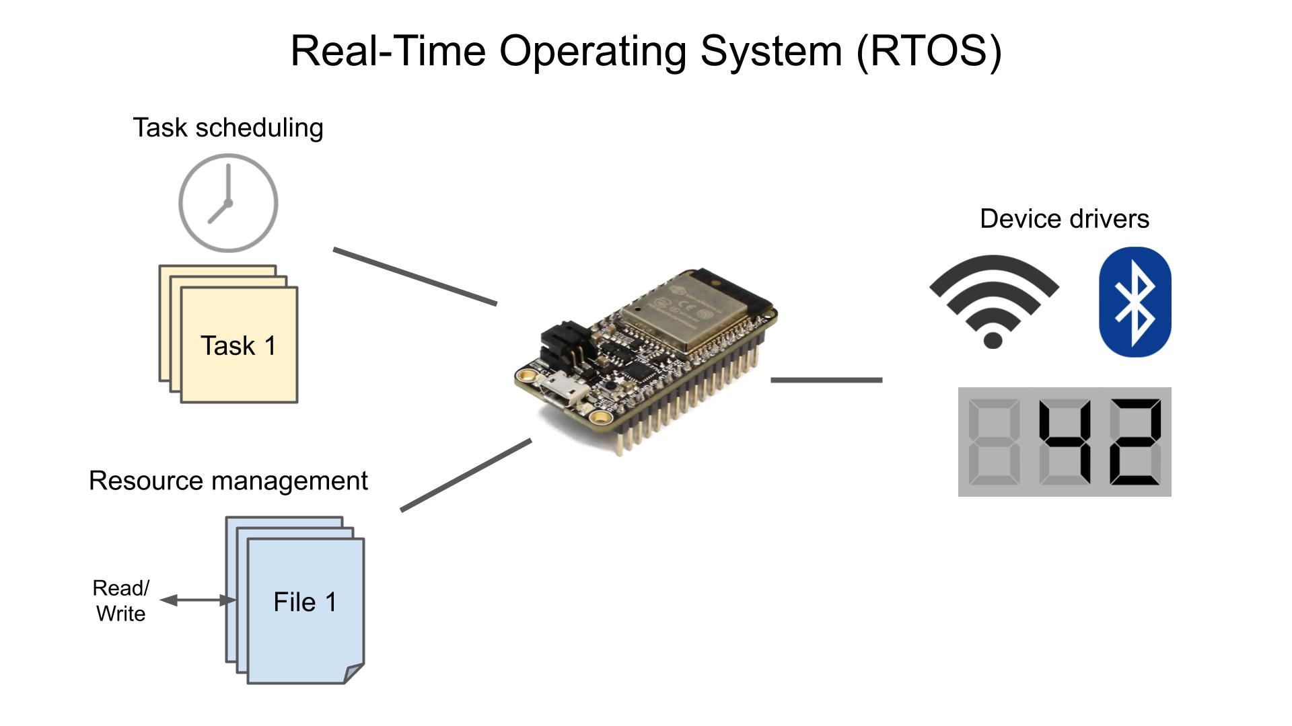
GPOS vs RTOS

Slide 5
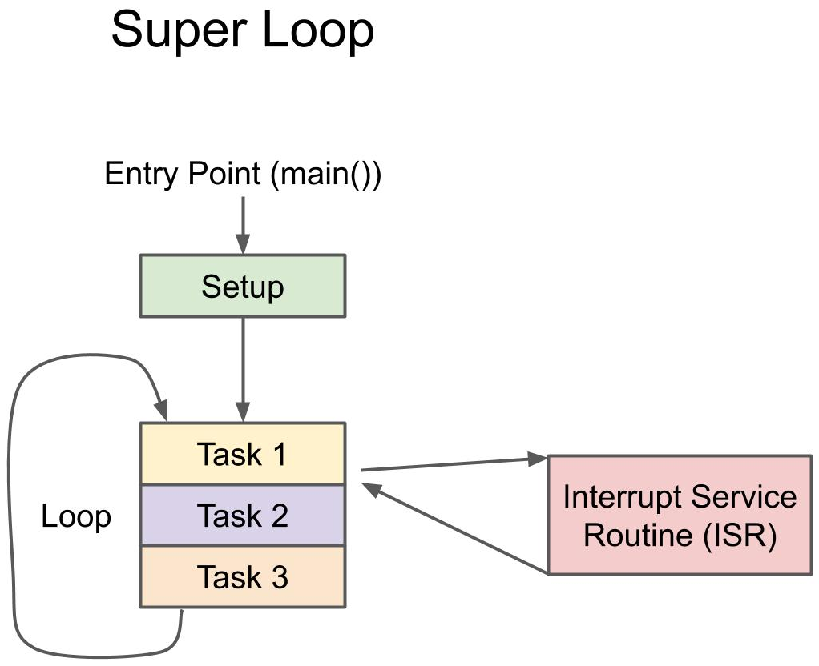
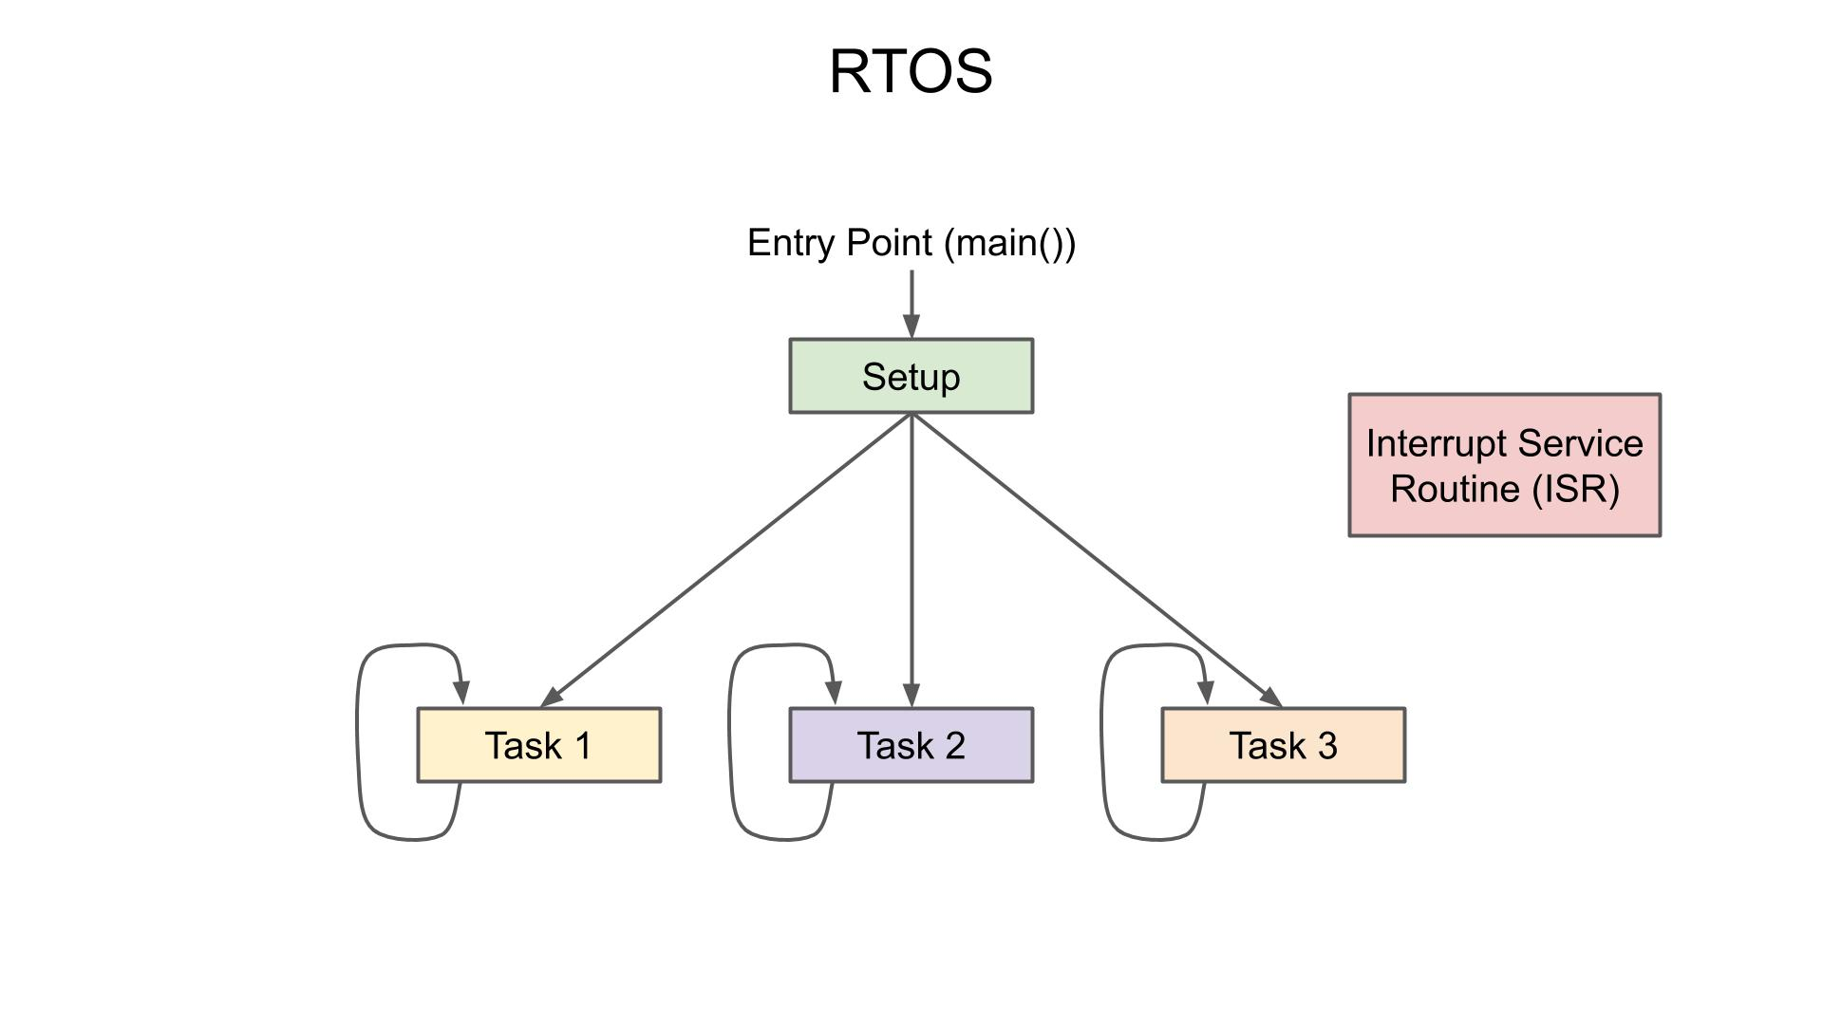
Super Loop Vs RTOS
Superloop makes it impossible to do other tasks or even enter a “power saving” or sleep mode
Not possible to guarantee that the peripherals will be serviced in the correct order or priority level

Slide 6
Super Loop Vs RTOS
If the system is responsible for a.) Eye Catching UI , b.)Complex communication stack , c.) Critical Sensor Reading.
Super loop approach for three things three functions are required but there can be a case where UI is working fine but other sensors reading is missed.
With RTOS approach three tasks are assigned priority critical sensor task high priority, complex communication stack medium priority, UI low priority next point
Guaranteeing that the most time critical tasks are always running when necessary and scheduling lower priority task to run whenever spare time is available is a strong point for preemptive schedulers.
While comparing a RTOS to a super loop an easy way to think about a task is that it is just another main loop.
Each task receives its own private stack. Unlike a super loop in main, which was sharing the system stack, tasks receive their own stack that no other task in the system will use. This allows each task to have its own call stack without interfering with other tasks.
Each task has a priority assigned to it. This priority allows the scheduler to make decisions on which task should be running (the goal is to make sure the highest priority task in the system is always doing useful work).
Given these two features, each task may be programmed as if it is the only thing the processor has to do.

Slide 7


Real Time Systems
Misinterpretations
  Real Time means FAST
Definition:
  Real Time Systems are characterized by severe consequences that result if logical as well as timing correctness properties of the system are not met
))

Slide 8
Features of real-time systems:
Determinism: Real-time systems must be deterministic, which means that the system's behavior must be predictable and repeatable for a given input. This ensures that the system will always meet its deadlines, regardless of the load or other factors.
Timing constraints: Real-time systems must meet timing constraints, which are deadlines that must be met in order for the system to function correctly. For example, a traffic light system must be able to change the light colors within a specified time period in order to keep traffic flowing smoothly.
Reliability: Real-time systems must be reliable, which means that they must be able to meet their deadlines even in the event of failures or unexpected events. This is critical for systems that are safety-critical, such as air traffic control systems.
Predictability: for these systems should mean that we are able to satisfy the timing requirements of critical tasks with 100% guarantee over the life of the system, be able to assess overall system performance over various time frames (a stochastic evaluation) and be able to assess individual task and task group performance at different times and as a function of the current system state. If all these assessments meet the timing requirements, then the system is predictable with respect to its timing requirements.

Slide 9
Types of RTOS
Soft Real Time:
Tasks are performed by the systems as fast as possible, missing of deadlines sometimes is allowed. These systems often offer only a best-effort promise for keeping deadlines. Cruise control in a car is a good example of a soft real-time system because there are no hard specifications or expectations of it. the control system will eventually get them close to their desired speed most of the time.
Firm Real Time:
As opposed to hard real-time systems, firm real-time systems need to hit their deadlines nearly all the time. If video and audio lose synchronization momentarily, it probably won't be considered a system failure, but will likely upset the consumer of the video.
Hard Real Time:
A hard real-time system must meet its deadline 100% of the time. If the system does not meet a deadline, then it is considered to have failed. Some examples of hard real-time systems can be found in medical devices, such as pacemakers and control systems with extremely tightly controlled parameters.

Slide 10
Ways to Guarantee Real Time Behavior
One of the way to guarantee real time system behavior is to make system as simple as possible, if the problem can be solved with hardware alone don’t complicate it with MCU e.g. Bread Toaster.
If a problem can be handled by using a simple while loop to perform some polling of the sensor status, then simply poll the sensor for the status; there may be no need to start coding interrupt service routines (ISRs). If the functionality of the device is single-purposed, there are many cases where a full-blown RTOS can simply get in the way—so don't use one!

Slide 11
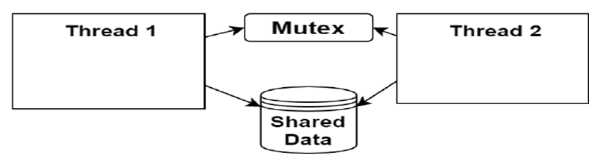
GPOS vs RTOS at microlevel
In the example below, a mutex is used to ensure that only one thread can access the
shared data at a time. In the case of a general-purpose OS, each thread will happily wait for
the mutex to become available indefinitely before moving on to access the shared data.
This is where RTOS diverge from general-purpose OS. In an RTOS, all blocking system calls are time-bound. Instead of waiting for the mutex indefinitely, an RTOS allows a maximum delay to be specified. For example, if Thread 1 attempts to acquire Mutex and still doesn’t have it after 100 ms, or 1 second, it will continue waiting for the mutex to become available.
In an RTOS implementation, the maximum amount of time to wait for Mutex to become
available is specified. If Thread 1 specifies that it must acquire the mutex within 100 ms and
still hasn't received the mutex after 101 ms, Thread 1 will receive a notification that the
mutex hasn't been acquired in time. This timeout is specified to help create a deterministic system.
Any OS that provides a deterministic way of executing a given piece of code can be
considered a Real-Time OS.

Slide 12
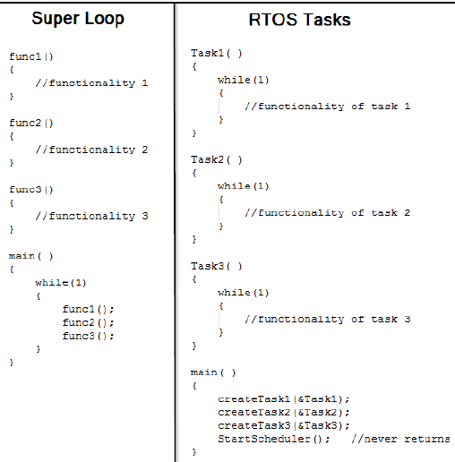
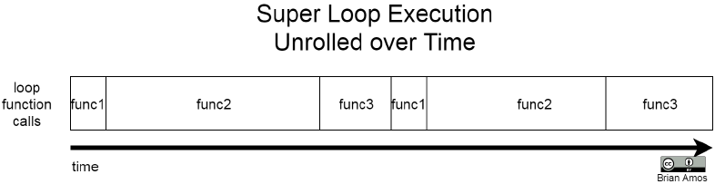
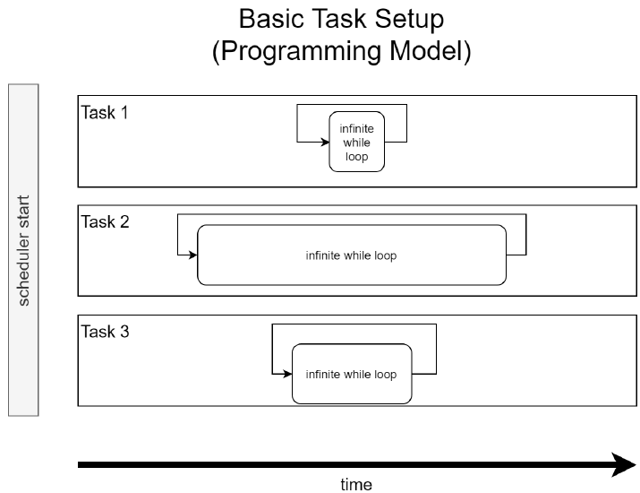
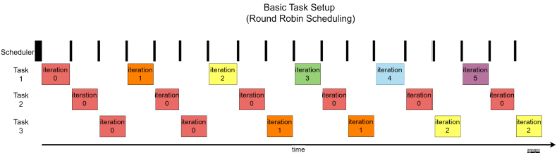
Superloop vs RTOS in Task Handling
Size of each while loop is different
2
1
3
Ref Fig 2 : func3 cannot complete before func2 is completed
Ref Fig 4: Task3 is completed before task2 in RR Scheduling
4

Slide 13
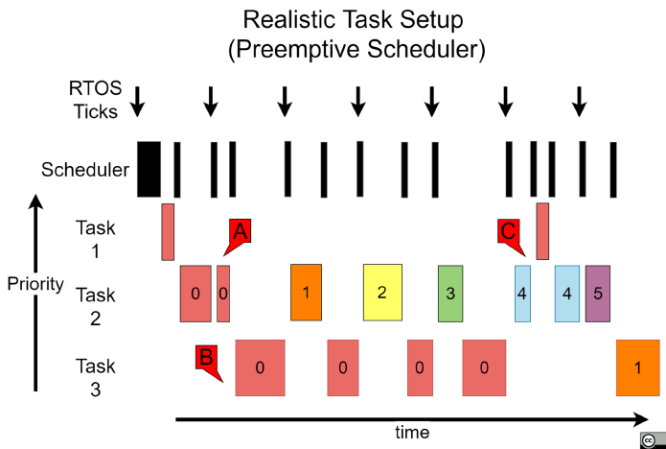
Realistic Task Setup
1. At each tick:
Tick Interrupt
↓
Scheduler Executes
↓
Chooses Highest Ready Task
↓
Context Switch (if required)
2. Preemption
Higher Priority Ready
↓
Immediate CPU Ownership

Slide 14
Challenges in the design of RTS
Why are Real-Time Systems Difficult to Design?
A Real-Time System must produce the correct result within a specified deadline. Missing a deadline can lead to degraded performance, system failure, or safety hazards.
Challenge | Impact
Meeting Deadlines | Tasks must complete before their timing constraints.
Determinism & Predictability | Worst-case behavior must be known and guaranteed.
Task Scheduling | Multiple tasks compete for CPU resources.
Priority Inversion | High-priority tasks may be blocked by lower-priority tasks.
Resource Sharing | Shared peripherals and data require synchronization.
Interrupt Handling | Fast response needed while minimizing latency.
Memory Constraints | Limited RAM for stacks, queues, and buffers.
WCET Analysis | Worst-Case Execution Time must be calculated accurately.
Jitter Control | Variations in task timing must be minimized.
Fault Tolerance | System should recover from errors and failures.
Power Management | Meet timing requirements while reducing energy consumption.

Slide 15
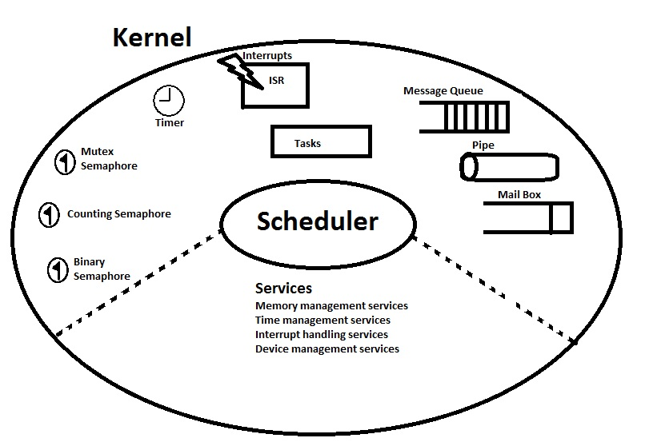
Overview of RTOS Components

Slide 16
Overview of RTOS Components cont..
Kernel Objects
The various kernel objects are Tasks, Task Scheduler, Interrupt Service Routines, Semaphores, Mutexes, Mailboxes, Message Queues, Pipes, Timers etc.
Scheduler
The scheduler is the heart of every kernel. A scheduler provides the algorithms needed to determine which task executes when.
Schedulable Entities
It is a kernel object that can compete for execution time on a system based on predefined scheduling algorithm. Tasks and process are examples of schedulable entities found in most kernel.

Slide 17
Kernel Objects
1.Tasks A task is a basic unit of execution that can be scheduled by an RTOS to use the system resources.
2.Interrupt Service Routines
An interrupt service routine (ISR), also known as an interrupt handler, is a callback subroutine in an operating system or device driver whose execution is triggered by the reception of an interrupt.
3.Semaphore
A semaphore is a kernel object that can be acquired or released by one or more tasks for the purposes of synchronization or mutual exclusion.
Binary Semaphore : A binary semaphore can have a value of either 0 or 1.
Counting Semaphore : A counting semaphore uses a count to allow it to be acquired or released multiple times.
Mutex : A mutual exclusion (mutex) semaphore is a special binary semaphore that supports ownership, recursive access, task deletion safety, and one or more protocols for avoiding problems inherent to mutual exclusion.
4.Message Queue
The Message Queue is a buffer-like object, which is used to send one or more messages to a task i.e the message queues are used to establish the Inter task communication.
5.Mailbox
A message queue with a length of 1 is called as mailbox.
6.Pipe
Pipes are kernel objects that provide unstructured data exchange and facilitate synchronization among tasks.

Slide 18
RTOS-aware Debugging
With traditional debugging setups used for bare-metal (for example, no OS) coding, there was only one stack to observe. Since the programming model was a single super loop with some interrupts, this wasn't much of a problem. At any point in time, the state of the system could be discerned by the following:
  Knowing which function the program counter (PC) was in
  Knowing which interrupts were active
  Looking at the value of key global variables
  Observing/unwinding the stack
With an RTOS-based system, the basic approach is very similar, but the programming model is extended to include multiple tasks running in parallel. Remember, each task is effectively an isolated infinite loop. Since each task has its own stack and can be in different operating states, some additional information is required to discern the overall system state:
  Knowing the current operational state of each task
  Knowing which task and function the PC was in
  Knowing which interrupts are active
  Looking at the value of key global variables
  Observing/unwinding the stack of each task
Due to the constrained nature of embedded systems, stack usage is often a concern because of the limited RAM of MCUs. In a bare-metal application, there is only one stack. In an RTOS application, each task has its own stack, which means we have more to monitor. Using a debugging system that provides RTOS-aware stack information helps to quickly evaluate the stack usage of each task in the system.
Monitoring the worst-case performance of the event response is also a critical aspect of realtime systems development. We must ensure that the system will respond to critical events in a timely manner. To help with all Above we use SEGGER SYSTEMVIEW to get detailed insights of Task.

Slide 19
Utility Measurement for Hard RTS
Utility measurement in hard real-time systems evaluates how well the system performs in meeting its deadlines and fulfilling its intended purpose.
Utility Function is Binary Set {1,0}
In hard real-time systems, a task’s utility is often binary:
High Utility (1): If the task completes within its deadline.
Zero Utility (0): If the task misses its deadline.
This reflects the critical nature of hard deadlines.
Incoming missile is intercepted by an anti-missile system from its target when it is only 20 meters away

Slide 20
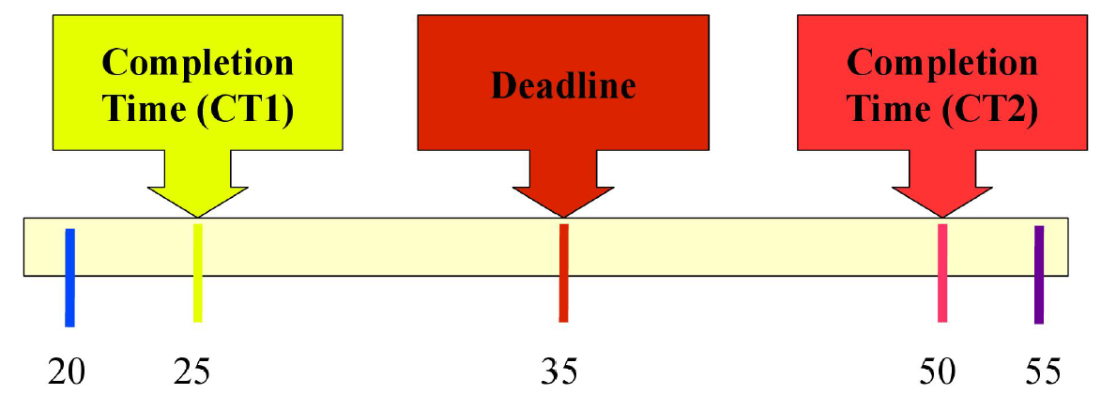
Utility Measurement for Soft RTS
Unlike hard real-time systems, utility in soft real-time systems is more flexible and often incorporates varying degrees of success based on timing.
Lateness == Completion Time - Deadline
Tardiness == MAX(0, Lateness)
Earliness == MAX(-Lateness, 0)

Slide 21
Address Space
Free RTOS does NOT deal with ‘virtual’ spaces/memory.
In part, because virtual memory is the enemy of Real-Time, the problem is that paging in virtual memory adds significant unpredictability to timing.
Kernal Space/User Space is a virtual space-ism, it doesn’t apply to Free RTOS.
Addresses stay at their physical addresses.
Many RTOSes do not implement a full process model with:
NO Virtual memory
NO User space
NO Kernel space
NO Process isolation

Slide 22
Foreground/Background Systems
In the context of embedded systems and RTOS (Real-Time Operating Systems) like FreeRTOS, the concepts of foreground and background processing can be aligned with ISR (Interrupt Service Routines) handling and task-level operations, respectively.
Background Processing (Task Level)
Background processing typically refers to the main application logic that runs in an infinite loop, calling various modules or functions to perform desired operations. These tasks are managed by the RTOS and can range from low to high priority, depending on their criticality.
Example Application Structure
Foreground Processing (ISR):
  Handles immediate, time-critical events.
  Runs asynchronously and preempts background tasks.
Background Processing (Task Level):
  Consists of tasks running in an infinite loop.
  Tasks perform various operations and are scheduled by the RTOS based on their priority.
Example Setup
Let's illustrate this with a FreeRTOS application where:
An ISR handles an external event (e.g., a button press).
Tasks handle LED blinking and sensor data processing.

Slide 23





Foreground-Background Systems
Background/Task Level
1
ISR
Foreground or
3 ISR makes the data available
Foreground/ Interrupt Level
5
Background or Task Level utilizes the data

Slide 24
Task Level Response
In real-time systems, critical operations are often handled by ISRs (Interrupt Service Routines) to ensure they are processed promptly. However, the information gathered or the signals processed by ISRs are usually handed off to background tasks, which process this information when they get their turn to execute. This mechanism is known as task-level response. Here’s a more detailed look at how this works:
Interrupt Service Routines (ISRs):
Handle time-sensitive and high-priority events.
Perform minimal processing and quickly offload data or signals to background tasks for further handling.
Use mechanisms like task notifications, semaphores, or queues to communicate with tasks.
Background Processing and Task-Level Response
Tasks:
Perform detailed processing of the data or signals provided by ISRs.
Are managed and scheduled by the RTOS based on their priority.
Ensure that information provided by ISRs is processed, albeit with some delay determined by task scheduling.
Example: Task-Level Response in FreeRTOS
Consider an example where an ISR handles UART data reception and a background task processes the received data.

Slide 25
Task Level Response (contd... )
The worst-case task-level response time is influenced by several factors, including the execution time of background tasks and the scheduling policy of the RTOS. This response time can be non-deterministic because the execution time of tasks in the background loop may vary due to various factors such as differing workloads, task priorities, and system interrupts.
Factors Affecting Task-Level Response Time
Task Execution Time: The time taken by tasks to complete their operations can vary, making the response time non-deterministic.
Task Priorities: Higher-priority tasks will preempt lower-priority tasks, affecting the scheduling of background tasks.
Interrupts and ISR Execution: ISRs can preempt tasks, leading to additional delays in task execution.
RTOS Scheduler: The scheduling algorithm and its efficiency can impact how quickly tasks are resumed.

Slide 26
Creating Task and Starting Scheduler
In order to get an RTOS application up and running, a few things need to happen:
1. The MCU hardware needs to be initialized.
2. Task functions need to be defined.
3. RTOS tasks need to be created and mapped to the functions that were defined in step 2.
4. The RTOS scheduler must be started.

Slide 27
Multi Tasking
Multitasking in General-Purpose Operating Systems (GPOS) and Real-Time Operating Systems (RTOS) differs fundamentally in terms of goals, scheduling policies, responsiveness, and predictability.
General-Purpose Operating Systems (GPOS) ,Examples: Windows, Linux, macOS
Goals: Maximize throughput, Ensure fairness among users and applications, Optimize for average-case performance.
Scheduling Policies:
Preemptive Multitasking: The OS can interrupt and switch between tasks based on priorities and time slices.
Time Slicing (Round-Robin): Each task gets a fair share of the CPU time in a cyclic manner.
Priority-Based Scheduling: Tasks are assigned priorities, and higher-priority tasks can preempt lower-priority ones. However, this is often balanced with time slicing to ensure fairness.
Responsiveness:
Not guaranteed for real-time performance, Varies depending on system load and task priorities.
Interrupts and task switching can introduce significant latency.
Predictability:
Non-deterministic. The execution time can vary due to system load, background processes, and other factors.
Real-Time Operating Systems (RTOS) ,Examples: FreeRTOS, VxWorks, QNX, RTEMS
Goals: Guarantee that critical tasks meet their deadlines, Optimize for worst-case performance and predictability., Ensure minimal and predictable interrupt latency.
Scheduling Policies:
Preemptive Priority-Based Scheduling: Tasks are strictly prioritized, and higher-priority tasks always preempt lower-priority ones.
Fixed-Priority Preemptive Scheduling: Ensures that the highest-priority ready task always runs.
Rate Monotonic Scheduling (RMS) and Earliest Deadline First (EDF): Advanced scheduling algorithms used in some RTOS for managing task priorities based on their periodicity and deadlines.
Responsiveness:
High responsiveness and low latency for high-priority tasks.
Designed to handle time-critical tasks with minimal jitter.
Predictability:
Deterministic: The system’s behavior is predictable and consistent, making it suitable for applications with stringent timing requirements.

Slide 28
Task
Task are very similar to Super Loop; main difference is system can have multiple task but only one super loop.
A task, also called a thread, is a simple program that thinks it has the CPU all to itself.
Real Time application involves splitting the work to be done in Tasks.
Each Task is assigned its own set of CPU Registers, Stack Area and a Priority.

Slide 29
Task State
1. DORMANT:
- This is the initial state of a task before it has been started or after it has terminated.
- The task is not yet part of the scheduling pool.
- It cannot be executed or be part of any scheduling decisions.
2. READY:
- In this state, the task is prepared to run and is waiting for the CPU to become available.
- Multiple tasks can be in the READY state, and the scheduler decides which one will be executed based on the scheduling policy.
3. RUNNING:
- The task is currently being executed by the CPU.
- Only one task can be in the RUNNING state at any given time on a single-core processor.
4. WAITING/BLOCKED:
- The task is blocked and waiting for an event or condition to be met before it can transition back to the READY state.
- Common waiting conditions include waiting for a timeout, semaphore, message, or I/O operation to complete(xSemaphoreTake(), xQueueReceive(), vTaskDelay())
5. Suspended State:
-A task in the suspended state is inactive and completely removed from the scheduler. It will not execute, even if it has the highest priority.
-Entry by explicitly calling vTaskSuspend() on the task.
-Exits by calling vTaskResume() or vTaskResumeFromISR() on the suspended task.

Slide 30
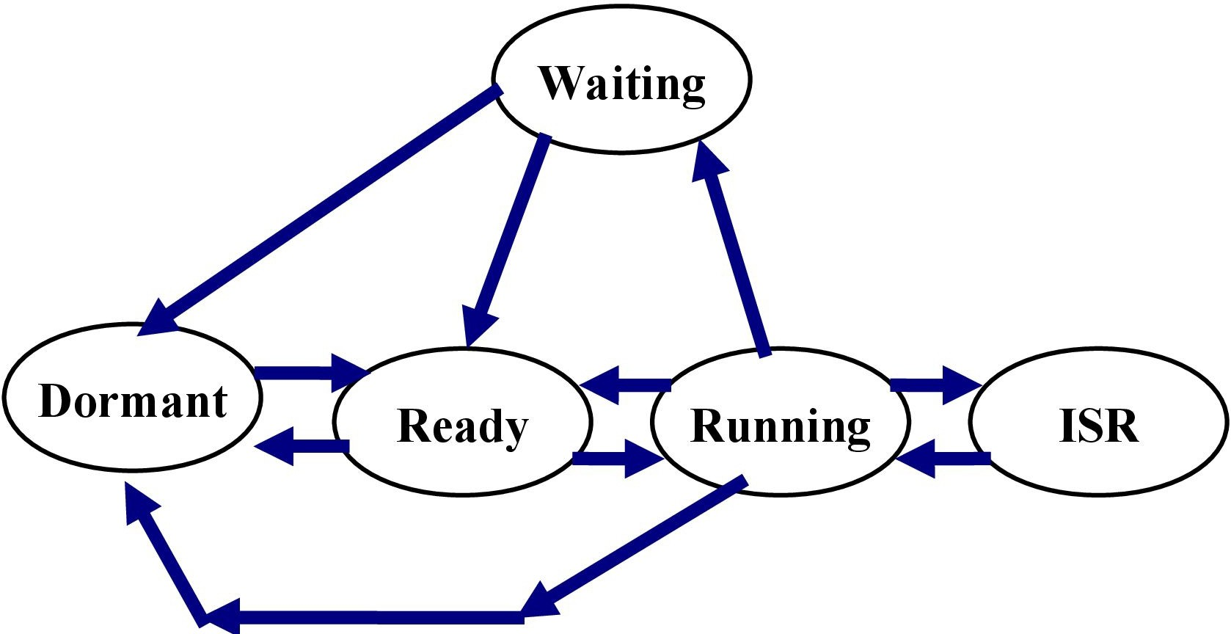
Task States
Why is vTaskDelay() frequently used in FreeRTOS tasks?
vTaskDelay() is used to block a task for a specified number of RTOS ticks. This allows other ready tasks to execute, enables periodic task execution, reduces CPU utilization, and prevents higher-priority tasks from monopolizing the processor. However, it is not required in every task. Tasks that wait on queues, semaphores, mutexes, or task notifications already block efficiently and usually do not need vTaskDelay().

Slide 31
Task Scheduling
Task scheduling in a real-time operating system (RTOS) is the process of determining which task should be executed next, based on the system's resources and the tasks' priorities and deadlines. RTOS task scheduling is critical for ensuring that real-time tasks meet their deadlines, as even a small delay in executing a task can have serious consequences.
There are two main types of RTOS task scheduling algorithms: preemptive and non-preemptive.
  Preemptive scheduling algorithms allow the RTOS to interrupt a running task and switch to a higher-priority task. This is important for ensuring that critical tasks meet their deadlines, even if lower-priority tasks are already running.
  Non-preemptive scheduling algorithms do not allow the RTOS to interrupt a running task. This can be useful for tasks that need to run to completion without being interrupted, but it can also lead to missed deadlines for higher-priority tasks if a lower-priority task takes a long time to complete.

Slide 32
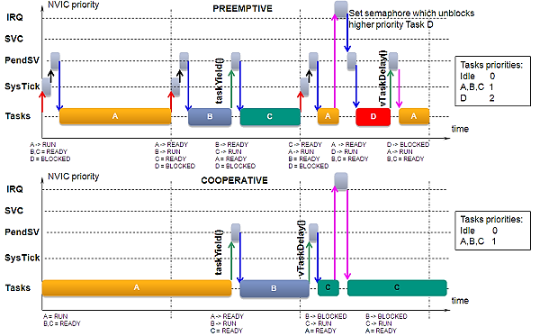
Preemptive and Non-preemptive

Slide 33
RTOS Task Scheduling Consideration
In addition to preemption, RTOS task scheduling algorithms also consider the following factors: Task priority, Task deadline, Task execution time, Resource availability
Some common RTOS task scheduling algorithms include:
Priority-based scheduling: This is the most common type of scheduling algorithm. It assigns a priority to each task and schedules the task with the highest priority to run first.
Round-robin scheduling: This algorithm gives each task an equal amount of time to run, regardless of its priority. This can be useful for tasks that need to be executed periodically, but it can also lead to missed deadlines for higher-priority tasks.
Deadline-based scheduling: This algorithm schedules tasks based on their deadlines. Tasks with earlier deadlines are scheduled to run first.

Slide 34
Managing task deadlines in an RTOS when tasks are preempted
Strategies for Ensuring Deadlines Are Met:
Priority-Based Scheduling
  Higher priority for tasks with stringent deadlines.
Deadline Monotonic Scheduling (DMS)
  Fixed-priority: shorter deadlines get higher priority.
Earliest Deadline First (EDF)
  Dynamic priority: tasks closest to their deadlines run first.
Rate Monotonic Scheduling (RMS)
  Fixed-priority: shorter periods get higher priority.
Deadline-Aware Task Management
  Monitor execution time and deadlines to avoid deadline misses.
Time Slicing and Time Quanta
  Allocate fixed time slices to tasks; manage CPU time efficiently.
Task Deadlines and Watchdogs
  Monitor deadlines; take corrective actions if necessary.
Efficient Context Switching
  Minimize overhead during task switches to resume tasks timely.
Resource Reservation
  Reserve CPU time/resources for critical tasks.
Slack Time Management
  Use slack time to allow lower-priority tasks to run safely.

Slide 35
Examples of task scheduling in RTOS:
A car engine control unit (ECU) uses an RTOS to schedule tasks such as fuel injection, ignition, and emissions control. These tasks must be completed within very strict timing constraints in order to ensure that the engine runs smoothly and efficiently.
A medical device such as a pacemaker uses an RTOS to schedule tasks such as heart pacing and monitoring. These tasks must be completed within very strict timing constraints in order to ensure the safety of the patient.
A mobile phone uses an RTOS to schedule tasks such as the user interface, the cellular network stack, and the media player. These tasks must be scheduled efficiently in order to provide a good user experience and to conserve battery life.

Slide 36
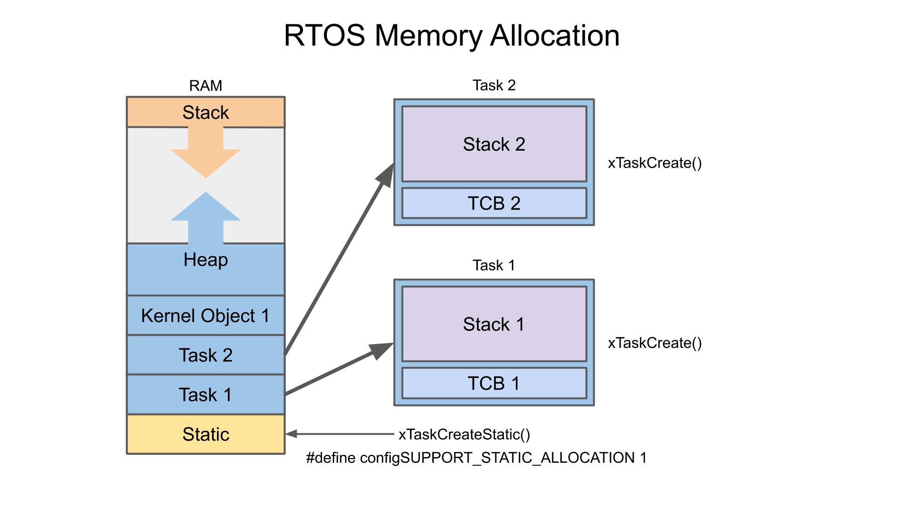
Memory Management

Slide 37
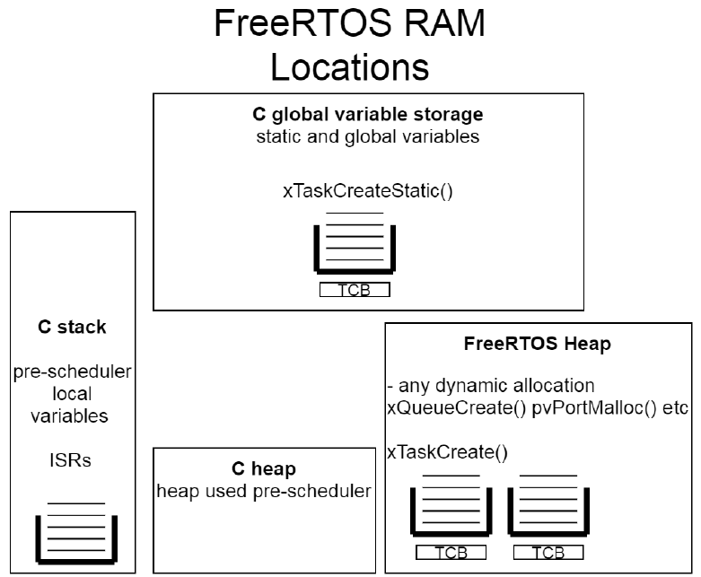
Resource Allocation

Slide 38
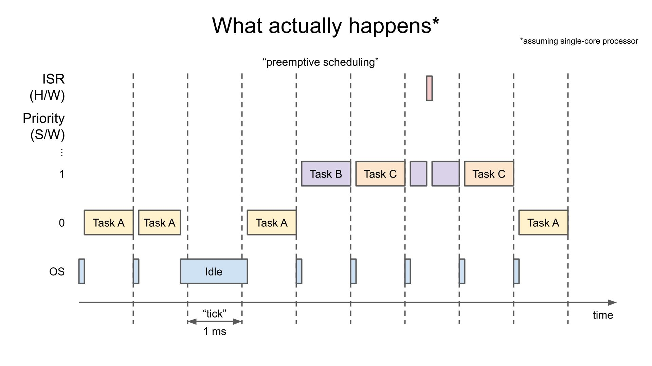
Task Partitioning and Priority Assignment
In a single-core system, the CPU must divide up the tasks into time slices so that they can appear to run concurrently. The scheduler in an operating system is charged with figuring out which task to run each time slice.

Slide 39
Task Partitioning and Priority Assignment Cont.
In FreeRTOS, the default time slice is 1 ms, and a time slice is known as a “tick.” A hardware timer(mostly Systick) is configured to create an interrupt every 1 ms. The ISR for that timer runs the scheduler, which chooses the task to run next.
#define configTICK_RATE_HZ ( ( TickType_t ) 1000 ) // 1 kHz tick rate or 1 ms tick period
#define configCPU_CLOCK_HZ ( ( unsigned long ) 72000000 ) // 72 MHz system clock
At each tick interrupt, the task with the highest priority is chosen to run. If the highest priority tasks have the same priority, they are executed in a round-robin fashion. If a task with a higher priority than the currently running task becomes available (e.g. in the "Ready" state), then it will immediately run. It does not wait for the next tick.
A hardware interrupt is always considered to have a higher priority than any task running in software. As a result, a hardware ISR can interrupt any task. Because of this, we recommend keeping any ISR code as short as possible to reduce interruptions to the running tasks

Slide 40
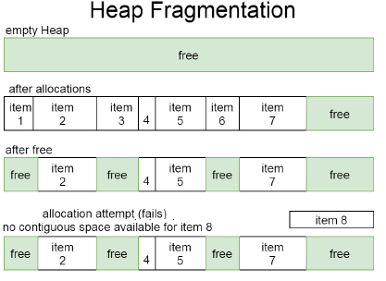
Resource Management and Allocation : Heap
Because FreeRTOS targets such a wide range of MCUs and applications, it ships with five different dynamic allocation schemes, all of which are implemented with a heap.
The different heap implementations allow different levels of heap functionality. They are included in the portable/MemMang directory as heap_1.c, heap_2.c, heap_3.c, heap_4.c, and heap_5.c

Slide 41
Heap Allocation
heap_1: Allocation only—no freeing is allowed. This is best suited for simple applications that don't free anything after initial creation. This implementation, along with heap_2, provides the most deterministic timing since neither heap ever performs a search for adjacent free blocks to combine.
heap_2: Allocation and freeing are both allowed, but adjacent free blocks are not combined. This limits appropriate use cases to those applications that can know/guarantee they are reusing several items that are the same size each time. This heap implementation is not a great fit for applications that make use of vPortMalloc and vPortFree explicitly (for example, applications that allocate memory dynamically themselves), unless there is a very large degree of discipline in ensuring that only a small subset of possible sizes are used.
heap_3: Wraps standard malloc/free implementations to provide thread safety.
heap_4: The same as heap_2 but combines adjacent free space. Allows locating the entire heap by giving an absolute address. Well suited for applications to use dynamic allocation.
heap_5: The same as heap_4 but allows for creating a heap that is distributed across different noncontiguous memory regions—for example, a heap could be scattered across internal and external RAM.

Slide 42
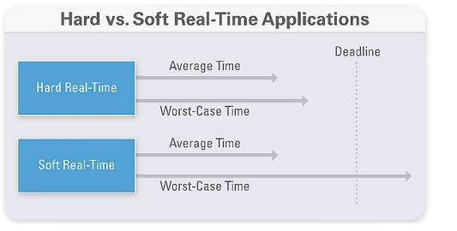
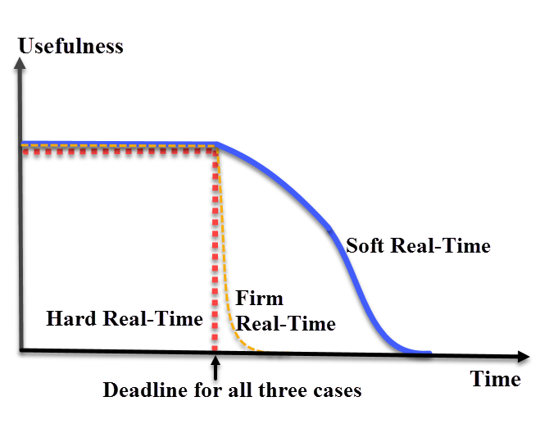
Deadline Analysis &Task Timing Requirement
Modeling and evaluation of a real-time scheduling system concern is on the analysis of the algorithm capability to meet a process deadline. A deadline is defined as the time required for a task to be processed.
For example, in a real-time scheduling algorithm a deadline could be set to five nano-seconds. In a critical operation the task must be processed in the time specified by the deadline (i.e. five nano-seconds). A task in a real-time system must be completed “neither too early nor too late”.
A system is said to be unschedulable when tasks can not meet the specified deadlines
A task can be classified as either a periodic or aperiodic process.

Slide 43
Fault Tolerance and Error Handling
Hard real-time operating systems focus on timing constraints as the most important issue in the system design
In systems like drive-by-wire systems in automobiles, fly-by-wire systems in avionics, missile control systems and autonomous space systems
Failure in these systems can lead to incorrect results due to erroneous computations or invalid results due to missed deadlines. Therefore, implementing fault tolerance techniques should be considered during system design.
In Automotive industry ISO26262 is followed for Functional Safety
Fault tolerance techniques that could be applied to each feature are Memory Management, Kernel Considerations, Process and Thread Management, Communications, I/O Management, Interrupt Handling and Programming Languages.

Slide 44
Context Switch (Task Switch)
Save current CPU task's context (CPU Registers) on the current task's context storage Area
The new task context is restored & start executing the new task
More the registers higher the overhead

Slide 45
PendSV in FreeRTOS for Context Switching
FreeRTOS uses the PendSV (Pendable Service Call) interrupt for context switching on ARM Cortex-M microcontrollers. PendSV is an ideal choice for this purpose because it has the lowest priority of all exceptions and can be pended (triggered) from within another interrupt service routine (ISR). This allows FreeRTOS to defer the context switch until after the current ISR completes, ensuring that the context switch occurs at a safe time.
Here's a brief overview of how PendSV is used in FreeRTOS:
1. Task Yielding: When a task yields or a higher priority task becomes ready to run, FreeRTOS triggers the PendSV interrupt.
2. Context Switching: The PendSV interrupt handler performs the actual context switch. It saves the context of the current task and restores the context of the next task to run.
3. Lowest Priority: Since PendSV has the lowest priority, it will only execute after all other ISRs have completed, ensuring that the context switch does not interfere with higher-priority interrupts.
This mechanism is efficient and helps maintain the real-time performance of the system by minimizing the latency of higher-priority interrupts.

Slide 46
SVC or SWI use in FreeRTOS
FreeRTOS does not use a formal distinction between user space and kernel space like more complex operating systems such as Linux or Windows. All tasks in FreeRTOS typically run in the same privilege mode, and there isn't a separation between user mode and kernel mode.
The use of the Supervisor Call (SVC or SWI) instruction in FreeRTOS
Starting the Scheduler: In some ARM Cortex-M ports, FreeRTOS might use an SVC call to start the first task. This is because the SVC handler runs in privileged mode, which can be useful for setting up the initial context of the first task to run. Also, the SVC handler resets the stack to the start of the stack. But If you are using the PendSV handler then you can’t reset the stack (because you are using it).
System Calls: Although FreeRTOS does not have a full user/kernel space separation, some ports may still use SVC for certain operations that need to ensure the execution context is correct. For example, making sure certain critical operations are performed with appropriate priority handling.
Switching between PSP & MSP Implementations: In FreeRTOS port.c(Portable/Gcc/ARM_CM4F) file, where vPortSVCHandler() is used for Switching between MSP and PSP.

Slide 47
MSP and PSP use in FreeRTOS
In FreeRTOS, particularly on ARM Cortex-M processors, the Process Stack Pointer (PSP) and Main Stack Pointer (MSP) are used to manage different types of operations and contexts. Here’s how these stack pointers are utilized:
Main Stack Pointer (MSP)
System Stack: The MSP is used by the processor when handling exceptions, interrupts, and the operating system's own operations. It's the default stack pointer after a reset.
Used by System Scheduler
Kernel Operations: When the system is running FreeRTOS kernel code or handling interrupts, the MSP is typically used.
Process Stack Pointer (PSP)
Task Stacks: The PSP is used by the processor when executing task-level code. Each FreeRTOS task has its own stack, and the PSP points to the current task's stack.
Context Switching: During a context switch, FreeRTOS saves the context of the currently running task using the PSP and then restores the context of the next task to run by switching the PSP to point to that task’s stack.

Slide 48
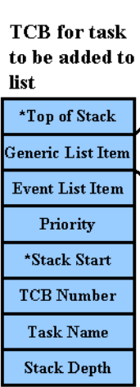
Task Control Block Model
The task-control block model is the most popular method for implementing commercial, full-featured, real-time operating systems because the number of real-time tasks can vary.
Implement thru data structure, called a task control block.
This data structure contains at least a PC, register contents, an identification string or number, a status, and a priority if applicable.
The system stores these TCBs in one or more data structures, such as a linked list.
Task State, Task Management, Resource Management

Slide 49
Critical Section of Code
Also called as Critical region.
Should be treated indivisibly.
Must not be Interrupted.
To ensure this, interrupts are typically disabled before the critical code is executed & enabled after the critical code is executed.

Slide 50
Resource & Shared Resource
A resource is a entity used by the task.
A resource can be a I/O device, or a variable, a structure or an array.
A shared resource is a resource that can be used by more than one task.
Each task should gain exclusive access to the shared resource to prevent data corruption.

Slide 51
Reentrancy
Reentrancy refers to the ability of a function to be interrupted in the middle of its execution and safely called again ("re-entered") before the previous executions are complete. This concept is crucial in concurrent programming and systems where functions might be called by multiple threads or in interrupt service routines.
A reentrant function can be used by more than one task without data corruption
A reentrant function can be interrupted at any time and resumed at a later time without loss of data
Non-reentrant function
int counter = 0;
void increment_counter()
{ counter++; }
If increment_counter is called by multiple threads or in an interrupt context, the counter variable may be corrupted because counter++ is not an atomic operation.
Reentrant function
void increment_counter(int *counter)
{ (*counter)++; }
In this version, the counter variable is passed as an argument, ensuring each caller has its own copy or access through a controlled mechanism.

Slide 52
Non-Reentrant Functions
int temp; // Global Variable can lead to an issue of race condition
void swap(int *x, int *y)
{
temp== *x;
*x == *y;
*y ==temp;
}

Slide 53
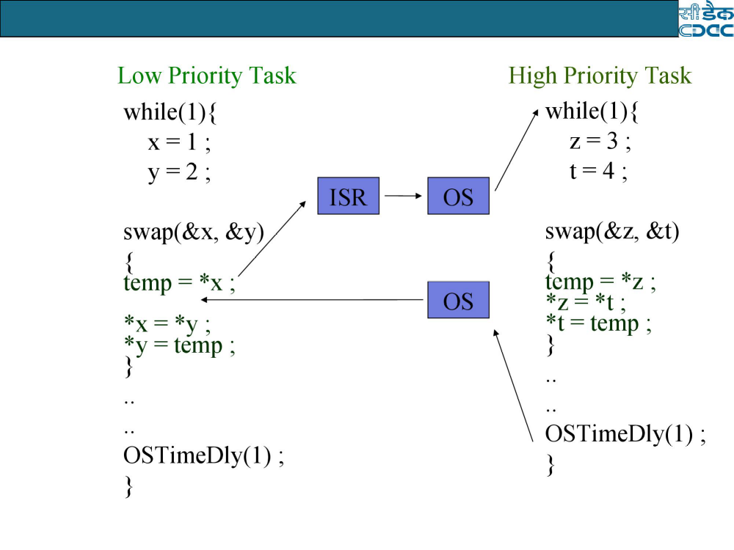
*

Slide 54
What is Interrupt latency?
Interrupt latency is the time that elapses between the occurrence of an interrupt and the execution of the first instruction of the interrupt service routine (ISR) that handles the interrupt.
It is a measure of the system’s ability to respond to external events in a timely manner.
The shorter the interrupt latency, the more responsive the system will be.
Interrupt latency is expressed in core clock cycles.

Slide 55
Importance of Interrupt Latency
Interrupt latency is an important consideration in the design and optimization of real-time and embedded systems. These systems often have hard real-time constraints, meaning that they must respond to external events within a specified time period.
A high interrupt latency can result in the system missing a deadline, which can cause the system to fail or produce incorrect results.
If interrupts are not handled in a timely manner, then the system will exhibit slow response times.

Slide 56
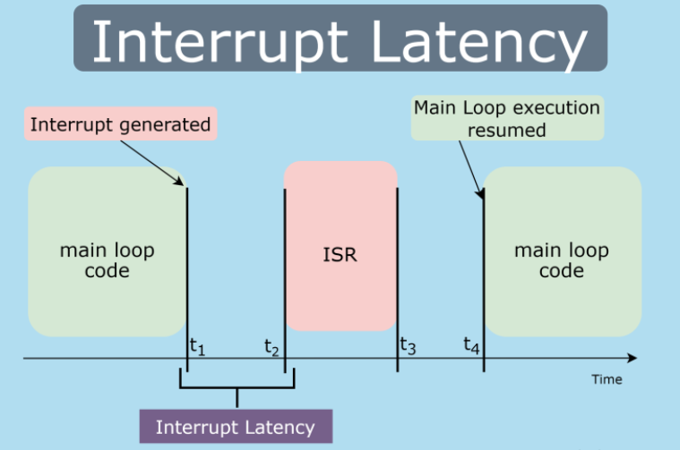

Slide 57
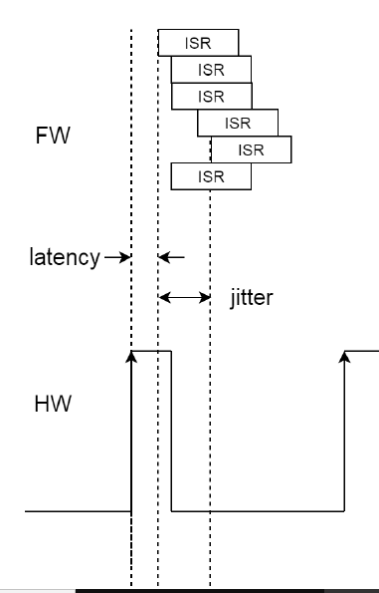
Jitter vs Latency
Latency is the difference between assertion of interrupt to first Instruction executed in ISR.
Jitter w.r.t. the ISR is the difference in the latency over many different cycles or difference in latencies between two or more events.

Slide 58
Factors Affecting Interrupt Latency
There are several factors that can affect interrupt latency, including:
Hardware: The architecture of the processor, as well as the design of the memory and I/O subsystems, can have a significant impact on interrupt latency.
Operating System: The operating system plays a big role in interrupt latency, with some OSes having fewer interrupt latencies due to advanced scheduler and interrupt handling mechanism.
Interrupt Priority: The priority level of the interrupt can also affect interrupt latency, with higher priority interrupts being serviced before lower priority interrupts.
Interrupt Storms: High number of interrupts from certain devices or software can lead to Interrupt Storm which can cause large interrupt latency and system hang
Interrupt Handlers: Interrupt handlers themselves can add to the latency of the system. The ISR should be optimized for speed and should avoid unnecessary operations.
System load: High system load can also increase interrupt latency, as the CPU is busy processing other tasks and may not be able to respond to interrupts in a timely manner.
Disabling interrupts: The system will not react to any interrupt requests if the software has disabled interrupts.

Slide 59
Interrupt Response Equation
Foreground/Background System
Interrupt Latency + Time to save CPU context
Non-Preemptive Kernel
Interrupt Latency + Time to save CPU context
Preemptive Kernel
Interrupt Latency
+ Time to save CPU context
+ Execution time of the kernel high priority ISR Entry Function

Slide 60
NOTE on Interrupt Response
A systems worst case response is its only response
Your system may respond to Interrupts in 50us 99% of the time, but if it responds to Interrupts in 250us the other 1% you must assume 250us Interrupt Response Time

Slide 61
Interrupt Recovery
Time required by the processor to return to the Interrupted Code
Equation
Time to restore the CPU's context+
Time to execute the return from Interrupt Inst

Slide 62
Clock Tick
The clock tick is a special interrupt that occurs periodically
This interrupt can be viewed as the system heartbeat
For FreeRTOS Default TICK = 1ms

Slide 63
What is deferred interrupt handling?
In Free RTOS, a deferred interrupt handler refers to an RTOS task that is unblocked (triggered) by an interrupt service routine (ISR) so the processing necessitated by the interrupt can be performed in the unblocked task, rather than directly in the ISR.
Standard ISR Processing will typically involve recording the reason for the interrupt, clearing the interrupt, then performing any processing necessitated by the interrupt, all within the ISR itself.
Deferred Interrupt Processing will typically involve recording the reason for the interrupt and clearing the interrupt within the ISR, but then unblocking an RTOS task so the processing necessitated by the interrupt can be performed by the unblocked task, rather than within the ISR.

Slide 64
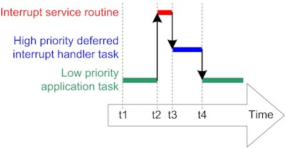
Deferred Processing Method
If the task to which interrupt processing is deferred is assigned a high enough priority then the ISR will return directly to the unblocked task (the interrupt will interrupt one task, but then return to a different task), resulting in all the processing necessitated by the interrupt being performed contiguously in time (without a gap), just as if all the processing had been performed in the ISR itself.

Slide 65
When to use deferred interrupt handling
Most embedded engineers will strive to minimize the amount of time spent inside an ISR (to minimize jitter in the system, enable other interrupts of the same or lower priority to execute, maximize interrupt responsiveness, etc.), and the technique of deferring interrupt processing to a task provides a convenient method of achieving this.
However, the mechanics of first unblocking, and then switching to, an RTOS task itself takes a finite amount of time, so typically an application will only benefit from deferring interrupt processing if the processing:
  Needs to perform lengthy operations, or
  Needs to perform an action that is not deterministic, within reasonable bounds.

Slide 66
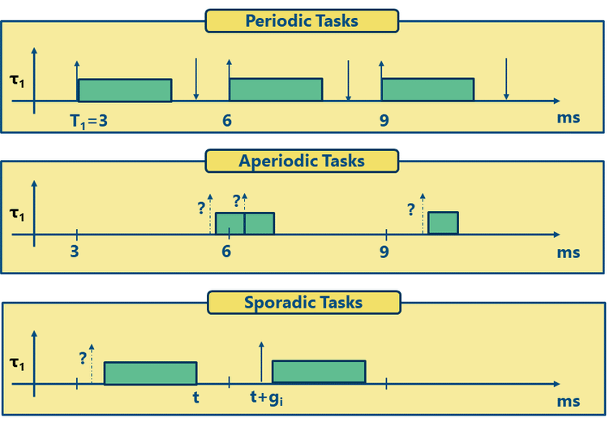
Categories of Real Time Task
Periodic Real-time Tasks :
The real-time task that is repeated after a certain time interval is known as periodic real-time task. Basically, the periodic real-time tasks are controlled by the clock interrupts
Aperiodic Real-time Tasks :
The dynamic tasks that reoccur at any random time and have soft deadline are known as aperiodic real-time tasks. Between two aperiodic real-time tasks the time interval may be even zero
Sporadic Real-time Tasks :
The real-time tasks that reoccur at any random instant and have hard deadline are known as sporadic real-time tasks.

Slide 67
RTOS Scheduling
In real time operating systems(RTOS) most of the tasks are periodic in nature.
These periodic tasks utilize most of the processor computation power.
A real-time control system consists of many concurrent periodic tasks having individual timing constraints.
The scheduling algorithms are used to determine which task is going to execute when more than one task is available in the ready queue.
The operating system must guarantee that each task is activated at its proper rate and meets its deadline.
Important terms related to timing constraints
Periodicity is the interval between task activations.
Computation Time is the worst-case time needed for task completion.
Execution Time is the actual time a task takes to execute.
Deadline is the latest time by which the task must be completed.

Slide 68
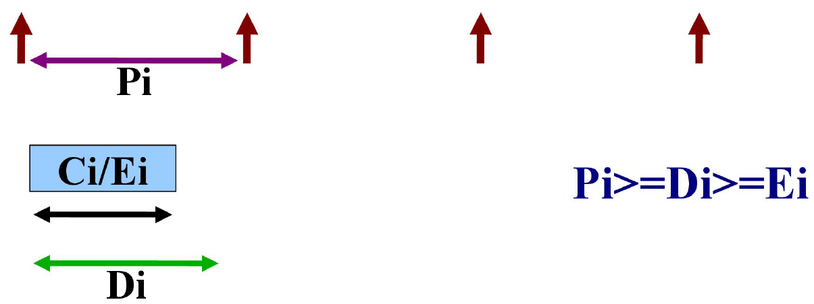
Timing Constraints
Periodicity, Pi
Computation Time / Execution Time, Ci/Ei
Deadline, Di
Task m /n

Slide 69


Processor Utilization Factor
The processor utilization factor is a measure used in real-time systems to quantify the proportion of the processor's time that is being utilized by tasks. It helps in determining whether the tasks can be scheduled to meet their deadlines. The utilization factor is particularly important in scheduling algorithms like Rate Monotonic Scheduling (RMS) and Earliest Deadline First (EDF).
Definition
The processor utilization factor U is defined as the sum of the utilization of all tasks in the system. For a set of n periodic tasks, where each task Ti has a computation time Ci​ and a period Ti​, the utilization factor U is given by:
Key Points
Computation Time (Ci) : The worst-case execution time of task Ti.
Period (Ti) : The time interval between successive activations of task Ti..
If the processor utilization is greater than one, then that task set will not be schedulable by any algorithm.

Slide 70


Schedulability analysis
The processor utilization factor is closely related to Schedulability analysis, which is the process of determining whether a set of tasks can be scheduled to meet their deadlines under a given scheduling algorithm. Here's how the utilization factor plays a role in Schedulability analysis for some common real-time scheduling algorithms:
Utilization Bound for RMS
For n periodic tasks, RMS guarantees that all deadlines will be met if the total utilization U satisfies:
Utilization Bound for EDF
EDF has a simpler utilization-based Schedulability test. A set of periodic tasks is schedulable under EDF if the total utilization U satisfies:
The processor utilization factor is a crucial metric in Schedulability analysis:
RMS: The task set is schedulable if the total utilization is within the Liu and Layland bound, which depends on the number of tasks.
EDF: The task set is schedulable if the total utilization is less than or equal to 1.

Slide 71
Worst Case Execution Time
The worst-case execution time (WCET) of a computational task is the maximum length of time the task could take to execute on a specific hardware platform.
What it is used for
Worst case execution time is typically used in reliable real-time systems, where understanding the worst-case timing behavior of software is important for reliability or correct functional behavior.
As an example, a computer system that controls the behavior of an engine in a vehicle might need to respond to inputs within a specific amount of time. One component that makes up the response time is the time spent executing the software – hence if the software worst case execution time can be determined, then the designer of the system can use this with other techniques such as Schedulability analysis to ensure that the system responds fast enough.
While WCET is potentially applicable to many real-time systems, in practice an assurance of WCET is mainly used by real-time systems that are related to high reliability or safety. For example, in airborne software some attention to software is required by DO178C section 6.3.4. The increasing use of software in automotive systems is also driving the need to use WCET analysis of software as defined in ISO26262.

Slide 72
Static and Dynamic Scheduling
Static Scheduling
Static scheduling algorithm selects a task to execute with reference to a predetermined schedule, which repeats itself after specific interval of time. For example, if we have three tasks Ta, Tb and Tc then Ta will always execute first, then Tb and after that Tc respectively.
Dynamic Scheduling
In Dynamic scheduling a task executes with respect to its priority, which is determined in real time according to specific rule and priorities of tasks may change during execution. They are more flexible because they can change the priority of tasks on run time according to the utilization factor of tasks.

Slide 73
Fixed/Static Priority and Dynamic Priority
Fixed/Static Priority
In fixed priority if the K^{th} job of a task T1 has higher priority than the K^{th} job of task T2 according to some specified scheduling event, then every job of T1 will always execute first then the job of T2 i.e. on next occurrence priority does not change. More formally, if job J(1,K) of task T1 has higher priority than J(2,K) of task T2 then J(1,K+1) will always have higher priority than of J(2,K+1) .
One of best example of fixed priority algorithm is rate monotonic scheduling algorithm.
Dynamic Priority
In dynamic priority algorithm, different jobs of a task may have different priority on next occurrence, it may be higher, or it may be lower than the other tasks.
One example of a dynamic priority algorithm is the earliest deadline first algorithm.

Slide 74
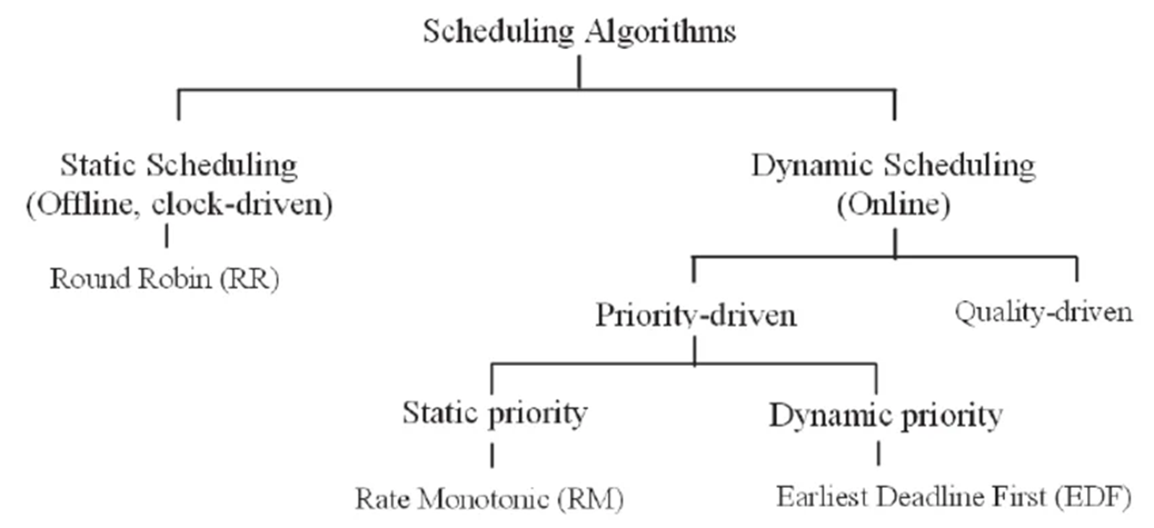
Types of Real Time Scheduling Algorithms
Static Table Driven Scheduling
Static Scheduling
Dynamic Scheduling

Slide 75
Rate Monotonic
Rate-Monotonic (RM) is a well-known real-time scheduling algorithm to schedule tasks with fixed or periodic deadlines. RM is a priority-based scheduling algorithm, where each task is assigned, a priority based on its period: shorter periods result in higher priorities.
The RM scheduling algorithm operates under the following principles:
The Rate Monotonic scheduling algorithm is a simple rule that assigns priorities to different tasks according to their time period.
That is, a task with the smallest time period will have the highest priority, and a task with the longest time period will have the lowest priority for execution.
As the time period of a task does not change, neither does its priority change over time. Therefore, Rate Monotonic is a fixed priority algorithm.
The priorities are decided before the start of execution and they do not change over time.

Slide 76
Rate Monotonic Scheduling
Static Priority Driven Scheduling
Priority assigned based on the period of each task
- Shorter the period, higher the priority
Tasks(m) | Pi | Ci | Di
Tl | 30 | 10 | 30
T2 | 40 | 15 | 40
T3 | 50 | 05 | 50

Slide 77
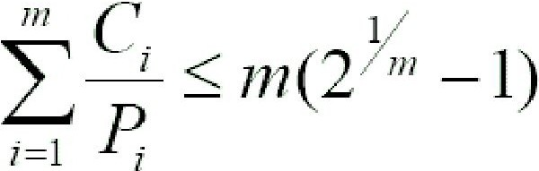
Rate Monotonic Scheduling
Value of is 0.780
Processor Utilization for m task
      10/30+15/40+5/50 == 0.808
Formula for Rate Monotonic
Schedulability Anaylsis
- Task are not schedulable as 0.808 > 0.780

Slide 78
Earliest Deadline First
Earliest deadline first (EDF) is dynamic priority scheduling algorithm for real time embedded systems.
Earliest deadline first selects a task according to its deadline such that a task with earliest deadline has higher priority than others.
It means priority of a task is inversely proportional to its absolute deadline. Since absolute deadline of a task depends on the current instant of time so every instant is a scheduling event in EDF as deadline of task changes with time.
A task which has a higher priority due to earliest deadline at one instant it may have low priority at next instant due to early deadline of another task.
EDF typically executes in preemptive mode i.e. currently executing task is preempted whenever another task with earliest deadline becomes active.

Slide 79
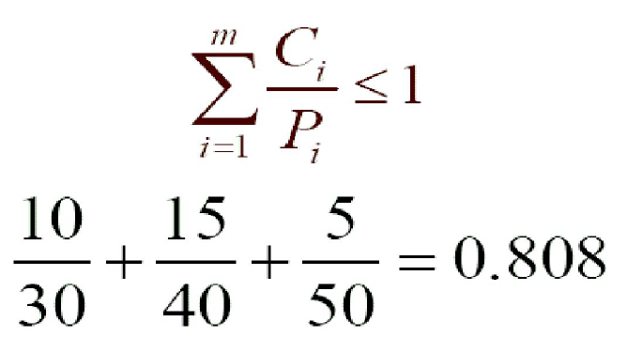
Earliest Deadline First
CPU Utilization should be less than 100%
Schedulability Analysis
- Task is schedulable

Slide 80
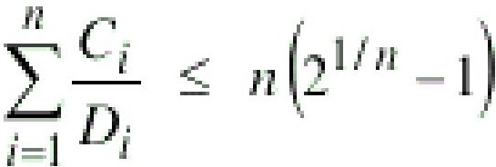
Deadline Monotonic Scheduling
Tasks | Pi | Ei |  |  |  | Di
Tl | 30 | 10 |  |  |  | 20
T2 | 40 | 15 |  |  |  | 25
T3 | 50 | 05 |  |  |  | 40
 |  |  | I | I | I |  | J
Deadline Monotonic Scheduling (DMS) is a fixed-priority preemptive scheduling algorithm used in real-time operating systems (RTOS). It assigns priorities to tasks based on their deadlines—the shorter the deadline, the higher the priority.

Slide 81
RMS or EDF or DMS Comparison
Aspect | Deadline Monotonic Scheduling (DMS) | Earliest Deadline First (EDF) | Rate Monotonic Scheduling (RMS)
Priority Type | Fixed | Dynamic | Fixed
Priority Assignment | Based on deadlines (shorter = higher) | Based on current deadlines (earliest = highest) | Based on periods (shorter period = higher priority)
Preemption | Higher fixed-priority tasks preempt lower ones | Tasks with closer deadlines preempt others | Higher fixed-priority tasks preempt lower ones
Optimality | Optimal for fixed-priority systems | Optimal for dynamic-priority systems | Optimal for fixed-priority systems with periodic tasks
Complexity | Simpler to implement | More complex to implement | Simpler to implement
CPU Utilization | Generally lower less than 100% | Can achieve up to 100% | Generally lower less than 100%
Best For | Fixed periodic tasks | Systems with varying deadlines | Fixed periodic tasks

Slide 82
FreeRTOS Scheduling Policy
FreeRTOS uses a priority-based preemptive scheduling policy by default, but it also supports time-slicing for tasks with the same priority. Changing the scheduling policy beyond these capabilities involves modifying the FreeRTOS kernel itself, which can be complex.
Here are the primary scheduling policies in FreeRTOS:
1. Priority-Based Preemptive Scheduling: Higher priority tasks preempt lower priority tasks. Tasks of the same priority use time-slicing to share CPU time.
2. Time-Slicing: If configUSE_TIME_SLICING is set to 1, tasks of the same priority will share CPU time equally in a round-robin manner.
Enable/Disable Time-Slicing:
In `FreeRTOSConfig.h`, set the `configUSE_TIME_SLICING` macro to 1 to enable or 0 to disable time-slicing. #define configUSE_TIME_SLICING 1 // Enable time-slicing
If you want to implement a custom scheduling policy, you would need to modify the FreeRTOS kernel code. This requires a deep understanding of the FreeRTOS scheduler and careful consideration of the potential impacts on system stability and performance.

Slide 83
Inter Task communication and Synchronization

Slide 84
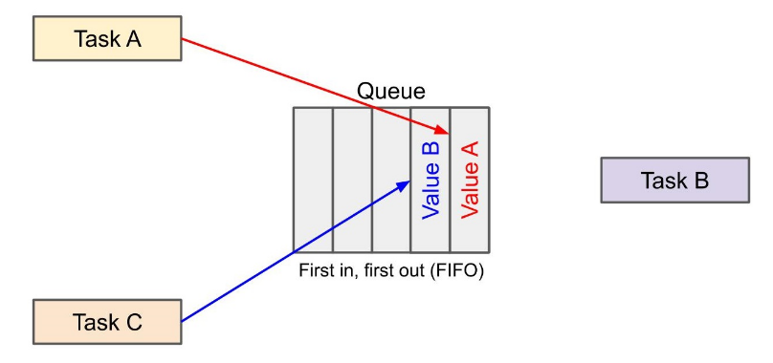
Queue
A queue in a RTOS is a kernel object that can pass information between tasks without incurring overwrites from other tasks or entering a race condition.
A queue is a first in, first out (FIFO) system where items are removed from the queue once read.
A queue is a simple FIFO system with atomic reads and writes. “Atomic operations” are those that cannot be interrupted by other tasks during their execution. This ensures that another task cannot overwrite our data before it is read by the intended target.
In this example, Task A writes some data to a queue. No other thread can interrupt Task A during that writing process. After, Task B can write some other piece of data to the queue. Task B’s data will appear behind Task A’s data, as the queue is a FIFO system.

Slide 85
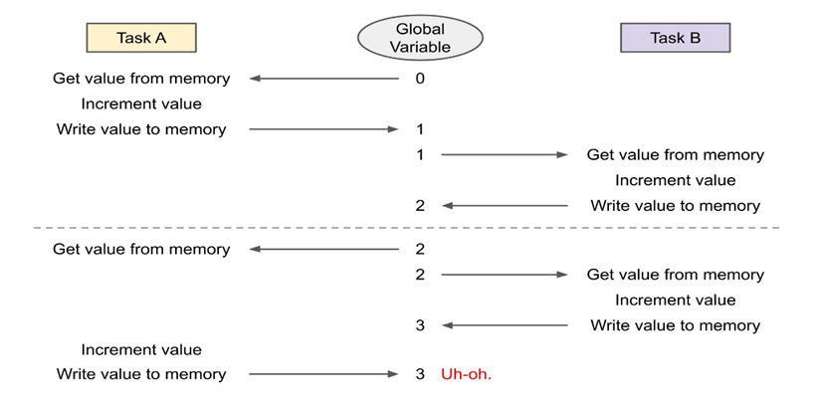
Mutex
A mutex (short for MUTual EXclusion) is a flag or lock used to allow only one thread to access a section of code at a time. It blocks (or locks out) all other threads from accessing the code or resource. This ensures that anything executed in that critical section is thread-safe and information will not be corrupted by other threads.
Without such a locking mechanism, we are liable to end up with a race condition in our code as multiple threads attempt to read and modify a common resource (such as a global variable, serial port, etc.).
This results in the same value being written to global/shared memory, even though two increment commands were executed. This is known as a “race condition”.

Slide 86
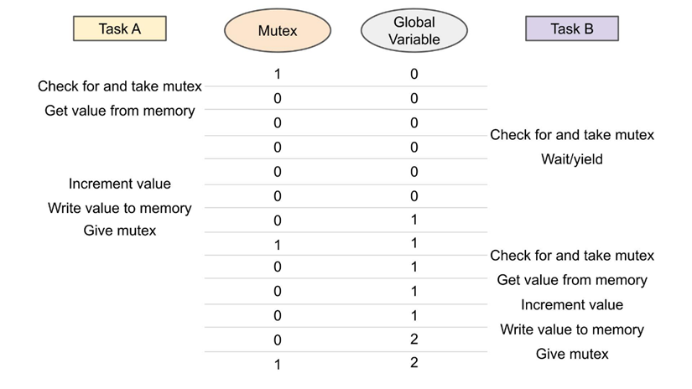
System Behavior with Mutex

Slide 87
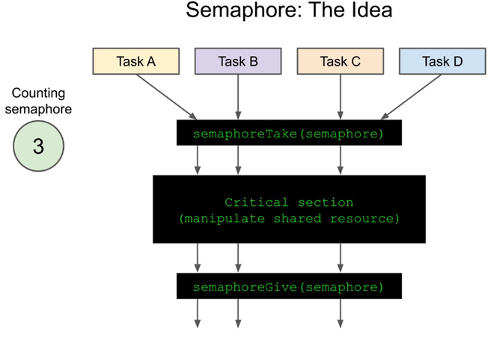
Semaphore
A semaphore is a variable used to control access to a common, shared resource that needs to be accessed by multiple threads or processes. It is similar to a mutex in that it can prevent other threads from accessing a shared resource or critical section.
In mutex there is level of ownership of the lock (i.e., a single thread is said to have the lock while executing in a critical section), a semaphore is a counter to that as it allows multiple threads to enter a critical section.
In theory, a semaphore is a shared counter that can be incremented and decremented atomically.

Slide 88
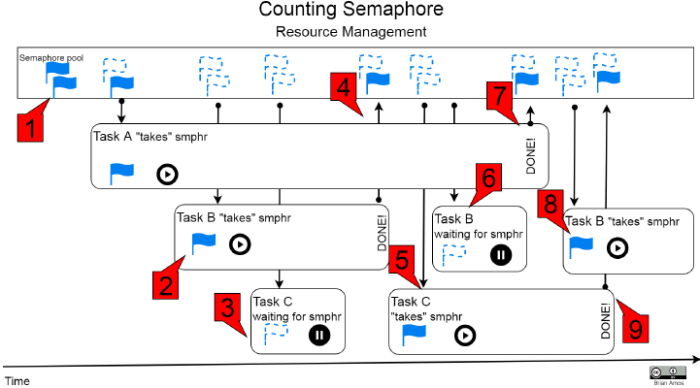
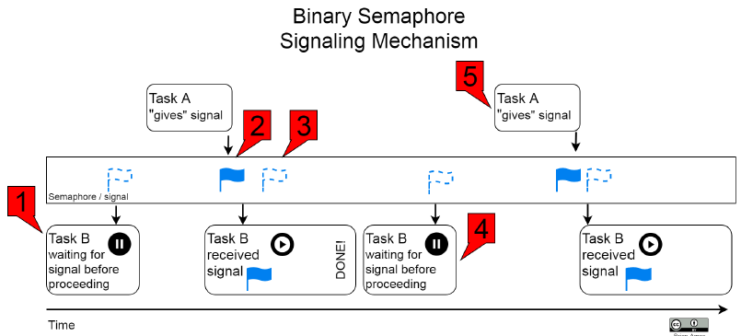
Use cases of Semaphore
Some example use cases of semaphores include the following:
An ISR is finished servicing a peripheral. It may give a semaphore to provide tasks with a signal indicating that data is ready for further processing.
A task has reached a juncture where it needs to wait for other tasks in the system to catch up before moving on. In this case, a semaphore could be used to synchronize the tasks.
Restricting the number of simultaneous users of a restricted resource

Slide 89
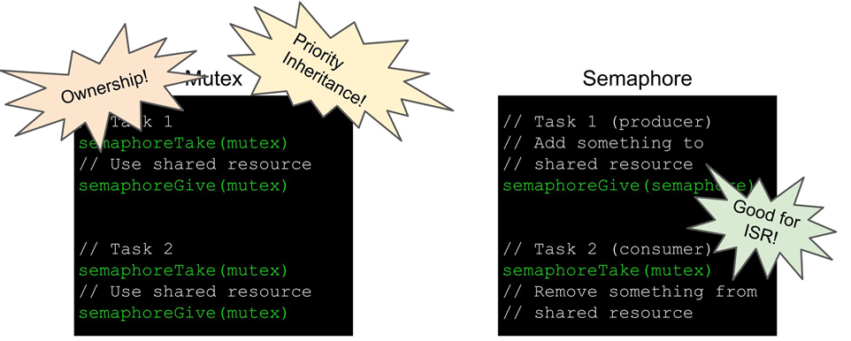
Mutex vs Semaphore
You can have a binary semaphore, which only counts to 1.
A mutex, as mentioned earlier, implies that the same thread must “take” and “give” the mutex, which means the thread “owns” the mutex during critical section execution. A semaphore is given and taken by different threads, which means it’s better used as a signaling mechanism to synchronize threads.
Because you do not want an interrupt service routine (ISR) to block (hogging the CPU), you generally do not want to use a mutex in an ISR.
However, you could use a semaphore in an ISR to signal to other threads that it has executed, and some data is ready for consumption.

Slide 90
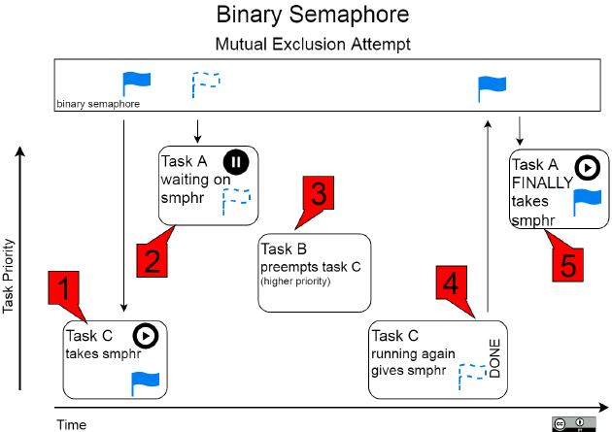
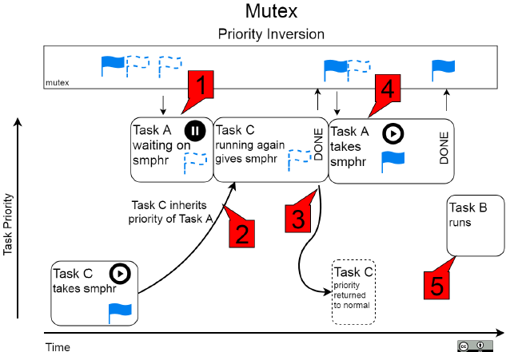
Priority Inversion and Priority Inheritance
In FreeRTOS a mutex involves priority inheritance for the calling thread.
If a high priority thread is waiting for a lock from a low priority thread, the low priority thread’s priority is raised to be equal to or above the waiting thread so that it can quickly finish executing the critical section and release the lock.
This helps alleviate the problem of priority inversion.

Slide 91
Direct Task Notification
Direct task notifications are like the other communication mechanisms discussed, except that they do not require the communication object to first be instantiated in RAM like it used to be in Queue.
They are also faster than semaphores or queues (between 35% and 45% faster).
They do have some limitations, the largest two being that only one task can be notified at a time and notifications can be sent by ISRs but not received.
Direct task notifications have two main components:
  Notification itself (which behaves very much like how a semaphore or queue behaves when unblocking a task)
  32-bit Notification value.
The notification value is optional and has a few different uses.
A notifier has the option of overwriting the entire value or using the notification value as if it were a bitfield and setting a single bit.
Setting individual bits can come in handy for signaling different behaviors that you'd like the task to be made aware of without resorting to a more complicated command-driven implementation based on queues.
Task notifications sound a bit like semaphores but it’s a faster alternative

Slide 92
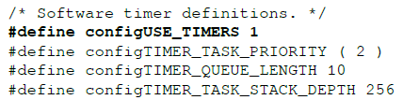
Software Timer
Software timers are timers that are implemented with software. In MCUs, its common to have many different hardware peripheral timers available.
Hardware Timers are often high resolution and have many different modes and features that are used to offload work from the CPU.
However, there are two downsides to hardware timers:
  Different MCUs will have slightly different implementations for timers. Because of this, it is easy for code to become dependent on the underlying hardware.
  They will generally take more development time to set up than using the software-based timer that has already been provided by the RTOS.
Software timers alleviate this coupling by implementing multiple timer channels via software, rather than hardware. So, instead of an application being dependent on specific hardware, it can be used (without modification) on any platform the RTOS supports, which is extremely convenient.
configUSE_TIMERS must be defined as 1 in FreeRTOSConfig.h
The code that's executed when the timer fires
is executed inside the context of
the Software Timer Task, so you need to
take care of stack depth

Slide 93
Thank You

