Slide 1
Patient Medical History Management System
Group: 09
1. Sayed Arbaaz
2. Asif Raju Shaikh
3. Mirza Adnan Baig Nusratulla
4. Omkar Suresh Mandavkar
5. Hrishikesh Helge
6. Umer Shafik Karbhari
AIT YCP (SEPT-2022)

Slide 2
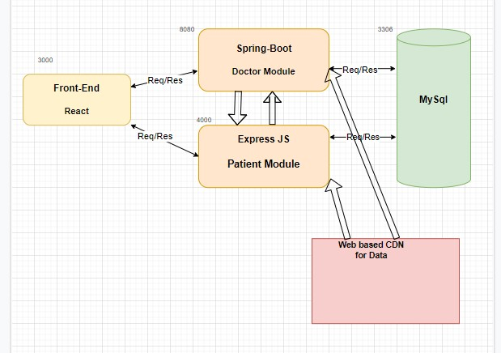
System Architecture: MicroServices

Slide 3
The Database First Approach:
Crowfoot Notations
Wireframe Diagram
Use Case Diagram

Slide 4
Technologies Implemented:
Spring Boot (J2EE)
The Spring boot application handles functions of Doctor and Admin
Express.js (Node.js)
The Express.js framework handles functions of patient.
React.js (Single Page Application)
MySql (RDBMS)
Cloudinary (External CDN)
This API stores images (prescriptions) and return url in response.

Slide 5
Doctor Module: SPRING
POST (/doctor/register)
Doctor data is inserted into all the related tables and in case of any conflict an 409(Conflict) is returned by the application.
If the all the data is valid then the data is entered in database and email is sent to the user on successful registration.
POST (/doctor/login)
Email and password and fetched from frontend and if the data is valid then the application return HTTP status 200 (OK) or 401(UNAUTHORIZED) if the data is invalid.

Slide 6
Doctor Module: SPRING
GET (/patient/medrecord/{abhaaNumber})
The database is searched with abhaaNumber (unique key).
All the data corresponding to the abhaaNumber is returned by the app.
GET (/doctor/medlog/{email})
The medical logs are fetched from the database using the email of the patient since email is a unique key in the database.
POST (/doctor/medlog/{email}
Doctor can post the prescriptoin from the UI.

Slide 7
Forgot Password? (SPRING)
POST (/doctor/forgotpassword)
An OTP is generated from using the email of the doctor and is sent to the doctors email id.
POST (/doctor/validateotp)
Validates the OTP sent by the doctor. Gives HTTP status 200 if OTP is valid else gives HTTP status 401.
POST (/doctor/resetpassword)
Resets password of the doctor using after the OTP is validated.

Slide 8
Admin: SPRING
GET (/admin/doctor)
Gets the list of the doctors present in the database.
POST (/admin/doctor)
Updates the doctors record. (VERIFIED)
GET (/admin/patient)
Return a list of all Patient in the database.
GET (/admin/doctors)
Returns list of all unverified doctors.
POST (/admin/login)
Logs in the admin using email and password

Slide 9
Patient Module: NODE.JS
POST (patient/register)
Registers the patient on the portal using all necessary information.
POST (/patient/login)
Logs in the patient if the credentials are valid and JWT token is generated for further authentication.
POST (/patient/medlogINS)
Inserts the patient medical log details.
POST (/patient/medrecordINS)
Inserts the patient medical records in the table.

Slide 10
Patient Module: NODE.JS
GET (/patient/getPatientPrimaryDetails/{id} )
Return data from patient primary table using id.
GET (/patient/getaddressDetails/{id})
Return address of the patient using the id.
GET (/patient/getMedRecordDetails/{id})
Return patients medical records using the id.
GET (/patient/getMedLogDetails/{id})
Return patients medical logs using the id.

Slide 11
Patient Module: NODE.JS
POST (/patient/updateProfile)
Updates the profile of the patient.
POST (/patient/updateMedRecord)
Updates the patient medical records
POST (/patient/forgotPassword)
Generates OTP and sends it to patients email id.
POST (/patient/otpValidate)
Validates OTP entered by the patient
POST (/patient/resetPassword)
Allows the patient to reset the password and validating otp.

Slide 12
THANK YOU

