Slide 1
Design Structures
ECE 506
Chris Daffron and Jacob Tobin

Slide 2
Types
Direct Form I/II
Cascade
Parallel
Lattice

Slide 3
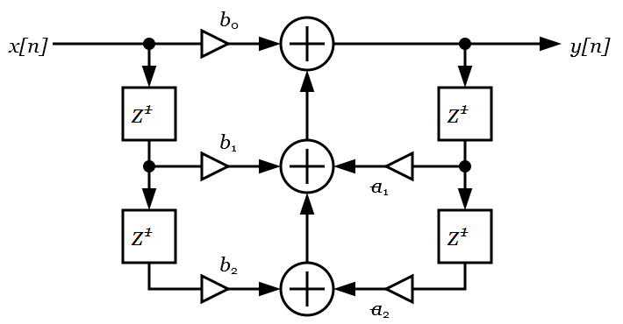
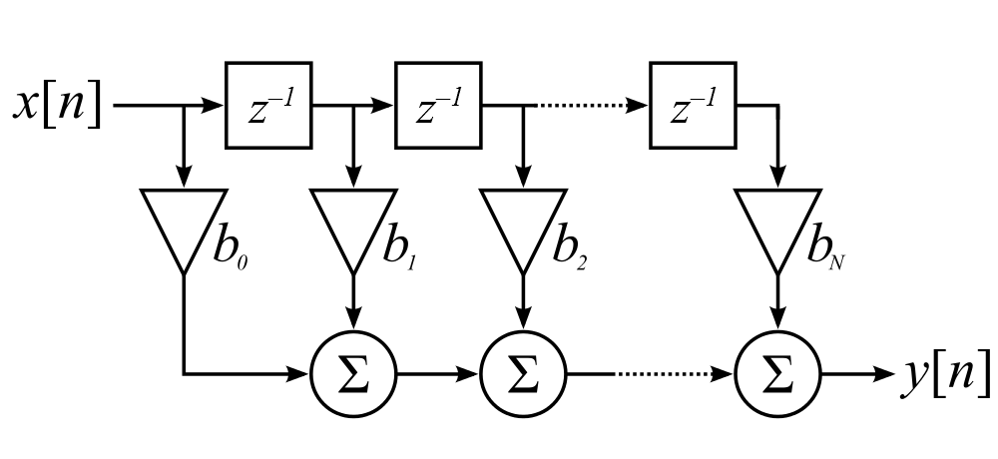
Direct Form I
2N delays for N order filter
~3100 clock cycles on DSK board (FIR)
~2300 clock cycles (IIR)
IIR DF-I
FIR DF-I

Slide 4
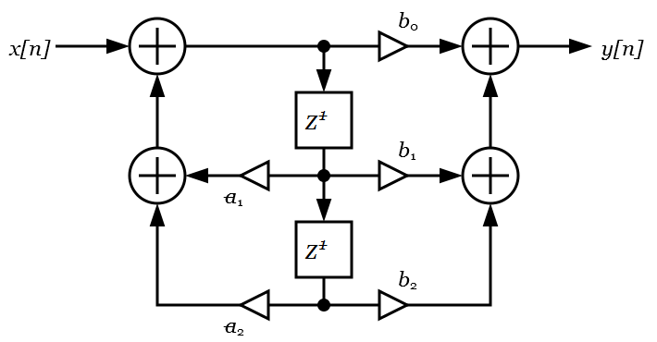
Direct Form II
N Delays
IIR DF-II

Slide 5
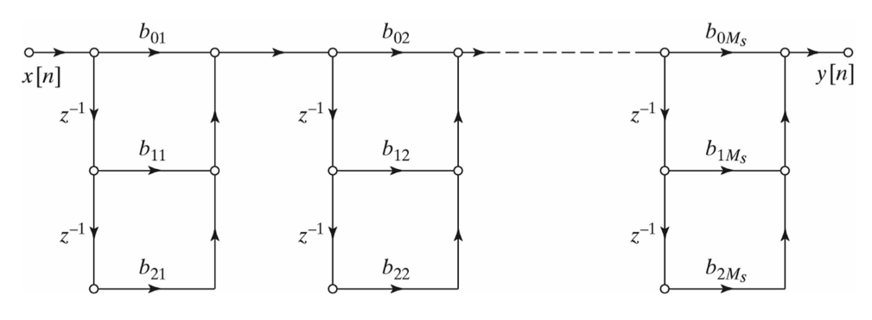
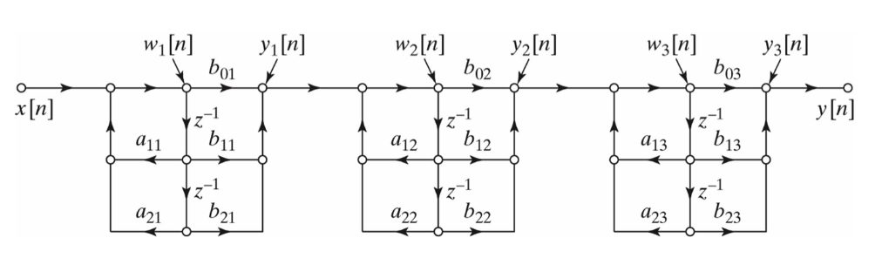
Cascade
FIR Cascade
N + 2 Delays for DF-I
N Delays for DF-II
~4000 FIR
~1200 IIR
IIR Cascade / Second Order Sections

Slide 6
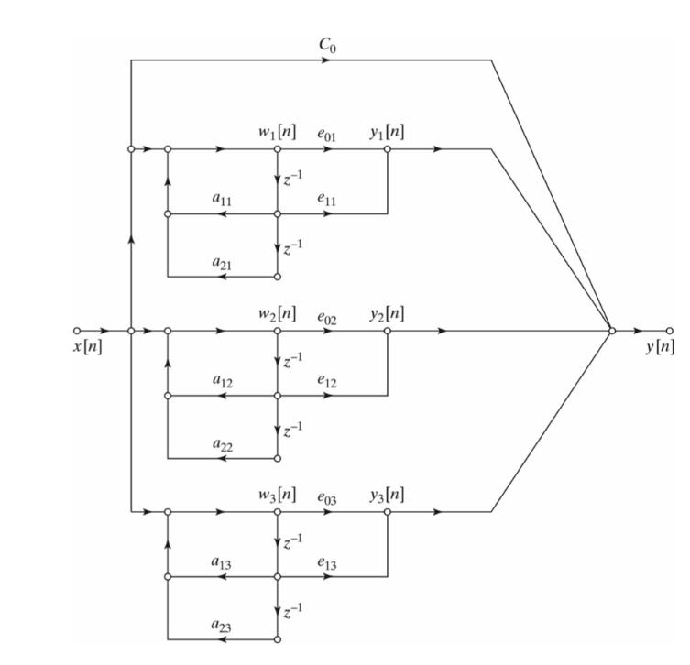
Parallel
Facilitates code parallelization to reduce computation time

Slide 7
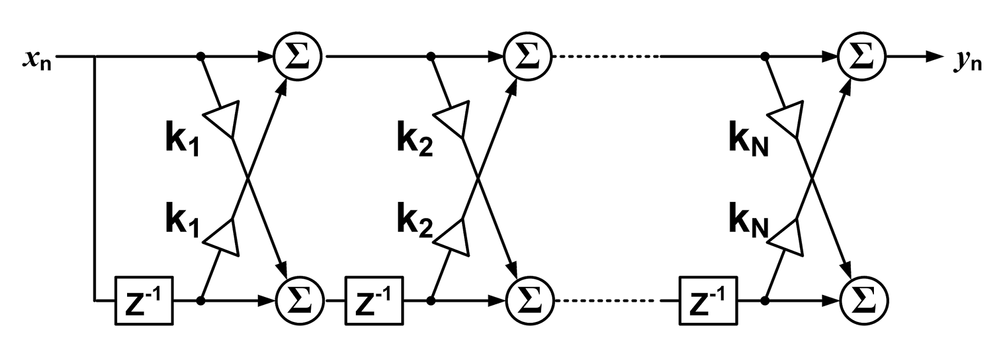
Lattice
N Delays
2*N Multiplies and Accumulates
~8500 Cycles

