Slide 1
Ransomware: Malicious Encryption
Colton Alseth
Notes:
A typical way people attempt to exploit computers is through the use of malicious software, or malware as many of you may know it. There are some commonly known types such as viruses, worms and spyware, but there is one type that has become a significant problem in the last few years.
This type of malware is known as ransomware, and it’s concept is simple: find a way to restrict someone’s access to their computer and then extort them for money in exchange for restoring their access. Most of the time this is done by encrypting the files on someone’s computer, so they’ll no longer have access to important documents, or family photos or anything else that is important.
That is part of the reason the subtitle of this presentation is “Malicious encryption,” because ransomware is completely reliant on encryption to work.
So, we will talk about encryption and how it benefits ransomware, as well as the history of ransomware and later, where it may be headed in the future.

Slide 2
Terminology in Cryptography
Encryption -
Decryption -
Plaintext -
Ciphertext -
Encryption Key -
Decryption Key -
Understandable information → Non-decipherable data
Non-decipherable data → Understandable information
Understandable information to be encrypted, producing ciphertext
Non-decipherable data to be decrypted, producing plaintext
Value(s) used in the encryption algorithm to give you ciphertext
Value(s) used in the decryption algorithm to give you plaintext
Notes:
Before I get started on the rest of the presentation, I was

Slide 3
The First Ransomware
Used in 1989
Known as the “AIDS Trojan”
Notes:
Ransomware is usually seen as a recent issue, but it has actually been around since 1989.
The first ransomware was created by Dr. Joseph Popp, an evolutionary biologist and he used it to target doctors in the World Health Organization, but no one really knows his motivations.

Slide 4
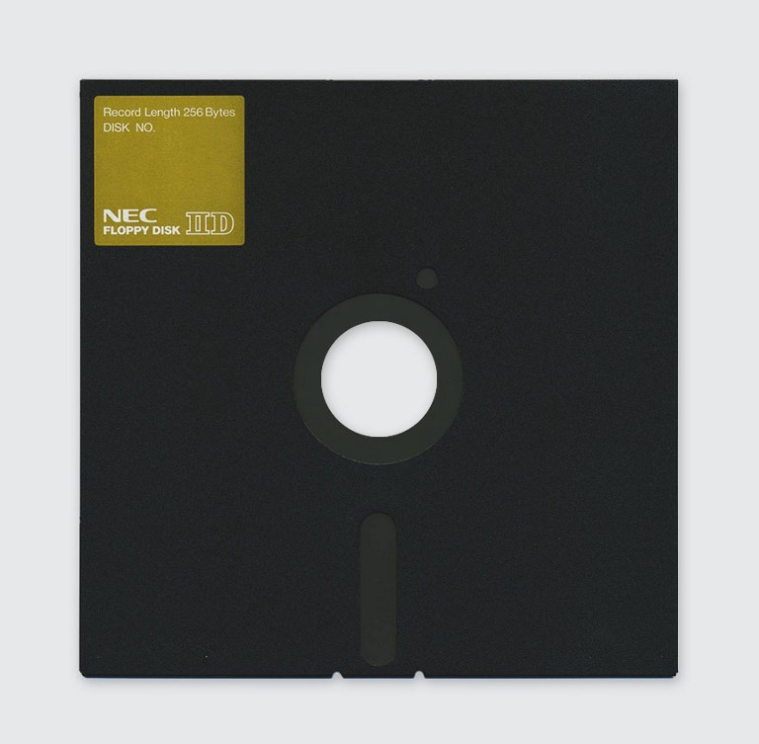
The First Ransomware
Used in 1989
Known as the “AIDS Trojan”
Notes:
The way he got them to install this on their computer at the time was by distributing floppy disks to all of the doctors.
They were under the impression that it was software to help diagnose their patients with HIV/AIDS.

Slide 5
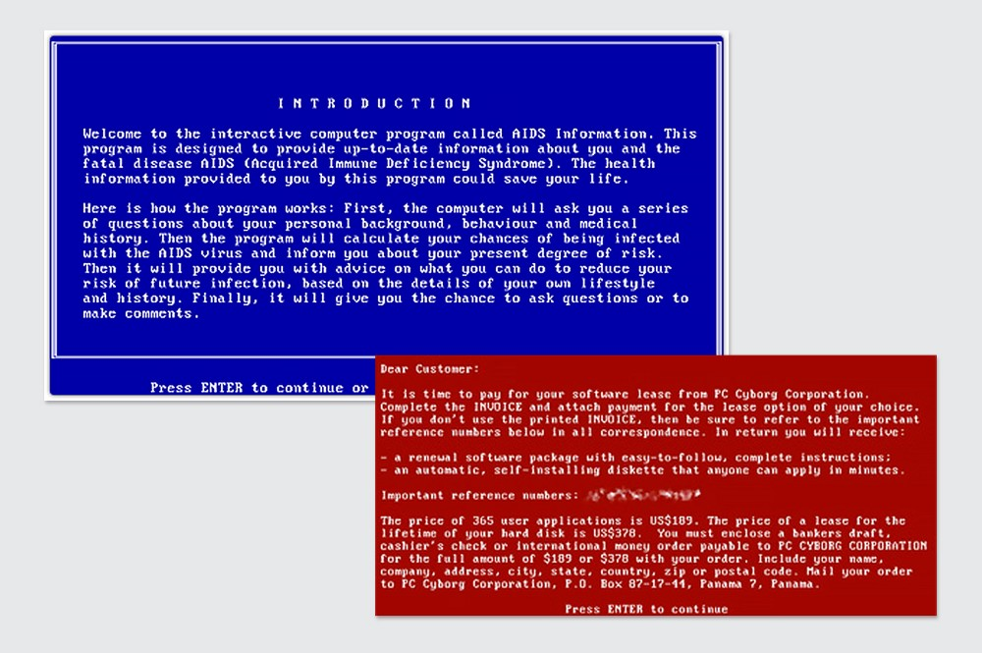
The First Ransomware
Used in 1989
Known as the “AIDS Trojan”
Notes:
So, after installing they would see a message like this, which presented itself as the software they thought it was.

Slide 6
The First Ransomware
Used in 1989
Known as the “AIDS Trojan”
Notes:
Then, after rebooting their computer a certain number of times they would be presented with this note.
Basically, it was telling them their trial of the software was over and they needed to pay to regain access to their computer.
They would need to send their payment out to PC Cyborg Corporation and send it to their PO Box.

Slide 7
The First Ransomware
Used in 1989
Known as the “AIDS Trojan”
Not successful
Symmetric encryption
Proof-of-concept for ransomware
Notes:
However, this piece of ransomware was not effective.
One of the primary reasons that it did not work was due to the style of encryption it used to alter the victims’ files. It used symmetric encryption, which uses the same key to encrypt data as well as decrypt it. Since the key was embedded in the software to encrypt the files, they were able to extract it from the software and decrypt the files.
Additionally, Dr. Popp gave away important information about himself. He provided his victims with PO Box to send the ransom, as well as a company name to make the payment out to. Because of these pieces of information, he was eventually caught.
However, even though it did not work as intended, it provided a proof of concept for future pieces of ransomware.

Slide 8
CryptoViral Extortion
Columbia University research
1995
Basis of most modern ransomware
Combine symmetric and asymmetric encryption
Symmetric Encryption to encrypt files
Asymmetric encryption to encrypt the symmetric key

Slide 9



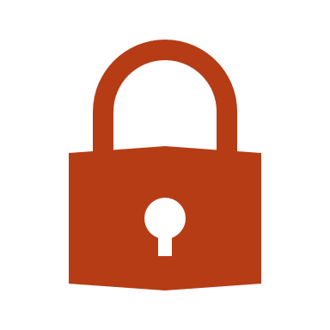
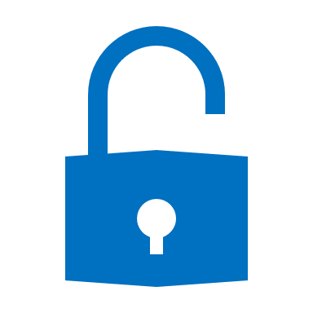
Symmetric Encryption
Single key
More efficient
Less secure
Key = 3
AES Encryption​
Plaintext
Ciphertext
Plaintext
+3
-3
1 2
3 4
4 5
6 7
1 2
3 4
Encrypt
Decrypt

Slide 10



Asymmetric Encryption
Public Key
Private Key
Two Keys
Public Key
Private Key
Less efficient
More computation
More secure
Public key can be shared with anyone
Private key only way to decrypt ciphertext
Plaintext
Ciphertext
Plaintext
;sdfF;Fdf<vm=s;IkL’d6l_nq
Encrypt
Decrypt
RSA Encryption

Slide 11
Asymmetric Encryption
The Plaintext
T = 10
p =
q =
11
= 187
Private Key
N = p * q
= 11 * 17
17
The Ciphertext
C =
Requirement
175
(p-1)(q-1) = 10 x 16 = 160
Must be relatively prime with e, the Encryption Key
187
N =
e =
Public Key
7
Decryption
Encryption
Find: e * d = 1 mod ((p-1)(q-1))
Encryption Formula
7 * d = 1 mod 160
C = T^{e} (mod N)
C = 10⁷(mod 187)
Decryption Key
d = 23
C = 10,000,000(mod 187)
Decryption Formula
T = 175²³(mod 187)
C = 175
T = 10
T = C^{d} (mod N)

Slide 12
Ransomware Attack
Private Key
p =11 q = 17
Public Key
N= 187 e = 7
Attacker
Victim

Slide 13
Ransomware Attack
Private Key
Public Key
p =11 q = 17
N= 187 e = 7
Ransomware
Public Key
N= 187 e = 7
Attacker
Victim

Slide 14
Ransomware Attack
Private Key
Public Key
p =11 q = 17
N= 187 e = 7
Ransomware
Public Key
N= 187 e = 7
Attacker
Victim

Slide 15
Ransomware Attack
Private Key
Public Key
7
p =11 q = 17
N= 187 e = 7
Text Document
Ransomware
Randomized
Symmetric Key
Public Key
k = 10
N= 187 e = 7
Attacker
Victim

Slide 16
Ransomware Attack
Private Key
Public Key
17
p =11 q = 17
N= 187 e = 7
Encrypted Text Document
Ransomware
Randomized
Symmetric Key
Public Key
k = 10
N= 187 e = 7
Attacker
Victim

Slide 17
Ransomware Attack
Private Key
Public Key
17
p =11 q = 17
N= 187 e = 7
Encrypted Text Document
Ransomware
Randomized
Symmetric Key
Public Key
k = 10
N= 187 e = 7
Attacker
Victim

Slide 18

Ransomware Attack
Private Key
Public Key
17
p =11 q = 17
N= 187 e = 7
Encrypted Text Document
Ransom Message
Ransomware
Encrypted
Symmetric Key
Public Key
k = 175
N= 187 e = 7
Attacker
Victim

Slide 19

Ransomware Attack
Private Key
Public Key
17
p =11 q = 17
N= 187 e = 7
Encrypted Text Document
Ransom Message
Ransomware
Encrypted
Symmetric Key
Public Key
k = 175
N= 187 e = 7
Attacker
Victim

Slide 20
Ransomware Attack
Private Key
Public Key
17
p =11 q = 17
N= 187 e = 7
Encrypted Text Document
Ransom Message
Ransomware
Encrypted
Symmetric Key
Public Key
k = 175
N= 187 e = 7
Attacker
Victim

Slide 21
Ransomware Attack
Private Key
Public Key
17
p =11 q = 17
N= 187 e = 7
Encrypted Text Document
Ransom Message
Encrypted
Symmetric Key
Ransomware
k = 175
Public Key
N= 187 e = 7
Attacker
Victim

Slide 22
Ransomware Attack
Private Key
Public Key
17
p =11 q = 17
N= 187 e = 7
Encrypted Text Document
Ransom Message
Decrypted
Symmetric Key
Ransomware
k = 10
Public Key
N= 187 e = 7
Attacker
Victim

Slide 23
Ransomware Attack
Private Key
Public Key
17
p =11 q = 17
N= 187 e = 7
Encrypted Text Document
Ransom Message
Ransomware
Decrypted
Symmetric Key
Public Key
k = 10
N= 187 e = 7
Attacker
Victim

Slide 24
Ransomware Attack
Private Key
Public Key
7
p =11 q = 17
N= 187 e = 7
Decrypted Text Document
Ransom Message
Ransomware
Decrypted
Symmetric Key
Public Key
k = 10
N= 187 e = 7
Attacker
Victim

Slide 25
Notes:
Now that we’ve seen how ransomware works and its history, I’d like to talk about where it may be going in the next few years.

Slide 26
Ransomware Attacks
2016
2017
“The Year of Ransomware”
638 million ransomware attacks
7.86 billion malware attacks
Ransomware at 8.107% of attacks
$209 million paid to cybercriminals in Q1 alone
184 million ransomware attacks
9.32 billion malware attacks
Ransomware at 1.974% of attacks
Ransomware is mostly contained to desktop computers
Notes:
For some context, we can take a look at some figures from the last few years.
If we look at 2016, we can see that there were a large number of ransomware attacks and the percentage of malware attacks relating to ransomware was high.
A year later, the number of ransomware attacks dropped significantly. There were still a large number of attacks, but ransomware was a small percentage of malware attacks as a whole.
As of right now, ransomware attacks are mostly contained to Windows desktop computers. I think this is the main reason ransomware has become less effective. I believe are more aware and are not as easily tricked as they were in the past, and also there are better anti-malware systems in place.
So I think if ransomware is going to continue to work, it will have to start targeting other platforms.

Slide 27
Mobile
Mobile ransomware has been done before
First seen in 2012
Cisco Visual Networking Index
Mobile devices:
447 million (2015) – 947 million (2020)
Mobile ransomware increased by 250%, Q4 2016 – Q1 2017
Ransomware use in general decreased in this time
Notes:
The first platform I think it will begin targeting is the mobile platform. One of the reasons I believe this is due to the fact that mobile ransomware has already been done. It was first seen in 2012, but has made up a small proportion of attacks.
Another reason I think this may be a possibility is due to the increase in mobile ransomware attacks seen between Q4 of 2016 and Q1 of 2017. Even while ransomware attacks in general decreased in this time, mobile ransomware increased.
Also, if we look at the growth that is projected for mobile devices in the coming years, there will be a lot of devices to target.
Finally, we can see that internet usage for smartphones is projected to double that of desktop computers by 2022. If desktop use declines and mobile use increases, it would make sense for ransomware to move away from the desktop environment.
When considering all of this, I think the mobile platform may be a target of ransomware in the future.

Slide 28
Internet of Things (IoT)
Internet of Things will grow
IoT Devices:
8.38 billion (2017) | 20.41 billion (2020)
IoT Security is poor
Example:
Mirai botnet (11.3 million devices)
IoT Ransomware has been shown to work
Proof-of-concept by Symantec
Notes:
The other platform I believe may see ransomware attacks in the coming years is the Internet of Things.
The number of IoT devices is expected to explode on the next few years, more than doubling by 2020. Like mobile, this will provide cybercriminals with many targets.
Additionally, IoT security is known to be poor in its current state. There are many examples, but the best one the illustrates this is the Mirai botnet. Hackers were able to scan the Internet for unsecure devices, most of which happened to be IoT, and then gain access to them by entering 61 common combinations of usernames and passwords. They were able to assemble a botnet of 11.3 million devices doing this.
Finally, IoT ransomware has been shown to work in the past. A researcher from the cybersecurity company Symantec successfully infected his smart tv using a man in the middle attack. Essentially, he was able to redirect a request to a legitimate server for an application on his tv to another server, which returned an infected version of the application to his TV.
Again, I think all of these things combined show why IoT devices may be a target of ransomware in the next few years.

Slide 29
Conclusion
Original piece of ransomware - 1989
Acted as a proof-of-concept
Asymmetric Encryption and Symmetric Encryption
Symmetric to efficiently encrypt files
Asymmetric to securely encrypt symmetric key
Ransomware attacks are slowing down
Ransomware will have to find new platforms
Mobile and IoT will likely be targeted

