Slide 1

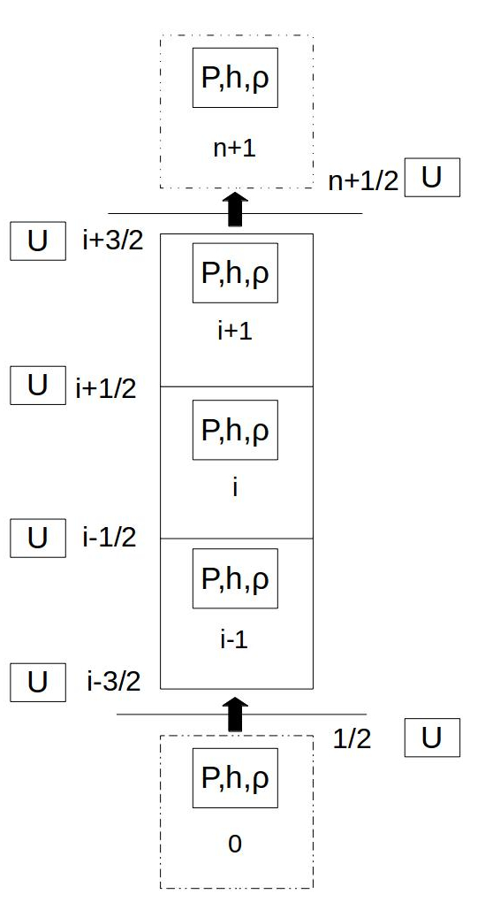
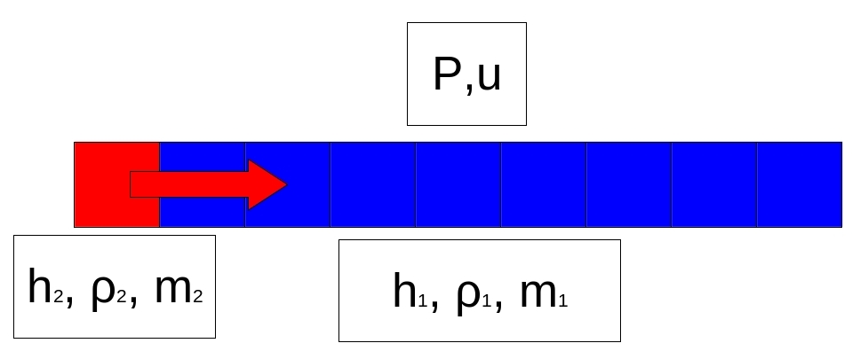
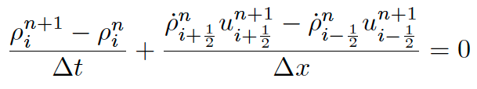
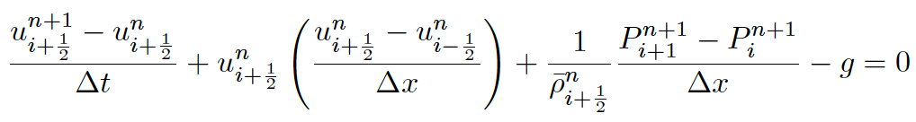
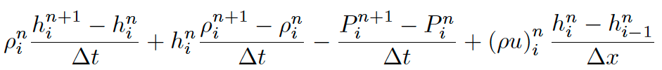
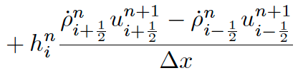

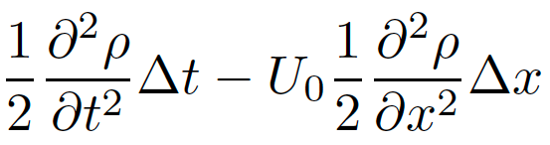
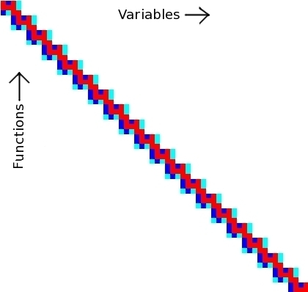
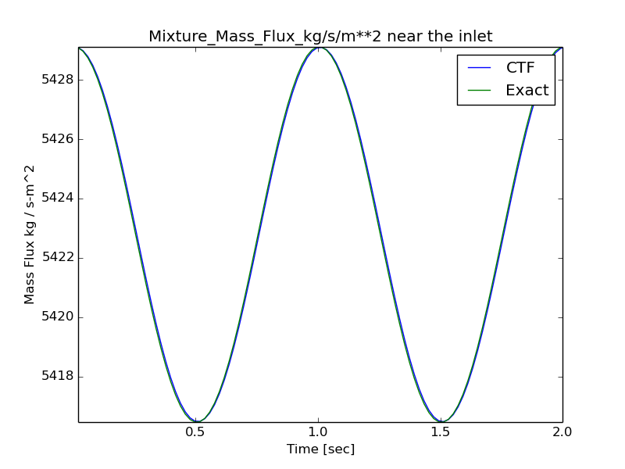
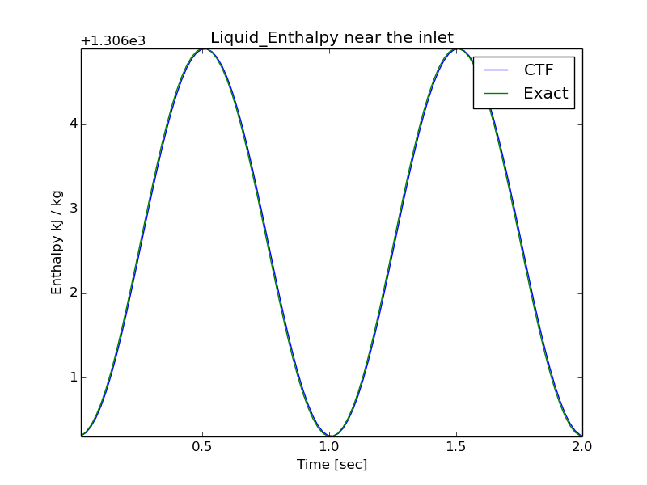
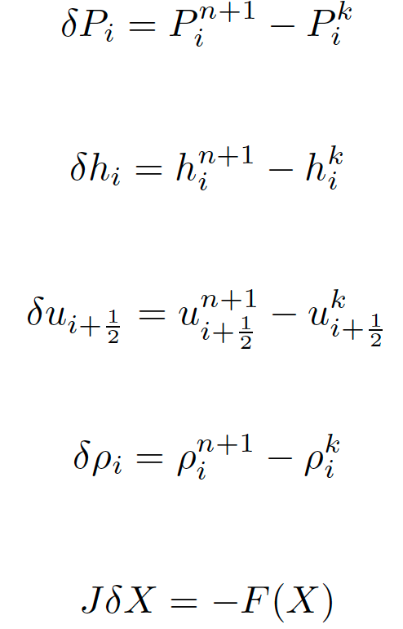
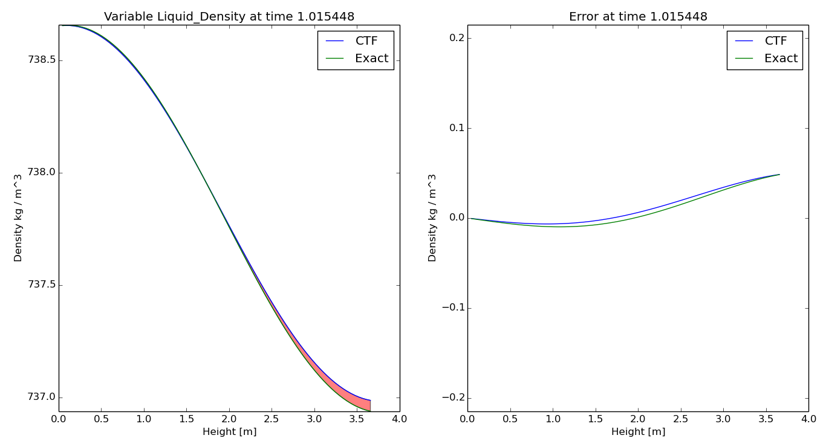
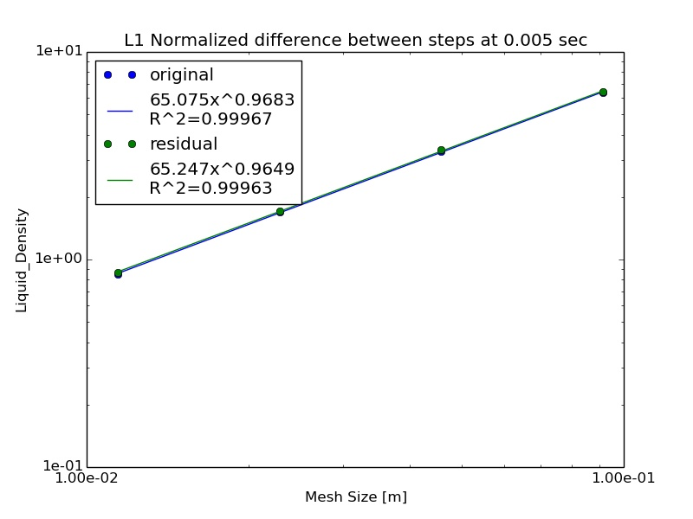
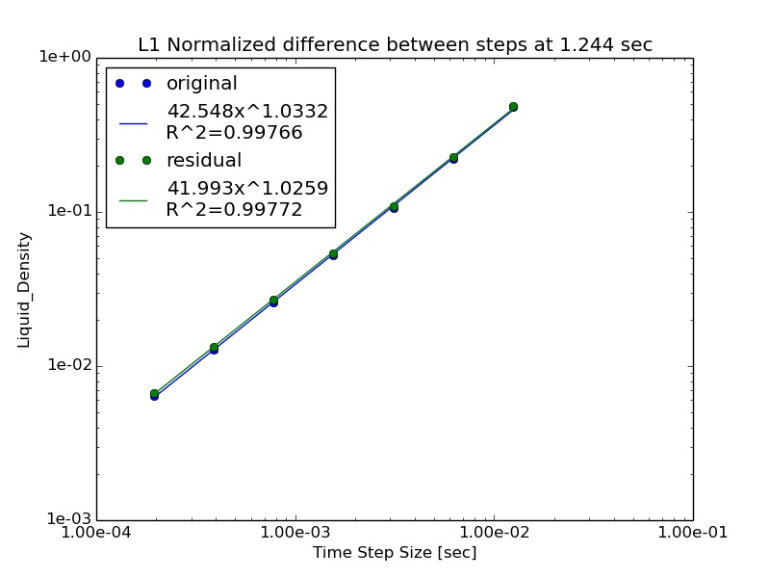
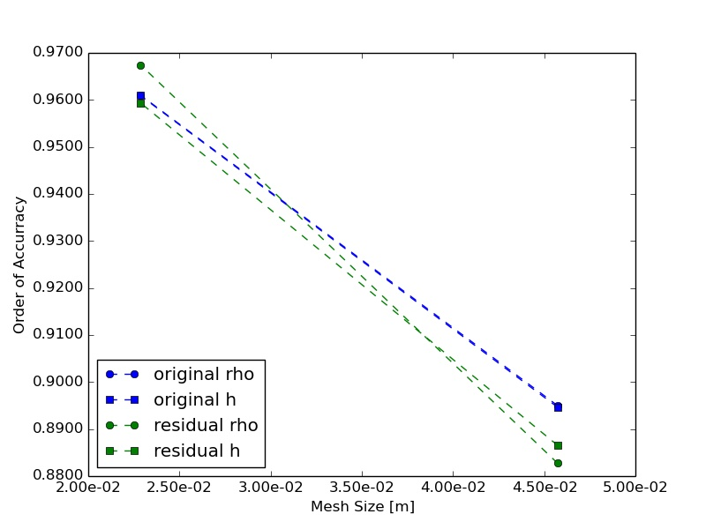
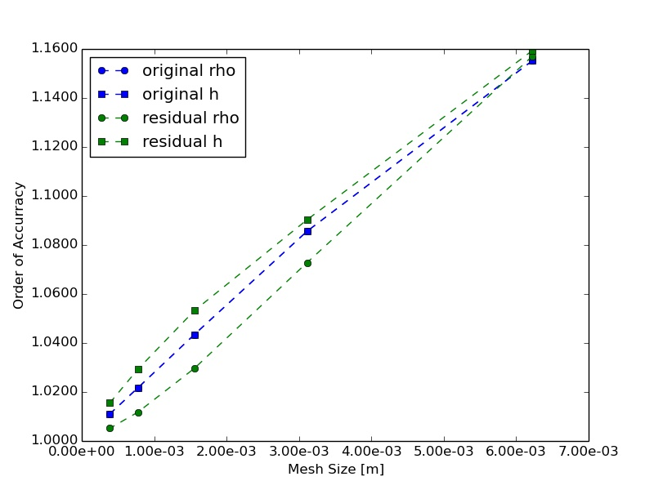
Initial 1-D Single Phase Liquid Verification of CTF
Chris Dances
Mentor: Dr. Vince Mousseau
Advisors: Dr. Kostadin Ivanov & Dr. Maria Avramova
Objective: To perform an initial verification study of CTF
1-D Single Phase Equations
Verification Problem Setup
Finite Difference Conservation Equations
Parameter | Value | Unit
Axial Length | 3.6586 | m
Channel Area | 4.94E-005 | m^2
Wetted Perimeter | 1.49E-002 | m
Velocity | 7.35 | m/sec
Pressure | 155.00 | bar
Temperature 1 | 290.00 | C
Temperature 2 | 295.00 | C
Enthalpy 1 | 1306.3 | kJ/kg
Enthalpy 2 | 1310.9 | kJ/kg
Mass Flow Rate 1 | 0.2707 | kg/sec
Mass Flow Rate 2 | 0.2672 | kg/sec
Final Time | 2.00 | sec
Wave Frequency | 1.00 | Hz
Mass
Mom.
A 1-D single phase channel
Velocity is held constant
Transient Boundary condition
Mass flow rate
Enthalpy
Smooth transitions avoid discontinuities
Analytical solution is easily obtained
Python scripting automates input generation, running CTF, and analysis
Energy
EOS
Modified Equation Analysis
Error =
Residual Formulation
Richardson Extrapolation
Error Comparison
Spatial
Temporal
The numerical error will propagate through the solution resulting in more error at the outlet
The expected error can be computed from the known solution, and compared to the observed
The expected error is local, and was found to scale by dimensionless length
Scaled expected error matches closely with observed error while in asymptotic range
Conclusions and Future Work
The residual formulation of CTF allows for a numerical computation of the multivariable Jacobian matrix compared to the original analytical derivation of a pressure matrix. The 1-D isokinetic single phase liquid verification problem is a good verification problem due its isolation of the order of accuracies through modified equation analysis. The discretization error for both versions of the code converged to zero with decreasing time step and axial mesh size. The order of accuracy for the temporal and spatial refinements matched very closely with the modified equation analysis for both codes. For all of these data points, the residual formulation of the code showed discretization errors that were very close with the original version of the code. This work will be expanded to perform verification on the single phase equations in both axial and transverse dimensions, and coupled fluid heat conduction.
Time step size reduce by half
Observed error converges to zero
Calculated order of accuracy converges to 1
Mesh size reduced by half
Observed error converges to zero
Calculated order of accuracy converges to 1

