Slide 1

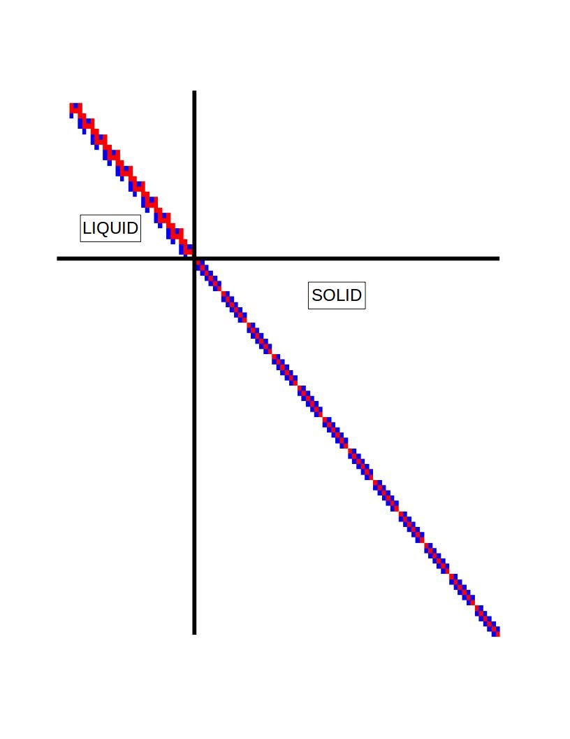
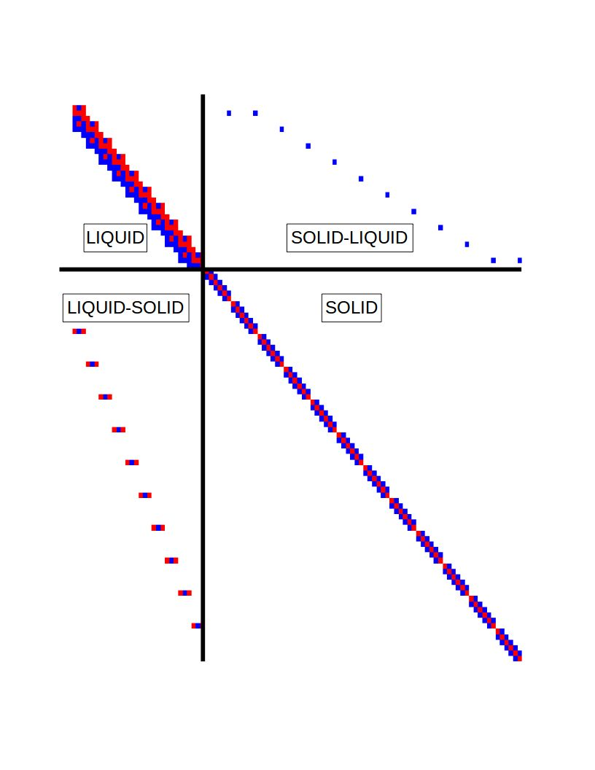
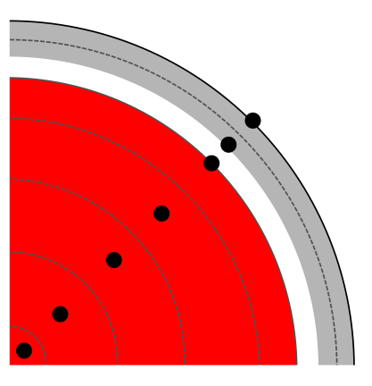

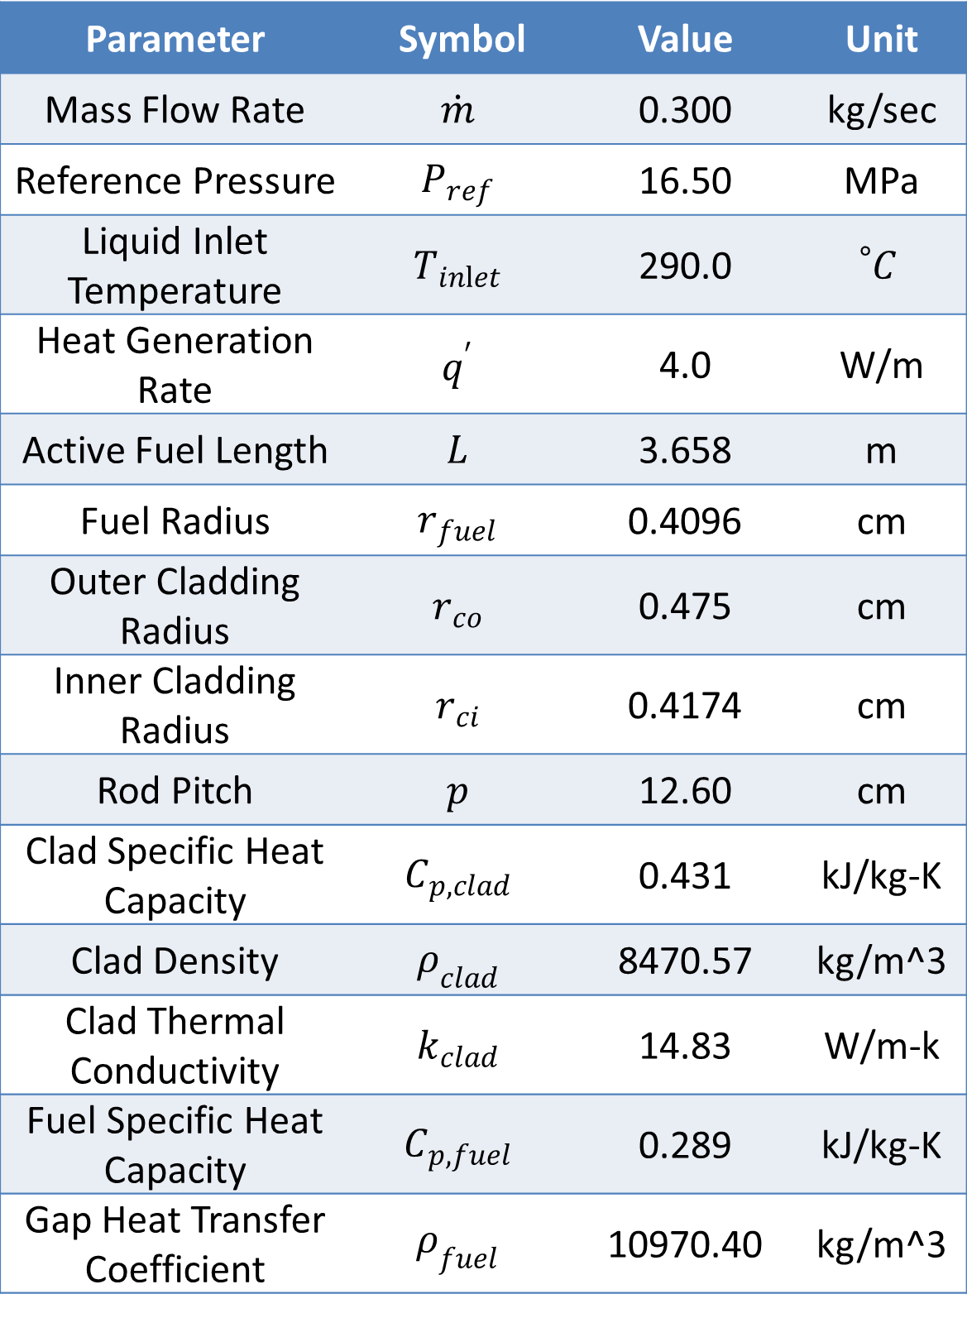
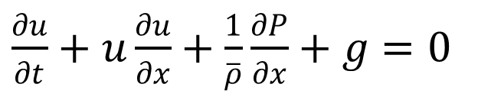
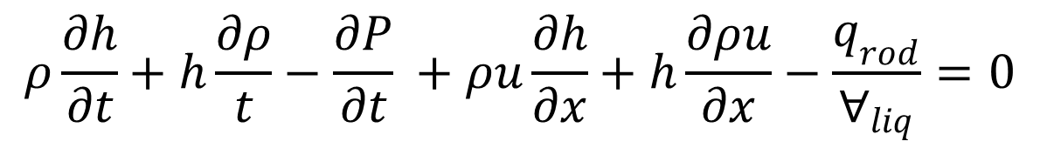
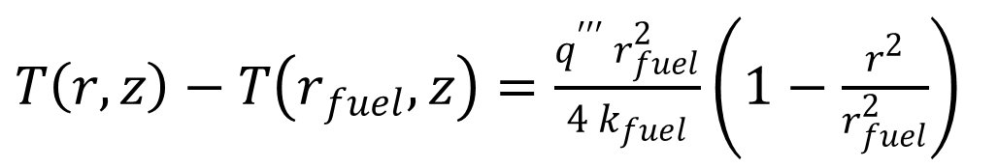
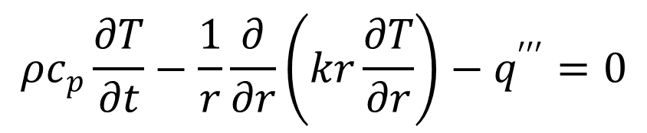
CTF RESIDUAL FORMULATION OF SOLID LIQUID COUPLING
Chris Dances
Advisors: Dr. Kostadin Ivanov & Dr. Maria Avramova
Objective: To integrate 1D solid conduction equations into the residual formulation CTF
1-D Single Phase Liquid + Solid
Verification Problem Setup
Finite Difference Conservation Equations
A 1-D single phase channel coupled to a solid cylindrical rod with only axial conduction
Mass flow rate is held constant
Heat generation rate is held constant
Steady state condition can be obtained independently for each axial level
Parameter | Symbol | Value | Unit
Mass Flow Rate | $$\dot{m}$$ | 0.300 | kg/sec
Reference Pressure | $$P_{ref}$$ | 16.50 | MPa
Liquid Inlet Temperature | $$T_{inlet}$$ | 290.0 | $${}_{}^{∘}C$$
Heat Generation Rate | $$q^{′}$$ | 4.0 | W/m
Active Fuel Length | $$L$$ | 3.658 | m
Fuel Radius | $$r_{fuel}$$ | 0.4096 | cm
Outer Cladding Radius | $$r_{co}$$ | 0.475 | cm
Inner Cladding Radius | $$r_{ci}$$ | 0.4174 | cm
Rod Pitch | $$p$$ | 12.60 | cm
Clad Specific Heat Capacity | $$C_{p,clad}$$ | 0.431 | kJ/kg-K
Clad Density | $$ρ_{clad}$$ | 8470.57 | kg/m^3
Clad Thermal Conductivity | $$k_{clad}$$ | 14.83 | W/m-k
Fuel Specific Heat Capacity | $$C_{p,fuel}$$ | 0.289 | kJ/kg-K
Gap Heat Transfer Coefficient | $$ρ_{fuel}$$ | 10970.40 | kg/m^3
Mass
$$\frac{∂ρ}{∂t}+\frac{∂ρu}{∂x}=0$$
Mom.
$\frac{∂u}{∂t}+u\frac{∂u}{∂x}+\frac{1}{\overline{ρ}}\frac{∂P}{∂x}+g=0$
Energy
$$ρ\frac{∂h}{∂t}+h\frac{∂ρ}{t}−\frac{∂P}{∂t} +ρu\frac{∂h}{∂x}+h\frac{∂ρu}{∂x}−\frac{q_{rod}}{∀_{liq}}=0$$
Conduction
$$ρc_{p}\frac{∂T}{∂t}−\frac{1}{r}\frac{∂}{∂r}\left(kr\frac{∂T}{∂r}\right)−q^{′′′}=0$$
Residual Formulation
Steady State Results
Transient
Analytical Result
$T\left(r,z\right)−T\left(r_{fuel},z\right)=\frac{q^{′′′} r_{fuel}^{2}}{4 k_{fuel}}\left(1−\frac{r^{2}}{r_{fuel}^{2}}\right)$
The numerical error will propagate through the solution resulting in more error at the outlet
The expected error can be computed from the known solution, and compared to the observed
The expected error is local, and was found to scale by dimensionless length
Scaled expected error matches closely with observed error while in asymptotic range
Radial Nodes in Fuel | Semi-implicit Transient | Implicit Transient | Implicit Steady State | Original Steady State
5 | 1.33% | 1.35% | 1.32% | 2.15%
10 | 0.45% | 0.48% | 0.45% | 0.78%
20 | 0.15% | 0.18% | 0.14% | 0.20%
Conclusions and Future Work
The residual formulation of CTF allows for a numerical computation of the multivariable Jacobian matrix compared to the original analytical derivation of a pressure matrix. The 1-D isokinetic single phase liquid verification problem is a good verification problem due its isolation of the order of accuracies through modified equation analysis. The discretization error for both versions of the code converged to zero with decreasing time step and axial mesh size. The order of accuracy for the temporal and spatial refinements matched very closely with the modified equation analysis for both codes. For all of these data points, the residual formulation of the code showed discretization errors that were very close with the original version of the code. This work will be expanded to perform verification on the single phase equations in both axial and transverse dimensions, and coupled fluid heat conduction.

