Slide 1

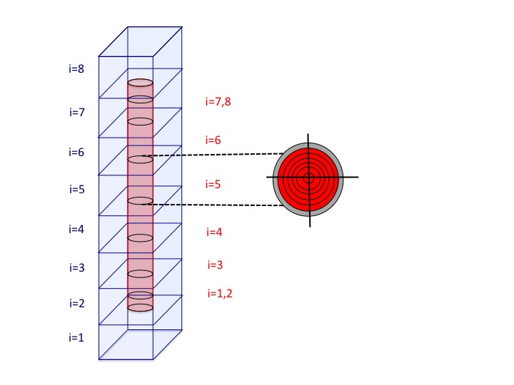
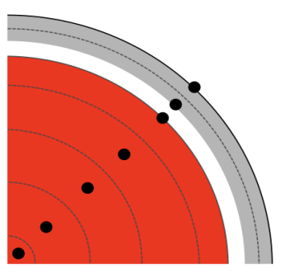
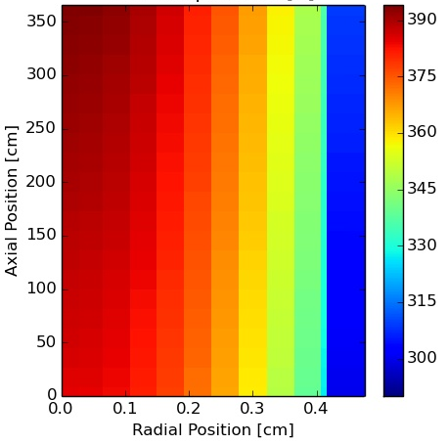
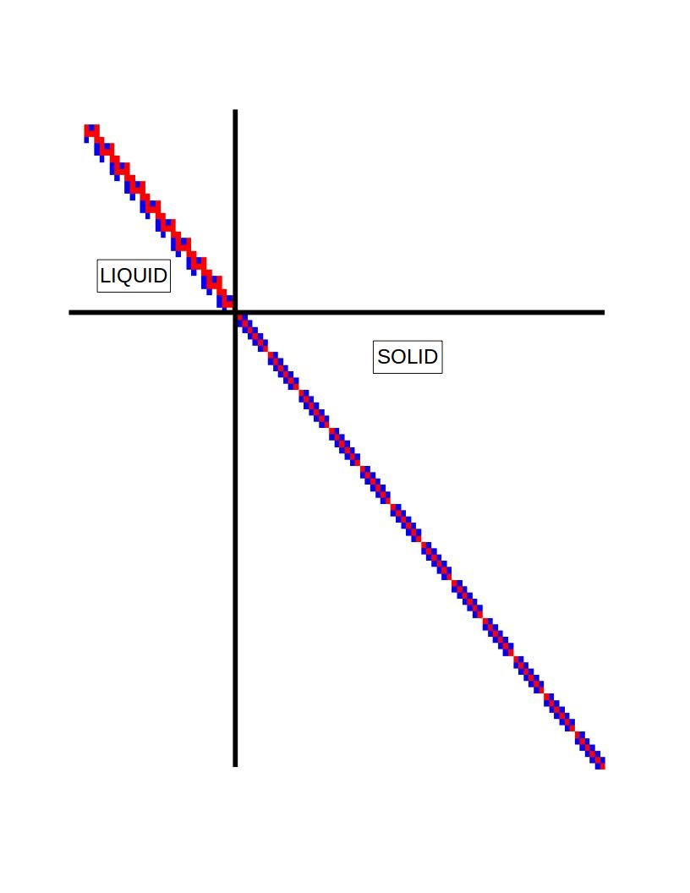
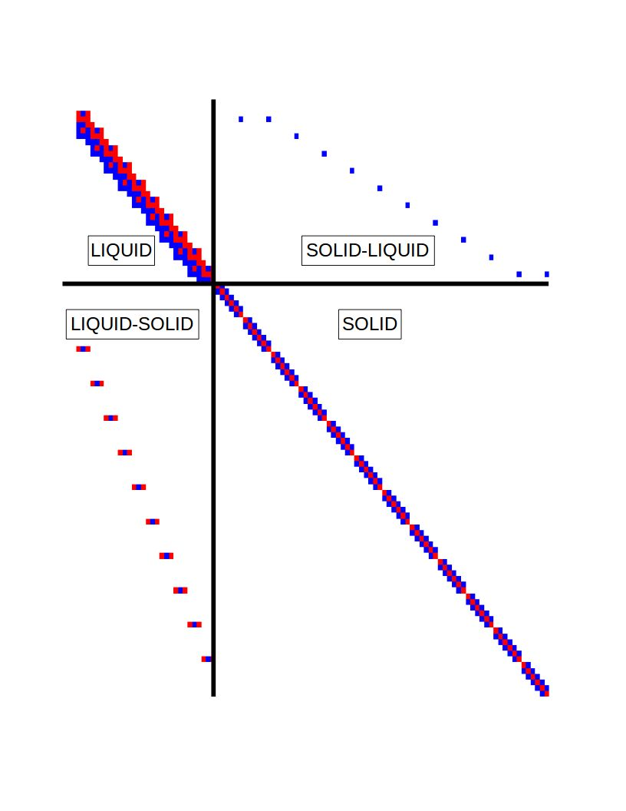
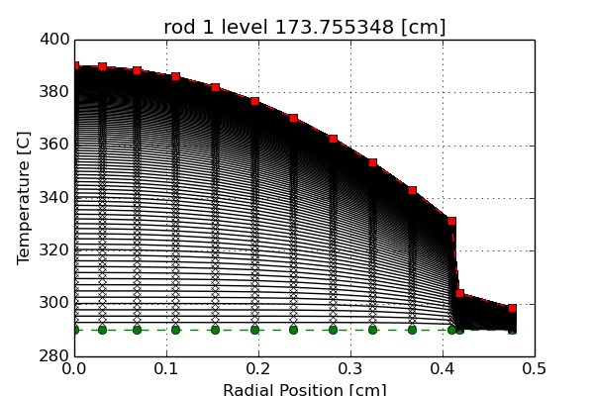
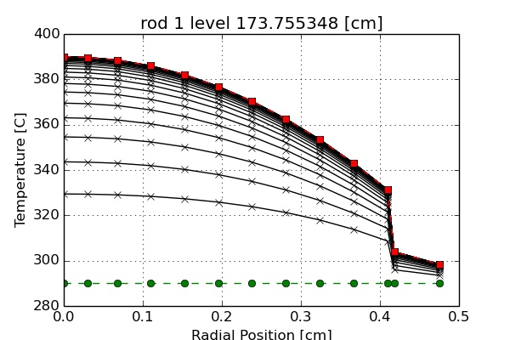
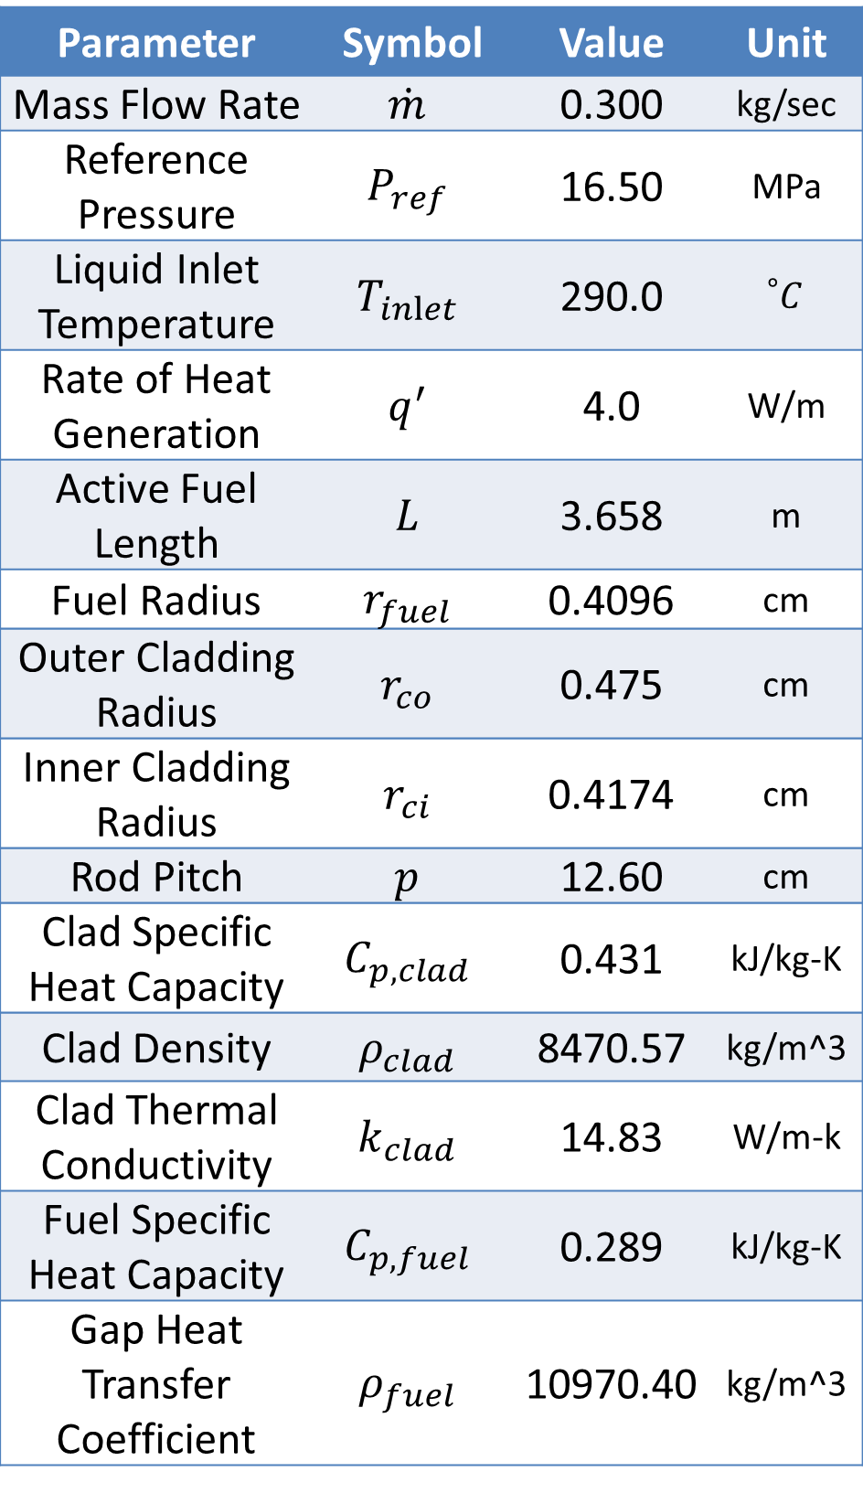
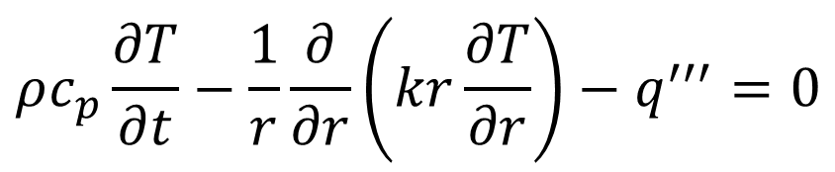
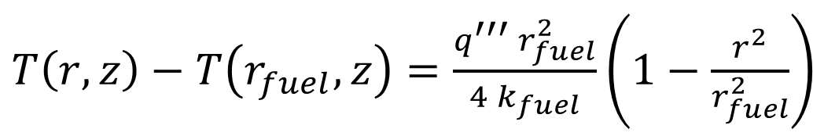

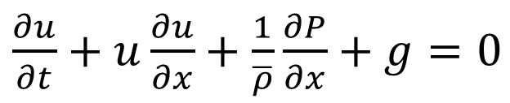
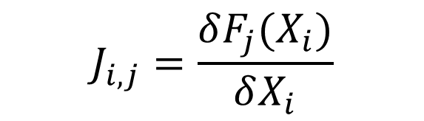
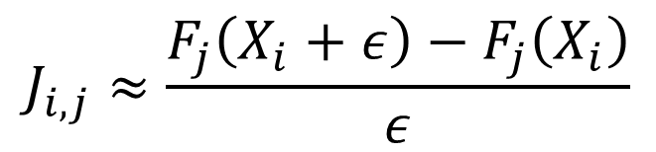
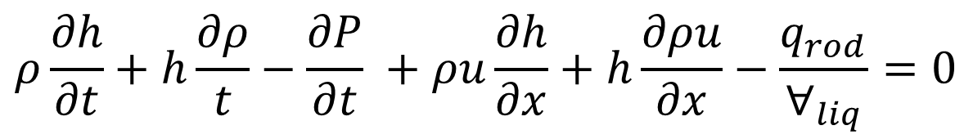
CTF RESIDUAL FORMULATION OF SOLID LIQUID COUPLING
Chris Dances and Maria Avramova, Penn State University
Vincent Mousseau, Sandia National Laboratory
Objective: To integrate 1D solid conduction equations into the residual formulation CTF
1-D Single Phase Liquid + Solid
Verification Problem Setup
Partial Differential Equations
Finite Difference Mesh
A 1-D single phase channel coupled to a solid cylindrical rod with only axial conduction
Constant mass flow rate
Constant heat generation rate
Constant material properties
Temperature changes axially due to liquid advection
Analytical solution for relative rod temperature in solid volume for each radial region
Parameter | Symbol | Value | Unit
Mass Flow Rate | $$\dot{m}$$ | 0.300 | kg/sec
Reference Pressure | $$P_{ref}$$ | 16.50 | MPa
Liquid Inlet Temperature | $$T_{inlet}$$ | 290.0 | $${}_{}^{∘}C$$
Rate of Heat Generation | $$q^{′}$$ | 4.0 | W/m
Active Fuel Length | $$L$$ | 3.658 | m
Fuel Radius | $$r_{fuel}$$ | 0.4096 | cm
Outer Cladding Radius | $$r_{co}$$ | 0.475 | cm
Inner Cladding Radius | $$r_{ci}$$ | 0.4174 | cm
Rod Pitch | $$p$$ | 12.60 | cm
Clad Specific Heat Capacity | $$C_{p,clad}$$ | 0.431 | kJ/kg-K
Clad Density | $$ρ_{clad}$$ | 8470.57 | kg/m^3
Clad Thermal Conductivity | $$k_{clad}$$ | 14.83 | W/m-k
Fuel Specific Heat Capacity | $$C_{p,fuel}$$ | 0.289 | kJ/kg-K
Gap Heat Transfer Coefficient | $$ρ_{fuel}$$ | 10970.40 | kg/m^3
Liquid Mass
$$\frac{∂ρ}{∂t}+\frac{∂ρu}{∂x}=0$$
Liquid Momentum
$\frac{∂u}{∂t}+u\frac{∂u}{∂x}+\frac{1}{\overline{ρ}}\frac{∂P}{∂x}+g=0$
Liquid Energy
$$ρ\frac{∂h}{∂t}+h\frac{∂ρ}{t}−\frac{∂P}{∂t} +ρu\frac{∂h}{∂x}+h\frac{∂ρu}{∂x}−\frac{q_{rod}}{∀_{liq}}=0$$
Solid Conduction
$$ρc_{p}\frac{∂T}{∂t}−\frac{1}{r}\frac{∂}{∂r}\left(kr\frac{∂T}{∂r}\right)−q^{′′′}=0$$
2D Map of Rod Temperature
Semi-Implicit Jacobian
Implicit Jacobian
Matrix Construction
Axial Position [cm]
Temperature [C]
$$J_{i,j}=\frac{δF_{j}(X_{i})}{δX_{i}}$$
$$J_{i,j}≈\frac{F_{j}\left(X_{i}+ε\right)−F_{j}\left(X_{i}\right)}{ε}$$
Radial Position [cm]
Analytical Result for any Axial Level
$T\left(r,z\right)−T\left(r_{fuel},z\right)=\frac{q^{′′′} r_{fuel}^{2}}{4 k_{fuel}}\left(1−\frac{r^{2}}{r_{fuel}^{2}}\right)$
Steady State Results
Transient Results
Relative Rod Temperature
Semi-Implicit
Implicit
Conclusions and Future Work
Convergence of Error for Finite Difference Solution
Radial Nodes in Fuel | Semi-Implicit Transient | Implicit Transient | Implicit Steady State | Original Steady State
5 | 1.33% | 1.35% | 1.32% | 2.15%
10 | 0.45% | 0.48% | 0.45% | 0.78%
20 | 0.15% | 0.18% | 0.14% | 0.20%
The residual formulation of the one-dimensional single-phase liquid and solid residual formulations were listed. Combining the liquid and solid equations into a single Jacobian matrix allowed for easy explicit or implicit coupling. This solution method was tested against the analytical solution for a single rod with uniform heat generation. Similar results were obtained between the two solutions, and the ability to exceed the time step limitations of the semi-implicit method was demonstrated. Future work will involve performing a more in depth verification analysis of the steady state and transient solutions. Further work will also include examining more challenging test problems that can properly demonstrate the advantages of the implicitly coupled fluid solid Jacobian matrix. The effect of temperature dependent material properties and dynamic gap conductance will also be considered. A homogenous energy equation can now be easily implemented by adding the liquid and solid conservation equations. Future work will be analyzing the homogeneous energy approximation over a state space to see when the approximation is valid. The conduction equations will be extended into the azimuthal and axial directions for more realistic heat transfer.
Problem Run Times
Code Version | Solution Method | Time Step Size [sec] | Wall Clock Time [sec]
Original | Original Semi-Implicit | 0.05 | 2.226
Residual | Semi-Implicit | 0.05 | 8.591
Residual | Implicit | 0.05 | 36.709
Residual | Implicit | 1.00 | 2.377
Residual | Implicit | 10.00 | 0.622

