Slide 1
AN INTELLIGENT TOOL TO ASSIST IN MAKING SMARTER PROPERTY DECISIONS Project ID : 19-010

Slide 2
Our team
Supervisor Mrs. M.P.A.W. Gamage
Co-supervisor Mrs. Pasangi Rathnayke
Bimali YMY | IT16423534
Rodrigo USD | IT16154490
Denuka Dharmaseelan | IT16116566
Kamaleshwaran Thayalini | IT15156884

Slide 3
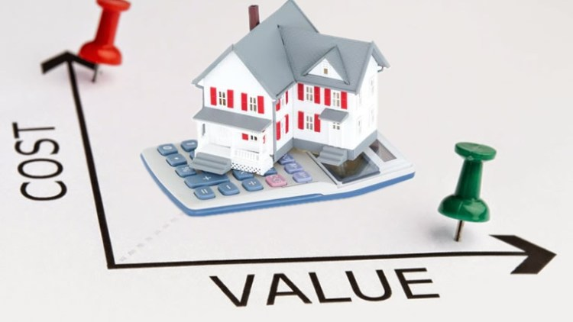
Introduction
This is an Intelligent tool which can help people to get an idea about the land they are hoping to buy, to decide the suitability of the land for their purpose.

Slide 4
Literature
Artificial Intelligence based land valuation has been suggested in literature from 1990s.
Many up and running valuation systems are there in developed countries.

Slide 5
Comparison of Existing System
 | Zillow | Trulia | QV- CoreLogic | HousePrice.ai | Our Product
Current Value Prediction | Yes | Yes | Yes | Yes | Yes
Use of AI/ Machine Learning | Yes | Unknown | No | Yes | Yes
Future Value forecasting | For 12 months | No | Yes, with E-Valuer report | For 3 years | For 5 years
Future Development effects prediction | No | No | Yes | No | Yes
Available for Sri Lanka | No | No | No | No | Yes

Slide 6
Research Gap
The current valuation process is subjective to the person and time consuming.
It does not give an insight of the future value of the land

Slide 7
Research problem
To develop an automated system to evaluate the land in terms of current and future commercial value, based on innovative idea from expertise, which would be an improvement to the corresponding land valuation domain.

Slide 8
Proposed Solution
To develop a portable application which can provide instant report of a selected land parcel to provide the users with an insight of the land with current value and future value, just by giving the location.

Slide 9
Main Objective
To provide people with fair and accurate prediction of the value of the land they are going to buy, on time, to make better decisions.

Slide 10
Sub Objectives
● Identifying the most accurate methodology of application of conventional and non-conventional techniques in the domain of current value prediction following the Sales Comparison Approach and optimizing the same
● Identifying method to predict future value based on the fluctuation rates, records of weather conditions and the effect of proposed development plans on the future price of the selected land plot

Slide 11
System Diagram

Slide 12

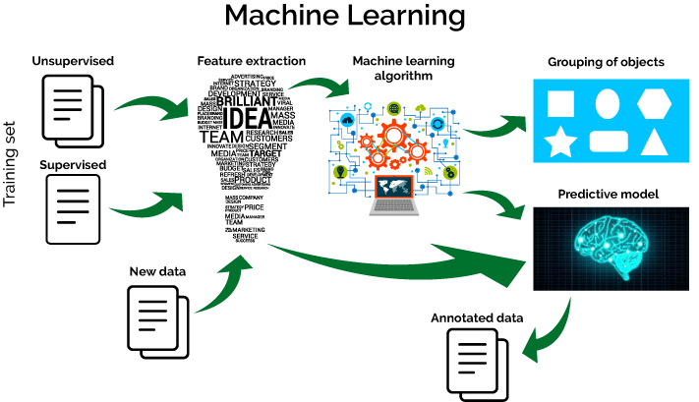






Current value Predictor
Report Generator
Optimization unit of current Value
Effect of past fluctuation rates , weather
Effects calculation unit
Effect of Future development calculation unit
Future Commercial value predictor

Slide 13
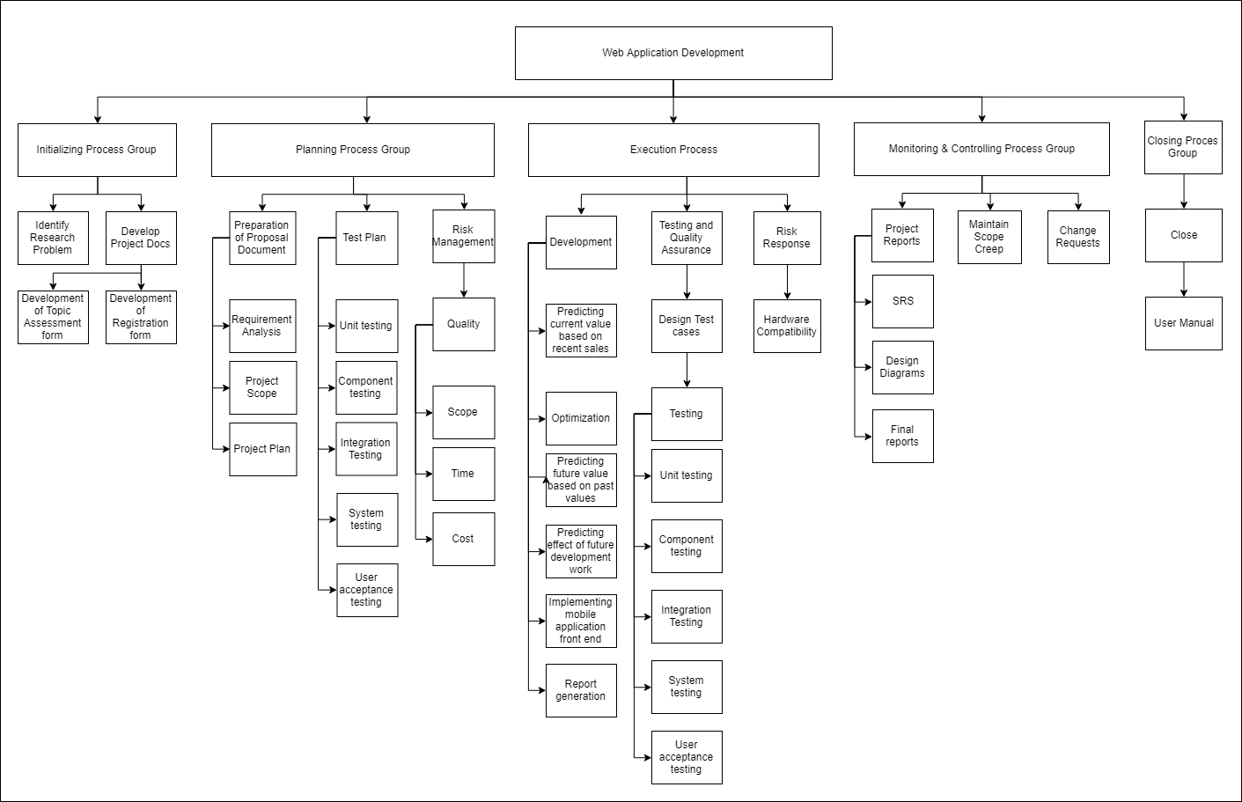
Work Breakdown Structure

Slide 14
Individual Research components
Rough Valuation based on the recent sales happened in the area
Optimization of the rough valuation
Predicting the future commercial value based on the past fluctuation rates
Predicting the effect of future development projects on future commercial Value
Bimali YMY
Rodrigo U.S.D
D.Denuka
K.Thayalini

Slide 15
Rough Valuation Based On Neighbourhood Commercial Value
This component tests the accuracy of Multiple Regression Analysis(MRA) verses Artificial Neural Networks(ANN) in its training environment on the prediction of vacant land price and the most accurate algorithm will be used in determining the current value
IT16423534

Slide 16
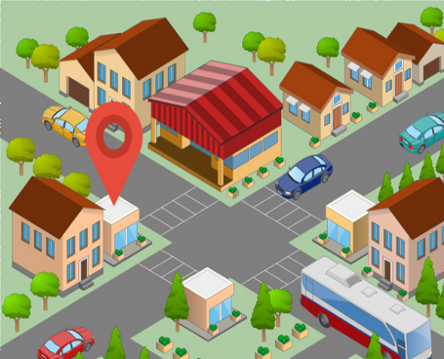




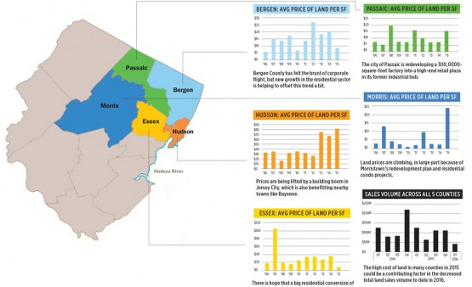
Location of the
land
Training environment selects the best out of MRA and ANN and that is used for AI model
Get the prediction by Selected Al model
Data about recent sales
IT16423534

Slide 17
Optimization of the rough valuation
To minimize the objective error , the current value predicted based on recent sales is optimized by gradient descent technique, stochastic gradient descent.
Tradeoffs might be made among the Gradient Descent Techniques depending on the accuracy rate
IT16154490

Slide 18
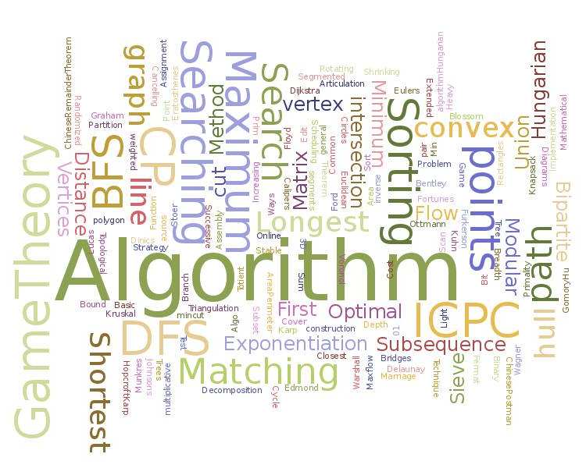

Get the prediction by Selected Al model
Identifying Algorithm to minimize the error
Apply the Optimization algorithm to predicted value
Training Environment
IT16154490

Slide 19

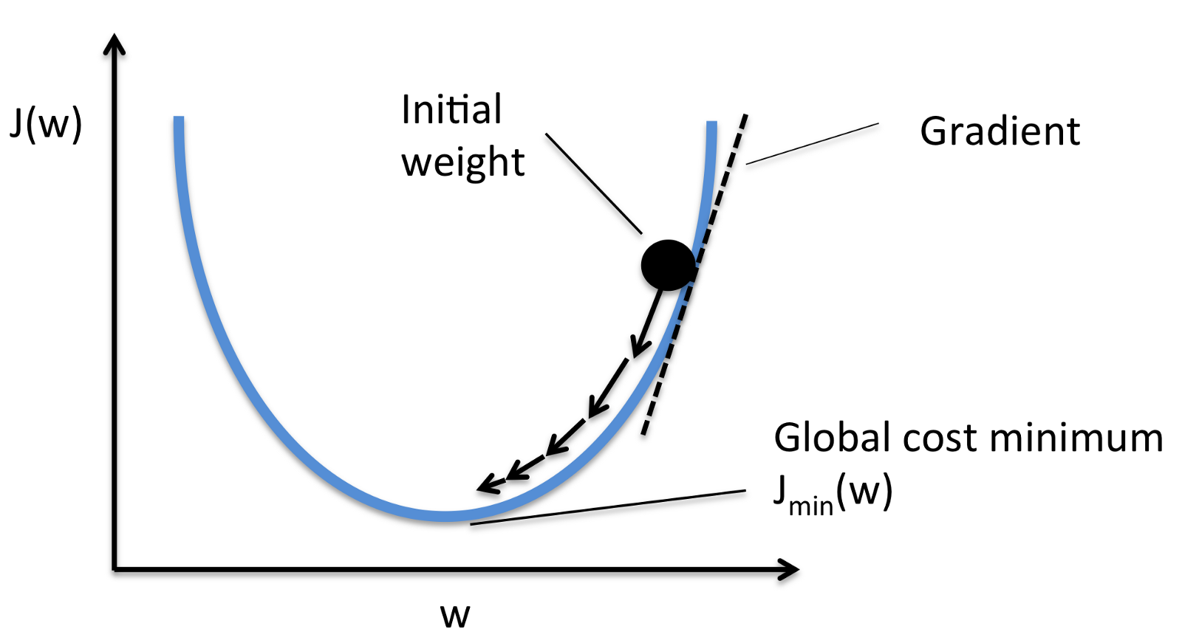
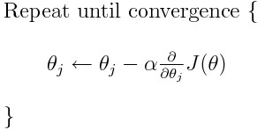
Finding the minima
Cost Function
Gradient Descent Algorithm
IT16154490

Slide 20
Possible Approach
Finding the minima
Cost Function
Gradient Descent Algorithm
20
IT16154490

Slide 21
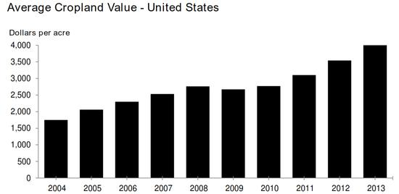
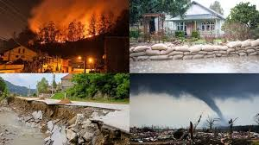
Predict The Future Commercial Value Of The Land
Prediction of value of the property considering local trends, using standard prediction algorithms and statistics
IT16116566

Slide 22
Get the prediction by Selected Al model
Location of the
land
Last 10 years Values
IT16116566

Slide 23

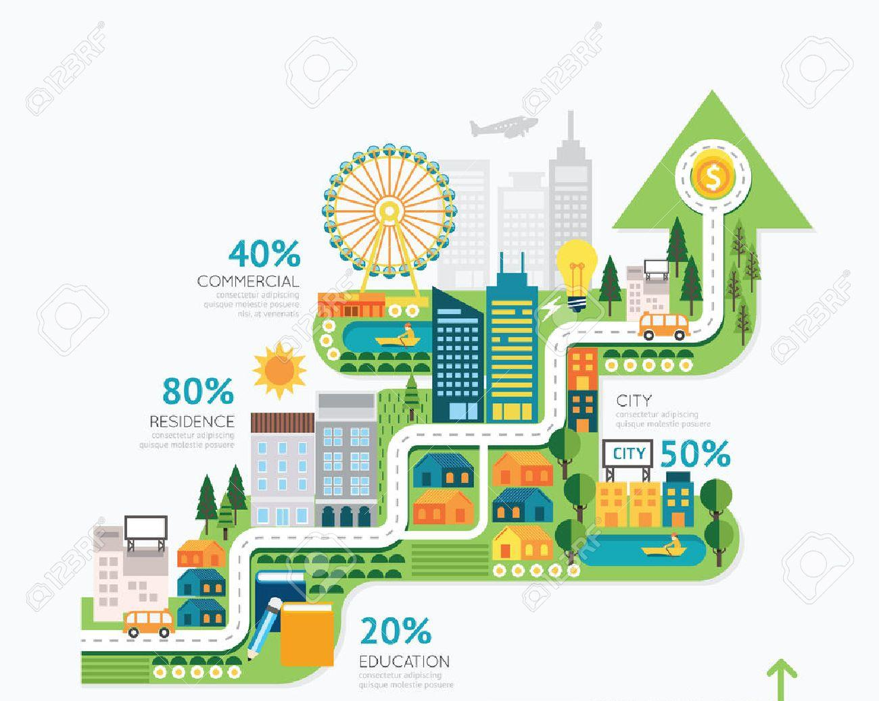
Predicting The Effect Of Proposed Development Projects On Future Commercial Value
The system will automatically find the current land value and compare with future development infrastructure facilities such as future apartments, hospital, railway station, bus stand, airport and schools and calculating the commercial value of the land
IT15156884

Slide 24


Data about recent infrastructure
Effect of future Development projects Calculation
Location of the
land
IT15156884

Slide 25
Technology To Be Used
Python (Numpy, Pandas, Matplotlib)
Anaconda distribution
AngularJS/ReactJS
Google API
Elasticsearch (Optional)

Slide 26
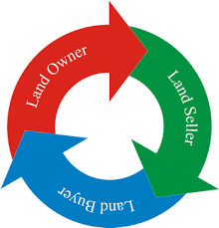
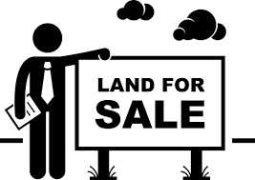


Commercialization
Targeted Customers
Surveyors
Land sale companies
Brokers
Land buyers & Sellers

Slide 27
Thank You……!

