Slide 1
Project Review
LunchAround
June Ist, 2011
Lorenzo Bovio
Francesco Bronzino
Davide Concas

Slide 2
Project Review
Agenda:
  Project goals
  User stories – use cases – scenarios
  Original Project plan summary
  Status as of May 30th 2011
    Analysis and Design
    Spikes
    Coding
    UI and user interaction draft
  Updates to the project plan

Slide 3
Project goals
Create a communication platform between clients and restaurateurs.
Our service will let to:
  Make searches of restaurants by using user location, kind of food and other types of filters.
  Visualize restaurants datas and the daily menus.
  Review a restaurant.
  Receive recommendations possibles liked restaurants.
Principal social networks interaction.
Access from various platforms.

Slide 4
User stories
Daily the manager setup his menu:
  The manager login to the service
  A page offer the possibility to insert new dishes and to assign them a category and a price.
  When the manager begin typing the system suggest him old dishes already inserted before.
  The manager assign to the menu a validity.
  The system save the menu(every dish insertion).
  The system redirect the manager to his own personal page.

Slide 5
User stories
A registered user review a restaurant:
  The user search the restaurant that he is looking to review.
  The system check that the user is already logged in.
  If the user has already reviewed the restaurant he will have the possibility to change it.
  The user review the restaurant filling out the related form.
  The system store the review and the user preferences.

Slide 6
Original Project plan summary
Analysis(discuss DB schema, define data dictionaries, object-oriented analysis, CRC cards): 5 weeks
Design(define modules and interfaces, map web pages, specify APIs for other groups interaction): 2 weeks
Spikes(Twitter, Facebook, Maps...): 3 weeks
Development: 6 weeks
Test: continuos tests + 1 final week

Slide 7
Status as of May 30th 2011
Analysis: completed.
Design(define modules and interfaces, map web pages, specify APIs for other groups interaction): complete the specification of the APIs
Spikes:
  Completed: Twitter, Facebook, JSF.
  Not completed: Maps, Directions,Buzz.
Development: ejb and related facades

Slide 8
Updates to the project plan
Added interaction with Google Directions.
Added interaction with Google Buzz.
Development time extended from 6 to 8 weeks (because of new interactions and related spikes).

Slide 9
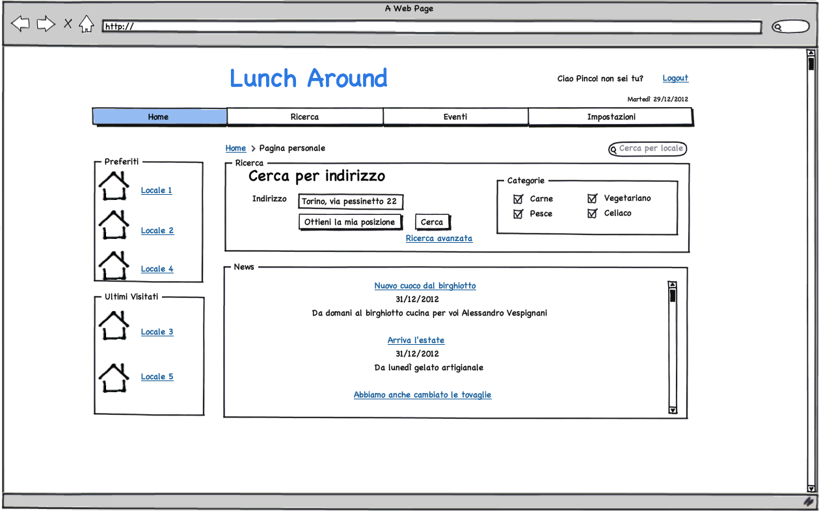

Slide 10
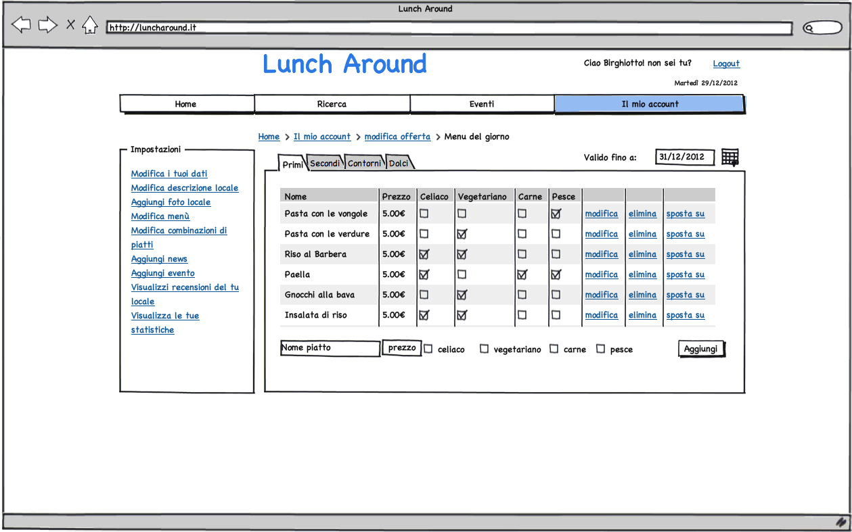

Slide 11
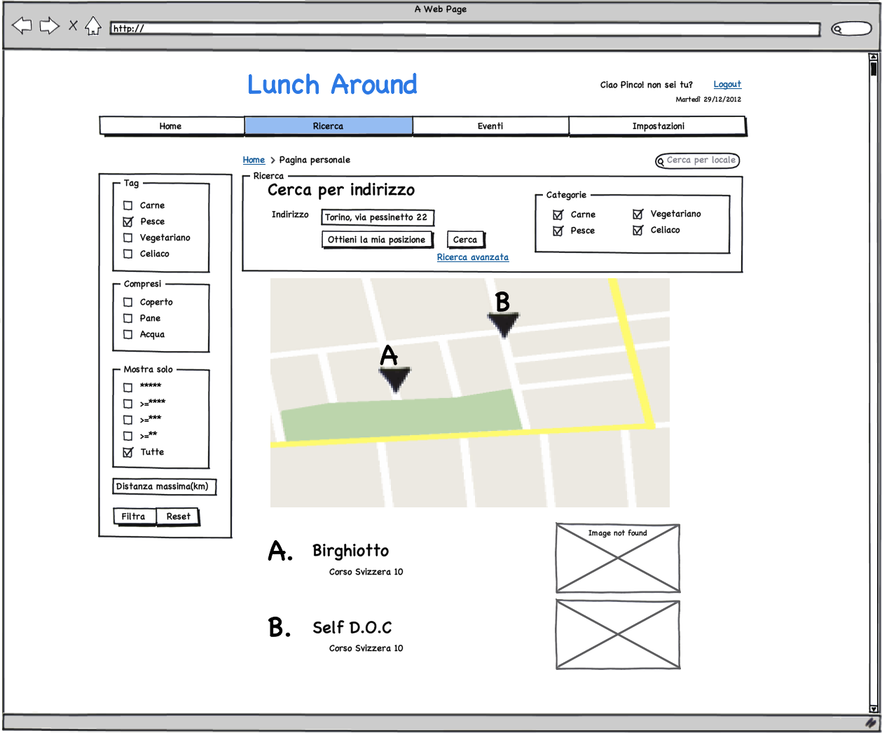

Slide 12
Thank you for your attention !
Questions?

