Slide 1
Forecasting Novel Modes Across Multiple Mode Choice Frameworks
Christopher Day
Greg Macfarlane, PhD PE

Slide 2
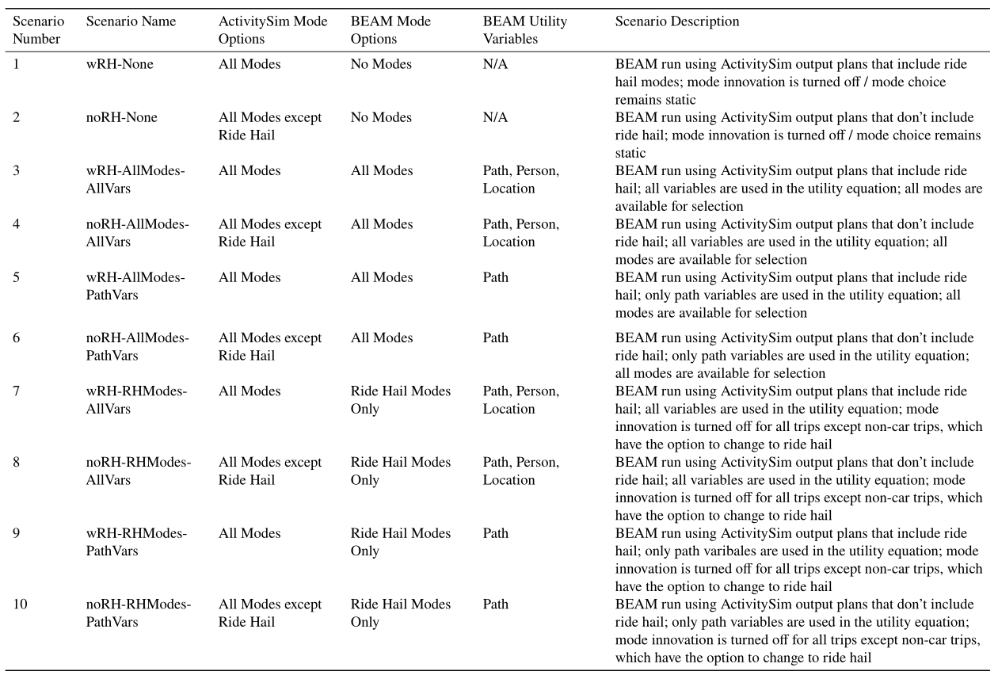
Mode Choice Combination Scenarios

Slide 3
Results
Ridership
Wait Times

Slide 4
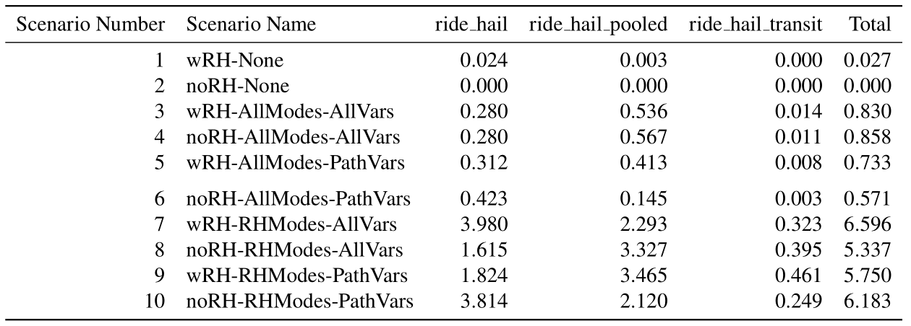
Ride Hail Ridership
Percent Ride Hail Ridership

Slide 5
Ride Hail Ridership
Percent Ride Hail Ridership
Ridership affected significantly by BEAM mode choice structure
ActivitySim may struggle with ride hail to transit
None
AllModes
RHModes

Slide 6
Ride Hail Ridership
Percent Ride Hail Ridership
3. Ridership is not affected by ride hail in the initial plans
With Ride Hail
Without Ride Hail

Slide 7
Ride Hail Ridership
Percent Ride Hail Ridership
Using path, person, and location estimates more ridership than path
Lack of person attributes make pooled and transit ride hail less appealing
Path, Person, Location
Path

Slide 8
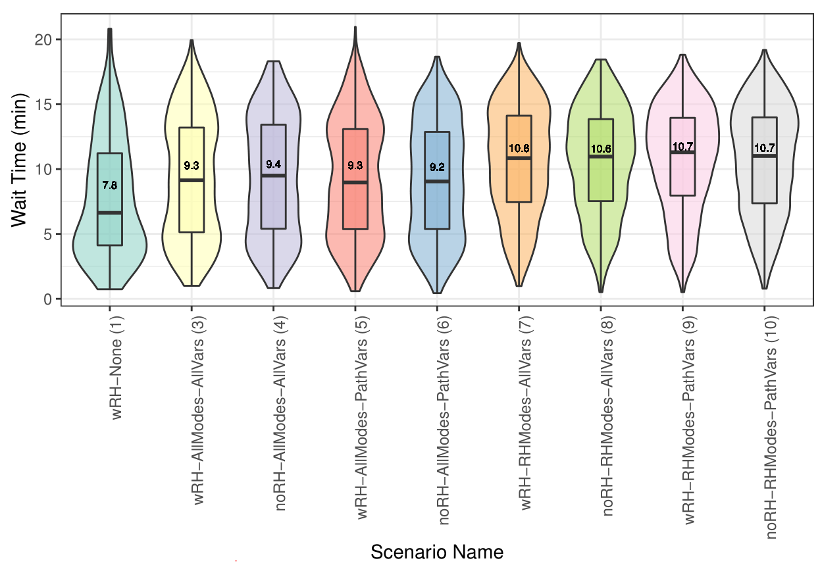
Ride Hail Wait Times
Wait Time Violin Plots
Dependent on BEAM mode choice
None – Smallest Mean, Largest Range, Bottom Heavy
AllModes – Even Spread
RHModes – Top Heavy
Not significantly affected by input plans or utility parameters
But greater max wait time when ride hail in initial plans
All wait times under 25 minutes (greater than that may have induced replanning)
Function of ride hail utilization

Slide 9
A Deeper Look
Utilization
Switch to Ride Hail
Switch to Walk

Slide 10
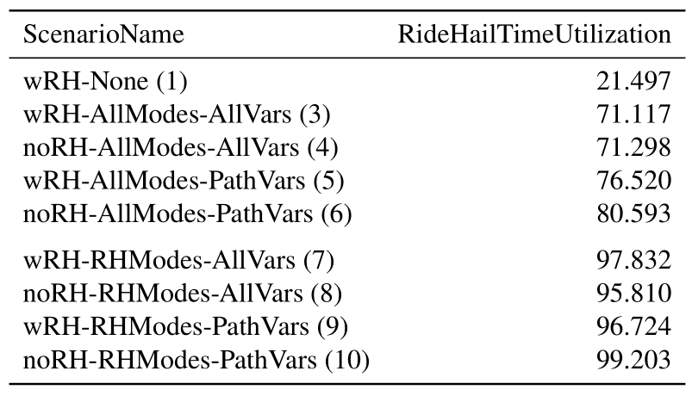
Ride Hail Utilization
Percent Ride Hail Time Utilization
952 driver shifts
Vastly different by BEAM mode choice
Explains difference in ridership and wait times
RHMode ridership would be higher with more ride hail vehicles
Wait times would be lower with more ride hail vehicles
Percent of total ride hail time available by total ride hail travel time

Slide 11
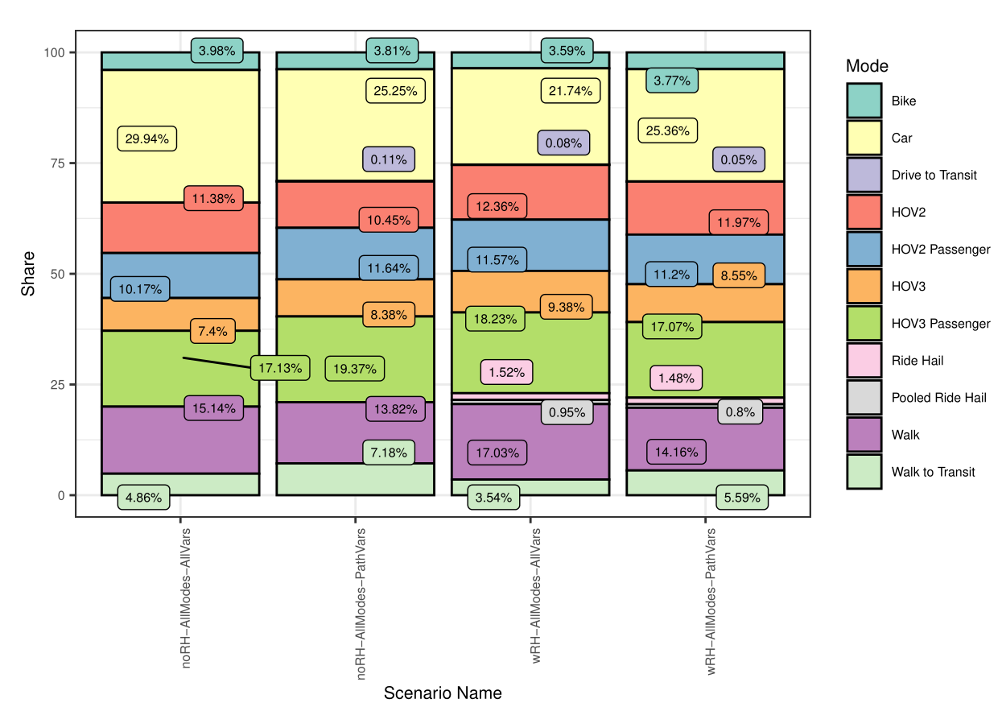
Switch to Ride Hail
Division of agents who switch from one mode toa ride hail modes
~75% from car type modes (car, hov)
14%-17% from walk modes
Why so many car?
~75% Car Modes

Slide 12
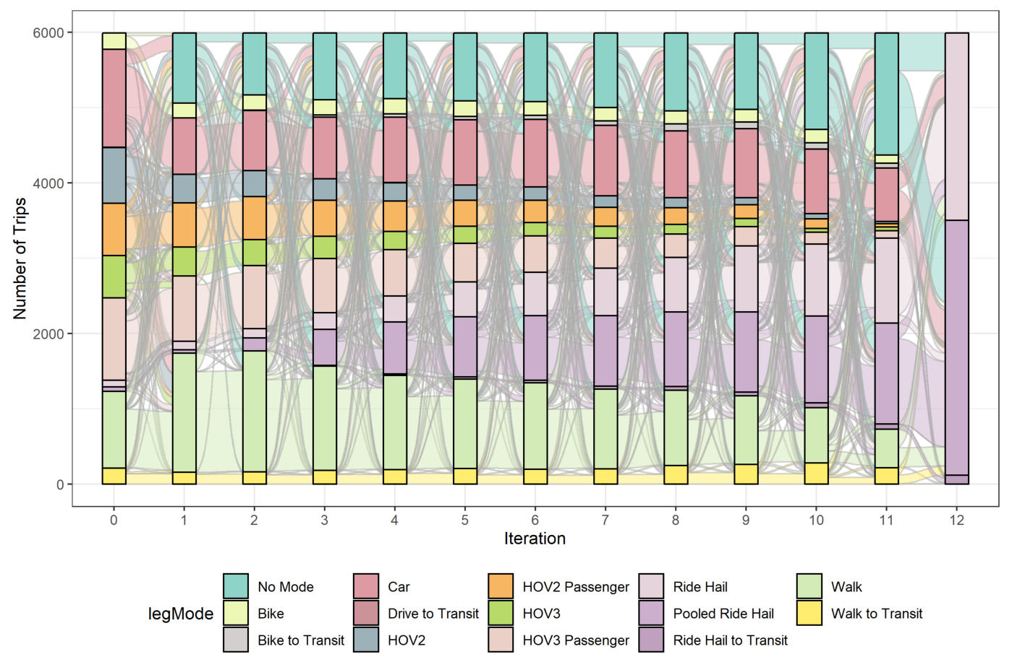
Switch to Ride Hail
Sankey Diagram of how agents switch to ride hail across each iteration
wRH-All-All scenario
Constructed by plans file (“No Mode” represents the clearing of modes)
Many Car users switch to Walk or No Mode before Ride Hail

Slide 13
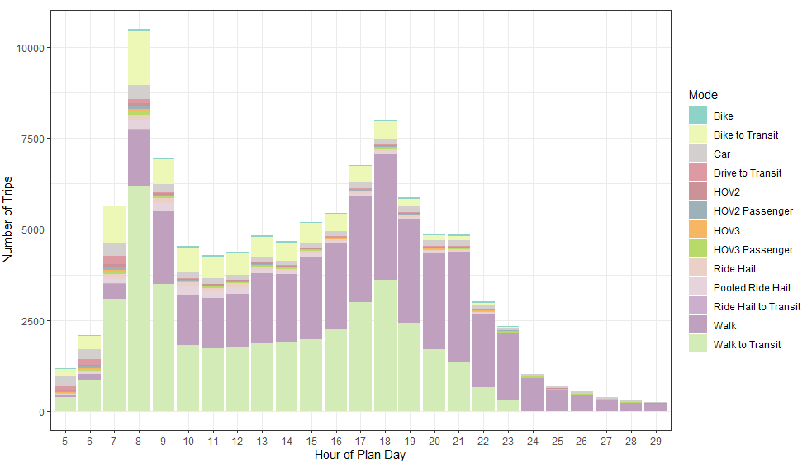
Switch to Walk
Diagram of agents who switch to walk by hour of day
wRH-All-All scenario
1000s of cumulative car trips switch to walk by end of day
Hours 26-29: potential agents who get “stuck” and don’t finish their day

Slide 14
Thank you

