Slide 1


Welcome to the MN M365 Fall Admin Workshop Day 2020!
Please help us drive event awareness by tweeting and posting about your experience at the Workshop:
@o365MN #M365WorkshopDay
Thank you for your participation!

Slide 2






Thank You To Our Sponsors!

Slide 3
Automating messages in Teams: Crawl, Walk, Run
Corey Buzzell
Principal Architect
Microsoft Technology Center, Minneapolis
Download this deck now at https://aka.ms/AutoMsgs

Slide 4
Why automate messages in Teams?
Replace email/Slack notifications
Notify a channel so that we don’t have to forward emails
Send notifications directly from other systems
Send alerts from your build, deployment and monitoring services
Collaborate on major incidents

Slide 5




Approaches we’ll talk about today…
Crawl | Walk | Jog | Run
Incoming Webhook | Power Automate + standard triggers | Power Automate + HTTP trigger | C# bot

Slide 6
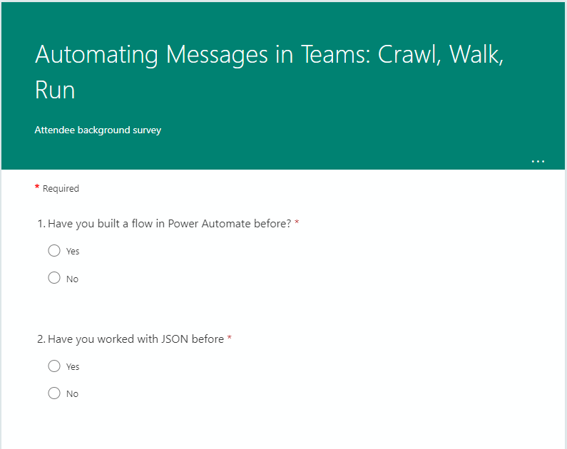
Quick survey to understand audience background…
https://aka.ms/AutoMsgs/survey

Slide 7
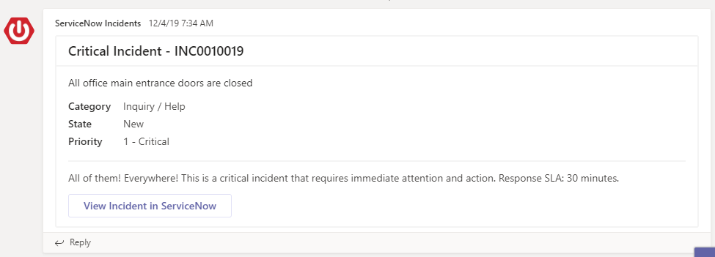
Crawl: Incoming webhook

Slide 8
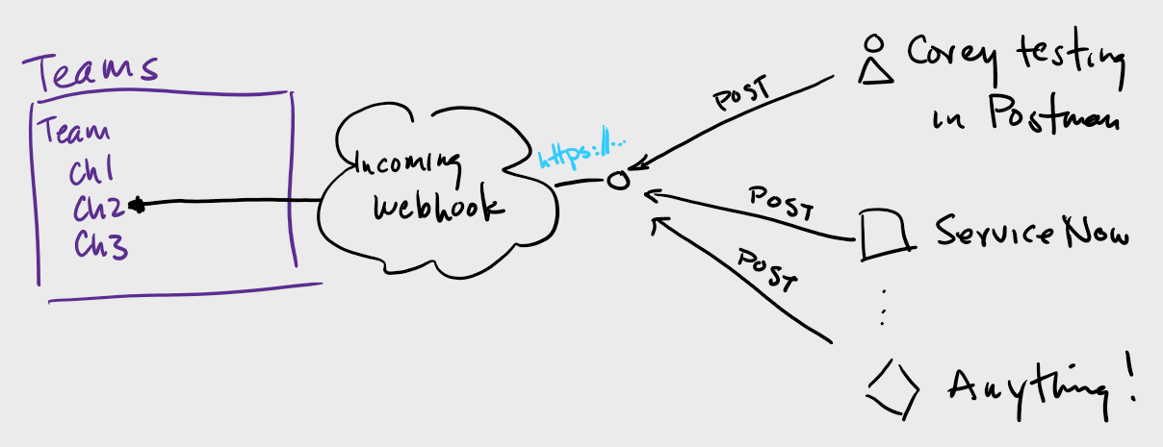
Crawl: Incoming webhook

Slide 9
Demo
Incoming webhook

Slide 10
Crawl: Incoming Webhook
Creates an HTTP endpoint (URL) that can be called from any system
Included/OOTB connector published by Microsoft
Message comes from brandable name/image
Configured on a channel, cannot post to person
Messages are JSON (actionable message card format)
Quick and easy to set up
Easily test with Postman (https://getpostman.com)
Cannot do other actions, just send and forget
Cannot update posted message
No developer needed (on Teams side)
https://docs.microsoft.com/en-us/microsoftteams/platform/webhooks-and-connectors/how-to/add-incoming-webhook
https://github.com/cdbuzzell/TeamsPriorityIncidentResponse/blob/master/Crawl.md

Slide 11
 | CRAWL Incoming Webhook | WALK Power Automate + standard triggers | JOG Power Automate + HTTP Trigger | RUN C# bot
Call from any system | X |  | X | X
Need > O365 license |  |  | X | X
Brandable notifier | X |  |  | X
IM individuals |  | X | X | X
Requires configuration of each team/channel | X | * | * | **
Adaptive cards |  | X | X | X
Do more than notify |  | X | X | X
Update posted message |  |  |  | X
Requires development |  |  |  | X

Slide 12
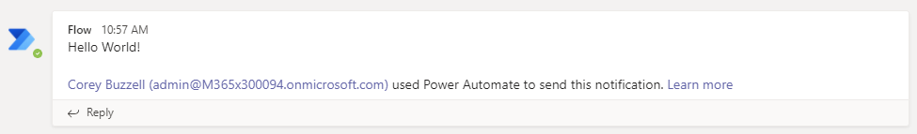
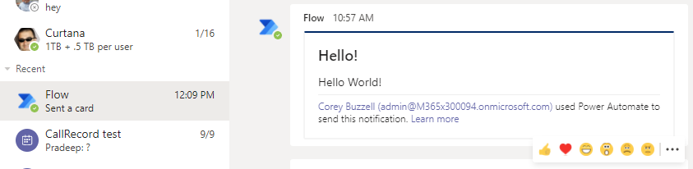
Walk: Power Automate + standard triggers

Slide 13
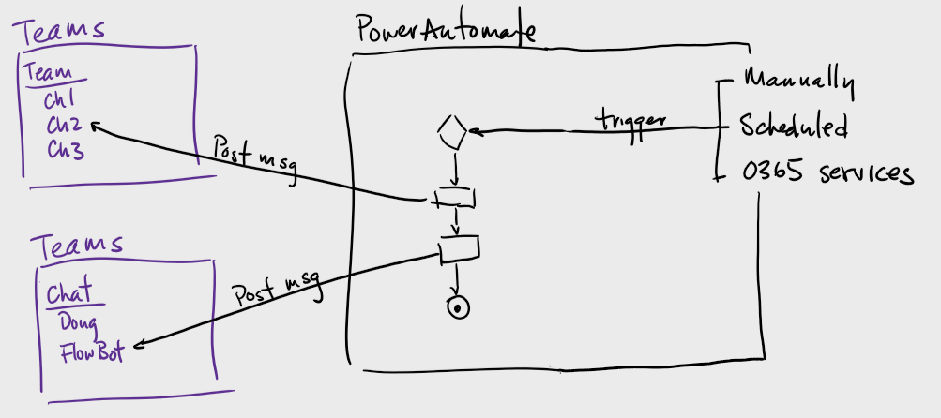
Walk: Power Automate + standard triggers

Slide 14
Demo
Power Automate + standard triggers

Slide 15
Walk: Power Automate + standard triggers
Triggered manually, scheduled, or by O365 services
Included/OOTB connectors published by Microsoft
Message comes from you (flow author) or Flow Bot
Post message to channel or person without pre-configuring
You must have access to the channel
Simple messages possible: no need for cards, JSON, etc.
Test within Power Automate
Flexibility to do other actions on top of posting messages (create teams, channels, call other processes, etc.)
Cannot update posted message
No developer needed
https://github.com/cdbuzzell/TeamsPriorityIncidentResponse/blob/master/Walk.md

Slide 16
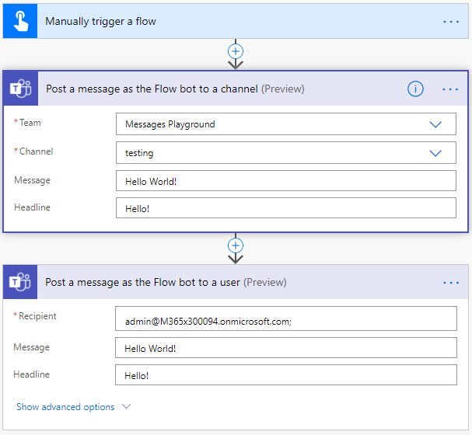
Walk: Power Automate + standard triggers

Slide 17
 | CRAWL Incoming Webhook | WALK Power Automate + standard triggers | JOG Power Automate + HTTP Trigger | RUN C# bot
Call from any system | X |  | X | X
Need > O365 license |  |  | X | X
Brandable notifier | X |  |  | X
IM individuals |  | X | X | X
Requires configuration of each team/channel | X | * | * | **
Adaptive cards |  | X | X | X
Do more than notify |  | X | X | X
Update posted message |  |  |  | X
Requires development |  |  |  | X
* You don’t have to configure in each channel, but you have to have access to the Team to configure the flow

Slide 18
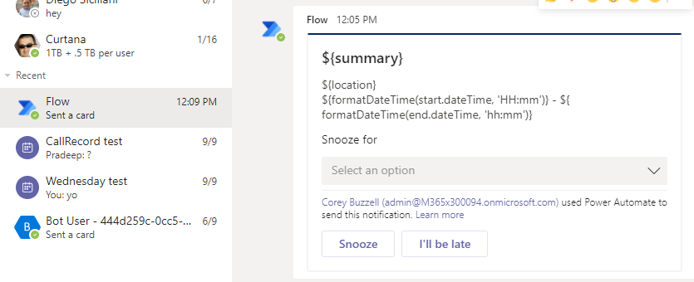
Jog: Power Automate + HTTP trigger

Slide 19
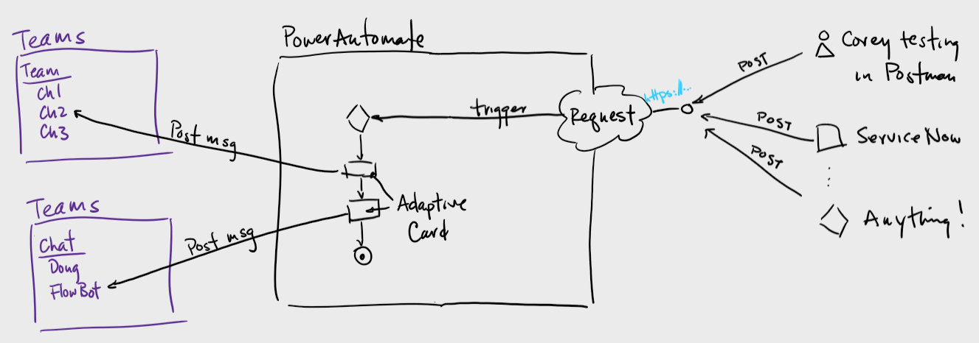
Jog: Power Automate + HTTP trigger

Slide 20
Demo
Power Automate + HTTP trigger

Slide 21
Jog: Power Automate + HTTP trigger
Creates an HTTP endpoint (URL) that can be called from any system
Premium connector required (Request trigger)
Message comes from Flow Bot
Post message to channel or person without pre-configuring
You must have access to the channel
Supports Adaptive Cards (https://adaptivecards.io) [previous example did, too]
Easily test with Postman (https://getpostman.com) and/or Power Automate
Flexibility to do other actions on top of posting messages (create teams, channels, call other processes, etc.)
Cannot update posted message
No developer needed (on Teams side)
https://github.com/cdbuzzell/TeamsPriorityIncidentResponse/blob/master/Walk.md

Slide 22
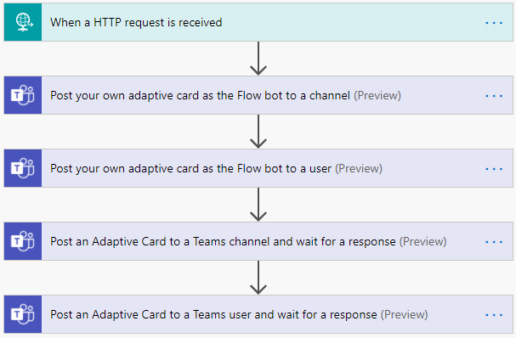
Jog: Power Automate + HTTP trigger

Slide 23
 | CRAWL Incoming Webhook | WALK Power Automate + standard triggers | JOG Power Automate + HTTP Trigger | RUN C# bot
Call from any system | X |  | X | X
Need > O365 license |  |  | X | X
Brandable notifier | X |  |  | X
IM individuals |  | X | X | X
Requires configuration of each team/channel | X | * | * | **
Adaptive cards |  | X | X | X
Do more than notify |  | X | X | X
Update posted message |  |  |  | X
Requires development |  |  |  | X
* You don’t have to configure in each channel, but you have to have access to the Team to configure the flow

Slide 24
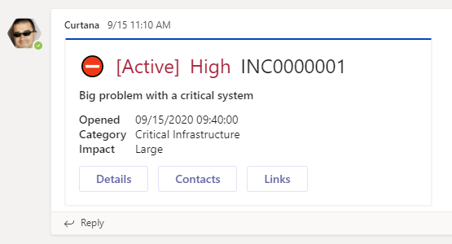
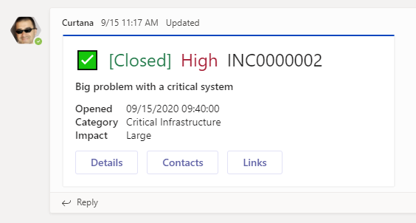
Run: C# bot

Slide 25
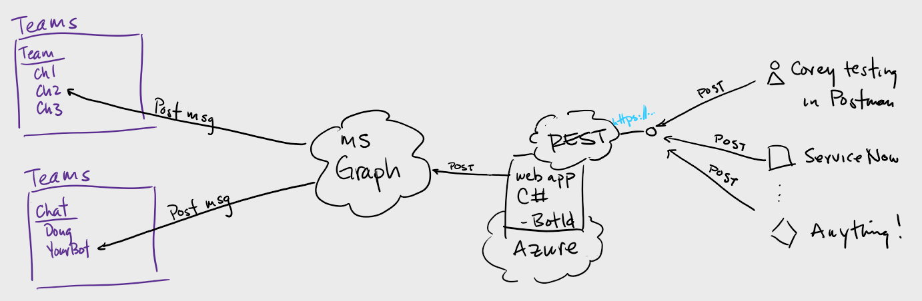
Run: C# bot

Slide 26
Demo
C# bot

Slide 27
Run: C# bot
Creates an HTTP endpoint (URL) that can be called from any system
REST API hosting costs, i.e. Azure usage (bot, web application)
Message comes from your bot (which you can brand)
Bot in name only, don’t need a traditional conversational bot
Must install bot for every channel/user you want to notify
Note: you can automate proactive install for each team/user
Supports Adaptive Cards (https://adaptivecards.io)
Easily test with Postman (https://getpostman.com)
Flexibility to do other actions on top of posting messages (call Graph APIs, etc.)
Developer needed
https://github.com/cdbuzzell/TeamsPriorityIncidentResponse/blob/master/Run.md
https://github.com/cdbuzzell/TeamsProactiveMessage

Slide 28
 | CRAWL Incoming Webhook | WALK Power Automate + standard triggers | JOG Power Automate + HTTP Trigger | RUN C# bot
Call from any system | X |  | X | X
Need > O365 license |  |  | X | ***
Brandable notifier | X |  |  | X
IM individuals |  | X | X | X
Requires configuration of each team/channel | X | * | * | **
Adaptive cards |  | X | X | X
Do more than notify |  | X | X | X
Update posted message |  |  |  | X
Requires development |  |  |  | X
* You don’t have to configure in each channel, but you have to have access to the Team to configure the flow
** You have to install your bot for each Team/user you want to notify, but there is a way to proactively install via automation
*** REST API hosting (i.e. in Azure)

Slide 29
Make it simpler for me, Corey…
 | CRAWL Incoming Webhook | WALK Power Automate + standard triggers | JOG Power Automate + HTTP Trigger | RUN C# bot
This approach is best for… | Send-and-forget notifications to limited number of Teams channels. | When you want to do more than notify when something happens in O365. When branding doesn’t matter ,and you don’t need to update the notification. | When you want to do more than notify when something happens in outside of O365. When branding doesn’t matter, and you don’t need to update the notification. | Full, end-to-end communication process (including updates from Teams and/or the back-end system), like a Major Incident bot.

Slide 30
Glossary
Term | Definition
Incoming webhook | Special type of Connector in Teams that provides a simple way for an external app to share content in team channels and are often used as tracking and notification tools. Teams provides a unique URL to which you send a JSON payload with the message that you want to POST, typically in a card format.
Connector | Used to retrieve information and trigger flows to automate tasks (in Power Automate, for this discussion)
HTTP | What browsers and most IT systems communicate over
JSON | Message (text) format using curly braces and name-value pairs. Human-readable, but used to communicate between IT systems. Long live XML!
Postman | App you download to mimic systems making HTTP calls (https://getpostman.com)
Adaptive Cards | Platform-agnostic snippets of UI, authored in JSON, that apps and services can openly exchange. When delivered to a specific app, the JSON is transformed into native UI that automatically adapts to its surroundings. It helps design and integrate light-weight UI for all major platforms and frameworks. (https://adaptivecards.io)
Power Automate | FKA Microsoft Flow. Low-code, power-user platform for building workflows.
Microsoft Graph | API to get data in and out of M365
C# | Programming language

Slide 31
Next steps
Follow instructions for all of today’s demonstrations at https://github.com/cdbuzzell/TeamsPriorityIncidentResponse
Create prototype of incident-type notification/update at https://github.com/cdbuzzell/TeamsProactiveMessage
Look at Company Communicator for production-ready proactive messages: https://aka.ms/CompanyCommunicator

