Slide 1
Doing something a lot of times: For Loops
UCI neuroscience programming club

Slide 2
Review of last time
Declaring variables is how your function ‘remembers’ from one line to the next. If the result of a operation is stored as a variable, that variable can be later used.
Declare lists with [ ]
A=[‘this’,’is’,1,’list’]
add stuff to lists with list.append(‘item’)
A.append(‘zeta’)
Declare np.arrays with np.array([[],[]])
A=Np.array([1,2,3],[4,5,6])
Declare strings with ‘’
B=‘strings’

Slide 3
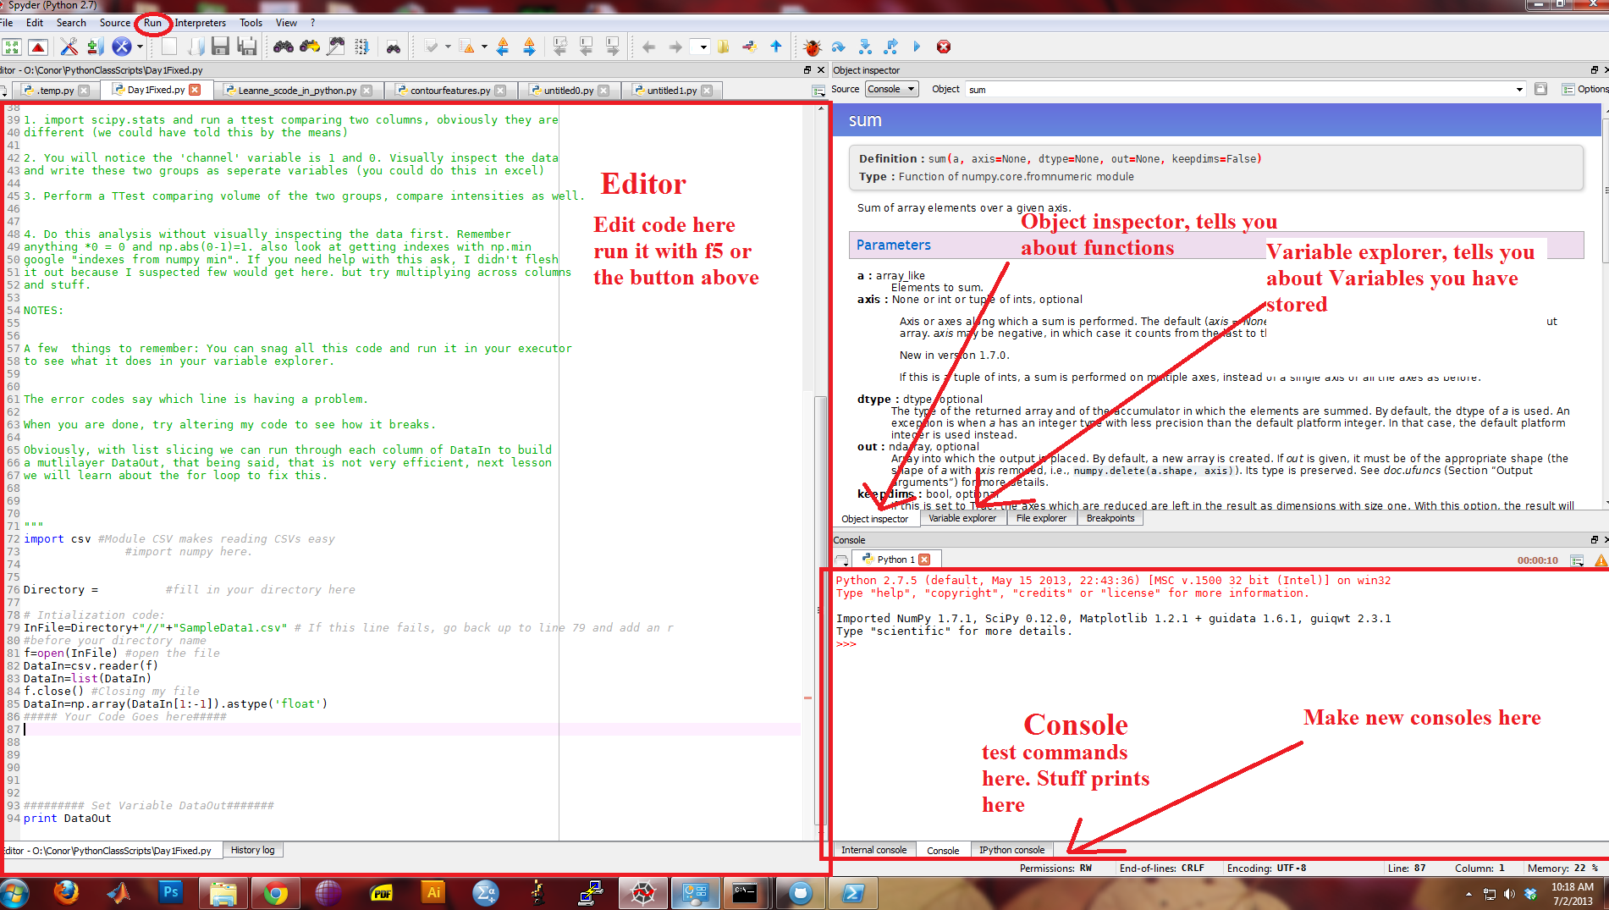

Slide 4
Why for loops?
Allows you to perform an action to every item in a list
Allows you to perform actions many times.
Pretty much the basis of all programming.

Slide 5
How to do for loops
2 ways:
for item in list:
b=item/30
for ItemNumber in range(len(list)):
b=list[ItemNumber]/30

Slide 6
Range
Very similar to list slicing. Basic range command is range(length)
More complicated range command:
range(start,stop,step)
So the previous command was just saying: for the numbers in range:
Go do something with that index

Slide 7
Whitespace is important!
In python:
This:
This:
This
Is good
This:
This:
This
Will not work
I usually use a tab for whitespace.

Slide 8
Indexing is more complicated but more powerful
Allows us to operate on multiple lists simultaneously.
For instance:
for idx in range(len(areas)):
Temp=areas[idx]*zs[idx]
volumes.append(Temp)
Would allow us to make a list of volumes.

Slide 9
How is this better than list slicing?
More controlled.
Allows greater depth, trying to do a list slice with multiple elements can get extremely messy.
Easier to write.
Deals better with multiple datatypes.
However, most things you can do with for loops you can also do with list slicing.

Slide 10
Combining for loops and list slicing
Often it is useful to use the two functions together
for idx in range(np.shape(manyareas,1)):
Atemp=manyareas[idx,:]
Ztemp=manyZs[idx,:]
Temp=Atemp*Ztemp
volumes.append(Temp)

Slide 11
For loops in for loops
For loops can be embedded within eachother
for idx in range(np.shape(matrix,1)):
for idx2 in range(np.shape(matrix,2)):
ouput.append(matrix[idx,idx2]**2)
Generally unless you have a good reason looping deeper than 3 is frowned on. Each loop makes the program **2 times slower.
For small data sets this doesn’t matter for big ones it can destroy programs.

Slide 12
Running for loops with a limit
for idx in range(0,3):
out+=idx
While this is good to practice, in general don’t do this. Hard fixing the ranges will end in sorrow.

