Slide 1
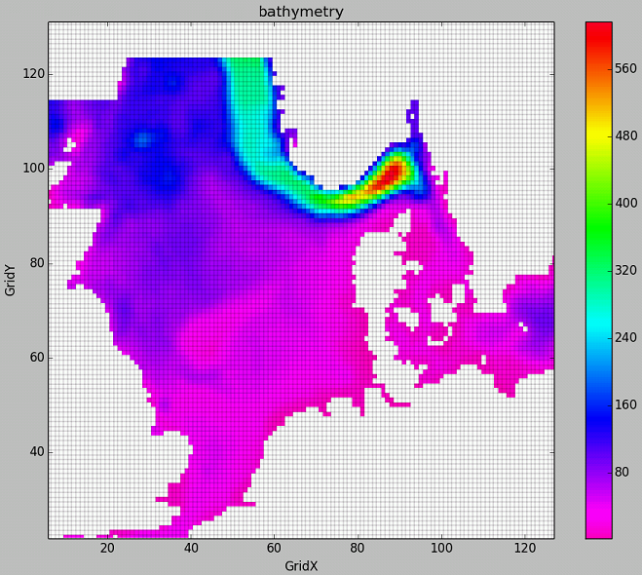
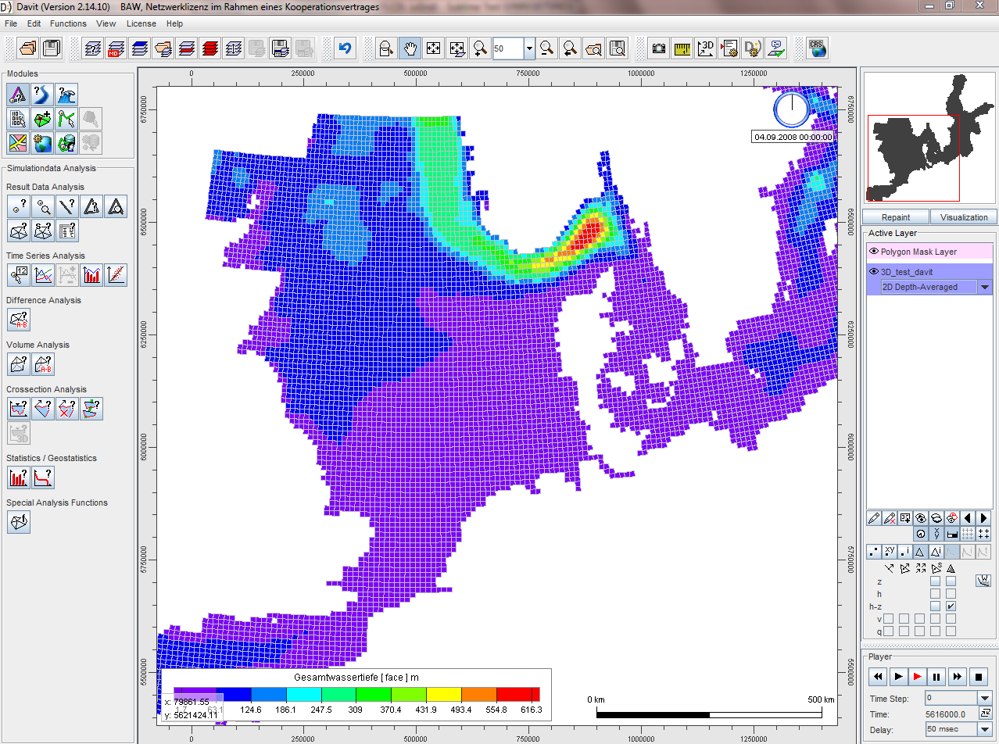
convert2ugrid: MOSSCO structured grid NetCDF = DAVIT unstructured grid NetCDF
Nikolai Chernikov

Slide 2
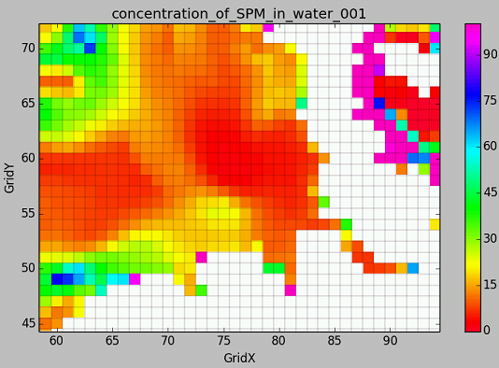
MOSSCO output
Grid:
Structured
Rectangular
Uniform
Sigma z-layers
Values at cell-center
Example of variable:
double c_spm_001(time, z, y, x)

Slide 3
Splitting jobs
Generate UGRID, map data
Rename vars, add proper attributes
Save in NetCDF file

Slide 4
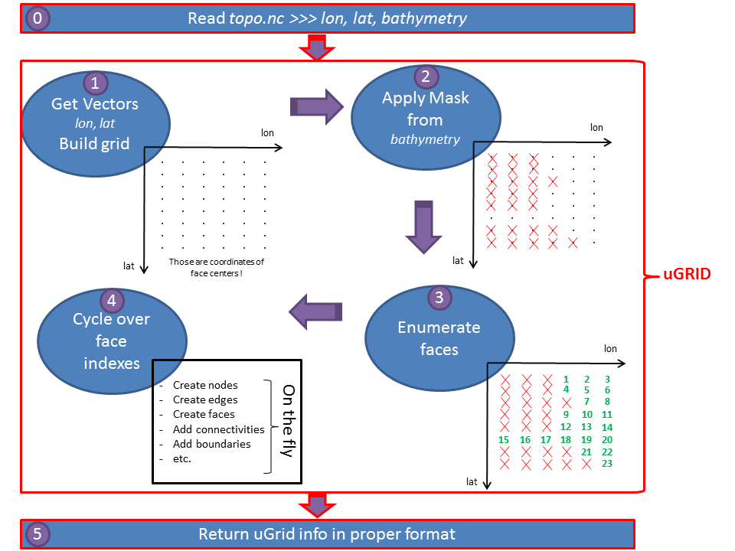
1. Generate UGRID, map data

Slide 5
2. Rename vars, add attributes
double temperature_in_water (time, getmGrid3D_getm_3, getmGrid3D_getm_2, getmGrid3D_getm_1) ;
temperature_in_water: standard_name = "temperature_in_water" ;
temperature_in_water: long_name = "temperature_in_water" ;
temperature_in_water: _FillValue = -1.e+30 ;
temperature_in_water: coordinates = "getmGrid3D_getm_z getmGrid3D_getm_y getmGrid3D_getm_x" ;
temperature_in_water: units = "degC" ;
temperature_in_water: creator = "getm" ;
temperature_in_water: missing_value = -1.e+30 ;
mossco
?
float Mesh2_face_Temperatur_3d (nMesh2_data_time, nMesh2_layer_3d, nMesh2_face) ;
Mesh2_face_Temperatur_3d: standard_name = "temperature_in_water" ;
Mesh2_face_Temperatur_3d: long_name = "Temperatur, Face (Polygon)" ;
Mesh2_face_Temperatur_3d: _FillValue = 1.e+31f ;
Mesh2_face_Temperatur_3d: coordinates = "Mesh2_face_x Mesh2_face_y Mesh2_face_lon Mesh2_face_lat Mesh2_face_z_face_3d" ;
Mesh2_face_Temperatur_3d: units = "degC" ;
Mesh2_face_Temperatur_3d: grid_mapping = "Mesh2_crs" ;
Mesh2_face_Temperatur_3d: cell_measures = "area: Mesh2_face_wet_area" ;
Mesh2_face_Temperatur_3d: cell_methods = "nMesh2_data_time: point nMesh2_layer_3d: mean area: point" ;
Mesh2_face_Temperatur_3d: name_id = 6 ;
Mesh2_face_Temperatur_3d: location = "face" ;
Mesh2_face_Temperatur_3d :mesh = "Mesh2" ;
davit

Slide 6
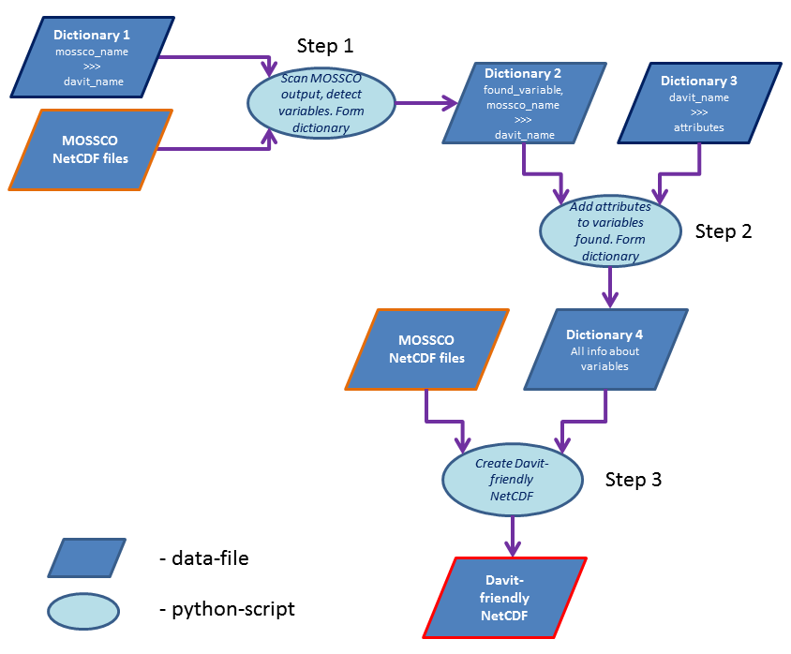
2. Rename vars, add attributes

Slide 7
2. Rename vars, add attributes
Filter out variables
Rename them

Slide 8
2.Example of “Dictionary 1”
MOSSCO >>> DAVIT
'depth_averaged_x_velocity_in_water' >>> 'Mesh2_face_Stroemungsgeschwindigkeit_x_2d'
'depth_averaged_y_velocity_in_water ' >>> 'Mesh2_face_Stroemungsgeschwindigkeit_y_2d'
'temperature_in_water' >>> 'Mesh2_face_Temperatur_3d'
'bathymetry' >>> 'Mesh2_face_depth_2d'

Slide 9
2.Example of “Dictionary 2”
"\\widar\home\mossco.nc", "Effect_of_Mbalthica_on_critical_bed_shearstress" >>> NOT_INCLUDED
"\\widar\home\mossco.nc", "Effect_of_Mbalthica_on_sediment_erodibility" >>> NOT_INCLUDED
"\\widar\home\mossco.nc", "temperature_in_water" >>> "Mesh2_face_Temperatur_3d"
"\\widar\home\topo.nc", "bathymetry" >>> "Mesh2_face_depth_2d"

Slide 10
2. Rename vars, add attributes
Add attributes

Slide 11
2.Example of “Dictionary 3”
float Mesh2_face_Temperatur_3d( nMesh2_data_time, nMesh2_layer_3d, nMesh2_face) ;
Mesh2_face_Temperatur_3d: long_name = "Temperatur, Face (Polygon)" ;
Mesh2_face_Temperatur_3d: units = "degC" ;
Mesh2_face_Temperatur_3d: name_id = 6 ;
Mesh2_face_Temperatur_3d: _FillValue = 1.e+31f ;
Mesh2_face_Temperatur_3d: cell_measures = "area: Mesh2_face_wet_area" ;
Mesh2_face_Temperatur_3d: cell_methods = "nMesh2_data_time: point nMesh2_layer_3d: mean area: point" ;
Mesh2_face_Temperatur_3d: coordinates = "Mesh2_face_x Mesh2_face_y Mesh2_face_lon Mesh2_face_lat Mesh2_face_z_face_3d" ;
Mesh2_face_Temperatur_3d: grid_mapping = "Mesh2_crs" ;
Mesh2_face_Temperatur_3d: standard_name = "temperature" ;
Mesh2_face_Temperatur_3d : mesh = "Mesh2" ;
Mesh2_face_Temperatur_3d: location = "face" ;
double Mesh2_face_depth_2d (nMesh2_time, nMesh2_face) ;
Mesh2_face_depth_2d: long_name = "Topographie" ;
Mesh2_face_depth_2d: units = "m" ;
Mesh2_face_depth_2d: name_id = 17 ;
Mesh2_face_depth_2d: _FillValue = 1.e+31 ;
Mesh2_face_depth_2d: cell_measures = "area: Mesh2_face_area" ;
Mesh2_face_depth_2d: cell_methods = "nMesh2_time: mean area: mean" ;
Mesh2_face_depth_2d: coordinates = "Mesh2_face_x Mesh2_face_y Mesh2_face_lon Mesh2_face_lat" ;
Mesh2_face_depth_2d: grid_mapping = "Mesh2_crs" ;
Mesh2_face_depth_2d: standard_name = "sea_floor_depth_below_geoid" ;
Mesh2_face_depth_2d: mesh = "Mesh2" ;
Mesh2_face_depth_2d: location = "face" ;
Mesh2_face_depth_2d: davit_role = "visualization_variable" ;

Slide 12
2.Example of “Dictionary 4”
float Mesh2_face_Temperatur_3d( nMesh2_data_time, nMesh2_layer_3d, nMesh2_face) ;
Mesh2_face_Temperatur_3d: long_name = "Temperatur, Face (Polygon)" ;
Mesh2_face_Temperatur_3d: units = "degC" ;
Mesh2_face_Temperatur_3d: name_id = 6 ;
Mesh2_face_Temperatur_3d: _FillValue = 1.e+31f ;
Mesh2_face_Temperatur_3d: cell_measures = "area: Mesh2_face_wet_area" ;
Mesh2_face_Temperatur_3d: cell_methods = "nMesh2_data_time: point nMesh2_layer_3d: mean area: point" ;
Mesh2_face_Temperatur_3d: coordinates = "Mesh2_face_x Mesh2_face_y Mesh2_face_lon Mesh2_face_lat Mesh2_face_z_face_3d" ;
Mesh2_face_Temperatur_3d: grid_mapping = "Mesh2_crs" ;
Mesh2_face_Temperatur_3d: standard_name = "temperature" ;
Mesh2_face_Temperatur_3d : mesh = "Mesh2" ;
Mesh2_face_Temperatur_3d: location = "face" ;
Mesh2_face_Temperatur_3d: _mossco_filename = "\\Widar\home\mossco.nc" ;
Mesh2_face_Temperatur_3d: _mossco_varname = "temperature_in_water" ;
double Mesh2_face_depth_2d (nMesh2_time, nMesh2_face) ;
Mesh2_face_depth_2d: long_name = "Topographie" ;
Mesh2_face_depth_2d: units = "m" ;
Mesh2_face_depth_2d: name_id = 17 ;
Mesh2_face_depth_2d: _FillValue = 1.e+31 ;
Mesh2_face_depth_2d: cell_measures = "area: Mesh2_face_area" ;
Mesh2_face_depth_2d: cell_methods = "nMesh2_time: mean area: mean" ;
Mesh2_face_depth_2d: coordinates = "Mesh2_face_x Mesh2_face_y Mesh2_face_lon Mesh2_face_lat" ;
Mesh2_face_depth_2d: grid_mapping = "Mesh2_crs" ;
Mesh2_face_depth_2d: standard_name = "sea_floor_depth_below_geoid" ;
Mesh2_face_depth_2d: mesh = "Mesh2" ;
Mesh2_face_depth_2d: location = "face" ;
Mesh2_face_depth_2d: davit_role = "visualization_variable" ;
Mesh2_face_depth_2d: _mossco_filename = "\\Widar\home\topo.nc" ;
Mesh2_face_depth_2d: _mossco_varname = "bathymetry" ;

Slide 13
3. Rename vars, add attributes
Using module netcdf4-python

Slide 14
Outline
Trailling errors
Easy editable
User interaction at any step
Start from any step
uGrid conversion-module – can be improved

Slide 15
Challenges
DAVIT:
Selection of elements
Timeseries
Vector-variable names
Sigma-z-layers
uGrid conversion-algorithm:
Curvilinear mesh
Flexible mesh

Slide 16
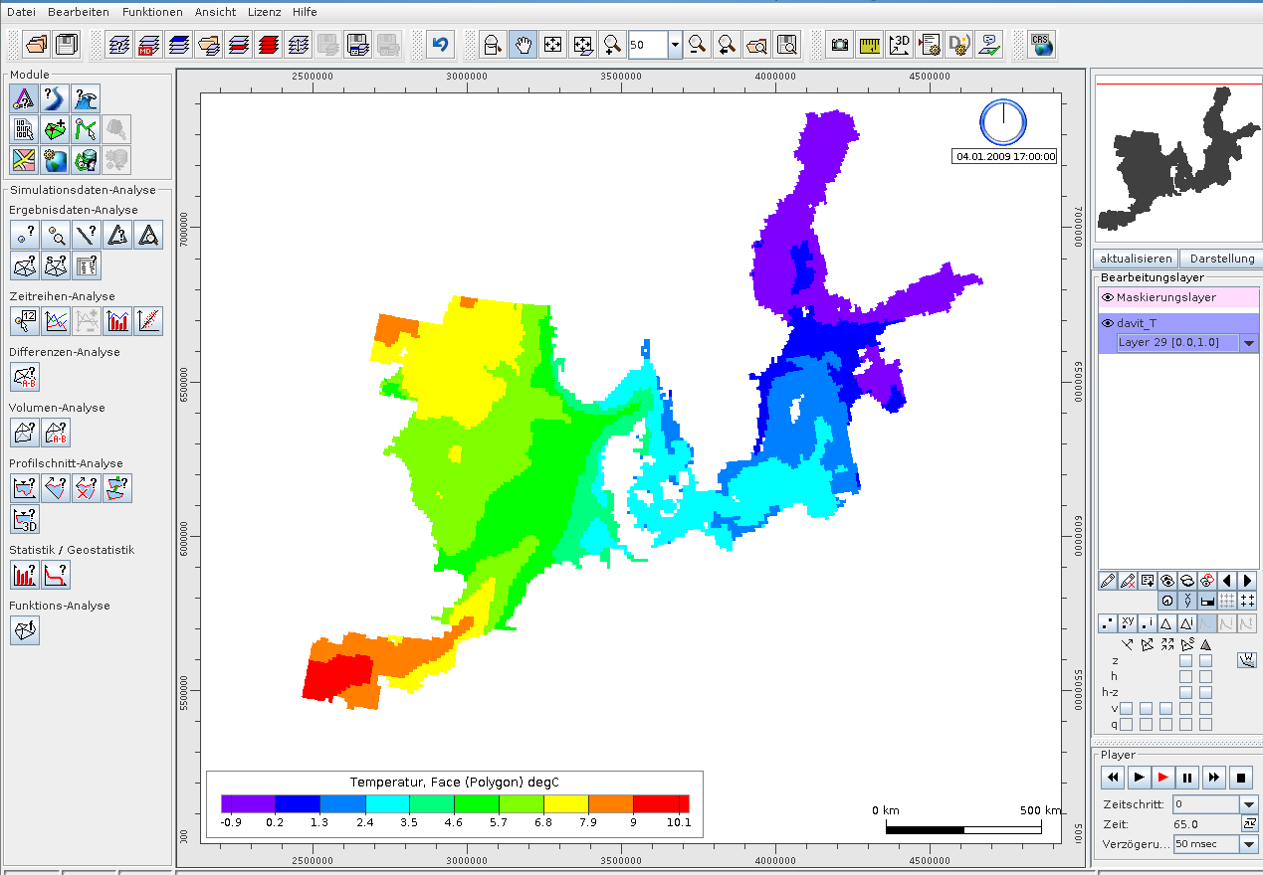
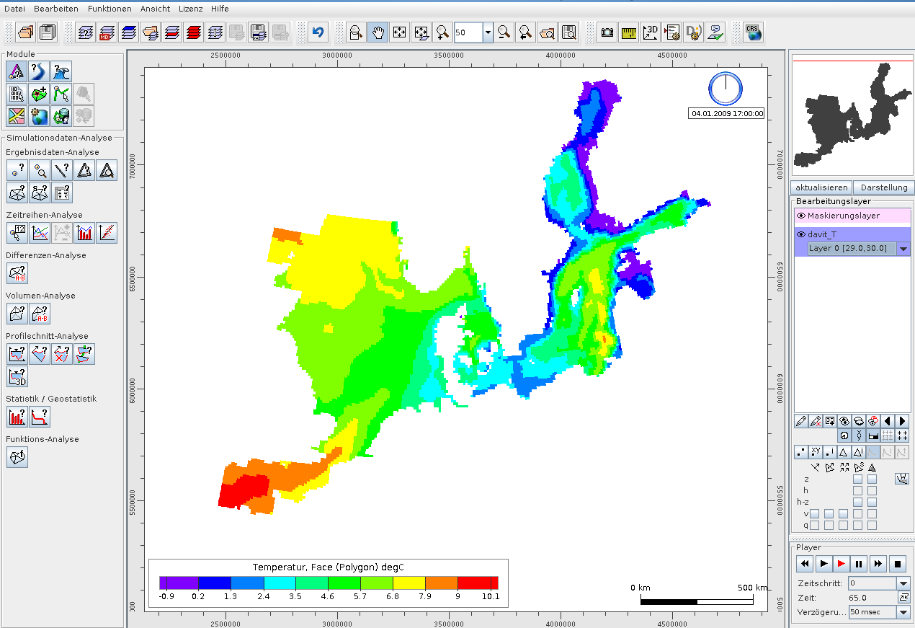
Problem: sigma z-layers

Slide 17
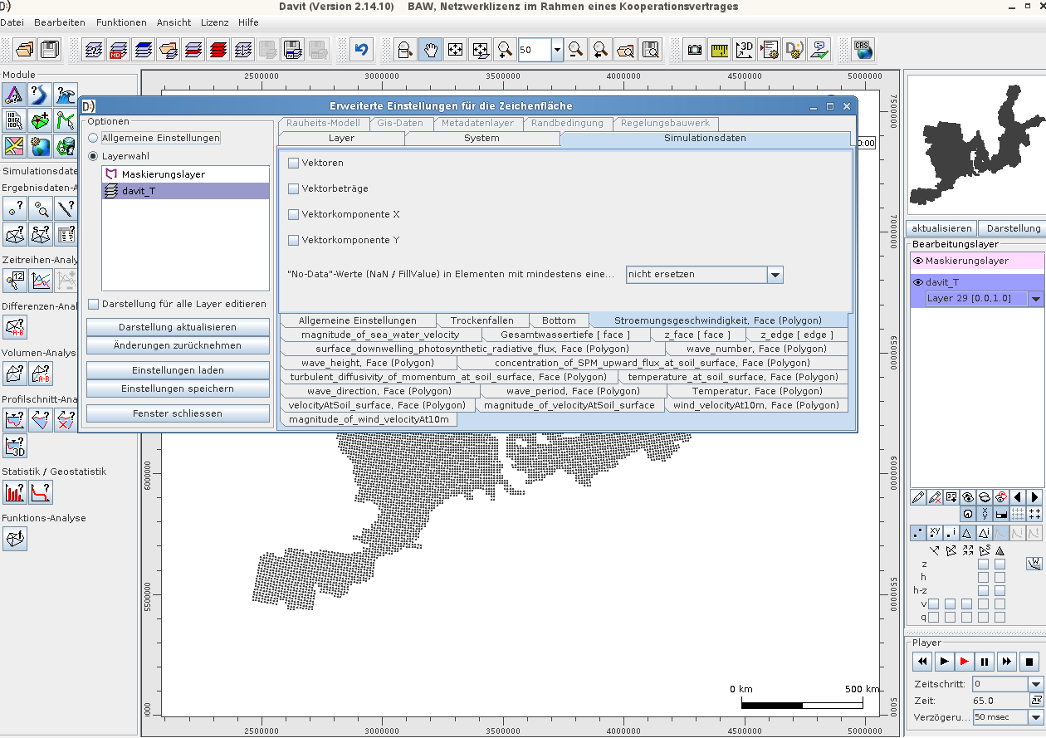
Problem: double vector-variable

Slide 18
Thank you for your attention
Source code and documentation can be found under:
\\themis\system\akprog\python\qad\convert2ugrid
Contact:
Nikolai Chernikov
(nikolai.chernikov.ru@gmail.com)
Dr.-Ing. M.Hassan Nasermoaddeli (hassan.nasermoaddeli@baw.de)

