Slide 1
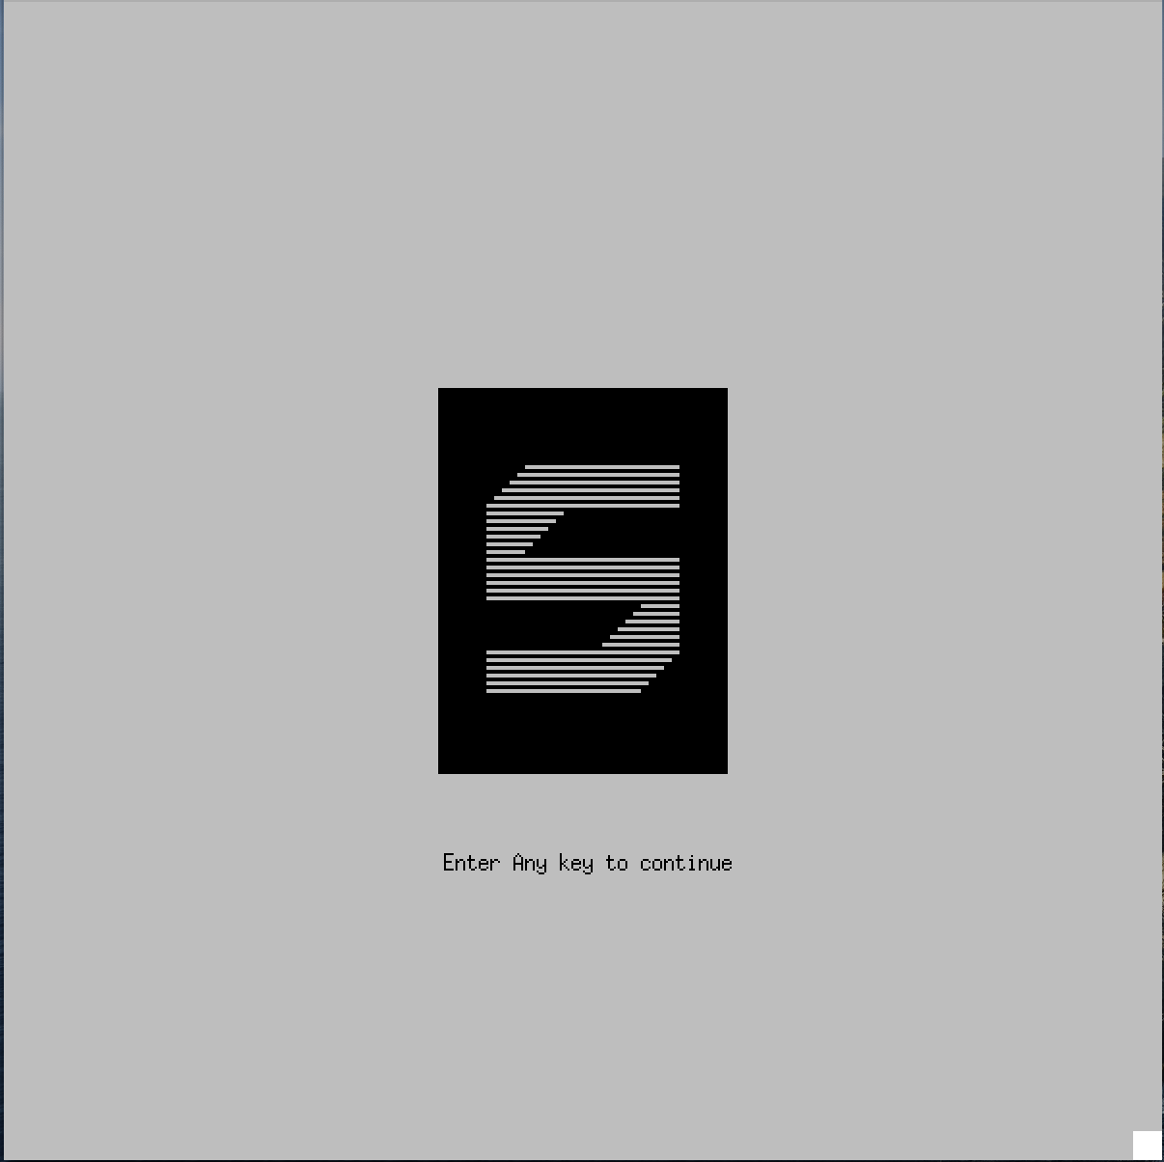
Straights Demo
CS 246 Final project
Name:
Student ID:

Slide 2
Table of Contents
Preparation
Graphic Settings
Other Settings
Game Start
Human Player
Computer Player
Round Ends
Game Ends
Appendix
Harder Computer Mode
New Rule Mode

Slide 3
Preparation
This part will let user to input some basic settings of this game, which include the following:
Will the user enable Graphic settings?
Will the user enable harder computer to this game?
Will the user apply new rule?
Is player 1-4 a computer player or a human player?

Slide 4
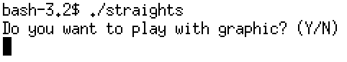
Graphic Settings
Graphic
Text
User can insert ’Y’ or ‘y’ to enable graphic settings and insert ‘N’ or ‘n’ for only text settings

Slide 5
Graphic Settings

Slide 6
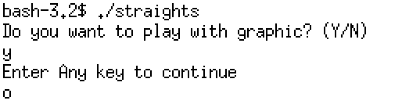
Any key to continue
User can insert any key here to continue to next step of straights.

Slide 7
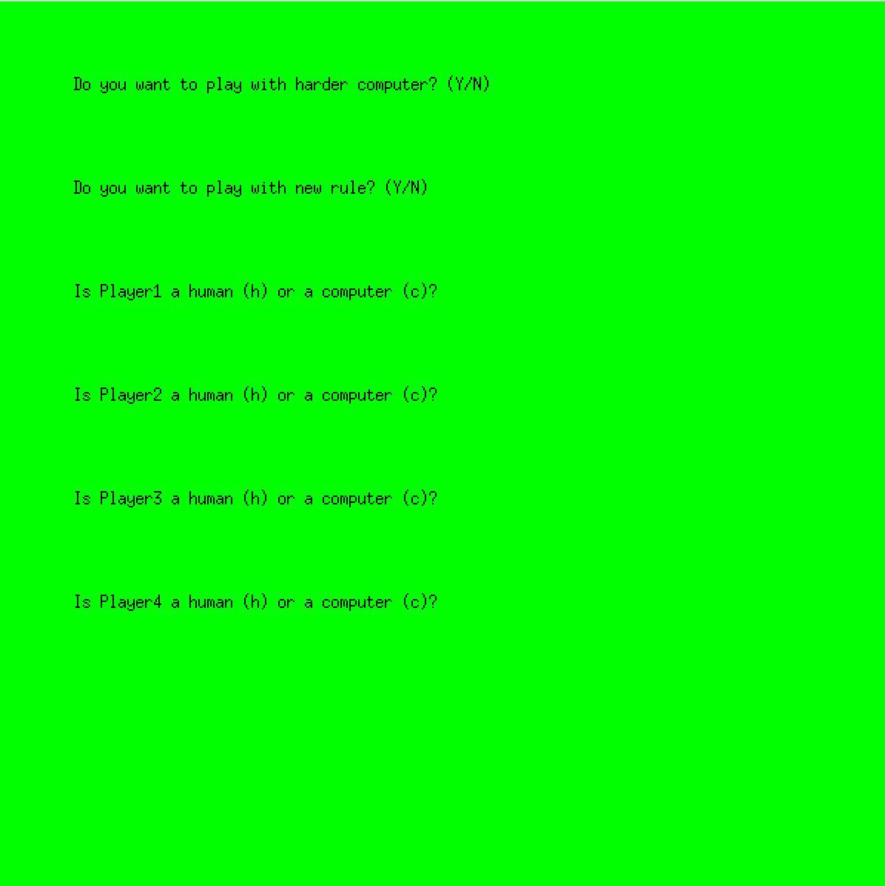
Prepartaion (other settings)

Slide 8
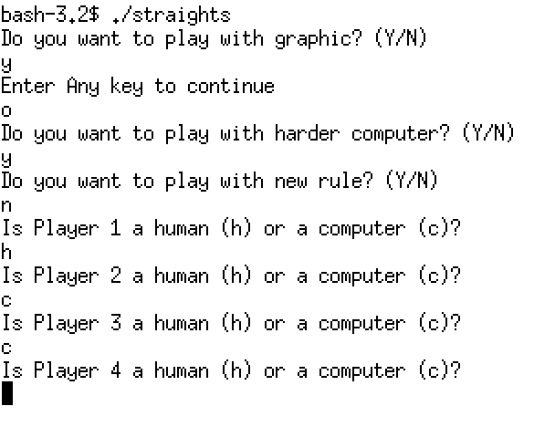
Preparation (text display)

Slide 9
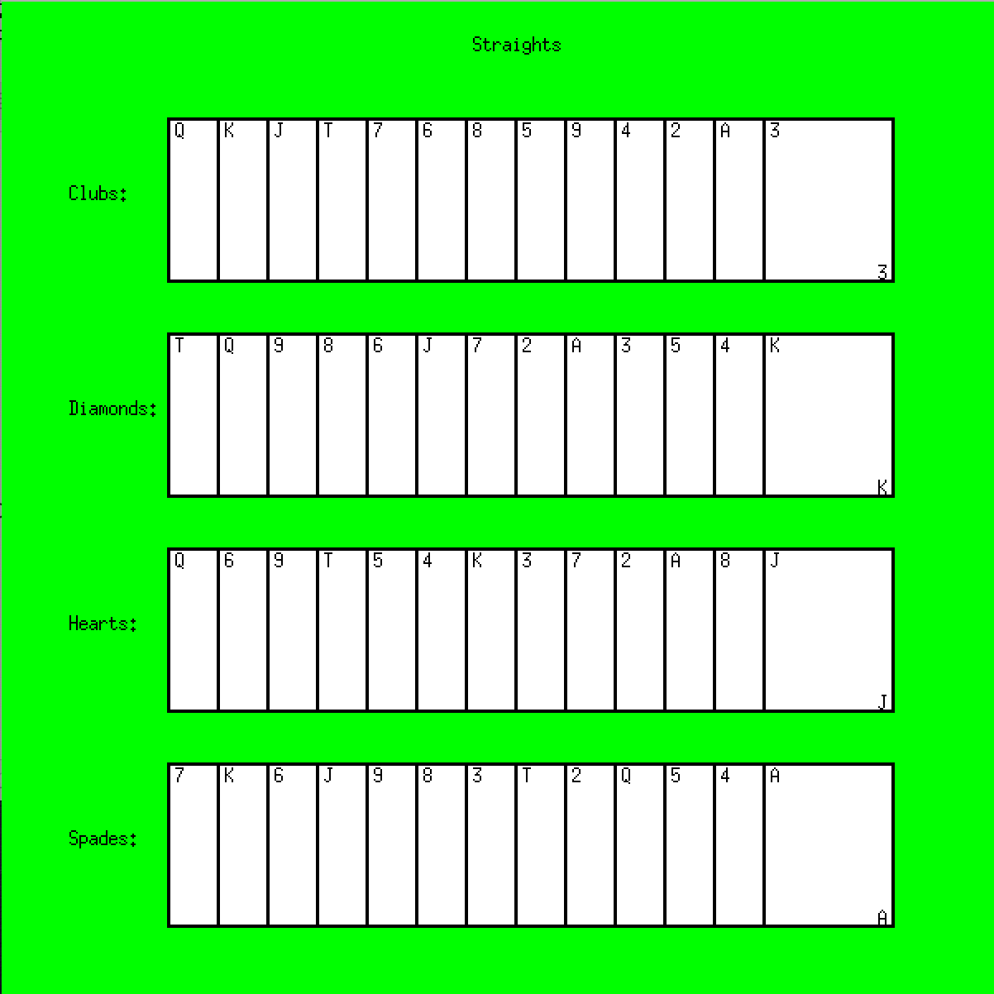
Game Start
Human Player
Computer Player

Slide 10
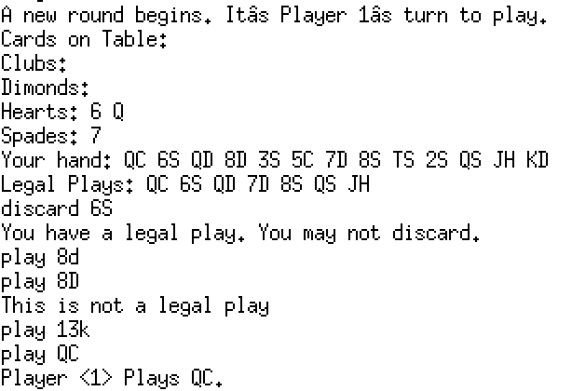
Human Player
A human player can do following command:
discard <rank><suit>
play <rank><suit>
ragequit
Quit

Slide 11
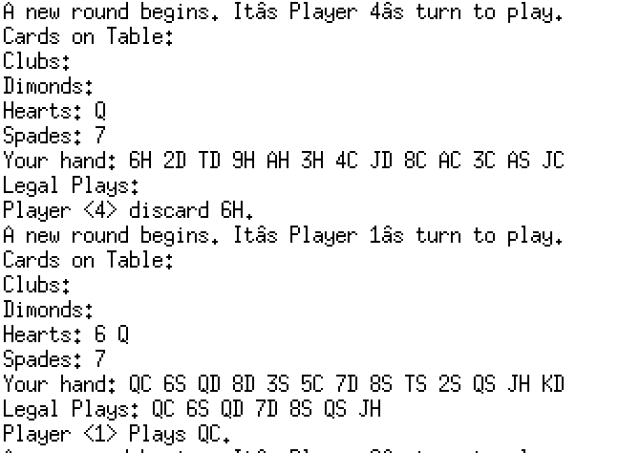
Computer Player
The computer player will automatically play and discard cards.

Slide 12
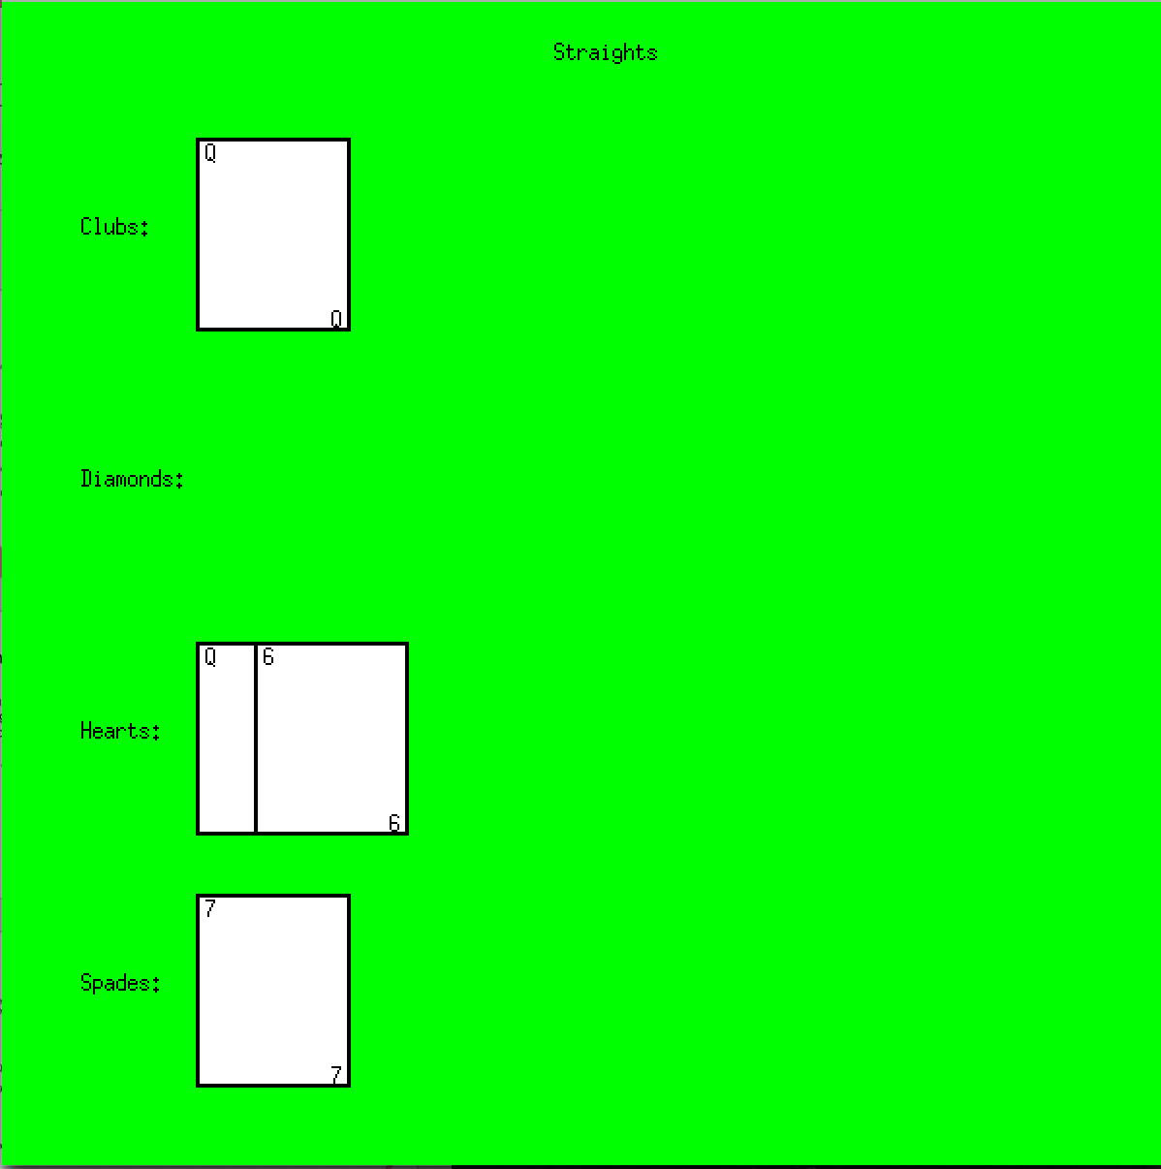
Table (GUI)
This GUI will show the cards on table

Slide 13
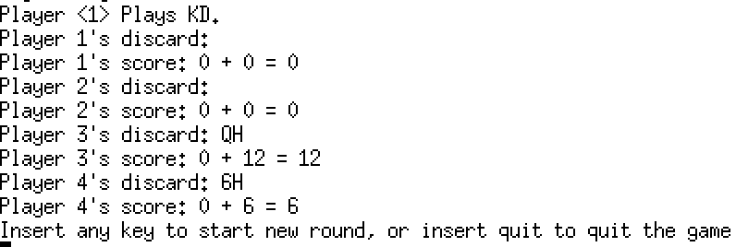
Round Ends
IF ALL CARDS ARE PLAYED AND NO ONE’S SCORE EXCEED 80, THEN YOU CAN INSERT ANY KEY TO START A NEW ROUND

Slide 14
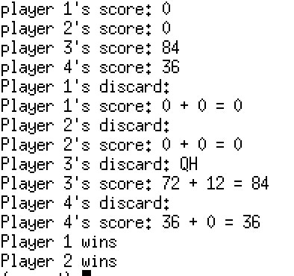
GAME ENDS
The player with the lowest score wins. Print the following victory message for the winning player(s)
If multiple players tie for the win, print the above message for each winner.

Slide 15
Appendix

Slide 16
Harder Computer mode
When a harder computer discard a card, it will always choose the cards has the smallest rank on its hand
When a harder computer play a card, it will check all cards on the table first, and then calculate every card on his/her hand to see which card will bring the least number of new legal cards. My propose is trying to let other people do more discard.

Slide 17
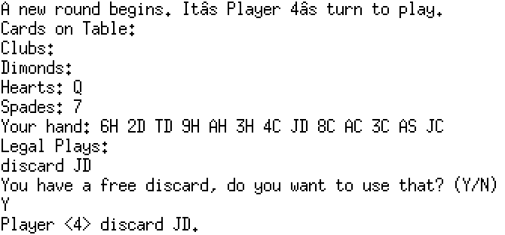
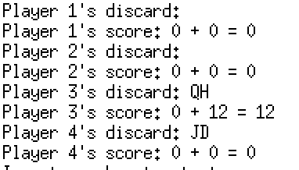
New Rule mode
When this mode is enabled, the human player can discard a card with no cost once.

