Slide 1
ECG Weekly Report
Cory Davis

Slide 2
UC Irvine Dataset
Obtained UCI arrhythmia dataset
Data appears to show a single reading per patient across 12 nodes
Node data
average length of each wave type
Amplitude of the wave type
Does not appear to contain full ECG wave for each patient

Slide 3
MIT Database
Switching to MIT data, UCI did not provide the desired data set
Each row represents a single heartbeat
The final column represents heartbeat classification
Data set classifies heartbeats into 5 categories
N(0): Normal beat
S(1): Supraventricular premature beat
V(2): Premature ventricular contractions
F(3): Fusion of ventricular and normal beat
Q(4): Unclassifiable beat
ML algorithm will learn “normal” beat and outside of that normal range will be considered an anomaly

Slide 4
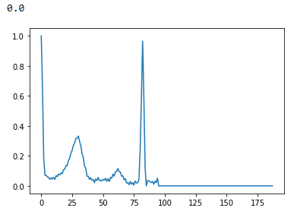
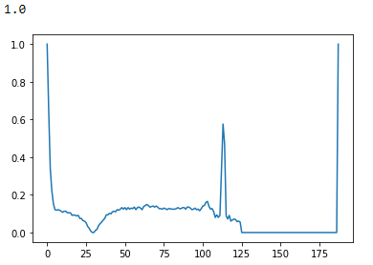
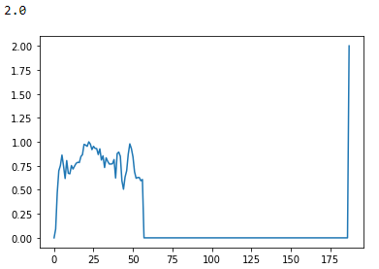
MIT Database

Slide 5
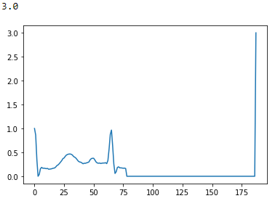
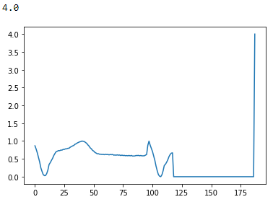
MIT Database

Slide 6
MIT Database
Worked with physionet WFDB and Biosppy APIs
Will use WFDB API
Converting the data into appropriate csv files for testing
Isolating each heartbeat, and then padding 0s to ensure all rows are of equal length
Will begin applying ML algorithm this week

Slide 7
Intracardiac Atrial Fibrillation Database
Switching Databases
Processing the data to separate each “beat”
Database is not adequately annotated
Would require unsupervised ML
Each beat is listed as “normal” but visual check does not confirm this
Separate csv files for each channel?
How long is okay to pad ‘0’
Don’t want a 10,000 long row of data with only 1,000 relevant data points

Slide 8
Researching possible methods
Literature review
Wavelet Based solution?
PCA, Guassian models, SVM are possible solutions
Working to replicate others tests first
MIT data resampled to length 300

Slide 9
Test methods
Linear Regression
OLS:
Mean squared error = 36.083502965731846
Ridge:
Mean squared error = 35.58477675157194
MSE is min when alpha = 390

Slide 10
SVM
ML techniques used are SVM with PCA
Papers written seem to achieve between 94%-98% prediction accuracy
Will test SVM prior to PCA and after PCA
Goal of PCA is to contain 98% of the data variability
Data is resampled and normalized

Slide 11
SVM Results – pre PCA
Linear: 70.3% accurate
RBF: 70.2% accurate
Poly
Deg 1: 70.4%
Deg 2: 69.2%
Deg 3-20 ≈ 69%
Sigmoid: 58.5%

Slide 12
SVM Results – post PCA
Applying PCA prior to fitting (reduction from 300 to 200 components)
Linear: 55.4%
RBF: 65.0%
Unable to achieve similar results with SVM
Other studies reduce the amount of beat types
5 types instead of 40
May lead to higher accuracy, but cannot predict as many arrythmias

Slide 13
Preprocessing
Making alterations to sampling for each pulse
Each data row will be resampled to 200 data points
Was using the ‘R’ peak as the start of the row
Instead it will be data point 100 of 200

