Slide 1
COLLABORATIVE EVALUATION COMMUNITIES IN URBAN SCHOOLS:
HOW HIERARCHICAL EDUCATIONAL POLICIES SHAPE ITS IMPLEMENTATION
Randi K. Nelson Frances Lawrenz
Christopher David Desjardins Lesa Clarkson
David J Fisher Anica Bowe
University of Minnesota
Twin Cities

Slide 2
Collaborative Evaluation Communities
  The CEC project is a collaborative partnerships between educators at public schools and graduate students and faculty at the University of Minnesota.
  This partnership creates school-based collaborative evaluation communities comprised of teachers, instructional coaches, STEM graduate students, and university faculty.
  Funded by the National Science Foundation (NSF)

Slide 3
Collaborative Evaluation Communities
  Purpose
  Improve the evaluation capacity of urban public schools
  Provide teachers of science and mathematics professional growth by improving their capacity to use evaluation data and engage in continuous improvement and data based decision-making
  Develop graduate-level educational leaders with the knowledge and skills to evaluate science and mathematics programs

Slide 4
Collaborative Evaluation Communities
THIS IS ACCOMPLISHED BY
Working with schools to identify shortfalls in their mathematics and science curriculum or instruction using existing data
Collaborating together to develop an intervention action plan
Assisting teachers with how to best collect and interpret data in their classrooms
Eventually leading to the developing of sustainable techniques for teachers to evaluate their classrooms.

Slide 5
Collaborative Evaluation Communities
Explore Data and Research
Communicate Findings
Position the Inquiry
Challenge Statement
Analyze and
Synthesize Data
Plan the Inquiry
Action Inquiry Map
Collect Data
  Parsons, B.A. (2002). Evaluative inquiry: Using evaluation to promote student success. Thousand Oaks, CA. Corwin Press, Inc

Slide 6
How Have Hierarchical Educational Policies Shape Its Implementation?
Over the past 3.5 yrs we have partnered with three schools from the same school district
There are multi-level educational policies in place that govern the dynamics of this partnership
We will highlight how three of them have shaped the progress of our partnership

Slide 7
How Have Hierarchical Educational Policies Shape Its Implementation?
Policies:-
Federal & State
State & District
School
How have these policies affected the overall progress and implementation of the CEC model in the St Paul, MN public school system at the three different schools?

Slide 8
Federal Educational Policies
Accountability & Quantitative Indicators
Academic Competitiveness Council (ACC)
Program Assessment Rating Tool (PART)
Highly Qualified Teachers
No Child Left Behind Act (NCLB)
Notes:
The overriding influence of federal educational policies on the implementation of the CEC, centers on its emphasis on accountability and quantitative indicators of success

Slide 9
Consequences of Policies
ACC & PART
Federal & local evaluation design
    Quantitative indicators
    Experimental design
    Summative
Highly Qualified Teachers
  Broader licensing requirements
NCLB
  Greatest impact on CEC
Notes:
The effect of ACC and PART on CEC was that they placed more emphasis on data based decision making, which was the foundation of the CEC project. As a result, the CEC project was favorably received within the district and the schools.
The CEC addressed the federal requirement that teachers be highly qualified since building teacher capacity to evaluate and improve their own teaching was also a cornerstone of the CEC project.
As a result of both of these federal policies, the CEC program was well-received by school administrators and teachers. These policies set the stage for acceptance of the CEC projects as important to the educational goals of teachers and school & district administrators. It supported state and federal goals of improved student achievement and high quality instruction.
The NCLB had the greatest impact and influence on the implementation of the CEC program in schools.

Slide 10
NCLB Increased State Testing
MN Comprehensive Assessments-II (2003)
Graduation-Required Assessment for Diploma Test of Emerging Academic English
MN Student Oral Language Observation Matrix
Mathematics Test for English Language Learners
Minnesota Test of Academic Skills

Slide 11
Minnesota Comprehensive Assessments-II
Grade | Math | Reading | Science
3 | ✓ | ✓ | 2008
4 | ✓ | ✓
5 | ✓ | ✓ | 2008
6 | ✓ | ✓
7 | ✓ | ✓
8 | ✓ | ✓
9 |  |  | 2008
10 |  | ✓ | 2008
11 | ✓ |  | 2008
Notes:
Testing in gra3 through 8 is limited to math and reading &/or writing.
Until 2008, there were no state tests for science in Minnesota.

Slide 12
NCLB: Increased Availability of Data
State Average
Disaggregation of Data
By District
By School
By Demographic Group
  English Language Learners
  Low Income
  Special Education
By Ethnic Group
Trends over Time
AYP in Math &/or Reading
Notes:
The increase testing required by the No Child left Behind Act, resulted in a major increase in the type and amount of data that was available to state, district and school officials.
School districts developed research and assessment departments to analyze and report on the massive amount of data that was generated by state and district testing.
The massive amounts of data threatened to overwhelm teachers. The CEC helped them to better understand what the test data meant and to create classroom and student level data for the teachers to use for instructional improvement.

Slide 13
NCLB & Views about Data Use
Focuses the mind
  Establishes measurable goals for & evidence of improvement
  Shifts attention away from untested subjects
Climate Change
  Accountability for all students
  Weapon or tool?
Notes:
Focuses the mind
NCLB had a great impact on educators’ views and attitudes towards data use.
On the positive side, NCLB focused the attention of educators on increasing student achievement as an over-riding goal of school improvement policies and it provided a way to measure improvement.
On the negative side, the bright light shining on tested subjects, such as math and reading, tended to leave other subjects and educational goals in the shadows. We saw this in the CEC schools. Although the goal of the CEC was to improve educational outcomes for students in math and science, most of our effort went into math because it was a tested subject.
Climate Change
NCLB’s message is that schools must provide a high quality education for all students and educators are unlikely to argue this point. Collecting test data on individual students and summarizing data at the classroom level allowed teachers to see how their instruction affected individual students. Having classroom and individual student data allowed teachers to make changes in their instruction and to see the effect of their instructional changes on students.
CEC started in schools at a time when data were viewed as weapons and teachers felt they were going to be punished for poor student performance. Working with individual teachers in their own classrooms and creating teams of teachers, university faculty and graduate students helped teachers to begin to use data as tools for instructional improvement.

Slide 14

NCLB & Views about Data Use
NCLB
Pressure to increase student achievement
More Testing
More state, district & school data
Bottleneck:
Little classroom & student level data
Limited evaluation & data use skills
Limited access to technology support
Notes:
Schools that were not making Adequate Yearly Progress as required by the NCLB, were strongly motivated to participate in the Collaborative Evaluation Community. They saw their work with the CEC as a way to improve student achievement in areas in which they were struggling.
The CEC project helped to alleviate some of the bottlenecks in the educational system that tend to reduce the potential of NCLB to improve student achievement:
The CEC provided teachers with classroom level data on their own students
The CEC identified problems based on student test data and worked together to create new instructional approaches.
The CEC provided summarized data to teachers in forms that were accessible and useful.
There are other aspects of the educational system that produce bottlenecks that CEC could not address. These were the limited availability of technology support at schools. Teachers were not able to analyze their own data because of limited access to computers and unfamiliarity with data analysis and graphing using spreadsheet software.
The CEC model worked well in schools that had evidence of a need for improvement. This evidence is unlikely to have had much weight without the pressure supplied by the NCLB.

Slide 15
NCLB & the Collaborative Evaluation Community
Created a sense of urgency to improve student achievement
Focused most strongly on math - but left behind science
Evaluation & data use equated with assessment, not instruction:
  “If it ain’t broke...”
Notes:
In summary,
The NCLB helped to create a sense of urgency for improving student achievement that motivated teachers to participate fully in the CEC.
Because science was not a tested subject, there was less interest in including it as part of CEC attention.
When test scores showed that students were doing as well as other schools in the district or as well as the state average, there was little motivation to participate in the CEC. It was only through persistent effort that teachers saw the value of using data to make improvements in other (non-tested) areas of instruction.

Slide 16
The District
Midwestern
Urban
Student Population: 39050
Diverse

Slide 17
Demographics
American Indian 2%
Asian American 30%
African American 30%
Hispanic 13%
White 25%
Limited English Proficient 37%
Special Education 16%
Free and Reduced Lunch 71%

Slide 18
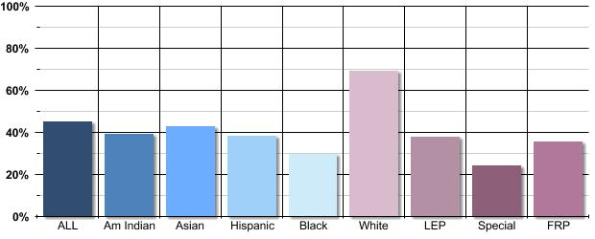
Math Proficiency Districtwide
2007 – 08 School Year

Slide 19
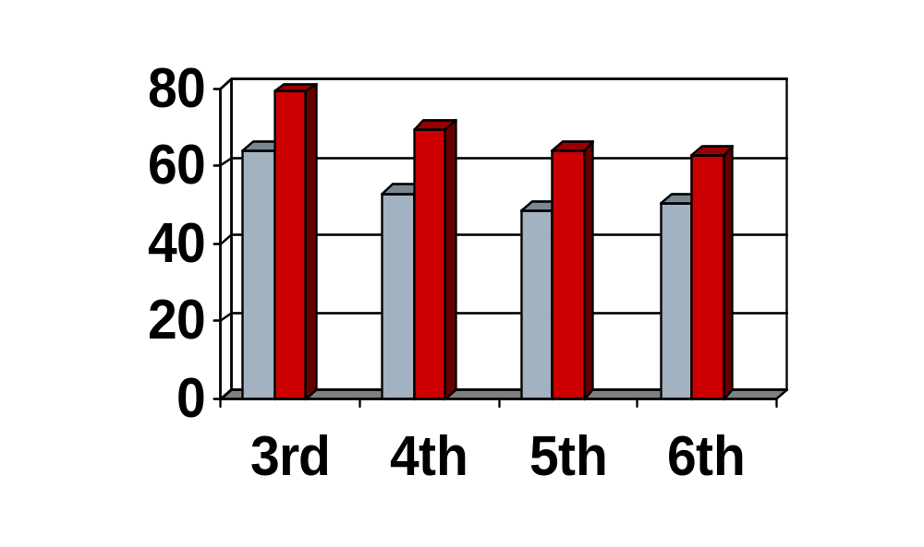
Math Proficiency by Grade
District Data
State Data
2007 – 08 School Year

Slide 20
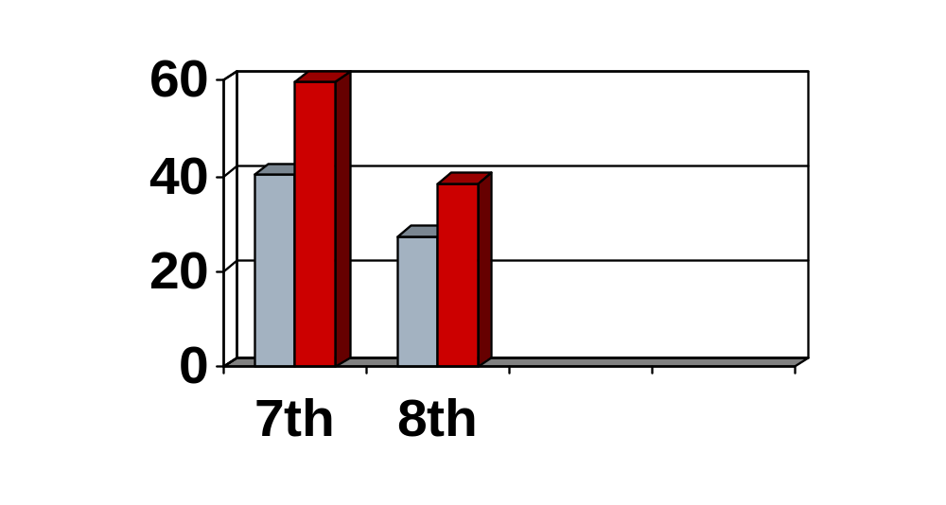
Math Proficiency by Grade
District Data
State Data

Slide 21
District Policies
Affecting CEC Implementation
Data driven decision making
Adopted mathematics curricula
“Math Second”
Length of school day
Open enrollment vs. Split policy for DaVinci

Slide 22
District Policies
Adopted mathematics curricula
  K – 5: Everyday Mathematics, 2001 edition
  Originally, grade K used Investigations. Grade 6 EM sometimes completed “the spiral” of some content topics.
  6 – 8: Connected Mathematics (CMP)
  Even though the district adopted curriculum was CMP, more than seven different curricula were being used across the district.

Slide 23
Daughter of the Moon
Preschool through grades 6
Public Montessori School
Classrooms are broken into 3 ‘levels’
  Early childhood with pre-school (4 year-olds) and kindergarten.
  Elementary 1: Grades 1, 2, and 3
  Elementary 2: Grades 4, 5, and 6

Slide 24
Daughter of the Moon
Large urban, Midwestern school district
400 students attend this school
55% of the students eligible to receive free/reduced meals
48% of the students have limited English proficiency
11% of the students require special education services
44% Asian, 36% White, 12% Black, 5% Hispanic, and 3% Native American

Slide 25
The Policies/Procedures
Montessori Curriculum
Open enrollment
Montessori mathematics and science taught separately
Teachers work with two grades at a time, e.g. teach grades 1 & 2 or grades 1 & 3
Participated with 7 teachers teaching in Elementary 1
Principal laissez faire and allows teachers to use this for their professional development

Slide 26
Interaction of Policy and Inquiry
Multi-grades in one classroom
  How to develop an inquiry for grades 1 & 2; 2 & 3; or 1 &3 in one classroom?
Lack of paper/pencil tests in Montessori curriculum
  Teachers concerned students may not have enough preparation for high-stakes tests in current curriculum
  Identified the need to develop ‘practice tests’ for students to gain experience

Slide 27
Interaction of Policy and Inquiry
Montessori curriculum rich in manipulatives
  Problem solving inquiry could be used to supplement and enrich the curriculum
  Students may have stronger math skills than non-Montessori students
Principal’s approach to using inquiry as professional development
  Strengthened desire for teacher participation
  Allowed easier entry

Slide 28
Interaction of Policy and Inquiry
Initial focus on both math and science inquiries
    Science teacher non-Montessori
    Pressure from state assessment directs inquiry towards mathematics
      Teachers more concerned about mathematics

Slide 29
Past and Present Inquiry
2nd year at Daughter of the Moon
Developed problem solving modules and practice paper/pencil test as directed by policy during 1st year.
Continue focus on mathematics
  More geared towards algebra and geometry to address state standards for 3rd graders
  Unique multi-grade environment potentially exposes 1st graders to state standards for 3rd graders

Slide 30
Banneker Elementary
Preschool through grade six
Public magnet school
Large urban, Midwestern district
325 students attend this school
95% qualify for free/reduced meals
14% of students have limited English proficiency
15%of students receive special education services
1% American Indian, 10% Asian, 82% Black, 3% Hispanic, 4% White

Slide 31
Policies and Procedures
Reform mathematics curriculum
Teacher looping for some grades
Open enrollment
Teacher participation grew from 8 the first year to 23 last year, new format this year
Principals, three administrators in four years
Each principal has a different participation model

Slide 32
Interaction of Policy and Implementation
Reform Curriculum
  Teachers uncertain about implementation
  Was there time for supplementation?
Principal Participation
  Initially teachers were required to participate
  Later teachers used data collected for Professional Development Plan to increase buy in
  New Principal more “hands on”

Slide 33
Interaction of Policy and Implementation
Original goal was for Science and Mathematics Inquiry
  School not meeting AYP under NCLB in Mathematics
  Principal sees raising Mathematics scores as more important at this time
  School has a Science Specialist who does science class as a “pull out”

Slide 34
Inquiries Past and Present
Measurement
Pre/Post testing of Curriculum Materials
Money
Problem Solving
Teacher Leaders

Slide 35
Year One
First and Second grades
Inquires:
  Measurement
  Money
  Pacing of Reform Curriculum
  Pre/Post testing of Curriculum Materials

Slide 36
Year Two
Third Grade Added
Inquiries
  Pre/Post testing of Curriculum materials
  Further development of Money materials
  Preparation for newer version of Everyday Math

Slide 37
Year Three
Change of administration at the beginning of the school year
CEC goes school wide
Inquiry: Problem Solving
  5 Strategies used
    Draw a Picture
    Make a list
    Look for a Pattern
    Make a Table
    Guess and Check

Slide 38
Year Four
Faze out year
Teacher Leader format
Teachers direct inquiry and take over much of the work done by Graduate Students in past years
University staff provides support as needed when asked

Slide 39
Implications of School Policies on Implementation
Initial participation decided by Principal
  By in by teachers took time. Collaboration took more time
School wide participation decided by Principal as well
  Again, an issue
Changes in administration – each Principal needed to feel ownership and this changed the nature of relationship between University personnel and schools

Slide 40
DaVinci
Grades 1-8
Gifted and talented (GT) magnet school for 1-6
Large urban, Midwestern school district
950 students attend this school
22% of the students eligible to receive free/reduced meals
11% of the students have limited English proficiency
4% of the students require special education services
43% students of color

Slide 41
The Policies/Procedures
Gifted and Talented Orientation
Open enrollment at 7th grade
Mathematics and Science taught separately
7-8th grades taught separately
Principal active in several initiatives
Whole school immersed in the initiative

Slide 42
The Inquiries
Persistence of enrollment; length of time students in the school
Measurement instruction; student attitudes and beliefs
Art and Science; pre post attitude and achievement and observations
Earth science instruction; pre post testing
Scale; pre post attitude achievement and observations
Achievement and enrollment patterns; differences related to GT testing
Effect of increased communication with parents

Slide 43
Interactions:
Gifted and Talented Magnet
Teachers perceived themselves as special to have the opportunity to teach here so were open and used to initial interactions
Teachers thought the students were gifted so had high expectations for all and were less prepared to cope with challenged students
Teachers didn’t feel they needed help so were less willing to participate

Slide 44
Interactions:
Open Enrollment at Grade 7
Different groups of students were allowed into the school so the teachers had ‘new’ students
Shift away from science and math focus to inquiry into effects of non-gifted student enrollment in grades 1-6
New students didn’t have the same past experiences so teachers were unsure as to what to do with students who weren’t part of the gifted school culture

Slide 45
Interactions:
Mathematics and Science Taught Separately
Mathematics and science teachers seldom interacted so they didn’t know each other
There was no integration of what was taught in mathematics with what was taught in science so finding a common inquiry was difficult
The teachers were unfamiliar with working as part of a group in designing lessons or investigations so group work was seen as burdensome

Slide 46
Interactions:
7th and 8th grades taught separately
Similar lack of interaction as in mathematics and science so group work was new and difficult
Teachers designed their lessons completely independently so planning group inquiries was a new task and extra work
Classes were not aligned so data from the state tests couldn’t be seen as building from one grade to another

Slide 47
Interactions:
Principal Active with Several Initiatives
Helped to make teachers comfortable with different people and activities taking place so they were very accepting in the beginning
Innovation overload reduced enthusiasm for CEC
Innovation interpreted as vacillation: Principal’s support of CEC reduced teacher enthusiasm for CEC

Slide 48
Interactions:
Whole School Involvement in an Initiative
Teacher overload reduced time for CEC
Teacher focus on competing issues reduced interest in CEC inquiries
Teachers had specific assignments so they wanted the CEC project to contribute to those

Slide 49
Summary: Positive Effects on Teachers
Building community
Sources of information/new ideas and materials
Promoting the use of data based decision making
Increasing their understanding of student science and math understanding
Providing the opportunity to participate in national meetings

Slide 50
Summary: Negative Effects on Teachers
Extra work even though it may be work they need to do
Time consuming (given how little time is available)
Causing them to work more than other teachers
Challenging to their ideas and culture
Having communication and collaboration difficulties

Slide 51
Summary: View from DaVinci
Positives
  Providing an opportunity to improve
  Addressing particular difficulties
  Providing professional development for teachers
Negatives
  Concentrating on these issues could decrease priority of others
  Schools have many more problems than can be addressed in this one project
  Teachers could end up requesting more resources

Slide 52
Summary: Project View
Positives
  Great learning opportunity
  Teachers were well prepared
  Teachers ended up very positive
Negatives
  Getting cooperation was challenging
  Demanding in terms of time
  Required flexibility and high level of interpersonal skill

Slide 53
Parallel Program
Doug Huffman and Kelli Thomas
  Effects of the different levels of policies on their parallel program.

