Slide 1
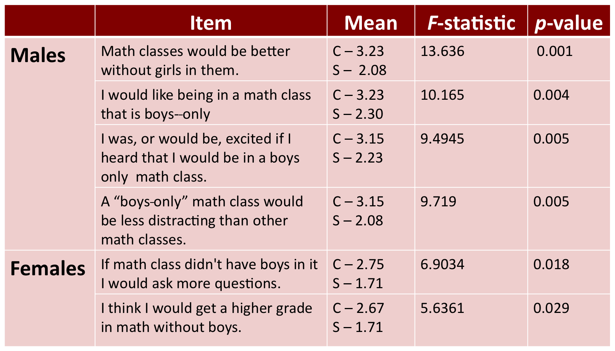
Anica Bowe, Christopher David Desjardins, and Frances Lawrenz
Department of Educational Psychology
University of Minnesota
Attitudes, Experiences, and Instructional Differences in Coed and Single-sex Elementary Math Classes: A Longitudinal Mixed-methods Case Study Approach
Introduction
ANICA’S STUFF HERE
Research Problem
ANICA’S STUFF
Methods
Data was collected through observations, interviews, and surveys administered during the 2008-2009 academic year at two elementary schools in a large urban Midwestern school district.
2 coed, 1 boys-only, and 1 girls-only 6th grade math class participated in this study.
Observations and interviews were coded in NVivo and conceptual models were developed.
The survey consisted of three sections: a section about math class; a section about perceptions/attitudes of math in a boy’s only class; and a section about perceptions/attitudes of math in a girl's only math class.
Differences in item responses by school and sex were explored used ANOVA in R¹.
Results
* 14 students at Single Sex Elementary (14 males and 7 females) and
26 students at Coed Elementary (13 males and 13 females) responded to the survey.
95% of the students at Single Sex Elem speak English at home whereas only 46% speak English at home at Coed Elem.
Students achieve approximately the same mean math grade and had the same median math grade at both schools.
Students at the two schools, collapsed over sex, differed little in their overall attitudes and experiences in math class with the exception that students at Single Sex believed that math would be more important in their future (p = 0.047) and have stronger opinions about wanting a teacher of their sex (p < 0.001).
Table 1: Significant items from the student survey. 1 corresponds to strongly agree & 5 to strongly disagree. C & S correspond to Coed Elementary and Single Sex Elementary.
Discussion
ANICA AND CHRIS STUFF
References
1 - R Development Core Team (2008). R: A language and environment for statistical computing. R Foundation for Statistical Computing, Vienna, Austria. ISBN 3-900051-07-0, URL http://www.R-project.org.
Acknowledgements
Christopher David Desjardins supported by the Interdisciplinary Education Sciences Training Program IES Award # R305C050059 Univ of Minn PRF# 473473 and NSF REC Grant#REC0514884.

