Slide 1
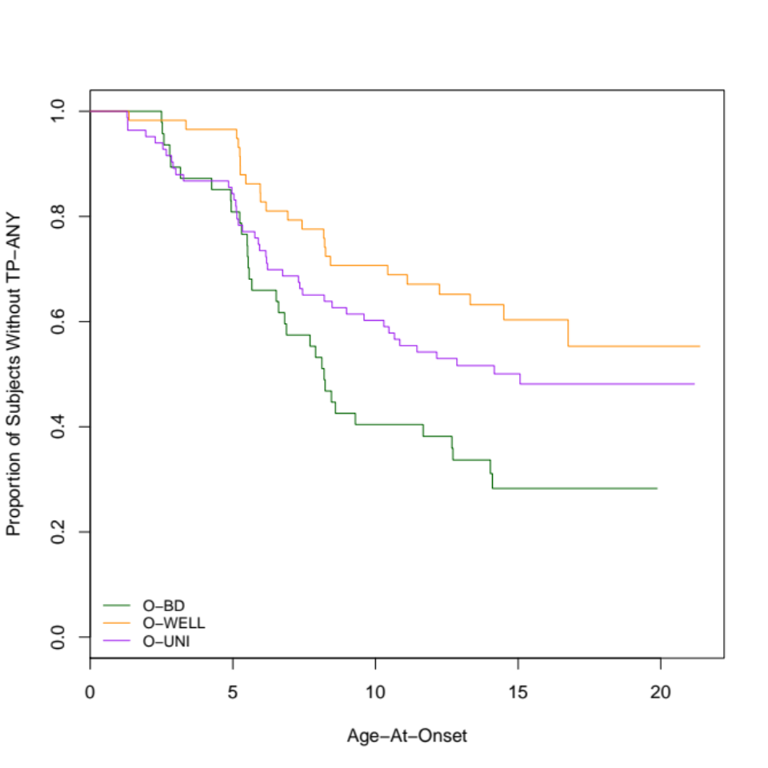
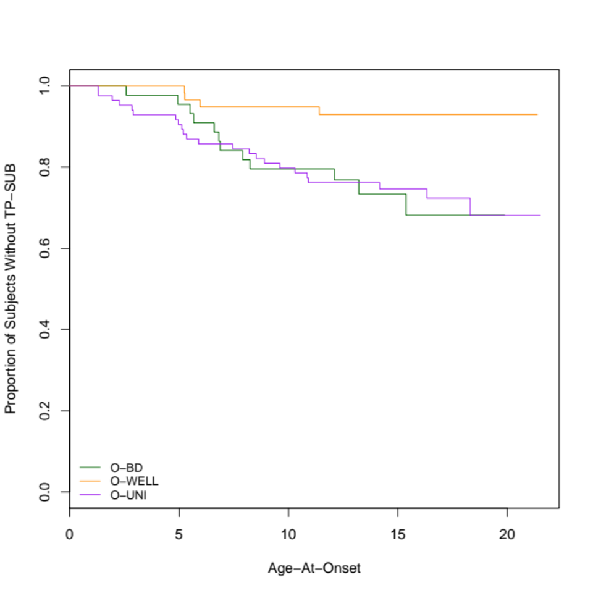
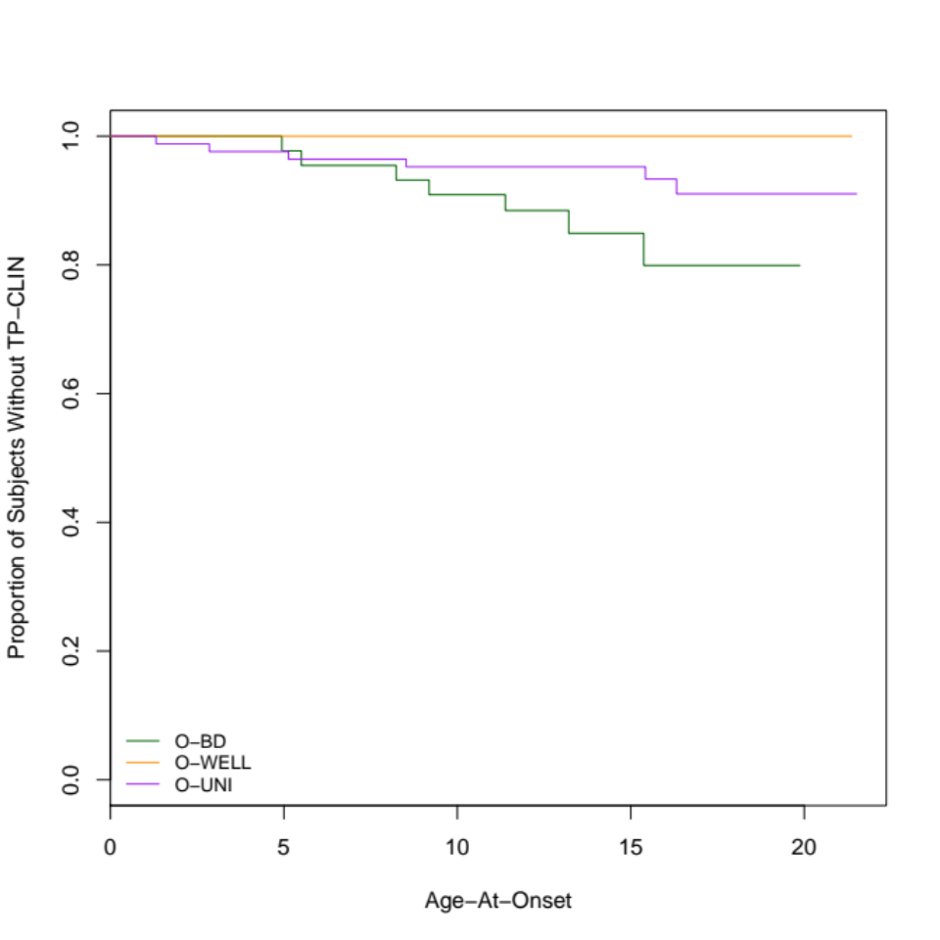
Christopher David Desjardins, Bonnie Klimes-Dougan, Matthew James, Angela Narayan & Jeffrey D. Long
A Multilevel Approach to Identifying Criterion-Related Profile Patterns
Introduction
Bipolar disorder (BD) is a severe, chronic mental illness that is highly familial and heritable.
Among offspring of BD parents (O-BD), about 10% develop BD.
A broad range of other severe developmental outcomes are characteristic of O-BD, including an elevated risk for psychosis and other associated disturbances in reality testing.
Much of the research to date has focused on dimensional assessments of cognitive and behavioral patterns representing disturbances in reality testing.
Infrequent and aberrant patterns of thinking/behavior threaten to disrupt normative development in childhood and adolescence.
Research Problem
The purpose of this poster is to develop and demonstrate a multilevel framework to the profile analysis approach developed in Davison & Davenport (2002). This poster extends this work by illustrating a method that controls for school differences for the level component.
Methods
98 families participated, with an older and a younger sibling participant from most families.
The families were seen at five periods of the offspring’s development from early childhood through young adulthood.
Thought problem subscale of CBCL was used for times 1 – 4 and YASR for time 5.
To examine differences in the onset of thought problems, we fit mixed effects Cox proportional hazard models. We examined time to onset of any (TP-ANY), subclinical (TP-SUB) and clinical levels of (TP-CLIN) thought problems.
We explored to what extent differences in survival rates for TP-ANY, TP-SUB, TP-CLIN could explain the development of psychopathologies at time 5.
Model selection was done with AICC and weight of evidence.
Results
Hazard Analysis
Outcome | Contrast | Parameter Estimate (SE) | z-value | p-value
TP-ANY | O-BD vs. O-WELL | -1.058 (.387) | -2.73 | .0063
 | O-BD vs. O-UNI | -.633 (.346) | -1.83 | .0670
 | Var(Family) | .976
TP-SUB | O-BD vs. O-WELL | -1.473 (.621) | -2.36 | .018
 | O-BD vs. O-UNI | .0244 (.421) | -.06 | .950
 | Var(Family) | .719
TP-CLIN | O-BD vs. BOTH | -1.479 (.572) | -2.58 | .0097
 | Var(Family) | .247
AICC results from T5 Analysis for TP-SUB
Outcome | AICC | ΔAICC with Covariate Present | Weight of Evidence
Bipolar Dx | 66.176 | 1.150 | .361
Thought Problems | 111.731 | -1.664 | .700
Internalizing Problems | 112.489 | -7.893 | .981
Total Problems | 125.499 | -5.378 | .938
GAF | 1041.379 | -44.836 | .999
Outcome refers to YASR; AICC is a sample size adjusted AIC; ΔAICC with covariate present refers to change in model fit with TP-SUB added to an intercept only model (negative is improvement).
Discussion
Differences in hazard rates associated with mother’s diagnosis.
O-BD at highest risk of TP-ANY and likely TP-SUB and TP-CLIN.
Presence of TP-SUB (and TP-ANY and TP-CLIN, not presented) during development predictive of adult psychopathologies.
See manuscript for further details.¹
References
¹Klimes-Dougan, B. Desjardins, C. D., James, M. G., Narayan, A. J., Long, J. D., Cullen, K. R., Gold, P. W., & Martinez, P. P. (Under Review). The Development of Thought Problems: A Family Risk Study of Offspring of Bipolar Parents. Submitted to Journal of the American Academy of Child and Adolescent Psychiatry.
Acknowledgements
Christopher David Desjardins supported by the Interdisciplinary Education Sciences Training Program IES Award # R305C050059 Univ of Minn PRF# 473473 and NSF REC Grant#REC0514884.

