Slide 1


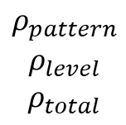
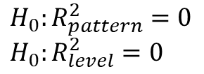
Hypothesis Testing with Profile Analysis
Extensions of Profile Analysis
One sample
Across k groups
Criterion Related
Profile Reliability
Multi
dimensional Scaling
Factor Model
$$ρ_{pattern}$$
$$ρ_{level}$$
$$ρ_{total}$$
$$H_{0}: μ=μ_{0}$$
$$H_{0}:μ_{1}=μ_{2}=…=μ_{k}$$
$$H_{0}:R_{pattern}^{2}=0$$
$$H_{0}:R_{level}^{2}=0$$
Latent Profiles
Dimensionality
Within-Person
Random Intercept
paos()
print()
pbg()
print()
summary()
cpa()
print()
summary()
plot()
pr()
print()
pams()
print()
wprifm()
print()
summary()
coef()

