Slide 1
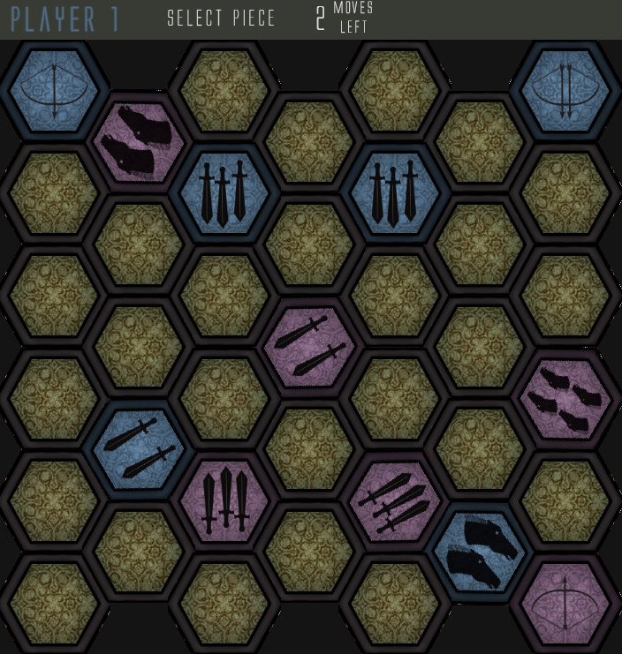
Gaveldor 2.0

Slide 2
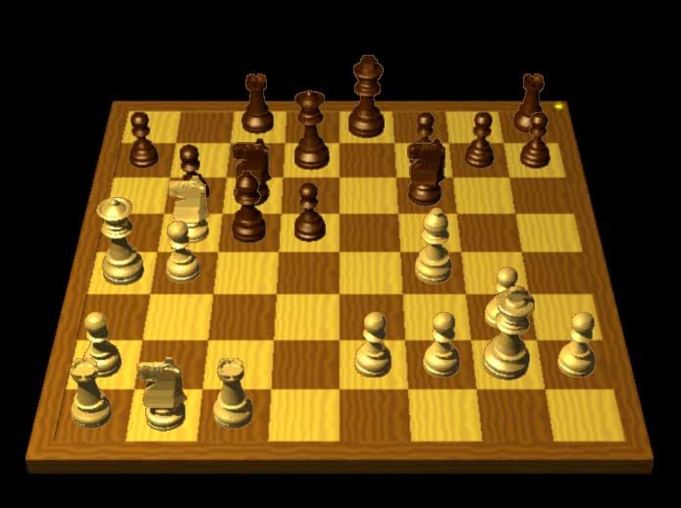
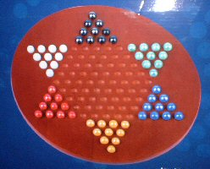
Traditional
Traditional board game
Feels limiting
Pure strategy

Slide 3
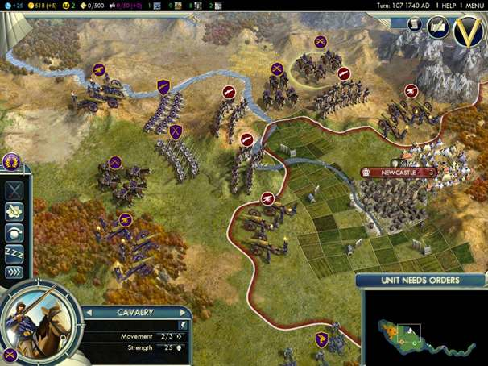
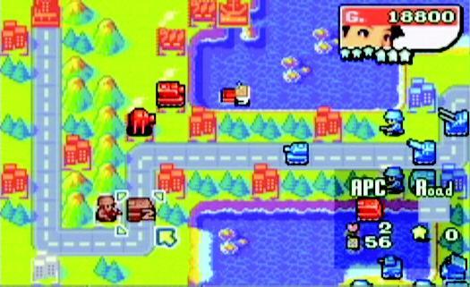
World of Infinite
Virtual world not limited
More realistic art
Feel less constrained

Slide 4
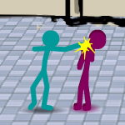
Action Break
Gives break from total strategy
Gives less experienced player a chance
More like true warfare, anything can happen

Slide 5
Responsibility Breakdown
Producers
Programmers
Artist
Sound Designers
Game Designers

Slide 6
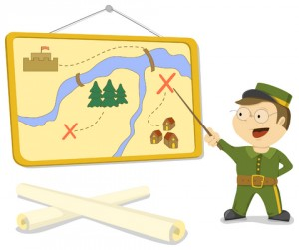
Plan of attack
Re-implement Gaveldor 1.0
Set up simple networking option
Get working action game
Experiment with win conditions
Implement Terrain, new units, risks

