Slide 1
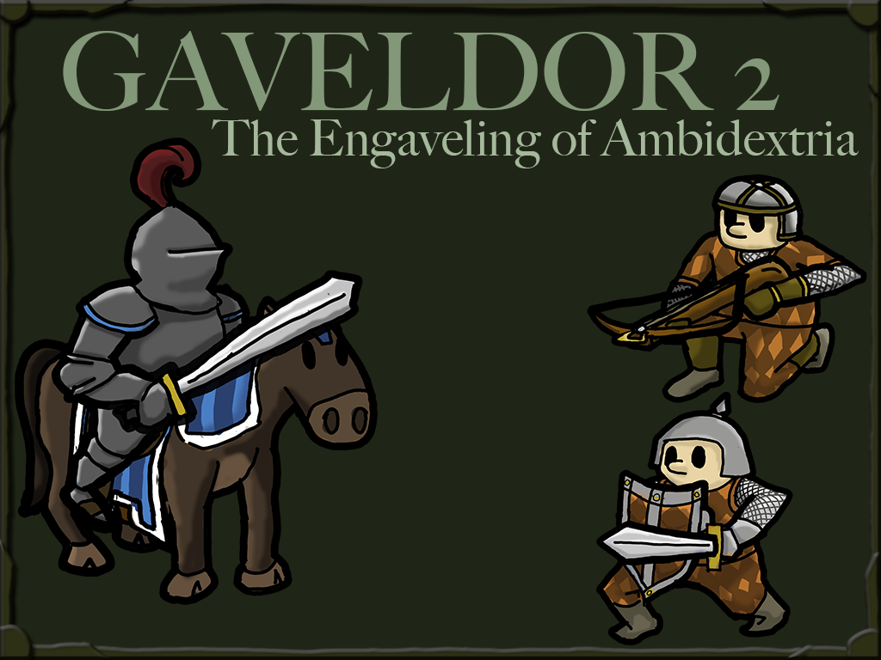

Slide 2
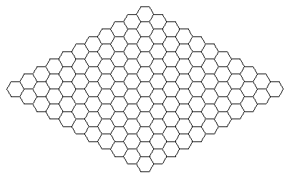
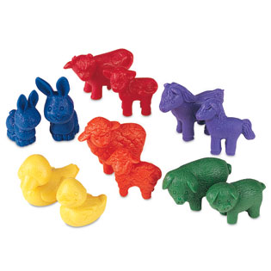
The Beginnings
Turn based tower warfare
Lane’s idea and the first game
Scaling back

Slide 3
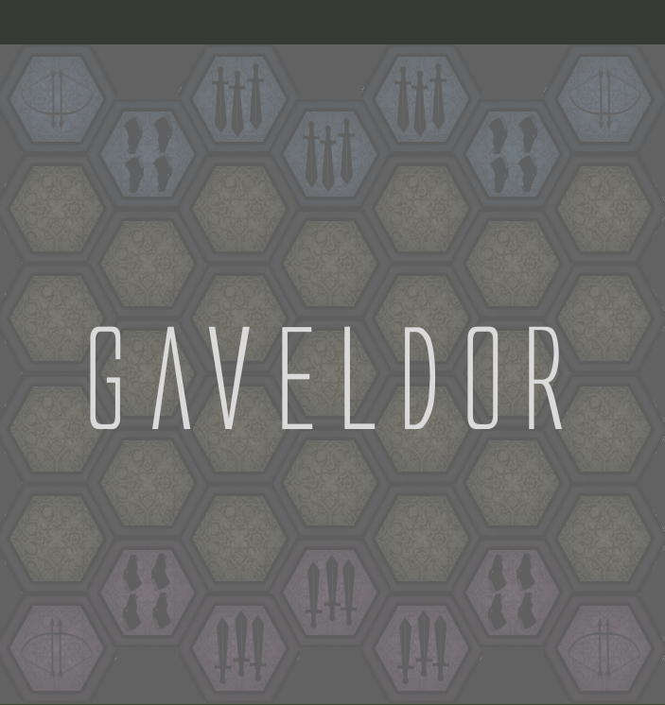
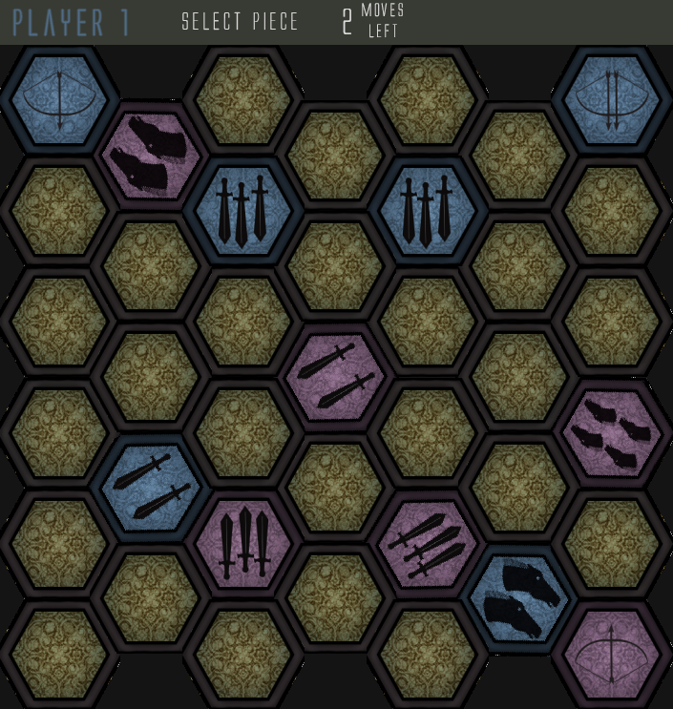
The Birth of Gaveldor
Are You Tough Enough To Conquer?

Slide 4

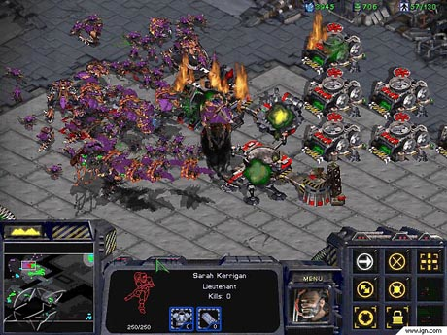

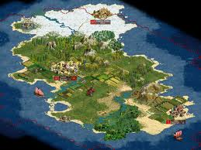
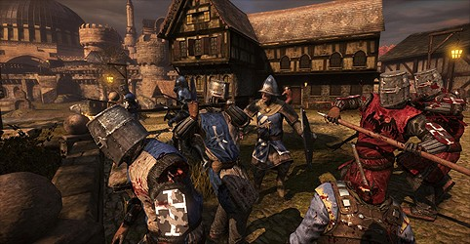
Gaveldor 2: The idea
Take the original and make it more
Better graphics
More units
Terrain
Different gameplay
Networking
AI

Slide 5
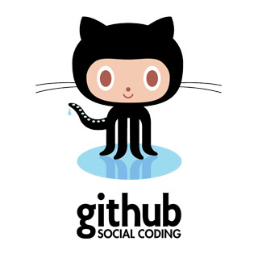
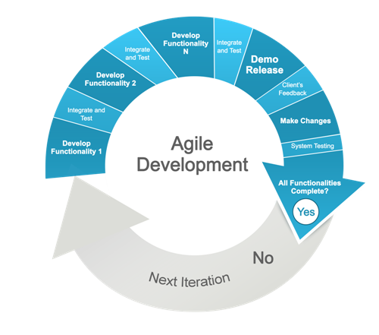
The Plan
Well organized
Tasks split up by skill
6 week plan

Slide 6

Scaling Back
New units
Simpler minigame
Map-based gameplay options

Slide 7
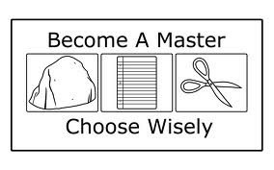
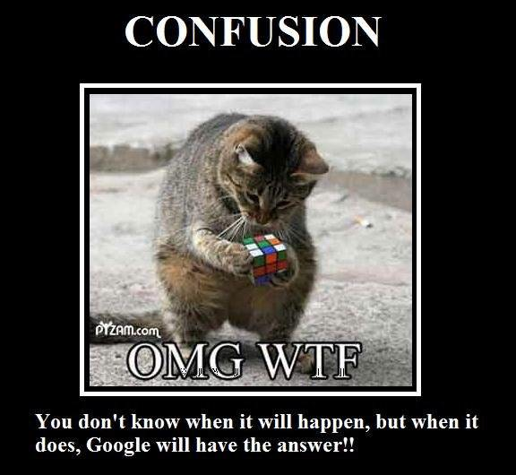
The Dreaded Minigame
Networking requirements
Playtester’s surprise
Separation from flow of game

Slide 8
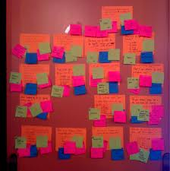
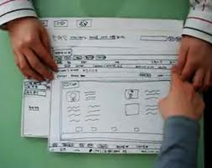
Hind Sight
Earlier playtesting
More use of paper prototype
Playing around with constants
Kept organization, very well done

