Slide 1
IoT Bluemix Tutorial
Christian Decker, HHZ, Reutlingen University
Sebastian Mantsch, MHP

Slide 2
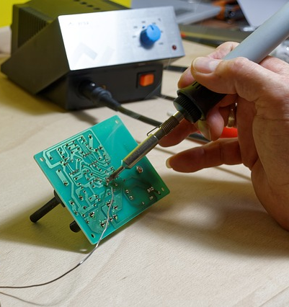
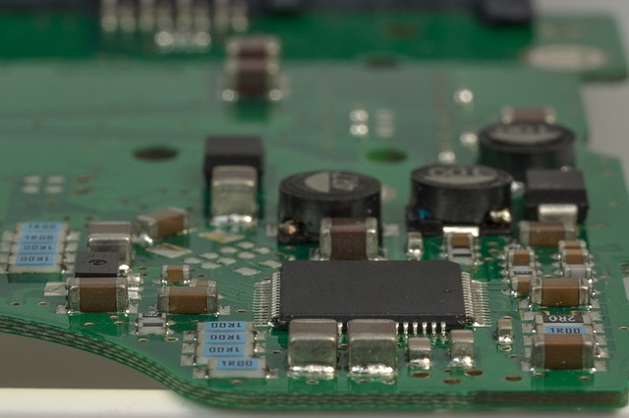
Rapid IoT Application Development
… in the past
Source: Werbefarbik, blickpixel, pixabay.com

Slide 3

Rapid IoT Application Development
It felt like …
Source: WikiImages, pixabay.com

Slide 4


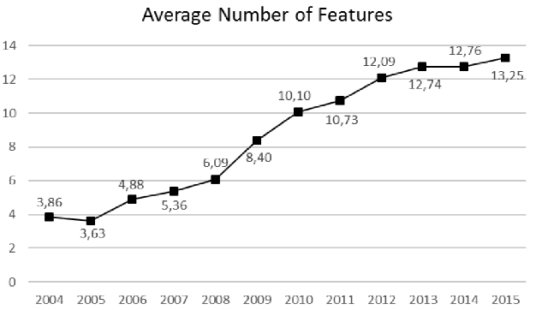
Rapid IoT Application Development
COTS technology, e.g. mobile phones with increasing number of sensors
Today…
Source: Geisse et al., A survey on smartphone features relevant for reality mining. Digital Enterprise Computing (DEC 2016) P-258, 107-116 (2016)

Slide 5
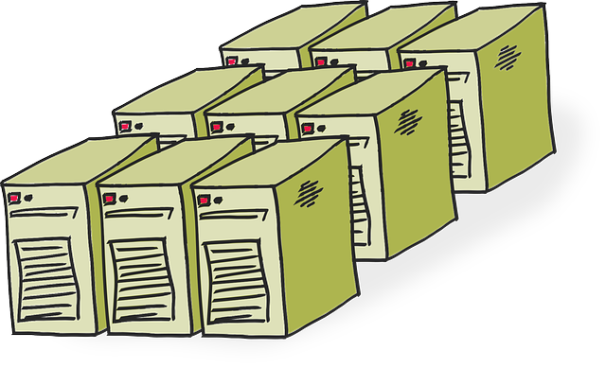
Rapid IoT Application Development
Powerful cloud-based backend systems
Today…
Source: OpenClipart-Vectors, pixabay.com

Slide 6

This Tutorial
… will facilitate IoT research using standard sensor technology and a powerful backend.
+
COTS sensor technology
Cloud-based IoT Platform

Slide 7
Agenda
Preparations
IoT Platforms
MQTT
Bluemix Introduction
Example Applications

Slide 8
Material
Hosted on Github repository
https://bit.ly/iotbluemix

Slide 9

Before we start…
Get your trial account
Go to github repository
https://bit.ly/iotbluemix
Deploy example apps in Bluemix
Phone Sensor Repository
NodeRED Repository
Enter account credentials when required

Slide 10
IoT Platforms
General Architecture

Slide 11
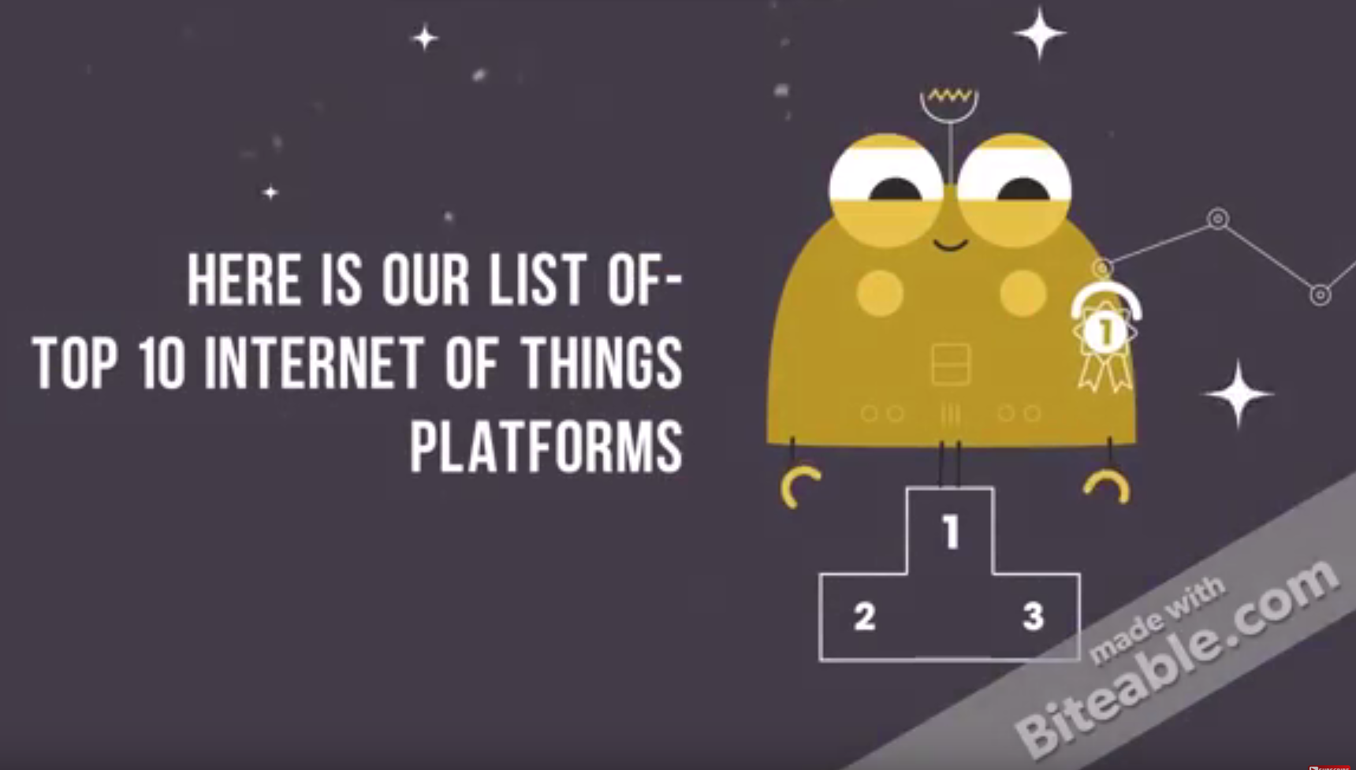
Everybody has one…They are everywhere
Amazon, Microsoft, IBM, Oracle, …
It is estimated, that there are 100+ platforms out there.
Lists are always incomplete…
Source: http://internetofthingswiki.com/top-10-iot-platforms/634/

Slide 12
IoT Platforms – Core Functions
Device Management
Device connection and integration, infrastructure operations
Devices become abstract things; accessible for other systems
Business Rules
Management and operation of business logic for event handling
Process Engine
Defines logical process steps of an application
Data Service Integration
Integration of external services for IoT application, e.g. REST based web services

Slide 13


How do IoT Platforms work?
They run in a cloud environment.
They virtualize a real-world IoT environment.

Slide 14





IoT Service and Virtual Entity Abstraction
Example Interactions
Physical World
IoT System
Virtual entity-based model models relevant
aspects of Physical World
Give me the
indoor
temperature in
Room 1.23
Virtual Entity
Level
Set light level
In Room 2.57
to 15
Association of IoT Services
to modelled Virtual Entities
Give me the
value of Temperature
Sensor 456
Resources exposed as IoT Services measure,
observe and
actuate on
Physical World
sensor
sensor
sensor
sensor
actuator
IoT Service
Level
Set Actuator 867
To “on”
Source: EU FP7 Projekt „IoT-A: Internet of Things Architecture“, Slides by Carsten Magerkurth (SAP), April 2013

Slide 15
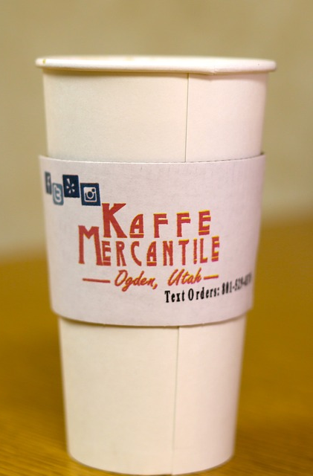
IoT Platforms
Cloud-based middleware betw. IoT devices and applications
Virtualize the real world by realizing an entity abstractions.
Take away
Core functions
Device management
Business Rules
Process Engine
Data Service Integration
Source: jp26jp, pixabay.com
Other functions
Analytics, Big Data Processing
Credentials, tenant management
UI Designer, Mashup Builder
Purpose
Design, build and execute IoT applications
Designer / Composer / IDE for application designs, partially codeless

Slide 16
Connecting Devices using MQTT

Slide 17
MQTT Message Queue Telemetry Transport
Said to be THE IoT protocol
Lightweight messaging protocol on top of TCP/IP
Interesting features
Pub / Sub communication model
Implemtations for all kind of (embedded) devices and lots of programming languages available
Supported by basically every IoT plattform

Slide 18
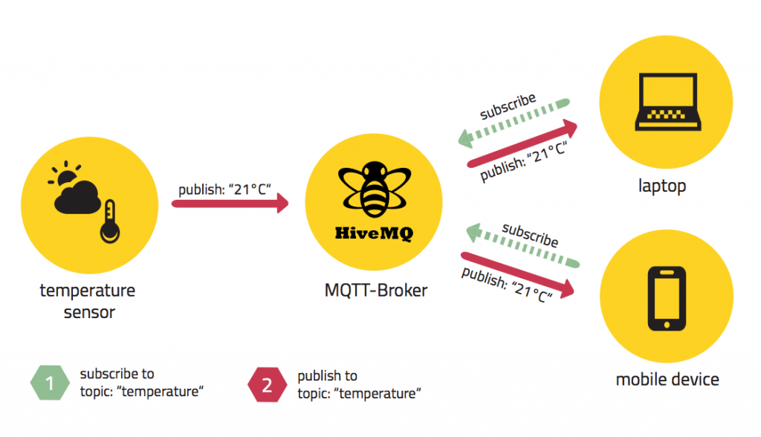
Pub / Sub Communication
Source: http://www.hivemq.com/blog/mqtt-essentials-part2-publish-subscribe

Slide 19

Topic Specification and Filtering
A topic specifies a message queue
A client subscribed to a topic receives all messages from this queue
Source: http://www.hivemq.com/blog/mqtt-essentials-part-5-mqtt-topics-best-practices

Slide 20

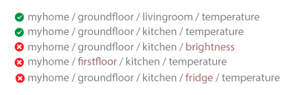
Topic Specification and Filtering
Single level specification will match to all messages from …
Source: http://www.hivemq.com/blog/mqtt-essentials-part-5-mqtt-topics-best-practices

Slide 21

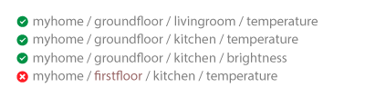
Topic Specification and Filtering
Multi-level specification will match all messages from …
Source: http://www.hivemq.com/blog/mqtt-essentials-part-5-mqtt-topics-best-practices

Slide 22
Bluemix Intro

Slide 23







Application Landscape
Dashboard
IoTBluemixTutorialNode
IoTBluemixTutorialPhone
iot-cloudant-cloudantNoSQLDB
iot-iotf-service
Services
Multiple instances of a cloud foundry application
Different applications may point to same services

Slide 24
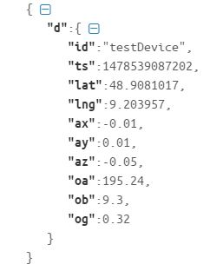
Bluemix MQTT Topic Specification
Always starts with iot-2
iot-2/type/<type-id>/id/<device-id>/evt/ <event-id>/fmt/<format-id>
Example
iot-2/type/iotphone/id/ testDevice/evt/sensorData/fmt/json
any
any
MQTT sample data payload

Slide 25
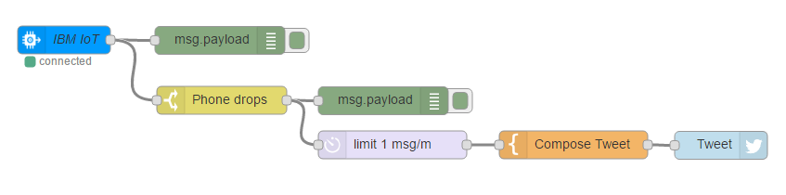
Node-RED
Node-RED is a node.js based tool for wiring together hardware devices, APIs and online services in new and interesting ways.
Node-RED home: https://nodered.org
Bluemix utilizes Node-RED as rapid development tool

Slide 26
Example Applications

Slide 27
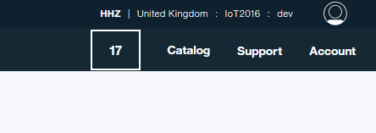
Login
Use URL to login in EU / UK Zone
https://console.eu-gb.bluemix.net/

Slide 28
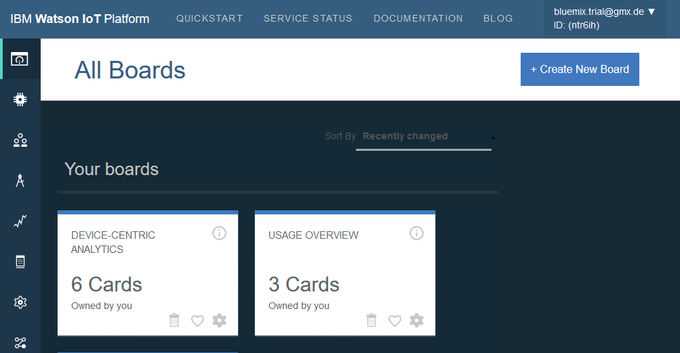

Bluemix Phone App Acquire Data and Display
Login into Bluemix, copy URL (w/o https), …
Access URL and choose device ID
Sensor data
Using MQTT over websockets

Slide 29
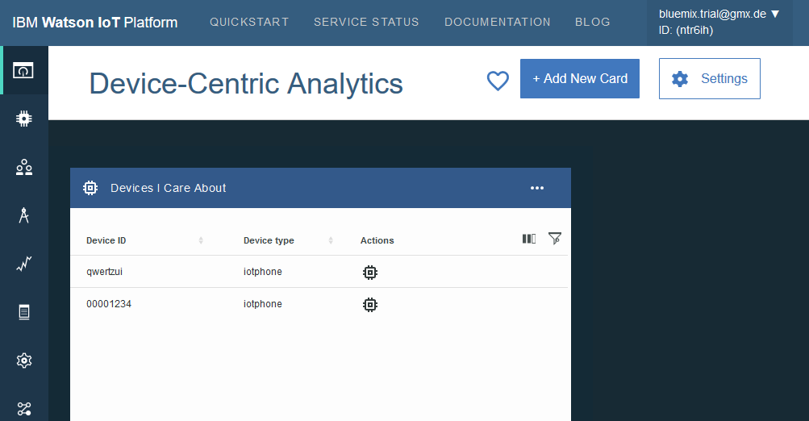
Device Centric Analytics Working with Data

Slide 30
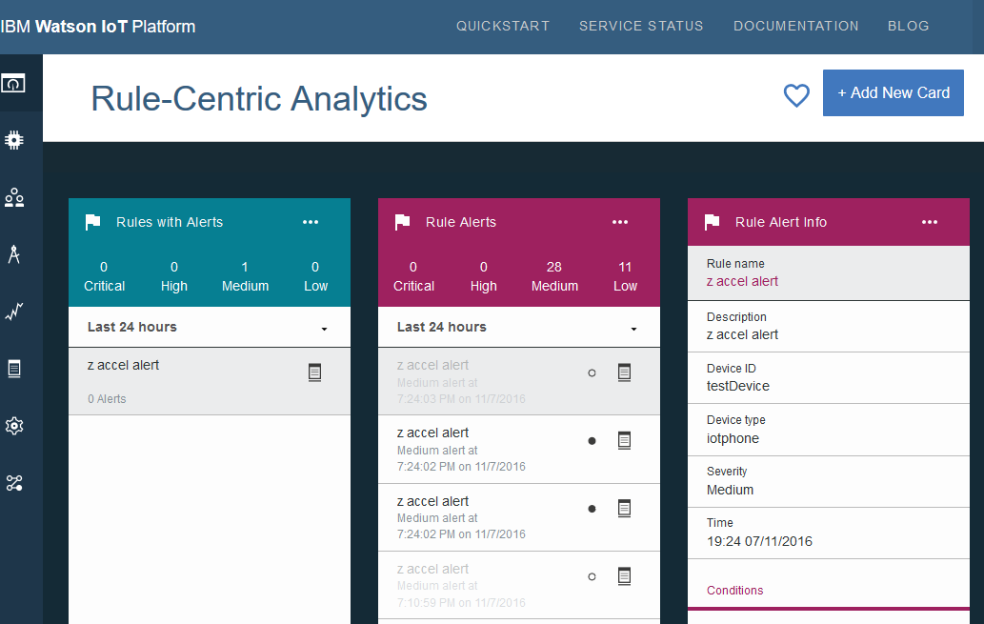
Rule Centric Analytics Alerts using Data

Slide 31
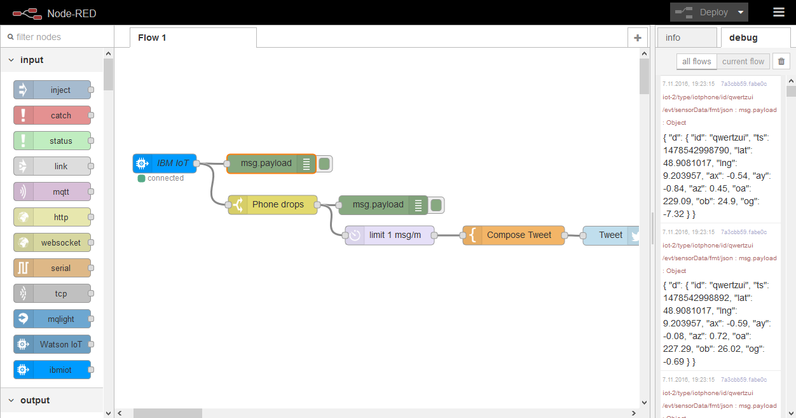
Node-RED App
Bluemix uses Node-RED as visual composer for rapid application development
More possibilities to work, analyze, store IoT data
Connect with external (REST based) data services, e.g. Twitter

Slide 32
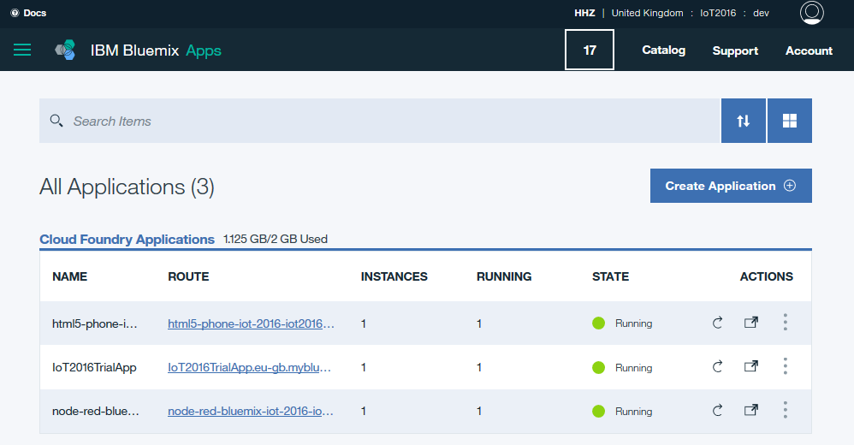
Access Node-RED App from Dashboard

Slide 33
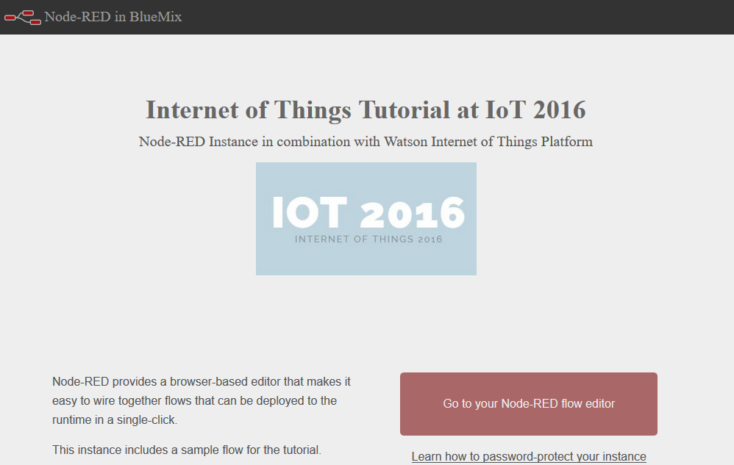
Launch Node-RED App

