Slide 1
GREEN PLATFORM
Purpose : develop an app to aggregate ecofriendly products in Hong Kong with cool user experience
Revenue : Advertisement, Services for shops

Slide 2







Architecture
Scrap once a day: Python Scrapy / Lambda function
Database
Return products
/category
/best
/new
/search
App : React Native

Slide 3
Database
Cart
ID
userID
productID
Date
Category
ID
Name
Products
ID
categoryID
Name
Short Description
Description
Image
Price
isNew
isBest
User
ID
Name
Phone N°
Country
Mail
Shops
ID
Name
Website
Address
Country
FavouriteProducts
userID
productID
FavouriteShops
userID
shopID

Slide 4
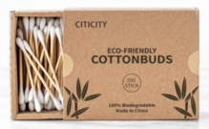

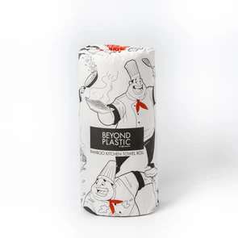



GP
APP | MAIN
Search
Home
Best
New
Advertisement
For you
$30
$50
$12
Cotton Buds
Incense
Towel Roll
Categories
$30
$30
Cotton Buds
Cotton Buds
GP

Slide 5
GP
APP | BEST (Deals)
Search
Home
Best
New
$30
$30
Cotton Buds
Cotton Buds
$30
$30
Cotton Buds
Cotton Buds
GP

Slide 6
GP
APP | NEW
Search
Home
Best
New
$30
$30
Cotton Buds
Cotton Buds
$30
$30
Cotton Buds
Cotton Buds
GP

Slide 7

APP | SHOPS
Search
rankings
favourites
Filter
1 Shop1
2 Shop2
3 Shop3
GP

Slide 8
APP |CATEGORIES
Search
Free Del.
Body
Food
Other
$30
$30
Cotton Buds
Cotton Buds
$30
$30
Cotton Buds
Cotton Buds
GP

Slide 9
APP | FAVOURITES
Search
$30
$30
Cotton Buds
Cotton Buds
$30
$30
Cotton Buds
Cotton Buds
GP

Slide 10
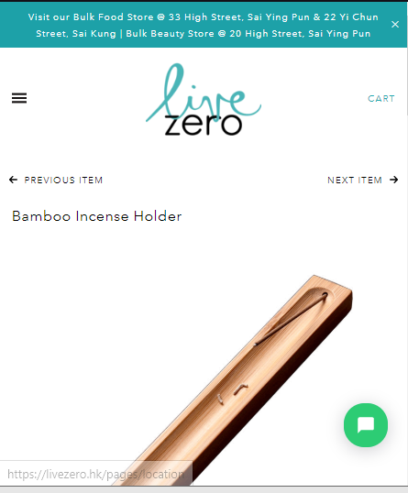
Clicked item
Shop1
Shop1
Description
Reviews (3)
HKD 50
Cart
Reviews (3)
HKD 50

Slide 11
Cart
APP | Cart
V
Select All
Shop 1
V
Cotton Buds
HKD 50
1
Shop 2
V
Cotton Buds
HKD 50
1
HKD 50

