Slide 1
Intro
CONFIDENTIAL | © 2019 EPAM Systems, Inc.

Slide 2
Git
Git is distributed version control system for tracking changes in source code during software development.
CONFIDENTIAL | © 2019 EPAM Systems, Inc.

Slide 3
Why git?
Easy file recovery.
It helps us to find the history of the changes created along with the information of the person who created it.
It can roll back to the previous working state.
Almost everything is local and after the final changes, we can push it to the remote server.
Git creates snapshots to track files. Taking a snapshot basically means recording your files at any given point of time.
CONFIDENTIAL | © 2019 EPAM Systems, Inc.

Slide 4
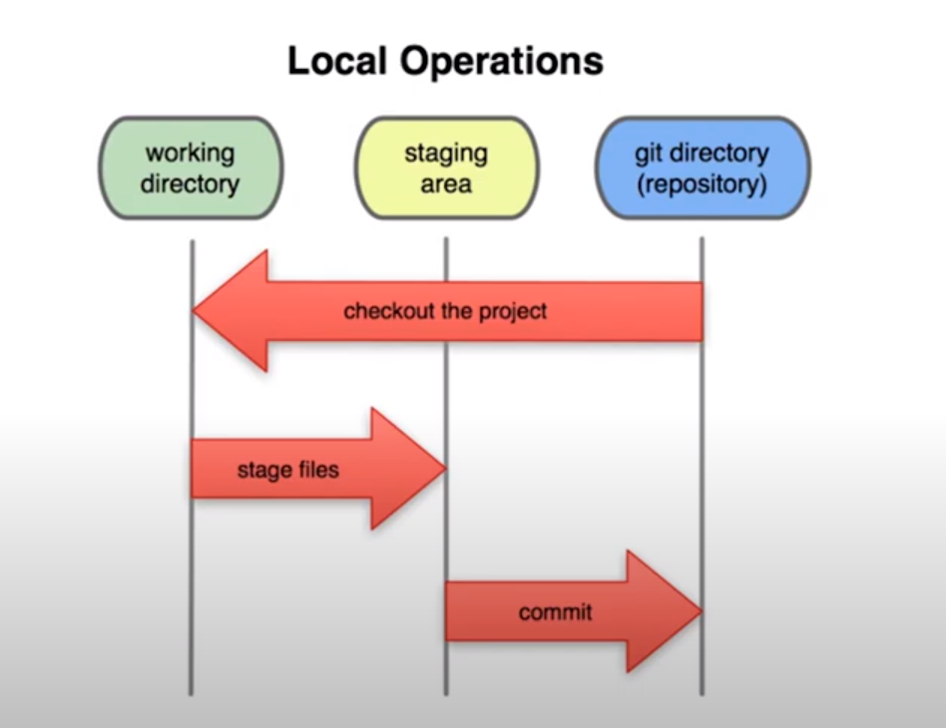
Common flow
CONFIDENTIAL | © 2019 EPAM Systems, Inc.

Slide 5
Python modules
module: any .py file. Its name is the file name.
built-in module: a “module” (written in C) that is compiled into the Python interpreter, and therefore does not have a .py file.
package: any folder containing a file named __init__.py in it. Its name is the name of the folder.
namespace package (in Python 3.3 and above): any folder without a __init__.py file
CONFIDENTIAL | © 2019 EPAM Systems, Inc.

Slide 6
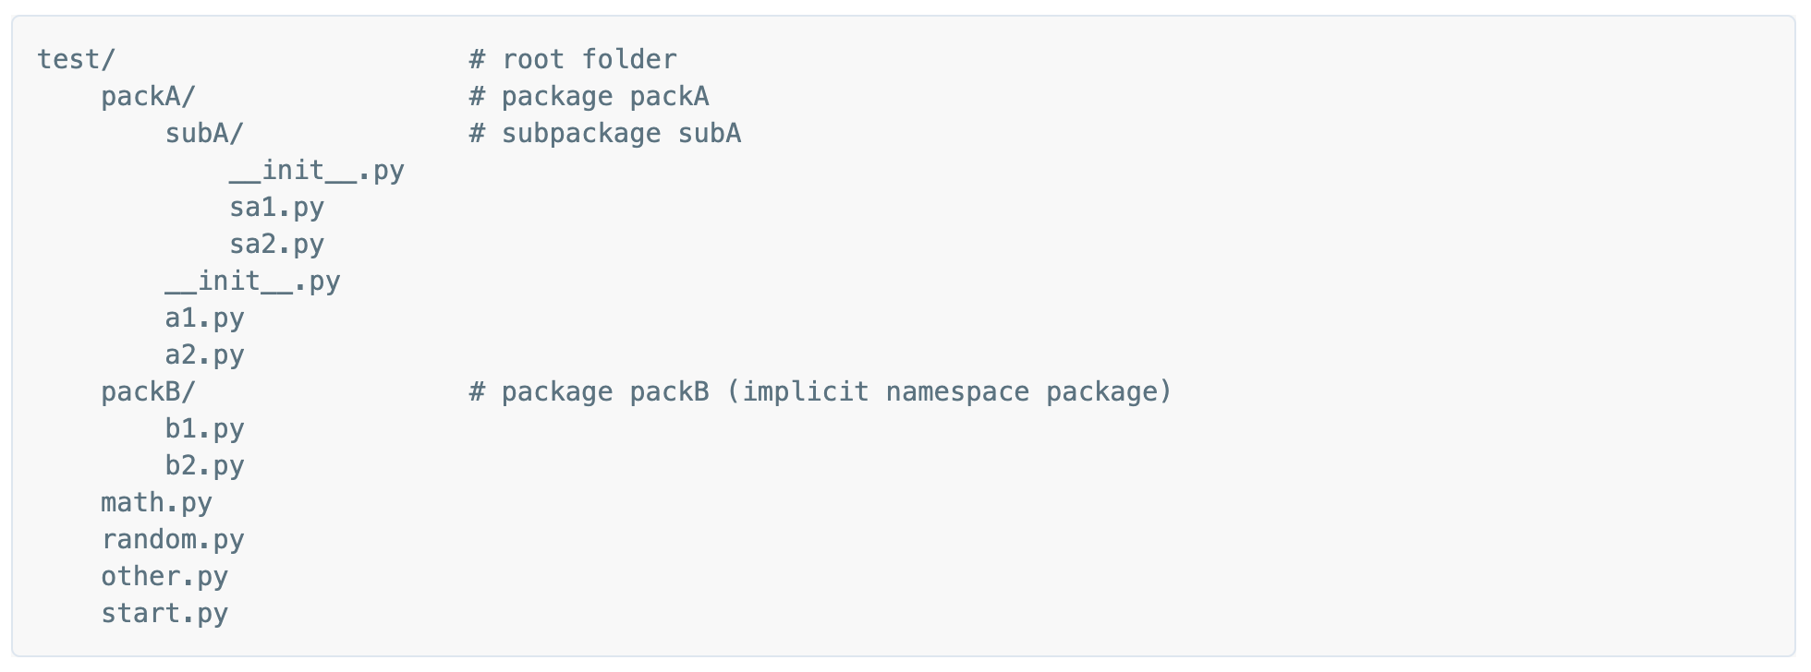
Python imports
import statements search through the list of paths in sys.path
sys.path always includes the path of the script invoked on the command line and is agnostic to the working directory on the command line
importing a package is conceptually the same as importing that package’s __init__.py file
CONFIDENTIAL | © 2019 EPAM Systems, Inc.

Slide 7
Python tests
pytest implements the following standard test discovery:
If no arguments are specified then collection starts from testpaths (if configured) or the current directory.
Recurse into directories, unless they match norecursedirs.
In those directories, search for test_*.py or _test.py files, imported by their test package name.
From those files, collect test items:
test prefixed test functions or methods outside of class
test prefixed test functions or methods inside Test prefixed test classes (without an __init__ method)
CONFIDENTIAL | © 2019 EPAM Systems, Inc.

Slide 8
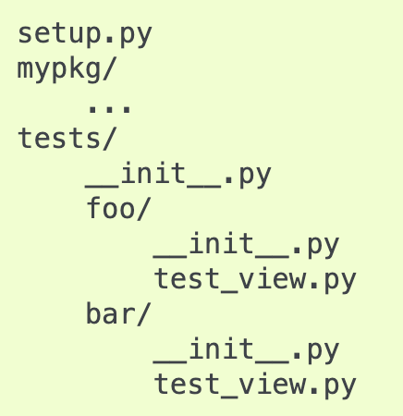
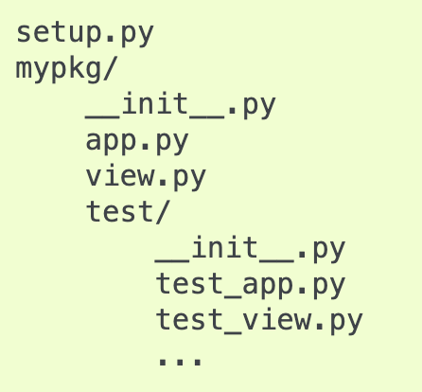
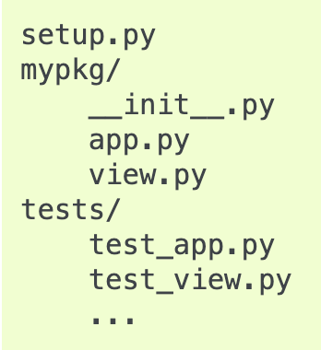
Python tests
Outside application code
Part of application code
CONFIDENTIAL | © 2019 EPAM Systems, Inc.

