Slide 1
EIT x Soft Robots: project update
Week of Monday 22/03/2021

Slide 2
Work accomplished this past week:
Complete online training courses
Produce EIT images of simple finger model

Slide 3
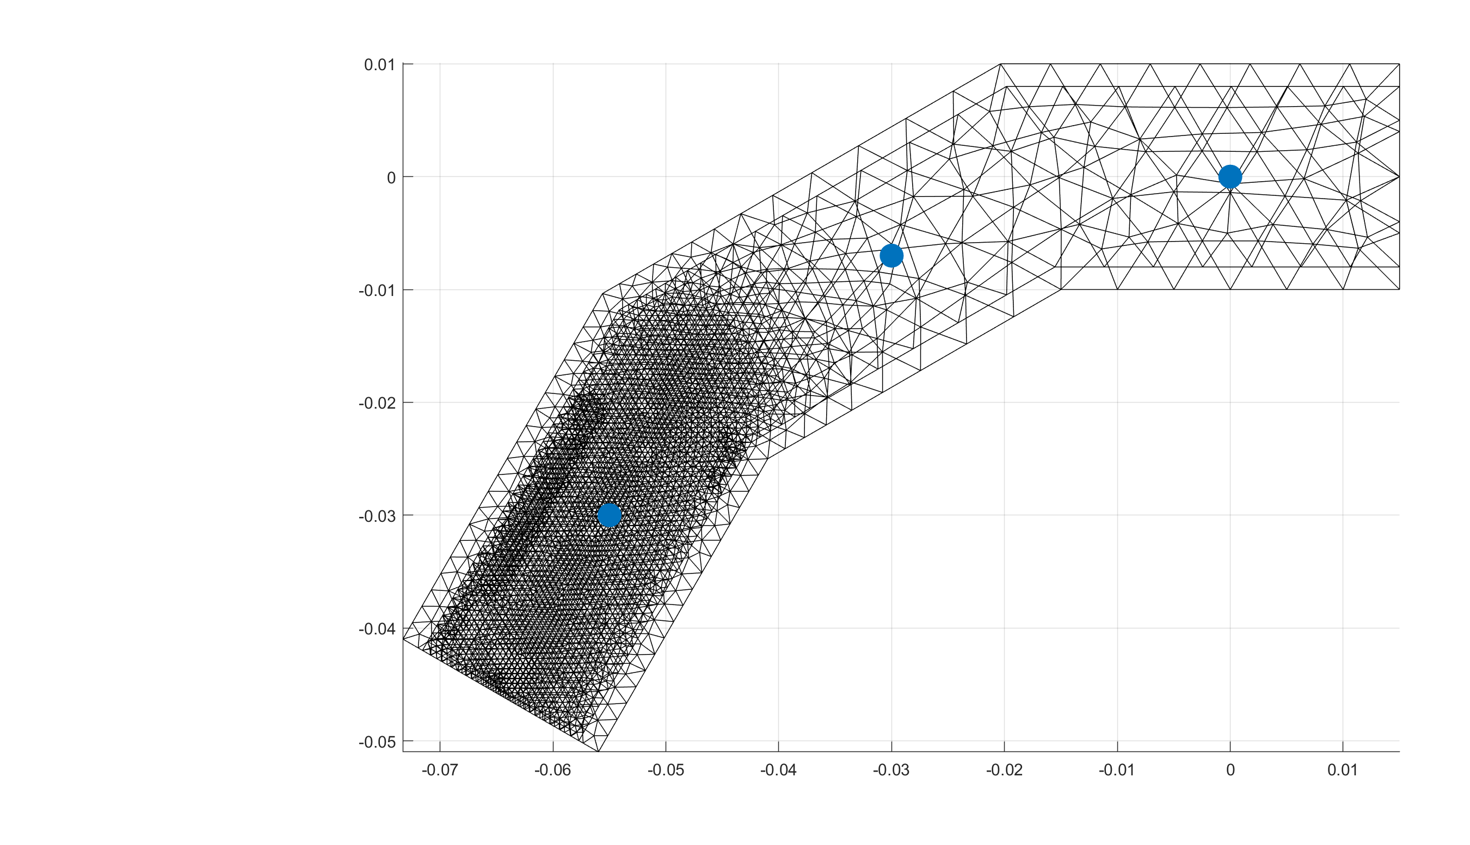
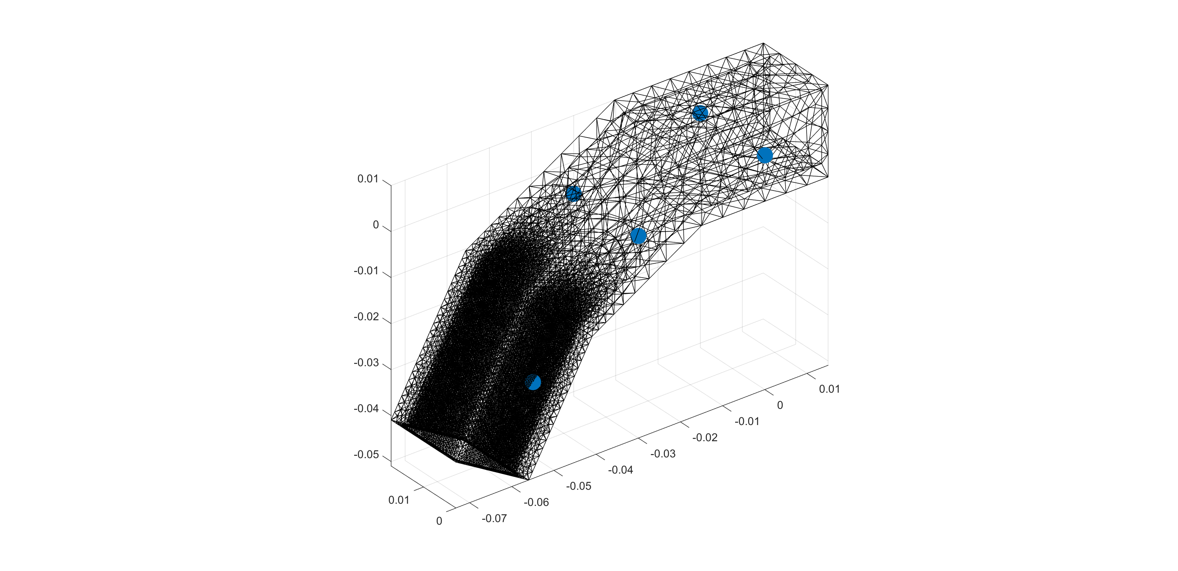
Finger mesh with electrode locations
6 electrodes
Lengths are in meters

Slide 4
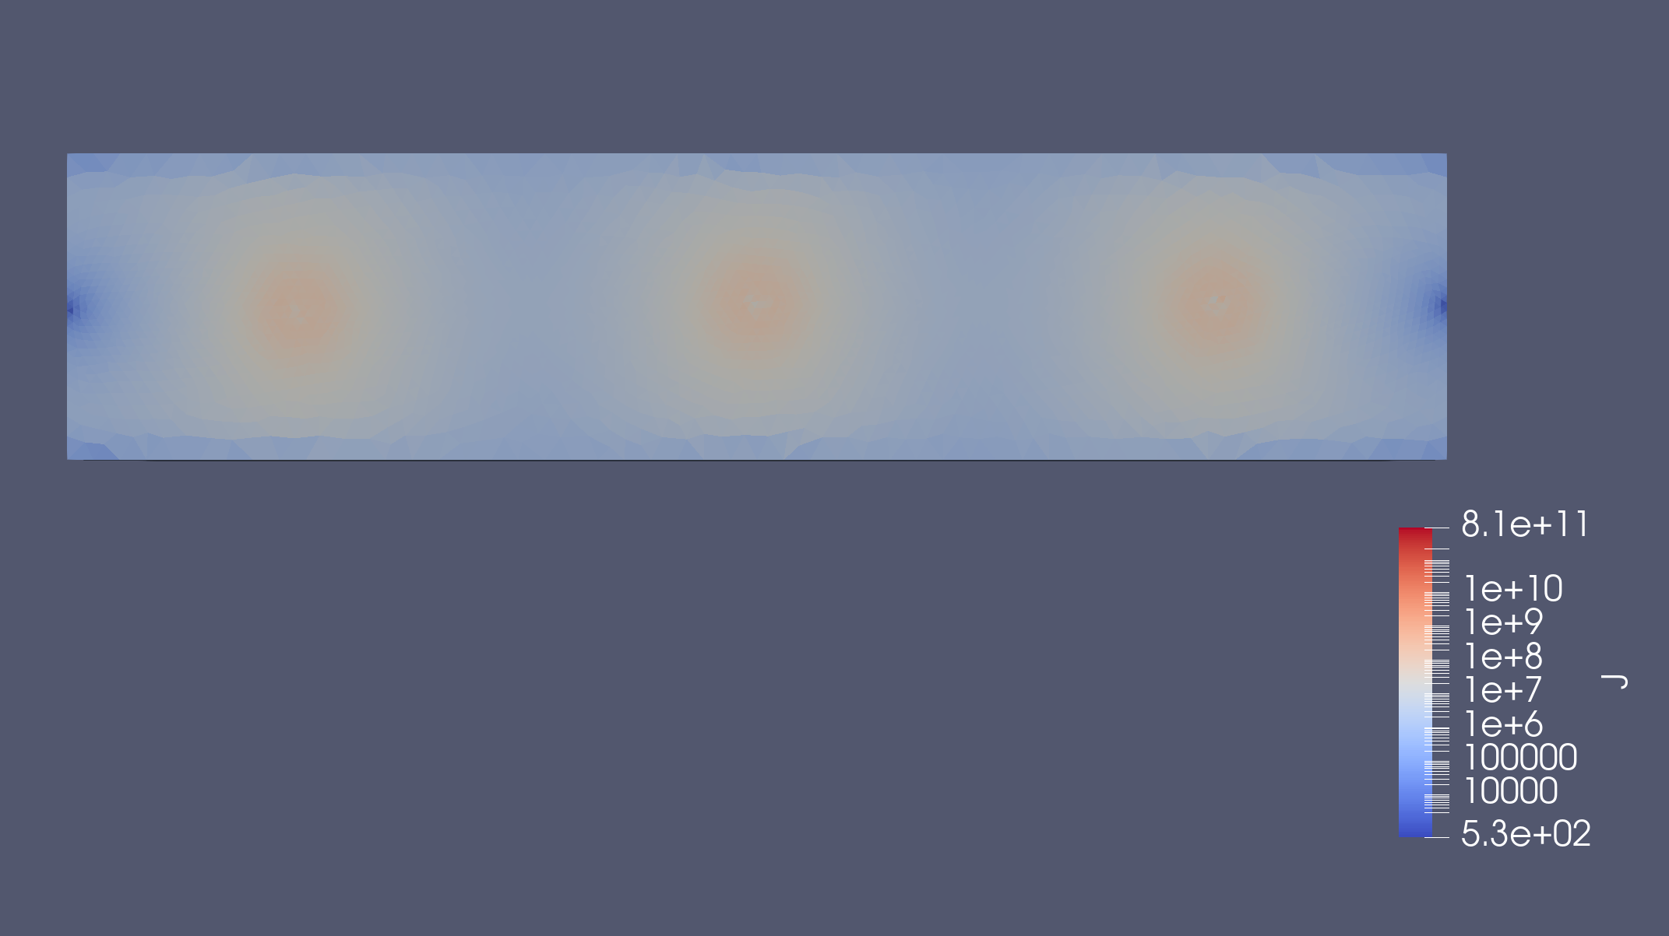
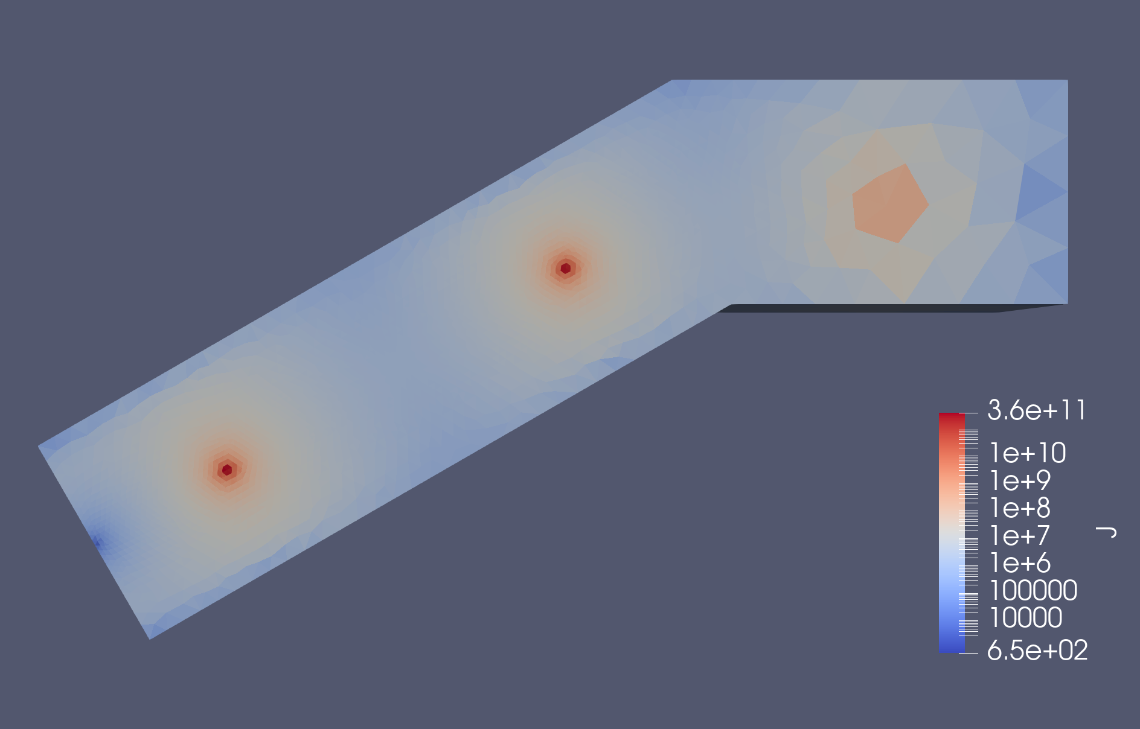
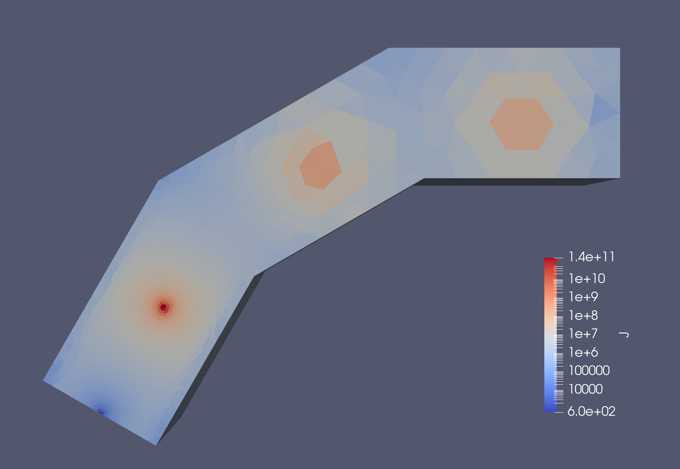
No bend
1 bend
Visualized with ParaView
Log scale
6 electrodes
2 bends

Slide 5
To do for this upcoming week:
Refine EIDORS simulation
Begin fabricating a simple actuator
Revise literature review

