Slide 1
EIT x Soft Robots: project update
Week of Monday 24/05/2021

Slide 2
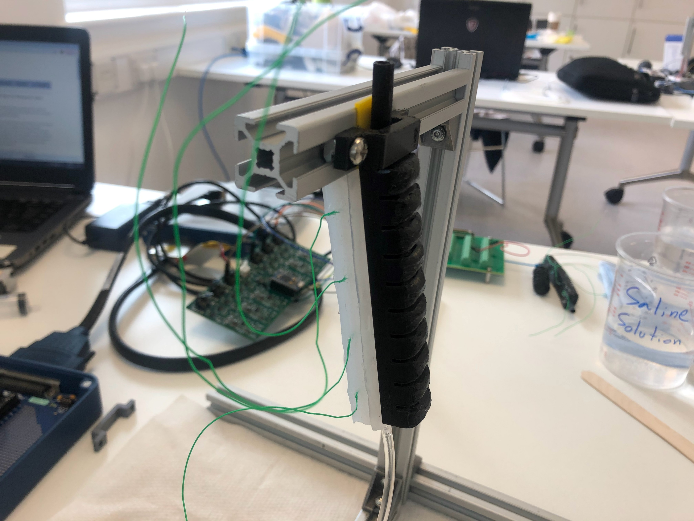
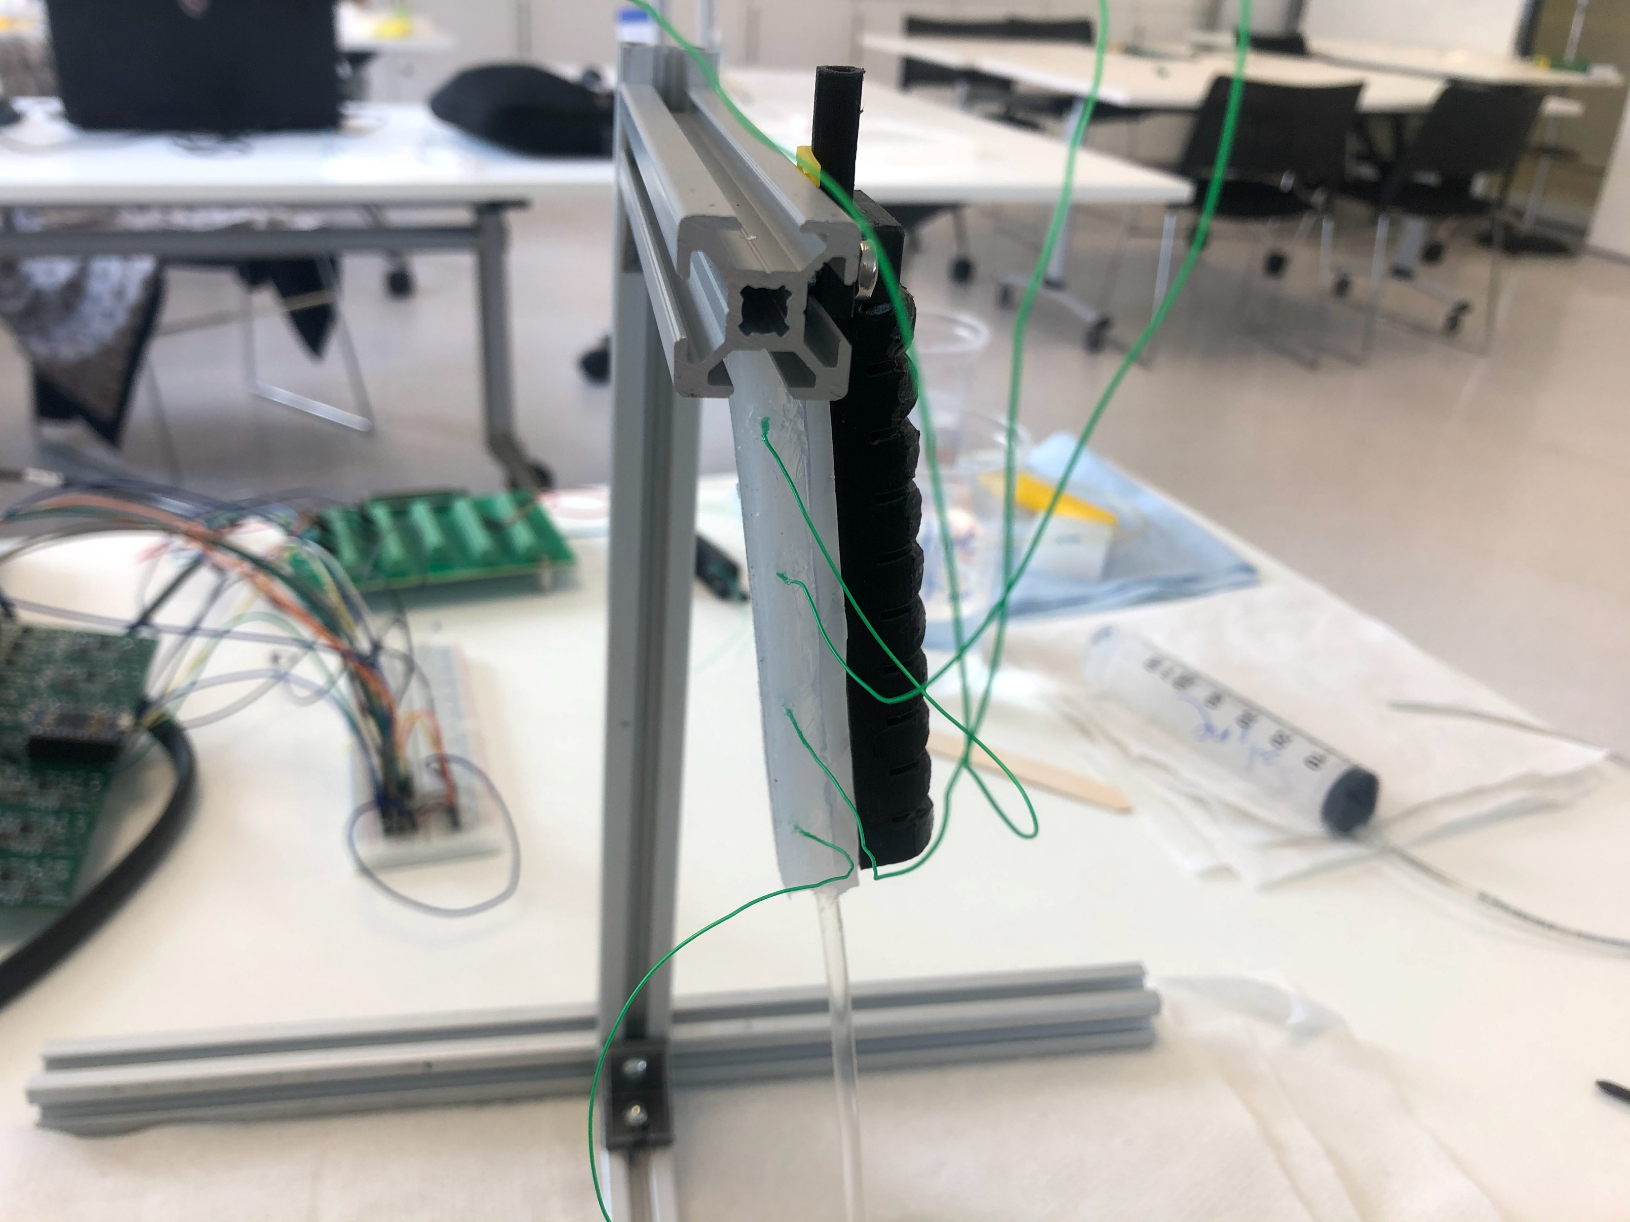
Actuator with anterior EIT chamber
Silicone layer to affix EIT chamber to actuator surface

Slide 3
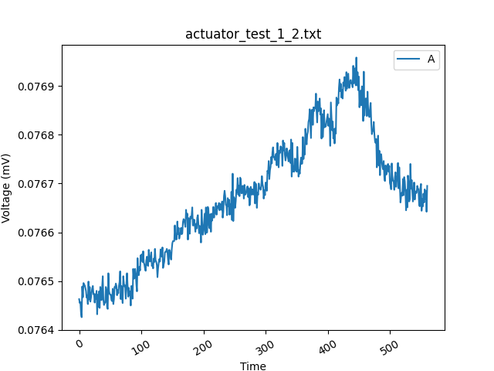
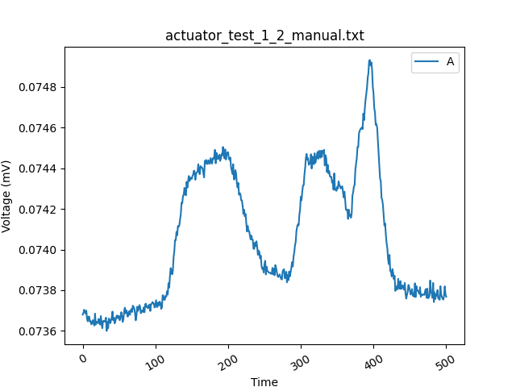
Actuator with anterior EIT chamber
Noise?
Actuated, but not enough change to see difference
Actuated to 22.5°
Actuated to 22.5°
Voltage reading over a 60ml pneumatic actuation (10ml at a time, ~1-2s per 10ml)

Slide 4
New idea: SDM actuator with EIT chamber
Noise?
Voltage reading over a 60ml pneumatic actuation (10ml at a time, ~1-2s per 10ml)

