Slide 1
EIT x Soft Robots: project update
Week of Monday 14/06/2021

Slide 2
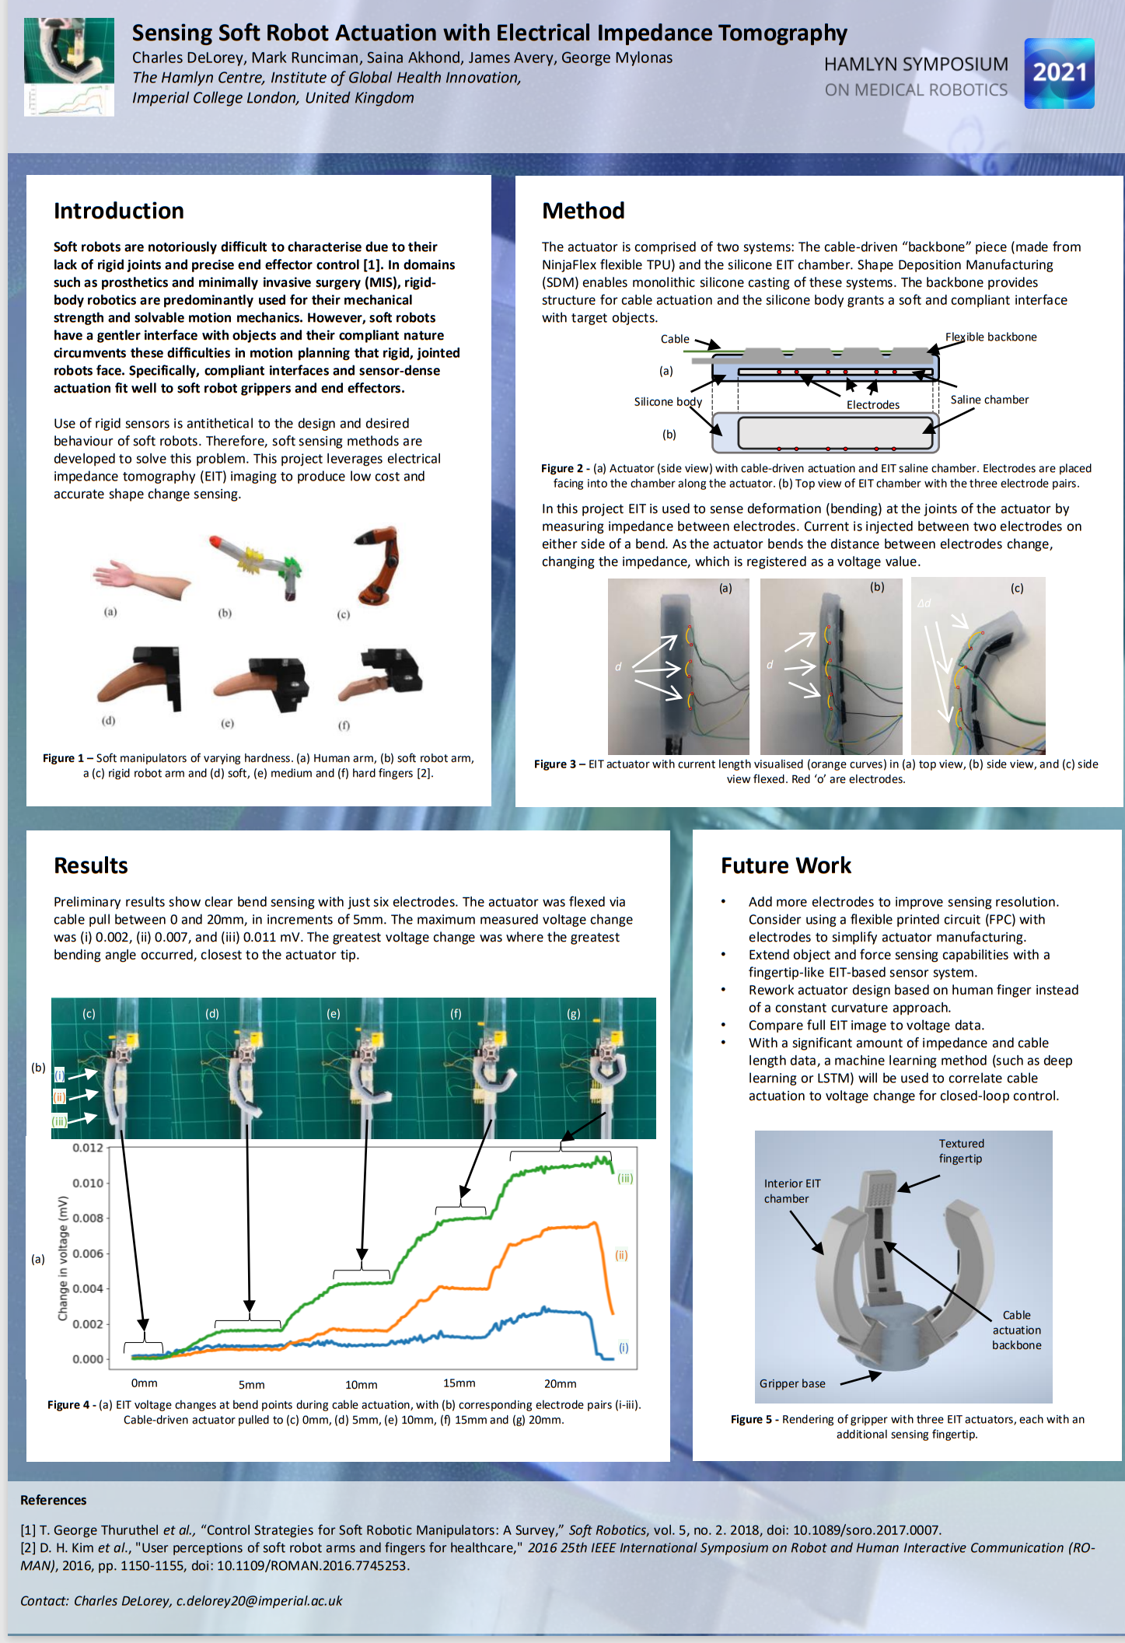
Project poster

Slide 3
TODO
Add stepper motor to get set/predictable actuation
Do multiple iterations of actuator tests to gather more data
Investigate ML solutions for control problem (possibly just with voltages, may need full EIT images)
Refine actuator design (new moulds, iterate on actuator until a satisfactory design)

Slide 4
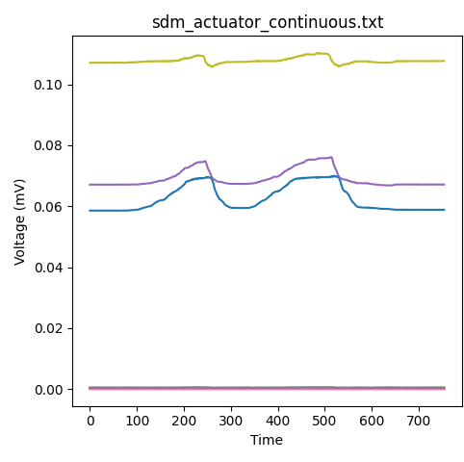
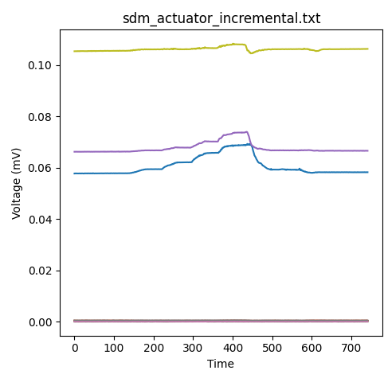
SDM actuator data: multiple iterations
20mm pull of cable
20mm pull of cable
10mm pull of cable
Voltage reading over a 20 mm cable actuation (5 mm at a time, ~1-2s per 5 mm)

Slide 5
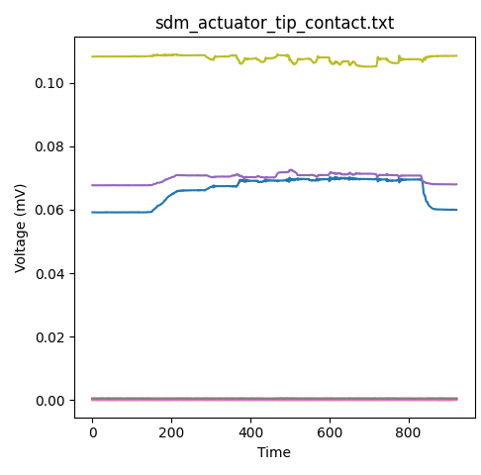
SDM actuator EIT data
20 mm change in cable length to flex actuator
Force against actuator tip

