Slide 1
EIT x Soft Robots: project update
Week of Monday 22/03/2021

Slide 2
Work accomplished this past week:
Completed online training courses
Produced EIT images of simple finger model

Slide 3
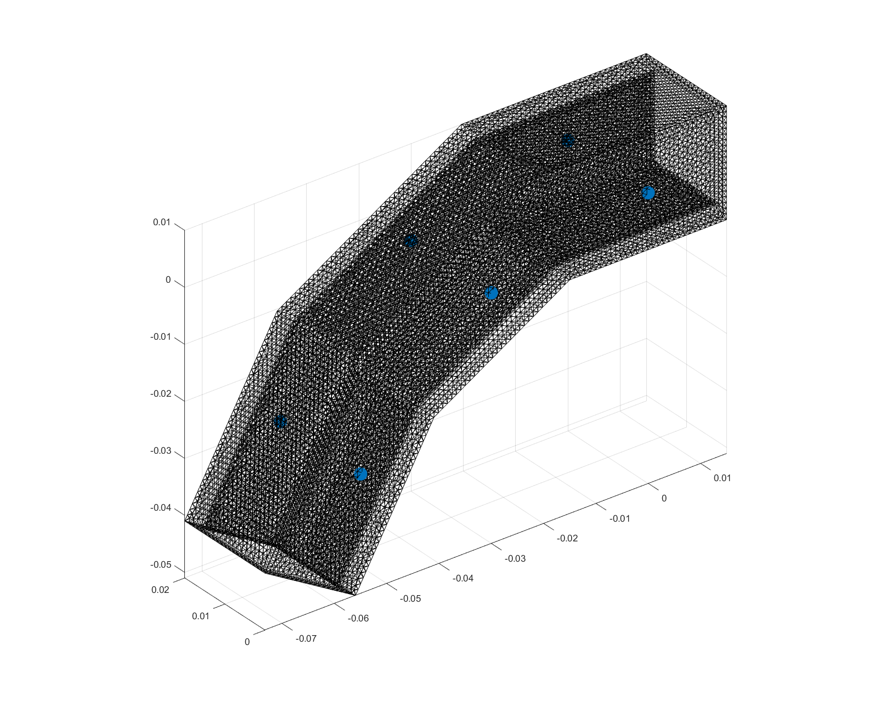
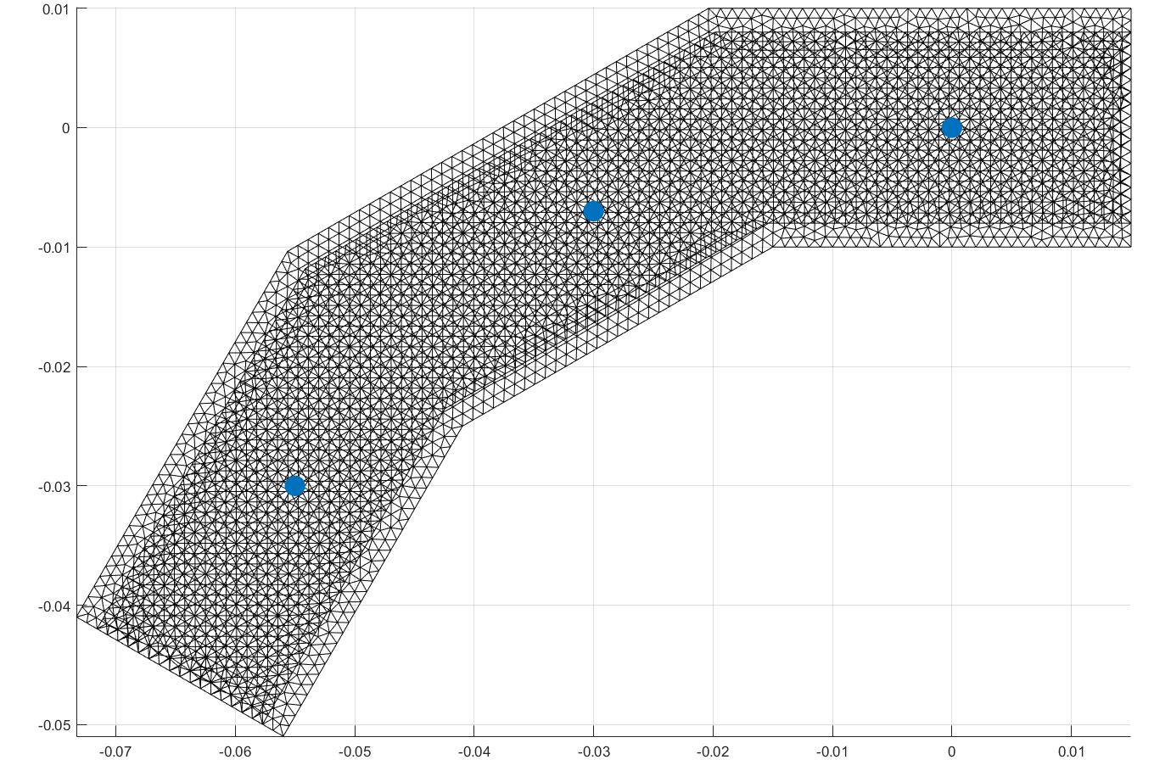
Finger mesh with electrode locations
6 electrodes
Actuator wall is 2 mm thick
Lengths are in meters

Slide 4
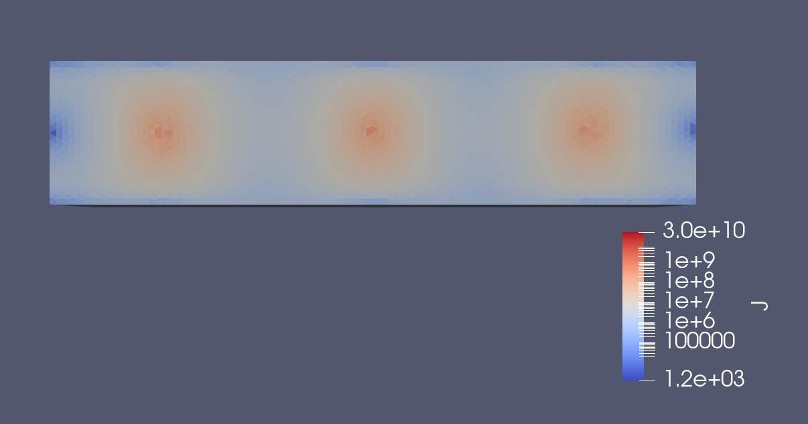
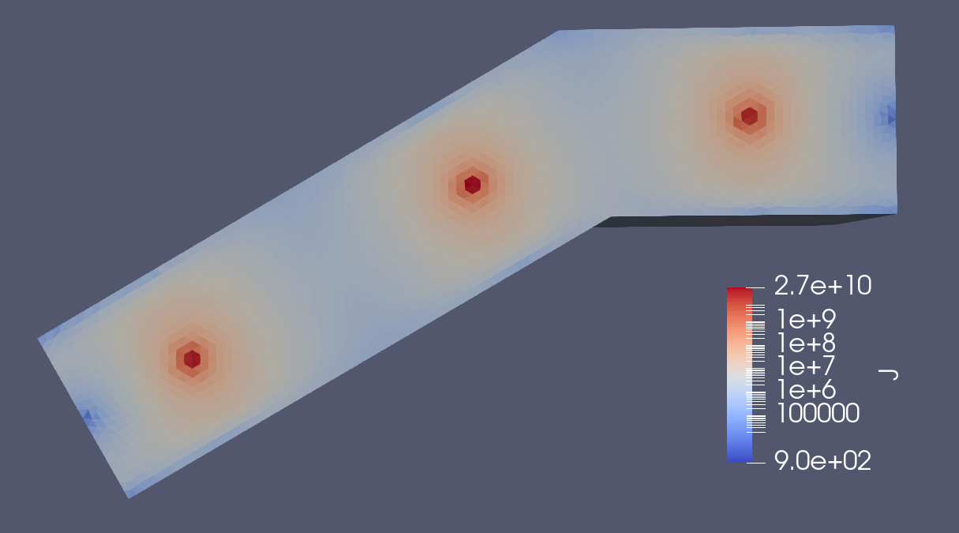
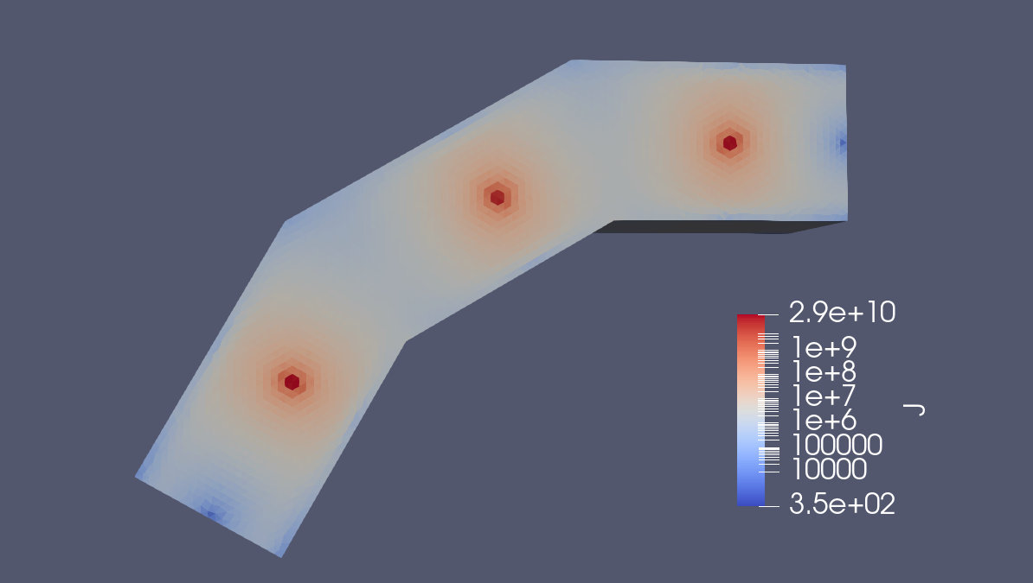
EIDORS simulations of simple 2-joint actuator
No bend
1 bend
Visualized with ParaView
Log scale
2 bends

Slide 5
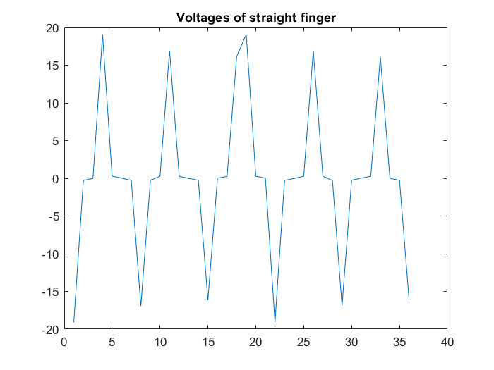
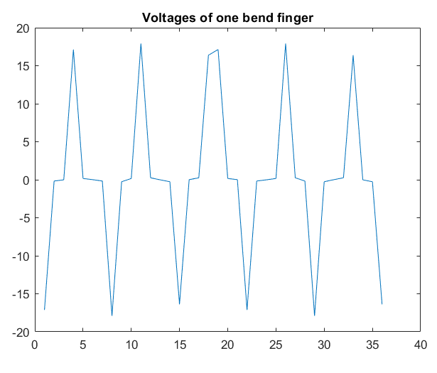
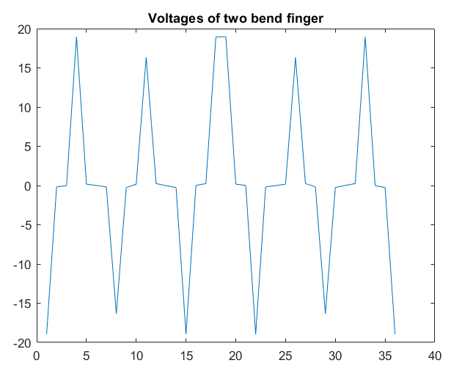
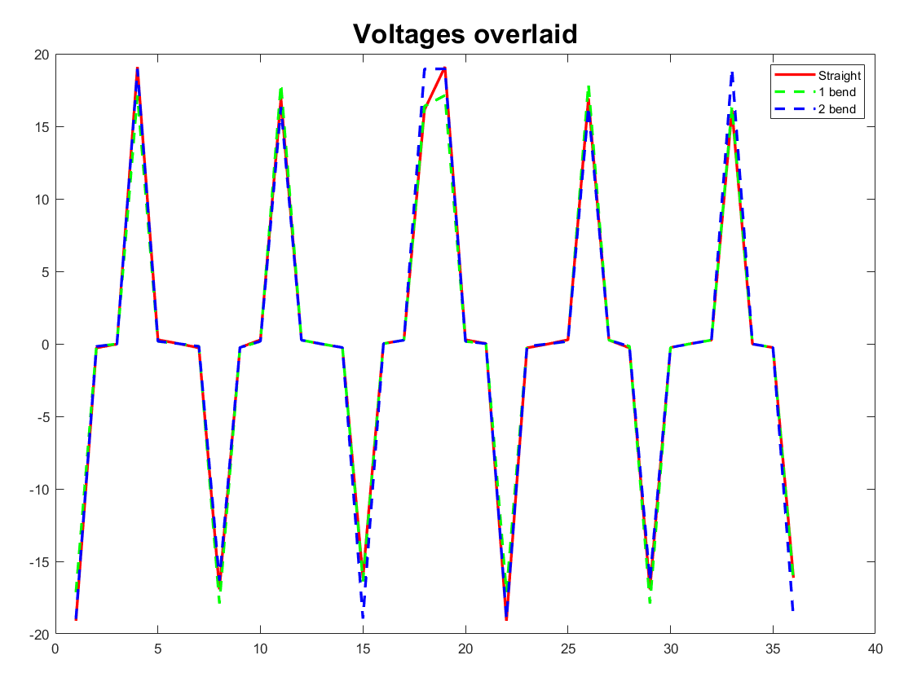
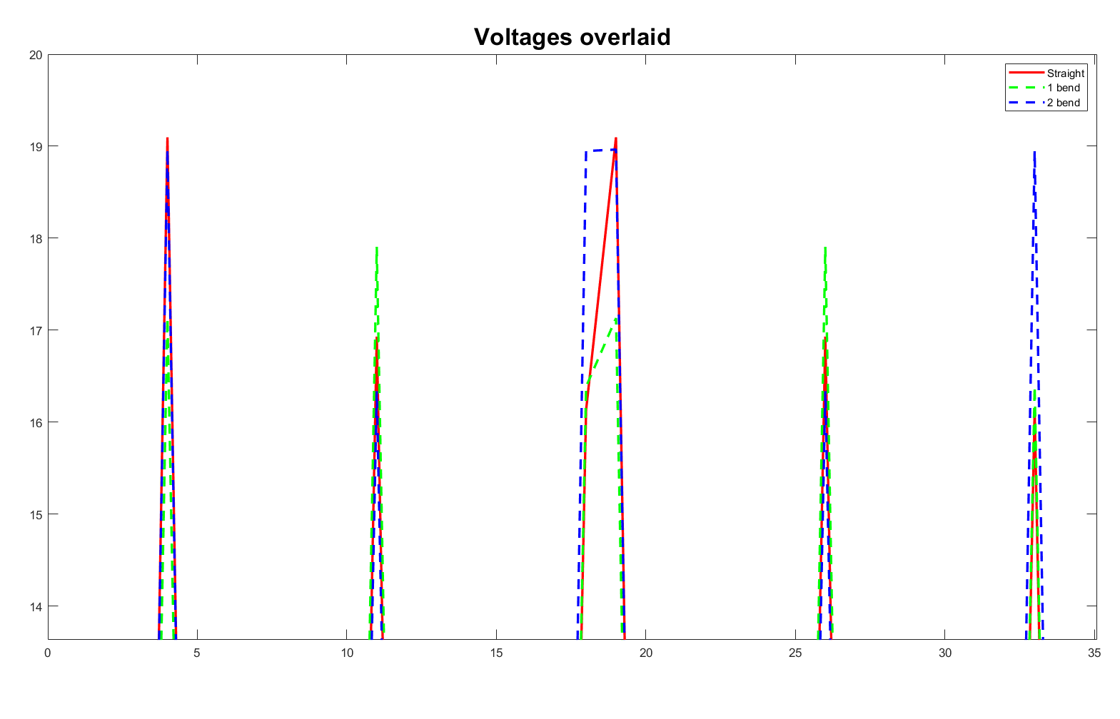
Voltages for each finger configuration:
Very slight changes

Slide 6
To do for this upcoming week:
Refine EIDORS simulation
Begin fabricating a simple actuator
Revise literature review

