Slide 1
EIT x Soft Robots: project update
Week of Monday 29/03/2021

Slide 2
Work accomplished this past week:
Refined EIDORS simulation
Begin fabricating a simple actuator

Slide 3
Pneunet mesh with electrode locations
6 electrodes
Lengths are in meters

Slide 4
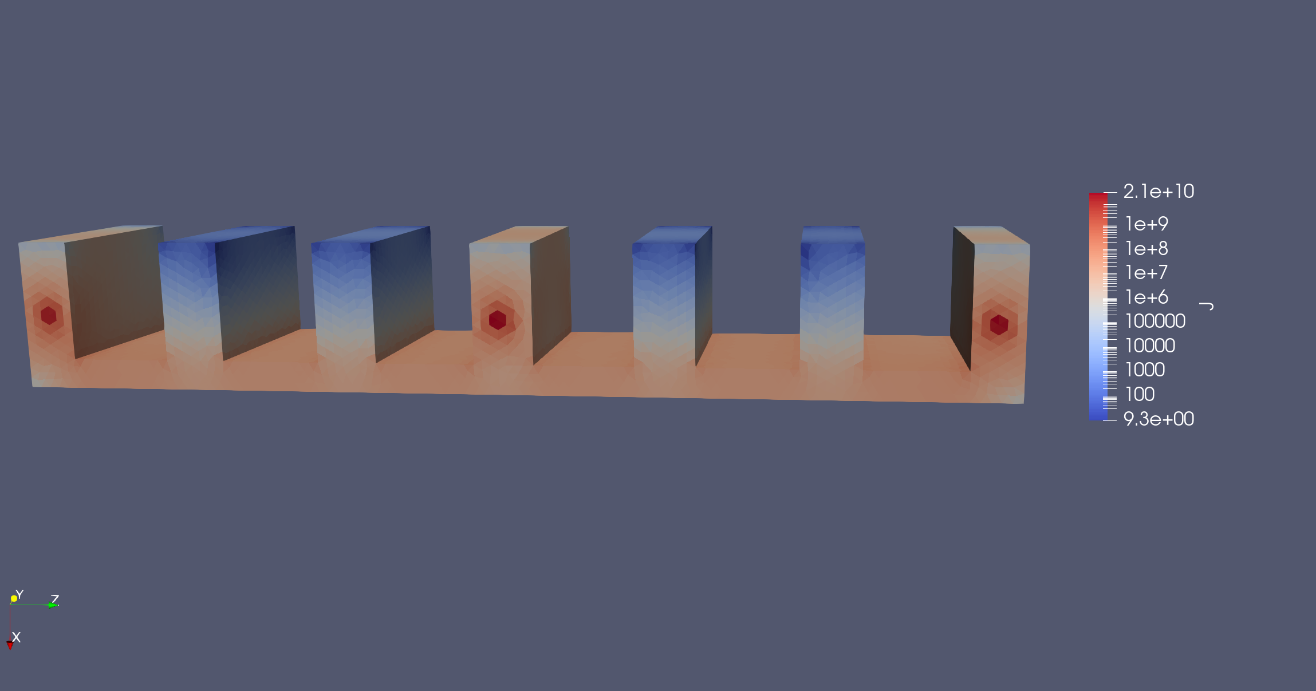
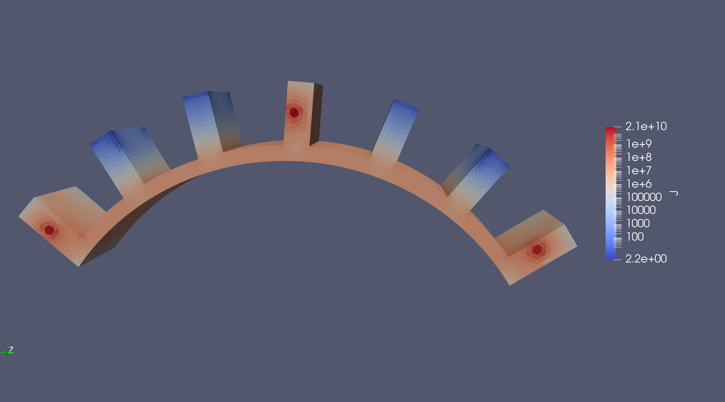
EIDORS simulations of simple 2-joint actuator
No bend
First bend
Visualized with ParaView
Log scale

Slide 5
Voltages for each finger configuration:

Slide 6
To do for this upcoming week:
Refine EIDORS simulation
Begin fabricating a simple actuator
Revise literature review

