Slide 1
Collision Avoidance

Slide 2
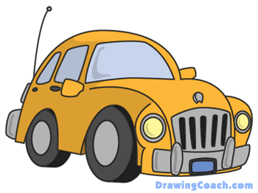


Scenario

