Slide 1
Homework Time!
Preview of Unit 1 Homework

Slide 2
Objectives
To organize and analyze data using Excel – specifically through:
Formulas
Conditional Formatting
Pivot Tables & Pivot Charts

Slide 3
Full Instructions & Data Set
Found in 01-Excel > Homework > Instructions > README.md
Data contained in StarterBook.xlsx

Slide 4
Background
$2B raised on Kickstarter, but not every project is a success
Only a third of projects are successful
Getting funded on Kickstarter requires meeting or exceeding the project’s initial goal
Many organizations analyze past data to discover “tricks” for finding success
For this week’s homework, you will organize and analyze a database of 4,000 past projects in order to uncover any hidden trends

Slide 5
Before You Begin
Create a new repository in GitHub called “Excel-Challenge”
Clone repository to your computer
This is the folder you should be working from!

Slide 6
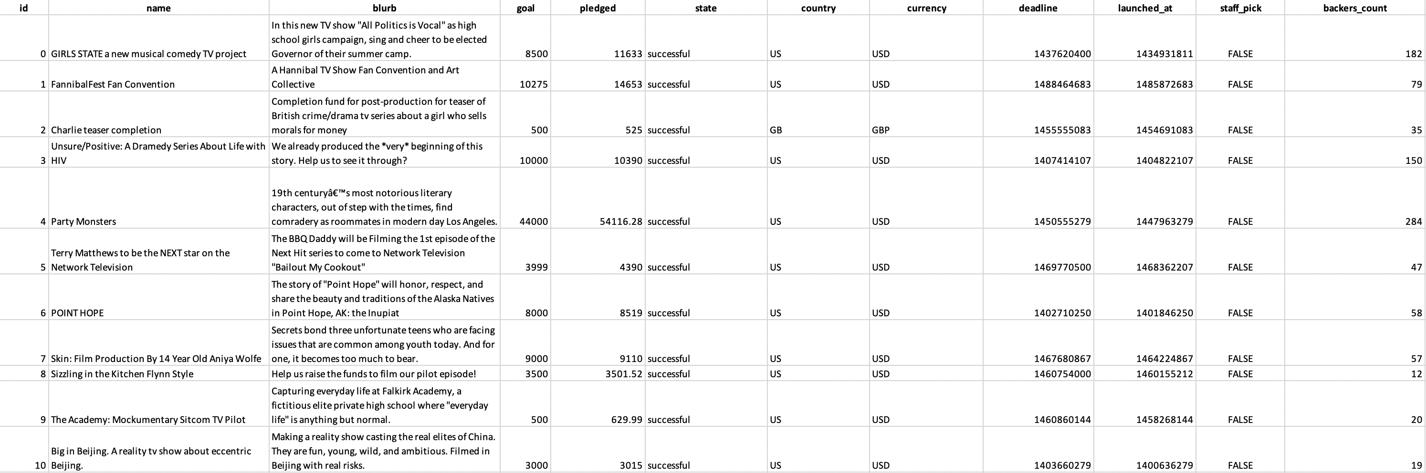
Starting Data

Slide 7
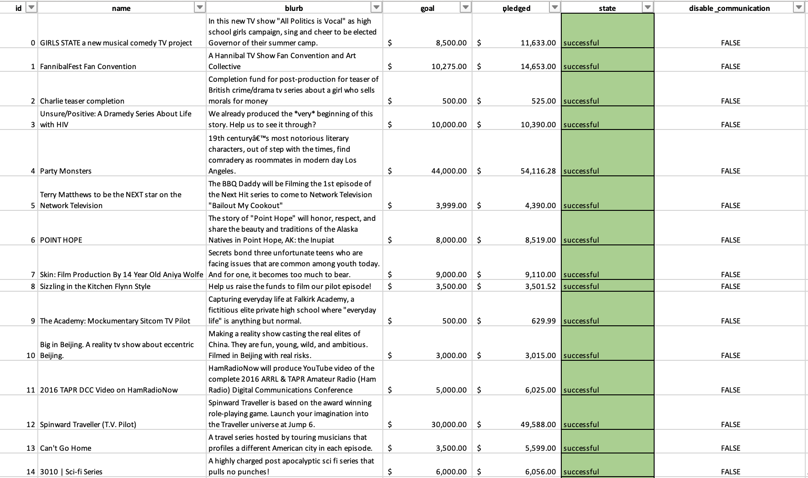
Conditional Formatting Example
In this case, we used conditional formatting to highlight each cell in green within the ‘state’ column if project was successful
In your homework, you will expand on this and include other colors to highlight whether the project failed, was canceled, or is currently live

Slide 8

Using Formulas Example
By using formulas, we created two new columns called Average Donation and Percent Funded
Manipulating and analyzing data with the help of formulas allows us tell a more powerful story

Slide 9
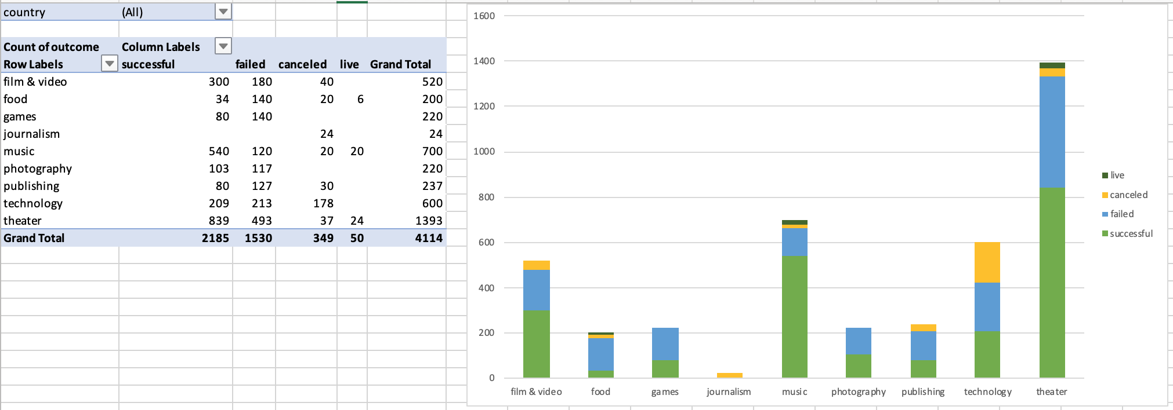
Pivot Table & Pivot Chart Examples

Slide 10
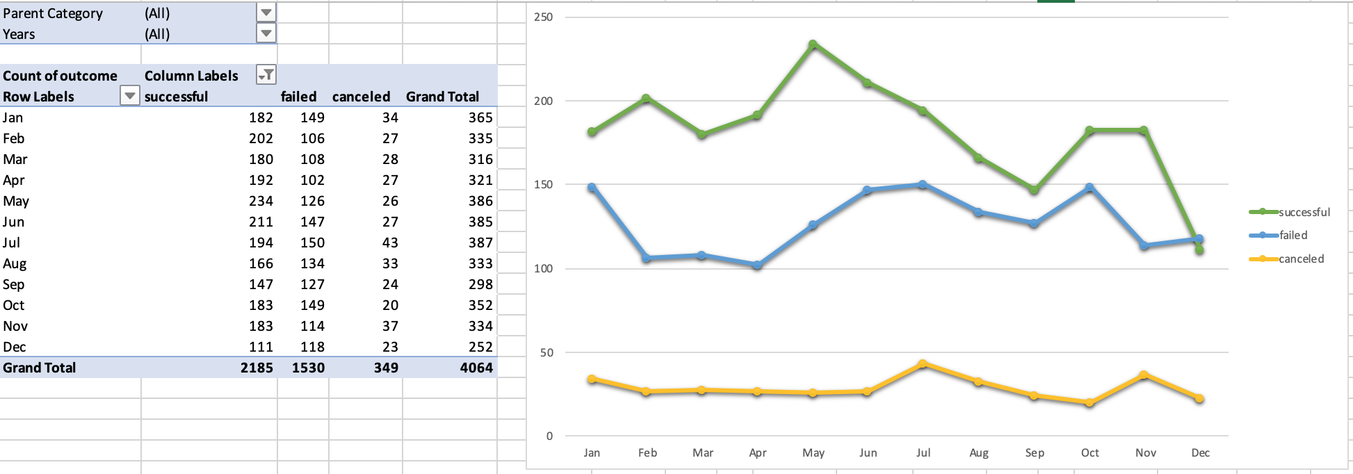
Pivot Table & Pivot Chart Example
To view more examples, navigate to Homework > Instructions > Images

Slide 11
Microsoft Word Report
Create a report in Microsoft Word document and answer the following:
1. Given the provided data, what are three conclusions we can draw about Kickstarter campaigns?
2. What are some limitations of this dataset?
3. What are some other possible tables and/or graphs that we could create?
Save this report and add it to your “excel-challenge” space

Slide 12
Bonus (Optional)
Part 1:
Find and graph the relationship between a goal’s amount and its chances at success, failure, or cancellation
Part 2 – Statistical Analysis:
Create your own summary statistics table

Slide 13
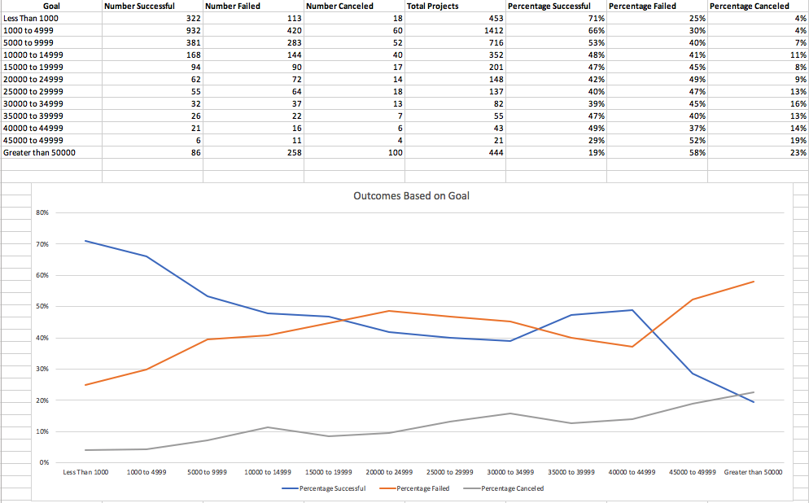
Bonus Example – Part 1

Slide 14
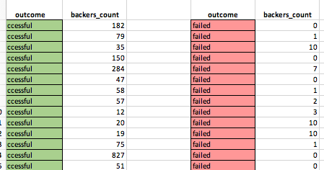
Bonus Example – Part 2

Slide 15
Submission
Add the files to your GitHub repository you cloned to your computer
Commit and push changes to GitHub repository
Example of how to do this:
Open up terminal or GitBash
Cd foldername
Git add .
// Adds all changes so you’re ready for commit
Git commit –m “message”
// Commits changes - use a meaningful message
Git push
You’re done!
Submit link to bootcampspot.com

Slide 16

Questions?

