Slide 1
Intro to Geospatial Analysis
Catherine DeRose, PhD | HILT 2019
CC-BY

Slide 2
Agenda
What do we mean by geospatial analysis — concepts
Why might we use maps — sample projects
How do we create our own maps — tools for geocoding, georeferencing, and mapping
Where do we find data — popular mapping collections
Hands-on practice

Slide 3
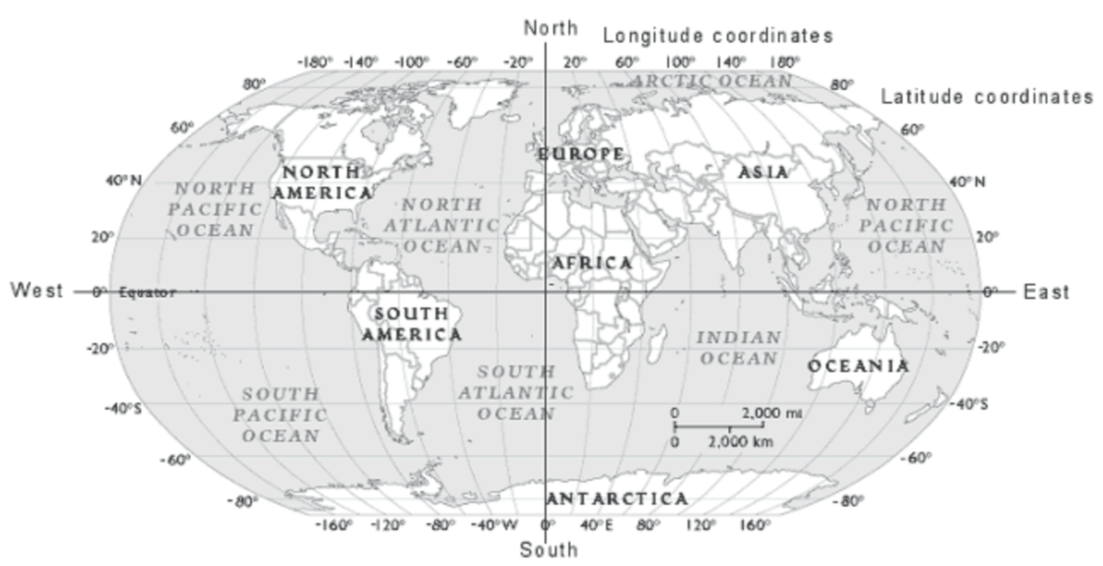
IUPUI’s University Library geographic coordinates:
Decimal degrees (DD): 39.773243, -86.172040
Degrees, minutes, seconds (DMS): 39°46'23.7"N 86°10'19.3"W
Notes:
Latitude = how north or south of the equator
Longitude = how east or west of the prime meridian

Slide 4
Geocoding
Process of identifying the geographic coordinates (latitude and longitude) for locations
Can be done by hand or by an application programming interface (API)
Notes:
We used an API when we grabbed latitude and longitude in OpenRefine on Monday

Slide 5
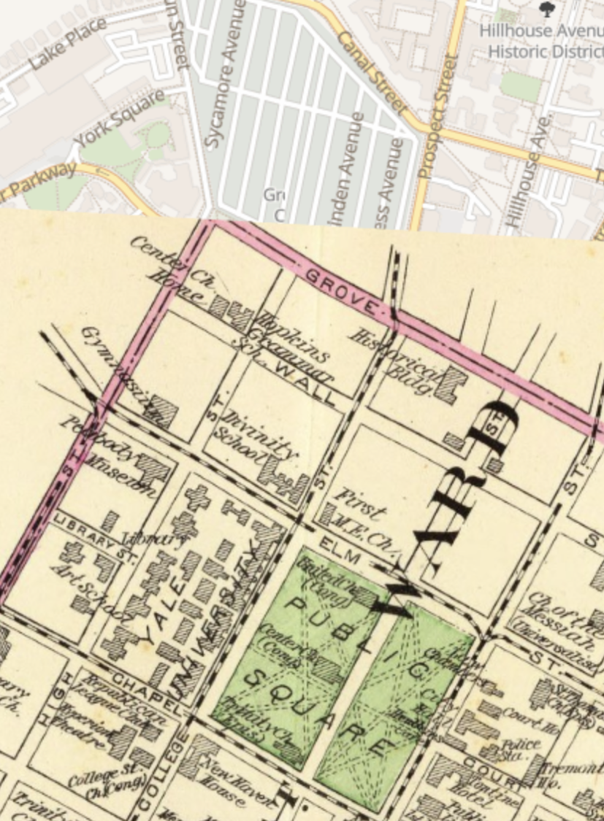
Georeferencing
Process of linking an image of a map to a spatial grid
Often a necessary step when using historical maps
Can lead to map distortion or warping
Free tools: NYPL Map Warper and Georeferencer
David Rumsey Map Collection contains many already georectified options: bit.ly/new-haven-georeference

Slide 6
Benefits of Digital Maps
Map layers can be added to connect to different data sets or to show change over time, can be turned on and off
Panning and zooming capabilities allow users to explore at different scales
Ability to link map to users’ location
Map visualization is generally interpretable without special training

Slide 7
Challenges of Digital Maps
Boundaries shift over time and can be hard to georeferenced
Place names change or are contested
Requires working with software that might have:
Storage limitations
Hosting limitations
Proprietary concerns
A financial expense
A learning curve

Slide 8
Sample Projects
What questions can we ask of maps that we couldn’t ask as well, if at all, of text mining visualizations or network graphs?
How does the project enable you to interact with the map?
The Atlas of Early Printing: http://atlas.lib.uiowa.edu/
Photogrammar: http://photogrammar.yale.edu/
Charles Booth’s London: https://booth.lse.ac.uk/

Slide 9
Preparing Geographic Data

Slide 10
Georeferencing Maps
https://www.georeferencer.com/

Slide 11
Geocoding by Hand
Review locations identified via named entity recognition (NER)
Retrieve latitude and longitude with Google Maps https://www.google.com/maps
Note any judgment calls you make during the process in the spreadsheet

Slide 12

ArcGIS Online
WHAT: Freemium online mapping tool
WHY: To create interactive maps
HOW: Runs in the browser

Slide 13
Story Maps
WHAT: Freemium online tool by Esri for combining multimedia content
WHY: To build a web app
HOW: Runs in the browser, with many template options to choose from

Slide 14
Resources
MAP COLLECTIONS
David Rumsey Map Collection: https://www.davidrumsey.com/
Old Maps Online: https://www.oldmapsonline.org/
New York Public Library: https://digitalcollections.nypl.org/search/index?filters%5BphysicalLocation_mtxt_s%5D%5B%5D=Map+Division&keywords=&sort=dateDigitized_dt+desc#

Slide 15
Resources
GEOREFERENCING TOOLS
Georeferencer: https://www.georeferencer.com/
Practice georeferencing random maps: https://davidrumsey.georeferencer.com/maps/275781414372/georeference
Map Warper: http://mapwarper.net/

