Slide 1
Introduction to
Network Analysis
Catherine DeRose, PhD | 2019
CC-BY

Slide 2
Agenda
What are networks
Why might you use them
How do you prepare data by hand and with a script
How do you generate a network graph (Gephi)
Hands-on practice

Slide 3
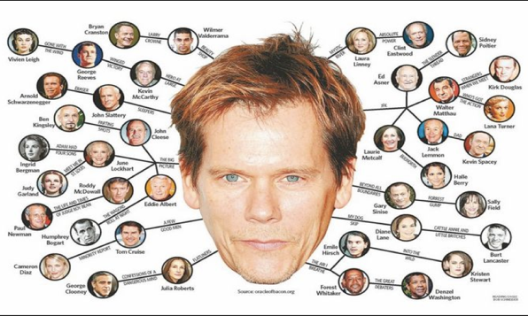

Slide 4
Nodes/Vertices/Actors
B
A
E
C
F
D

Slide 5
Nodes and Edges/Links/Ties
B
A
E
C
F
D

Slide 6
Edge Properties: Direction
B
A
E
C
F
D

Slide 7
Edge Properties: Weight
B
A
E
C
F
D

Slide 8


Bipartite/Bimodal Network

Slide 9
Unipartite/Unimodal Network
Notes:
Project the network (collapse)

Slide 10
Momo
Nell
Ye Seul
Amy
Clara
Jun Yan
Sergio
Lina
Isabel
Gabrielle
Lauren
Isabelle
Claire

Slide 11
Momo
Nell
Ye Seul
Amy
Clara
Making of the Modern Middle East
U.S. Lesbian and Gay History
U.S. Lesbian and Gay History
Jun Yan
American Encounters with Colonialism
U.S. Lesbian and Gay History
Making of the Modern Middle East
U.S. Lesbian and Gay History
Making of the Modern Middle East; Oil and Empire
Sergio
U.S. Lesbian and Gay History
Lina
U.S. Lesbian and Gay History
Isabel
U.S. Lesbian and Gay History
The American South Since Reconstruction
Gabrielle
Readings in American Literature
Lauren
Isabelle
Claire

Slide 12
Momo
Nell
Ye Seul
Amy
Clara
Jun Yan
Sergio
Lina
Isabel
Gabrielle
Lauren
Isabelle
Claire

Slide 13
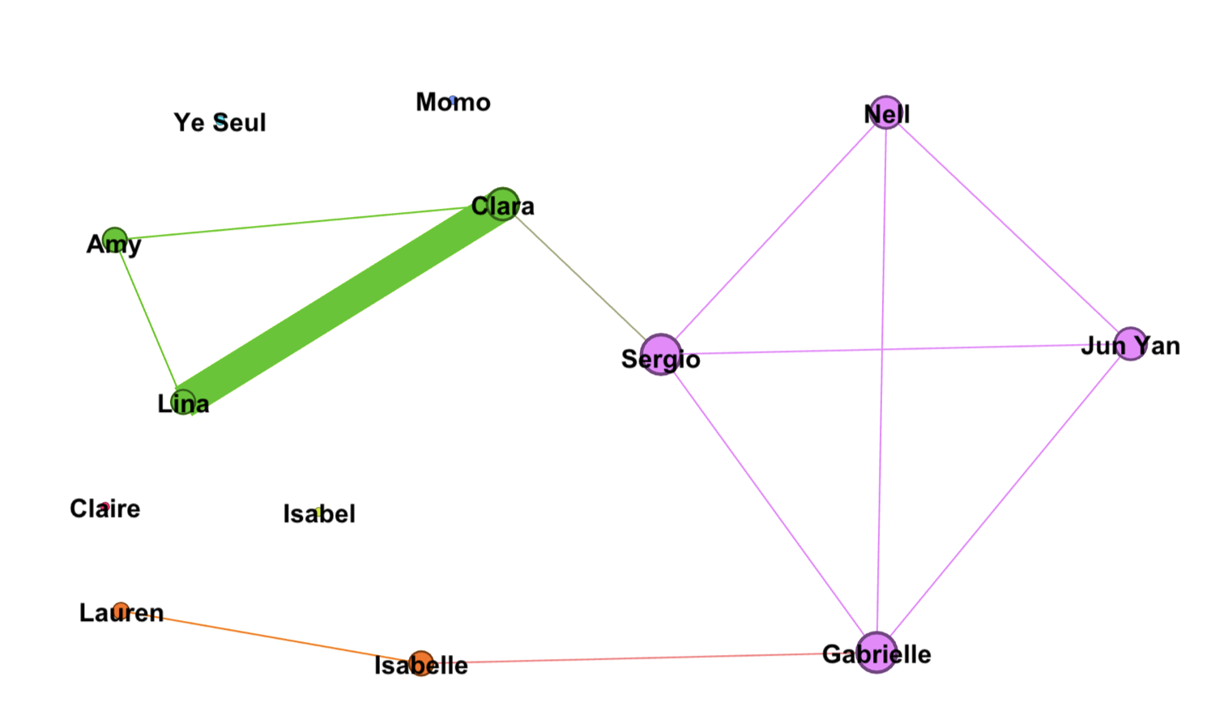
Notes:
Degree = how many edges a particular node has

Slide 14
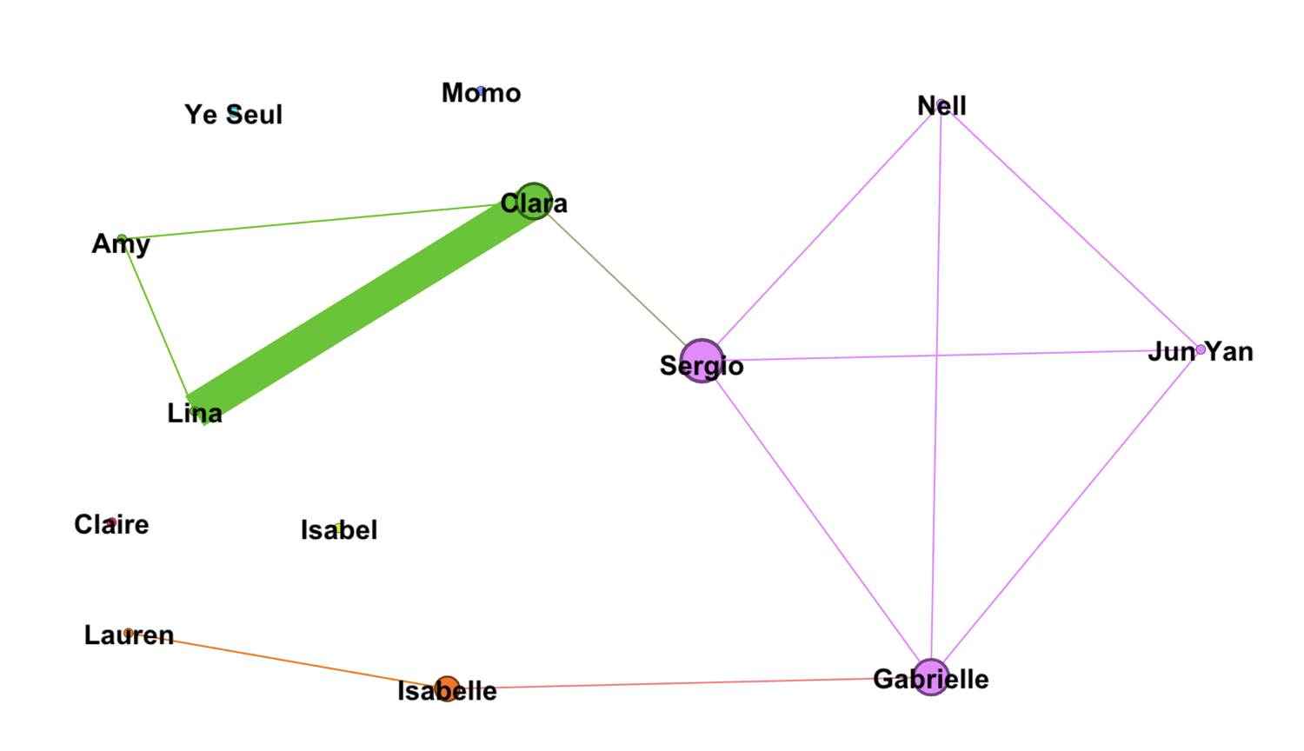
Notes:
Betweenness centrality = how often a node is on the shortest path to any other node

Slide 15
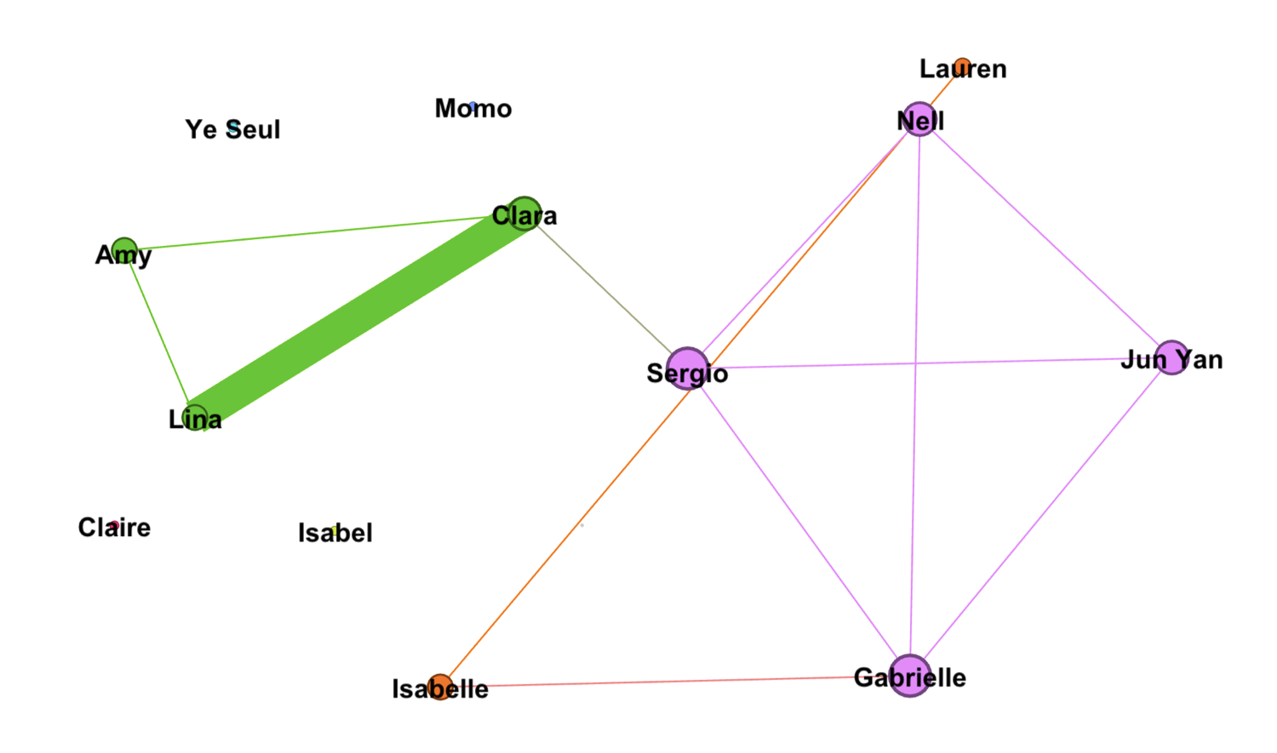

Slide 16
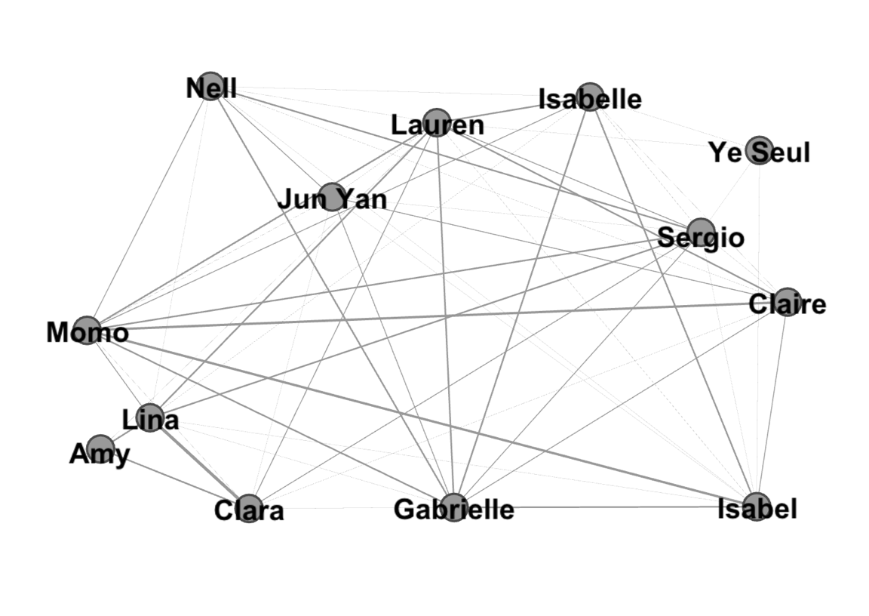

Slide 17
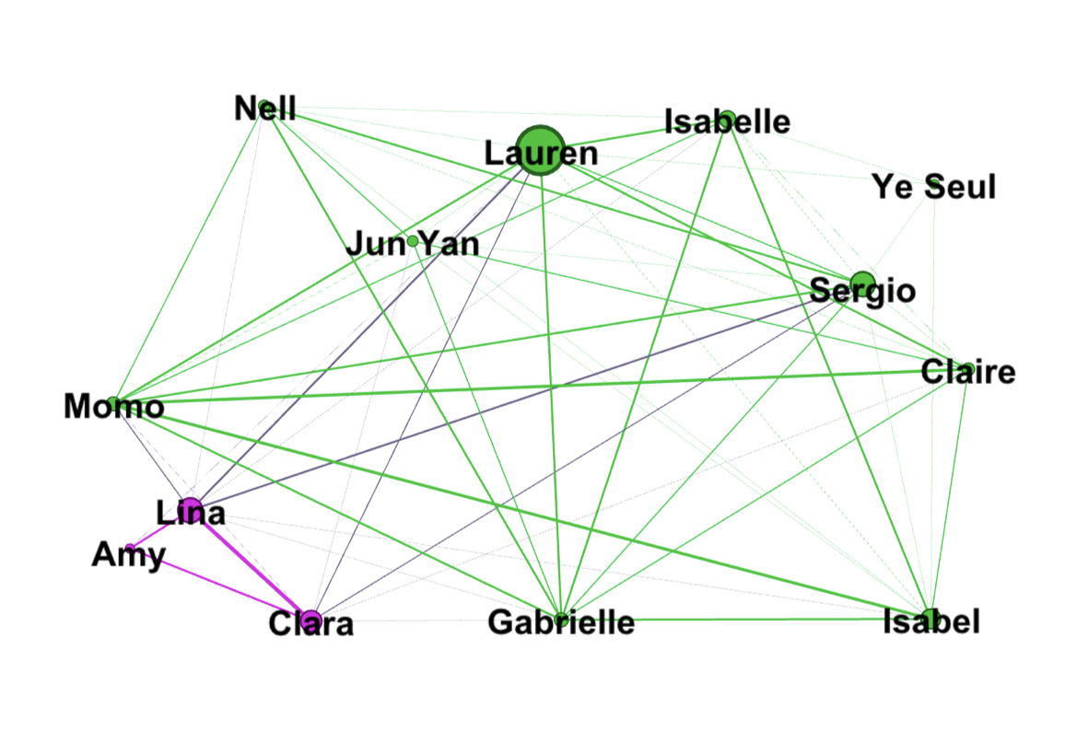

Slide 18
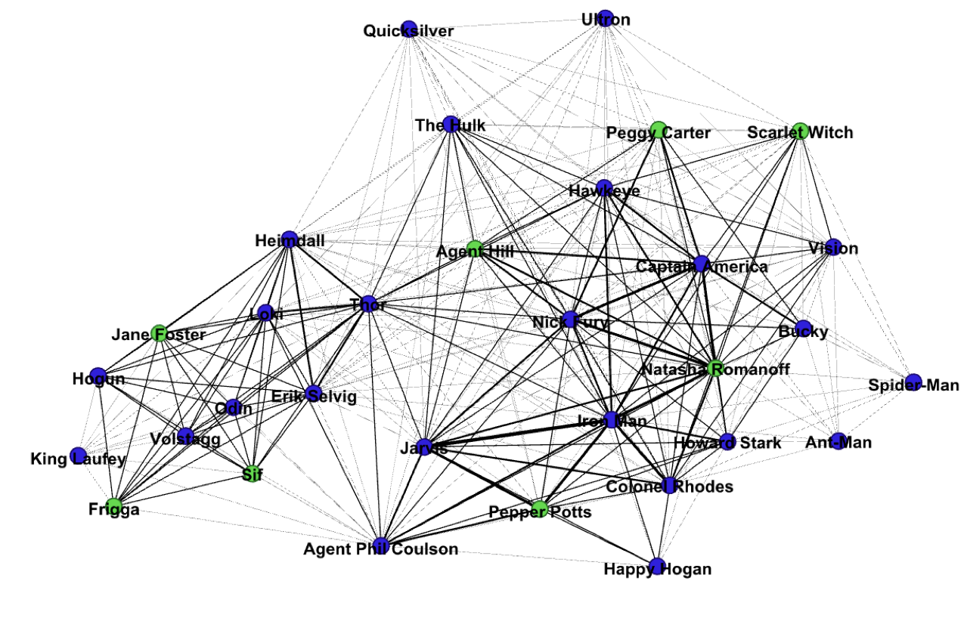

Slide 19
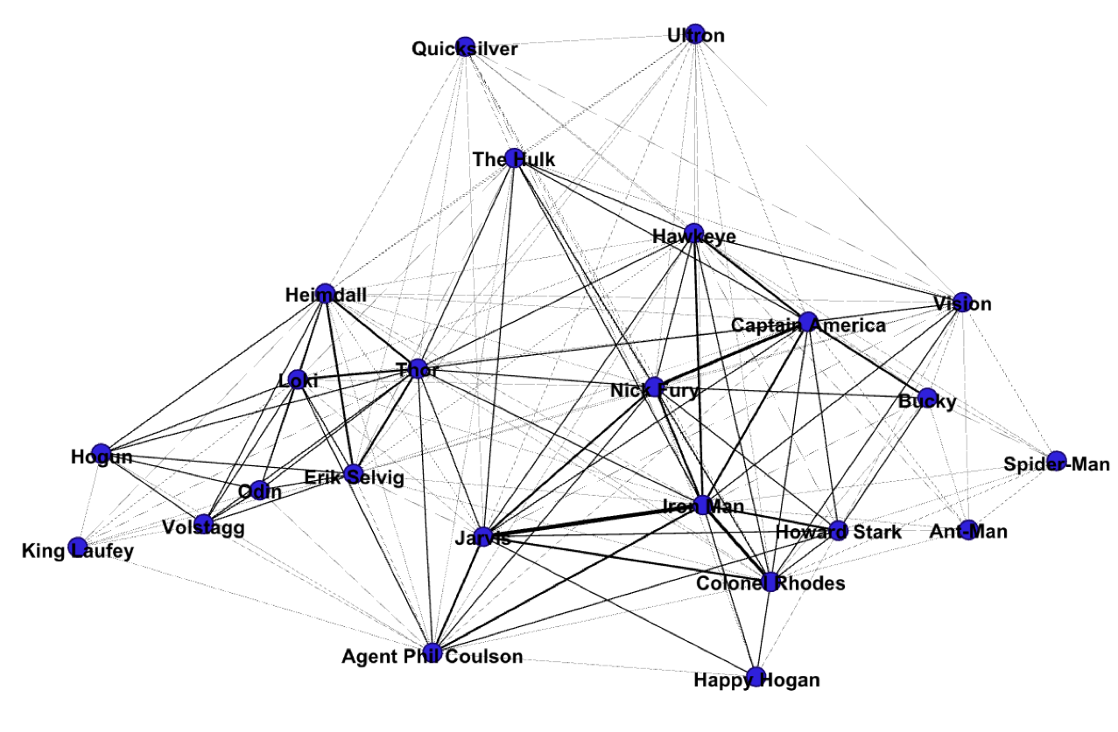

Slide 20
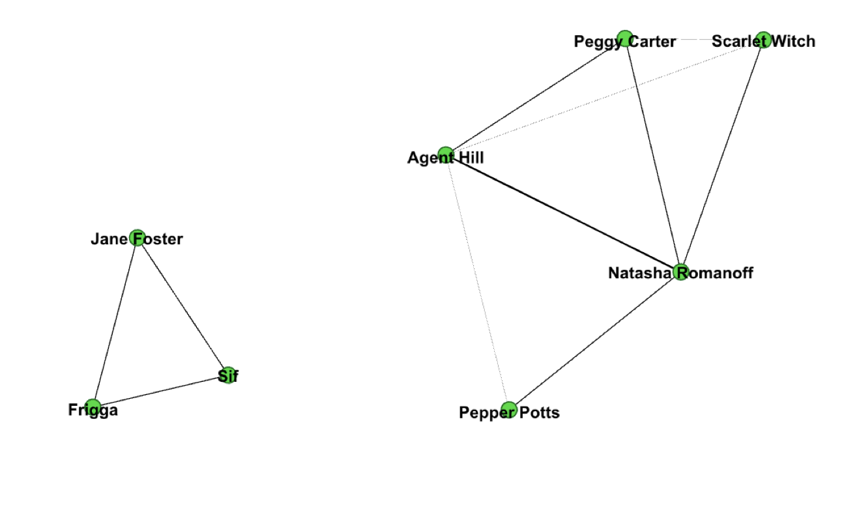

Slide 21
Recommended Reading
“Network Theory, Plot Analysis” (Stanford Literary Lab)
Helpful features of networks:
The past becomes “just as visible as the present” (4)
Underlying structures are highlighted (4)
Centrality and stability are not identical (5)
Notes:
https://litlab.stanford.edu/LiteraryLabPamphlet2.pdf

Slide 22
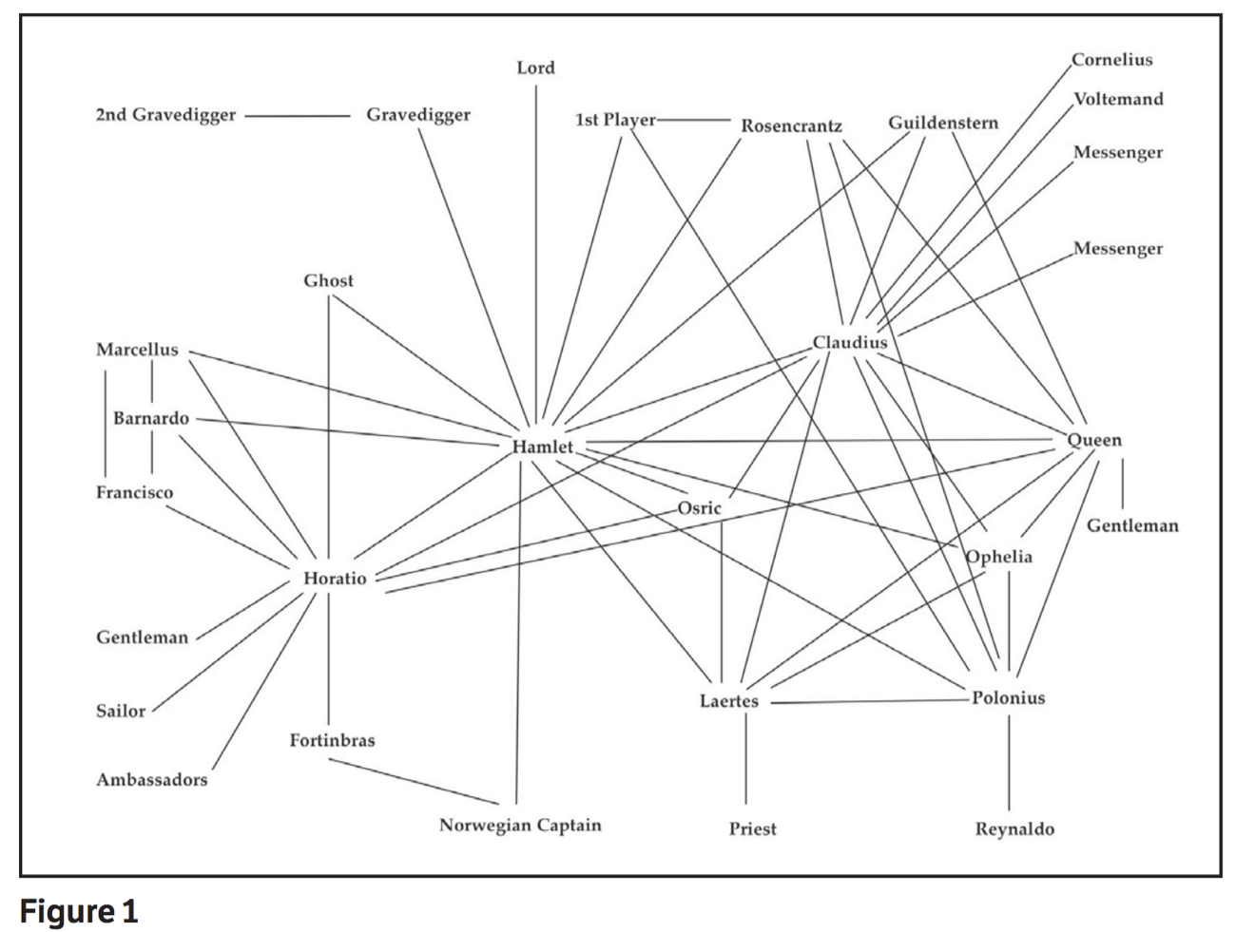
Stanford Literary Lab

Slide 23
Sample Projects
What do networks help you see that text mining did not?
How much context does the project provide for interpreting the network?
The Inner Life of Empires: https://sites.fas.harvard.edu/~histecon/innerlife/connections.html
Republic of Letters, Benjamin Franklin: http://republicofletters.stanford.edu/casestudies/franklin.html
Linked Jazz: https://linkedjazz.org/network/
Homer’s Iliad: https://www.researchgate.net/publication/273362057_HOMER'S_ILIAD_-A_SOCIAL_NETWORK_ANALYTIC_APPROACH

Slide 24
Requirements for Preparing Data for a Network
Node list (table)
Required columns: id, label
Optional: additional metadata (age, affiliation, gender, etc.)
Edge list (table)
Required columns: source, target, (strongly recommended) type
Optional: additional metadata (weight, label, date)

Slide 25
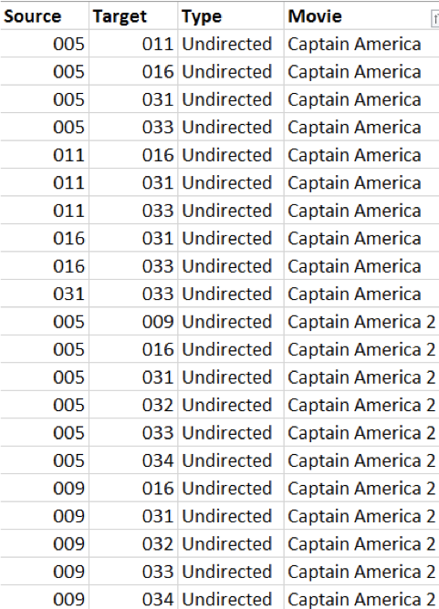
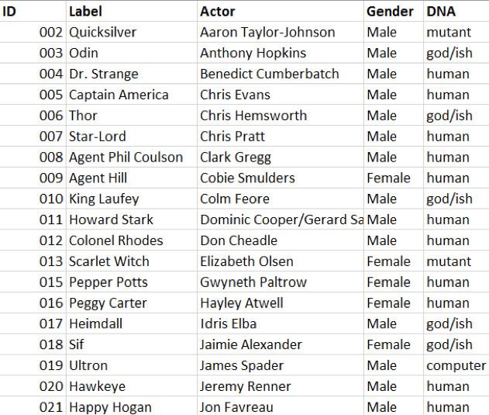
Nodes List Edge List

Slide 26
How to Gather Data and Create Node and Edge Lists
Node list
By hand, NER, API
Edge list
By hand, Excel, OpenRefine, Python (itertools)

Slide 27

Gephi
WHAT: Open-source tool for generating network graphs
WHY: To discover underlying structures
HOW: Runs locally, optional community-built plugins that expand functionality

Slide 28
Gephi Quirks
Particular about node and edge list headings (invisible spaces, reserved keywords)
No ‘undo’ button, so save often!
Can be quirky, so save often!
From ‘Preview’ screen, you need to click ‘Refresh’ to see changes each time

Slide 29
Getting Started
Create new project
From the ‘Data Laboratory’ window, import spreadsheets:
Import node list first, then import the edge list
From the ‘Overview’ window, you can:
Adjust the network’s appearance (labels, layout, color, size)
Set filters (change what data is displayed)
Run statistics (betweenness centrality, modularity score, etc.)
From the ‘Preview’ window, you can:
Prepare the network for publication
Export the network as an SVG, PDF, or PNG file

