Slide 1
Project Management & Assessment
Catherine DeRose, PhD | 2019
CC-BY

Slide 2
Designing a digital humanities project
Adapted from PM4DH project
0. Research question: what inquiry is driving the project?
Description and justification: what will you do and why?
Deliverables and sharing: what will the output(s) be?
Performance measures: what constitutes success?
Audience and stakeholders: who are your interlocutors and who might you need to answer to?
Resources and funding: what do you need to succeed?
Timeline: are there deadlines by which milestones need to be met and contingency plans for if they’re not?
Maintenance and preservation: who will look after the project?
Notes:
Link to PM4DH (Project Management for the Digital Humanities): https://scholarblogs.emory.edu/pm4dh/designing-a-project/

Slide 3
0-1 Research question, description, & justification
What question(s) are you looking to answer and why?
Have you looked at similar (in terms of content and/or approach) projects that might be out there?
What dataset(s) will use you?
Are they already in the format you need?
What methods or tool(s) will you need?
Do you need digital technology?
What is your current comfort level with that method or tool?

Slide 4
2 Deliverables and sharing
What will be the “end” products?
Will documentation be included?
Will they require a server?
How will they be circulated with your intended audience?
Will they be static or interactive?
Will they appear in color?
Have you considered accessibility standards?

Slide 5
3 Performance measures
What will constitute success?
Staying on time?
Specific deliverables?
Audience response?
Contributions to your and/or others’ research?
How will you measure that?

Slide 6
4 Audience and stakeholders
Who are you trying to reach with your project?
Who might find your project outside your intended audience?
Have people, units, or institutions contributed resources to your project?
Will they require a report?

Slide 7
5 Resources and funding
What equipment or software do you need?
Do you need web hosting or storage?
Are there financial costs to your data?
Do you need to pay for the “raw” data?
Do you need to pay for digitization or transcriptions?
Do you need to pay for storage?
Will collaborators or contributors be paid?
Do you need buy-in from other units?

Slide 8
6 Timeline
How long do you have to do work on this project from start to “finish?”
Are there upcoming deadlines for you or your collaborators?
For reporting on the project to others
That aren’t directly related to the project but that might impede progress
What are project milestones you could set?

Slide 9
7 Maintenance and preservation
How will the project be maintained?
Did you use open source tools and formats?
Can you maintain it on your own, or do you need support (whether that be a person or funding)?
Do you have a plan for keeping track of issues that might emerge (such as a broken link or changed codebase)?
For how long do you intend this project to be around?

Slide 10
Finding collaborators
Content Contributors
Libraries
Museums
Individuals
Expertise Contributors
Fellow researchers
Subject librarians
Technical partners
Community members
Resource Contributors
IT support
Physical space
Funders
Loop collaborators in early, not just when it becomes time for their contribution
Above examples largely from “Recruiting Partners” by Jennifer Guiliano and Simon Appleford
Notes:
DevDH: devdh.org

Slide 11
Working with collaborators
“I’m not just building tools for my friends; this is interesting for my field”
- anonymous Computer Science professor
Collaborations should be mutually enriching, even if in different degrees at different times

Slide 12
Defining partnerships
Establish parameters around the work
attribution
duration (one-time, ongoing)
agree on deliverables
agree on timeline(s)
establish methods for checking in

Slide 13
Templates & Tools for Project Management

Slide 14
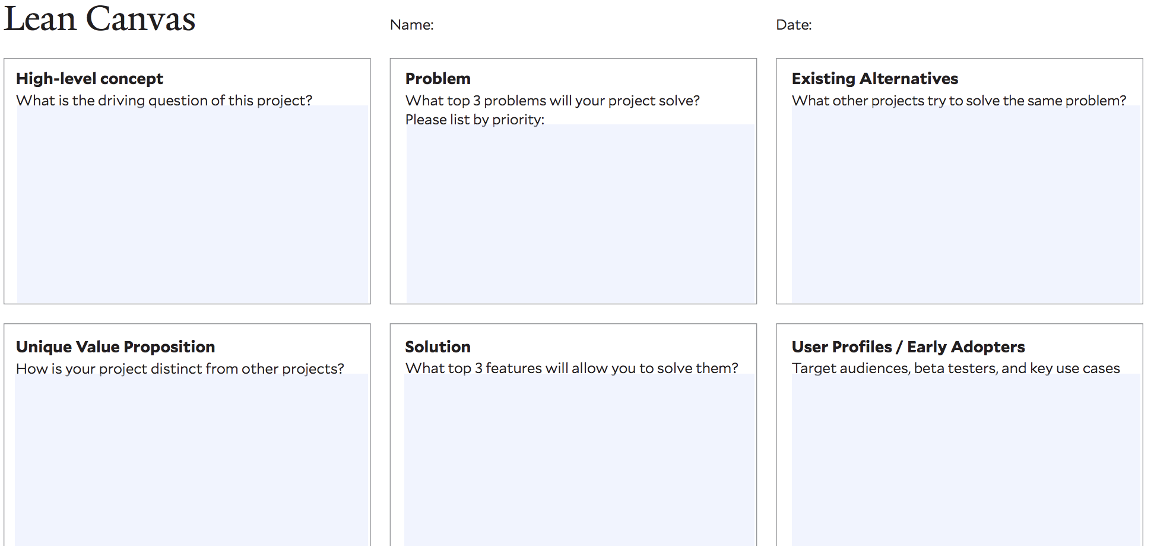
Lean canvas
http://dhlab.yale.edu/assets/docs/DH-LeanCanvas.pdf

Slide 15
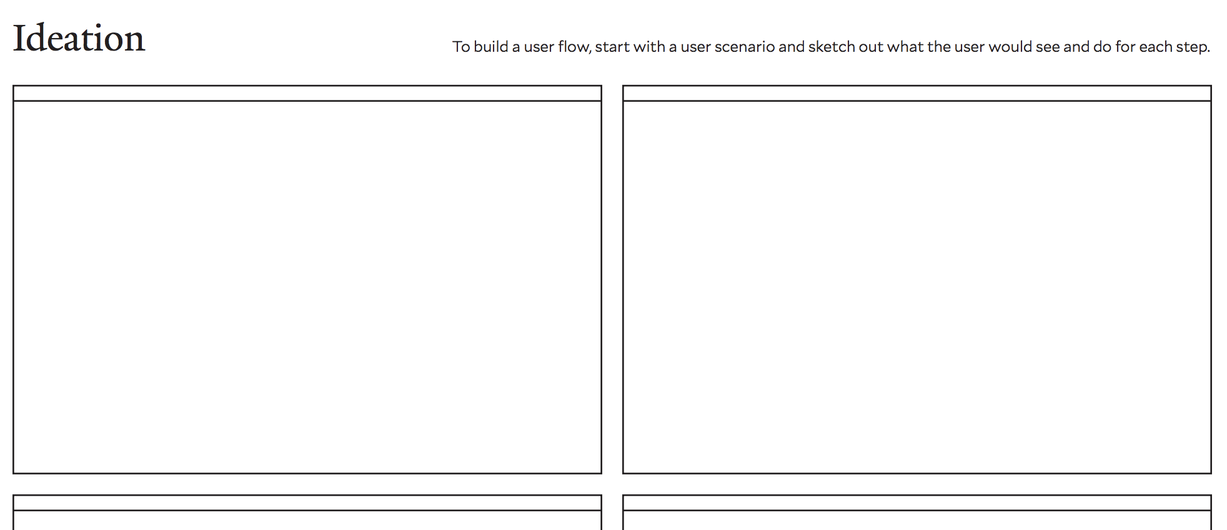
Ideation
http://dhlab.yale.edu/assets/docs/DH-Ideation.pdf

Slide 16
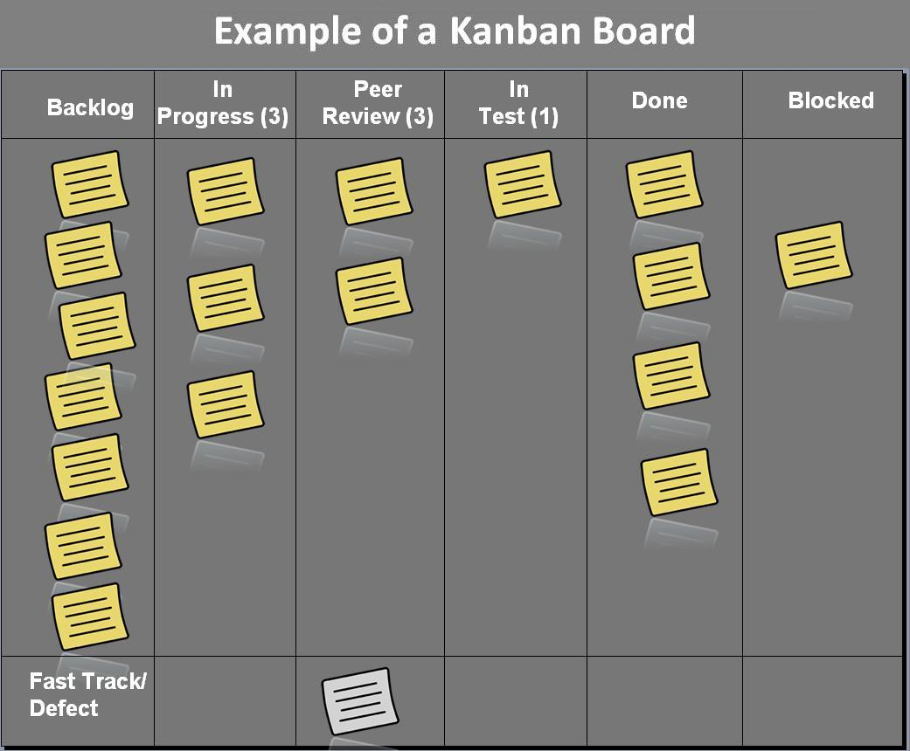
Trello
https://trello.com
Web-based Kanban board for keeping track of the different components of a project, from what state something is in (in-progress, halted, finished) to which team members are working on what
Image from Wikipedia
Notes:
Link to image: https://en.wikipedia.org/wiki/Kanban_(development)#/media/File:Kanban_board_example.jpg

Slide 17
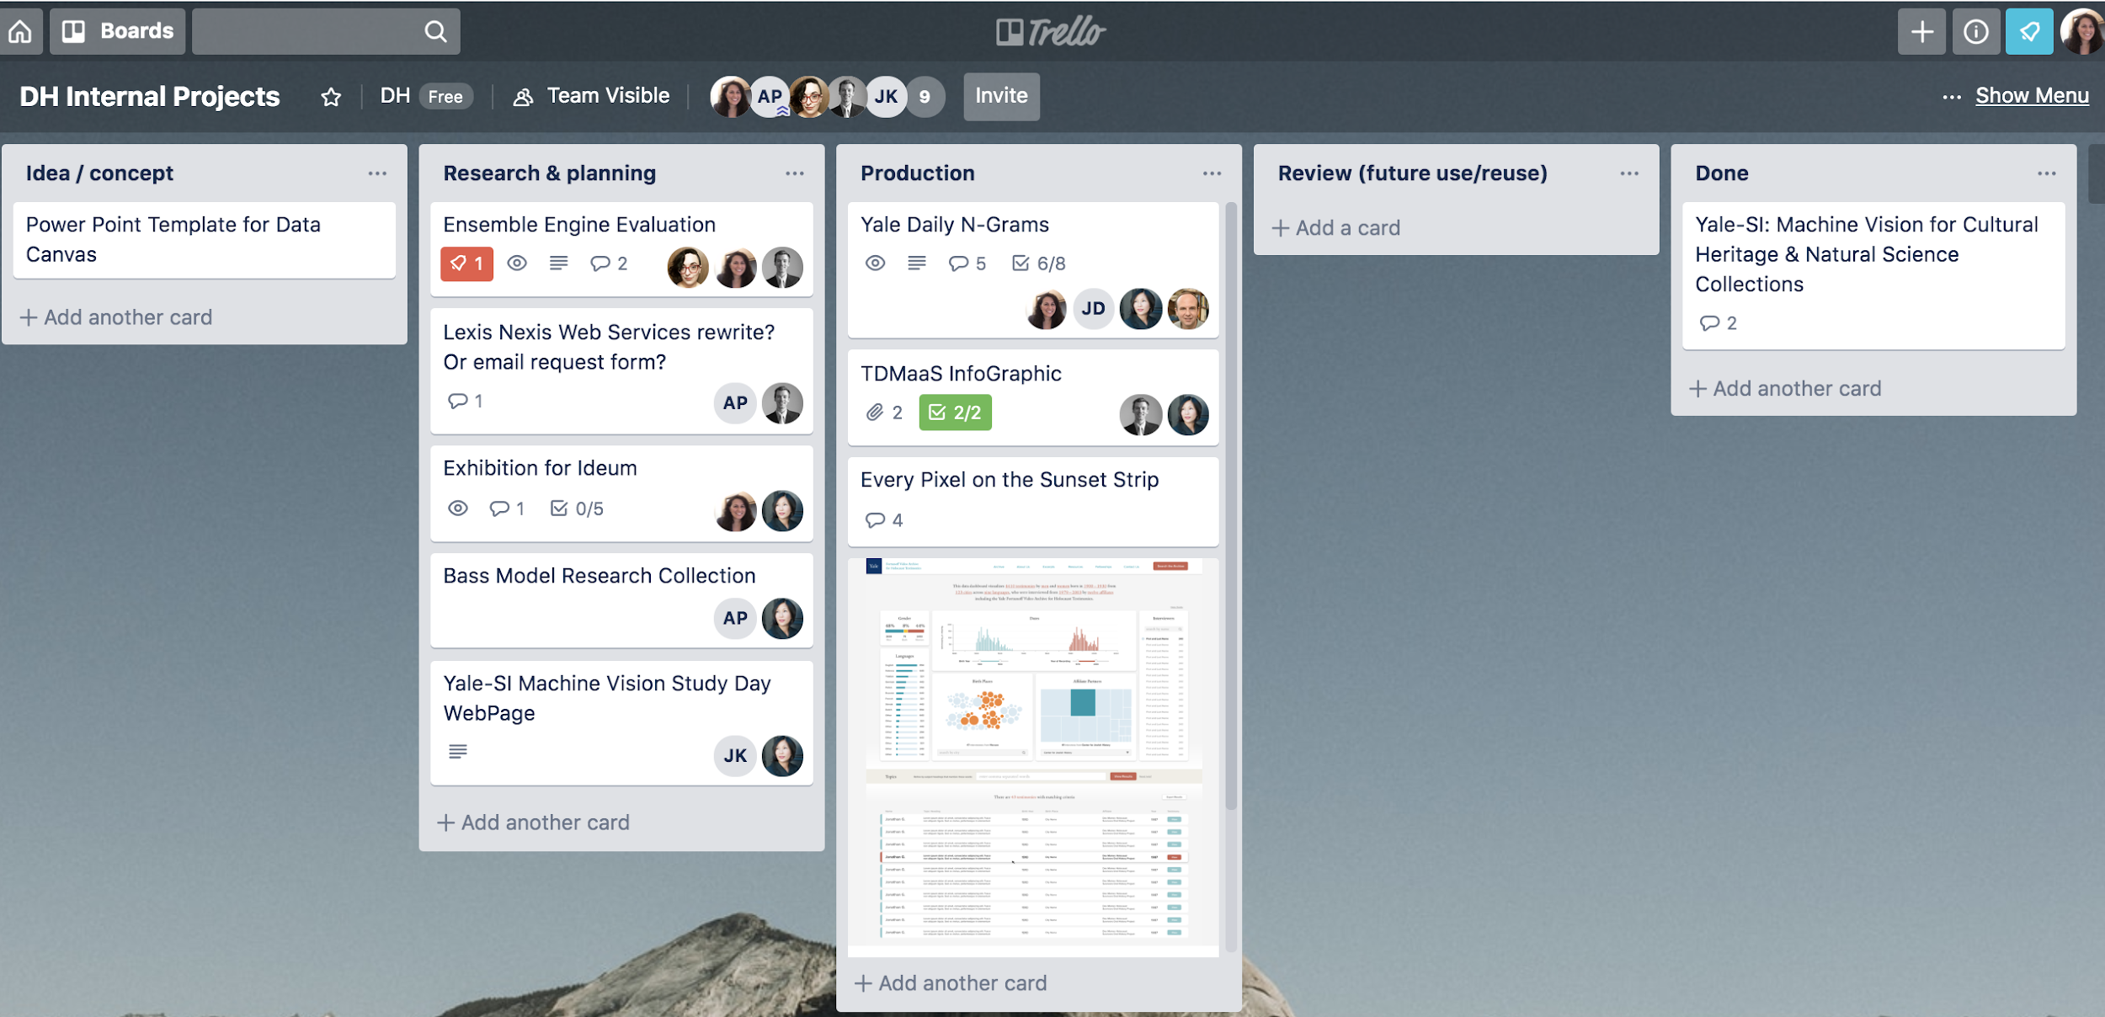
(Please don’t share this slide!)

Slide 18
GitHub
https://github.com
Includes version control, along with places for documentation and issue tracking
Notes:
Link to image: DHLab GitHub https://github.com/YaleDHLab/dhlab-site/issues

Slide 19
Assessment

Slide 20
Class-created criteria
What makes a DH project successful?
How much does the technical sophistication of the project matter?
How much does the aesthetic design of the project matter?

Slide 21
MLA & AHA guidelines
What recommendations or criteria emerge?
Are MLA and AHA in agreement or are there places where they differ (either in what they’re advocating for or in the areas they emphasize)?
Notes:
MLA guidelines: https://www.mla.org/About-Us/Governance/Committees/Committee-Listings/Professional-Issues/Committee-on-Information-Technology/Guidelines-for-Evaluating-Work-in-Digital-Humanities-and-Digital-Media
AHA: https://www.historians.org/teaching-and-learning/digital-history-resources/evaluation-of-digital-scholarship-in-history/guidelines-for-the-professional-evaluation-of-digital-scholarship-by-historians

Slide 22
Pretend you’re on a tenure committee
History Matters: The U.S. Survey Course on the Web: http://historymatters.gmu.edu/
Our Marathon: The Boston Bombing Digital Archive: https://marathon.library.northeastern.edu/
Colored Conventions: http://coloredconventions.org/
Remixing Rural Texts: Local Texts, Global Contexts: http://faculty.tamuc.edu/rrt/index.html
Above examples from 2017 MLA “Evaluating Scholarship at the Boundaries” workshop, led by Cheryl Ball

Slide 23
Questions to consider
What method(s) does the project employ?
Where does the data come from and what’s been done to it?
What is the visualization/project trying to communicate and how can you tell?
How do the design decisions affect your interpretation of the visualization/project?
What new insights might the visualization or larger project offer and to whom?
Who are the project team members, what are their roles, and what were their contributions?

