Slide 1
Introduction to Topic Modeling
Catherine DeRose, PhD | HILT 2019
CC-BY

Slide 2
Agenda
What is topic modeling?
What can that approach help you see?
Where can you find datasets?
How can you generate topic models?
Hands-on practice with Topic Modeling Jar

Slide 3
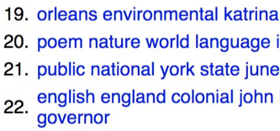
Topic Modeling
WHAT: Statistical, unsupervised technique for identifying topics or discourses in a collection of texts
WHY: To discover latent topics in your corpus, possibly over time, or to find new texts of interest
HOW: Mallet, Topic Modeling Jar

Slide 4
Topic Modeling How, Continued
Both Mallet and Topic Modeling Jar use Latent Dirichlet Allocation (LDA), a generative statistical model
LDA works from the following assumption: a document is made up of topics (in different proportions) and those topics are made up of words (that have different probabilities of appearing in passages describing the topic)

Slide 5
Bag-of-Words Model
The granular unit of text — whether that be a single sentence or an article — is represented by all of the words in it (except for words in the stoplist, which are not counted)
Grammar is ignored, but the frequency with which individual words occur is counted

Slide 6
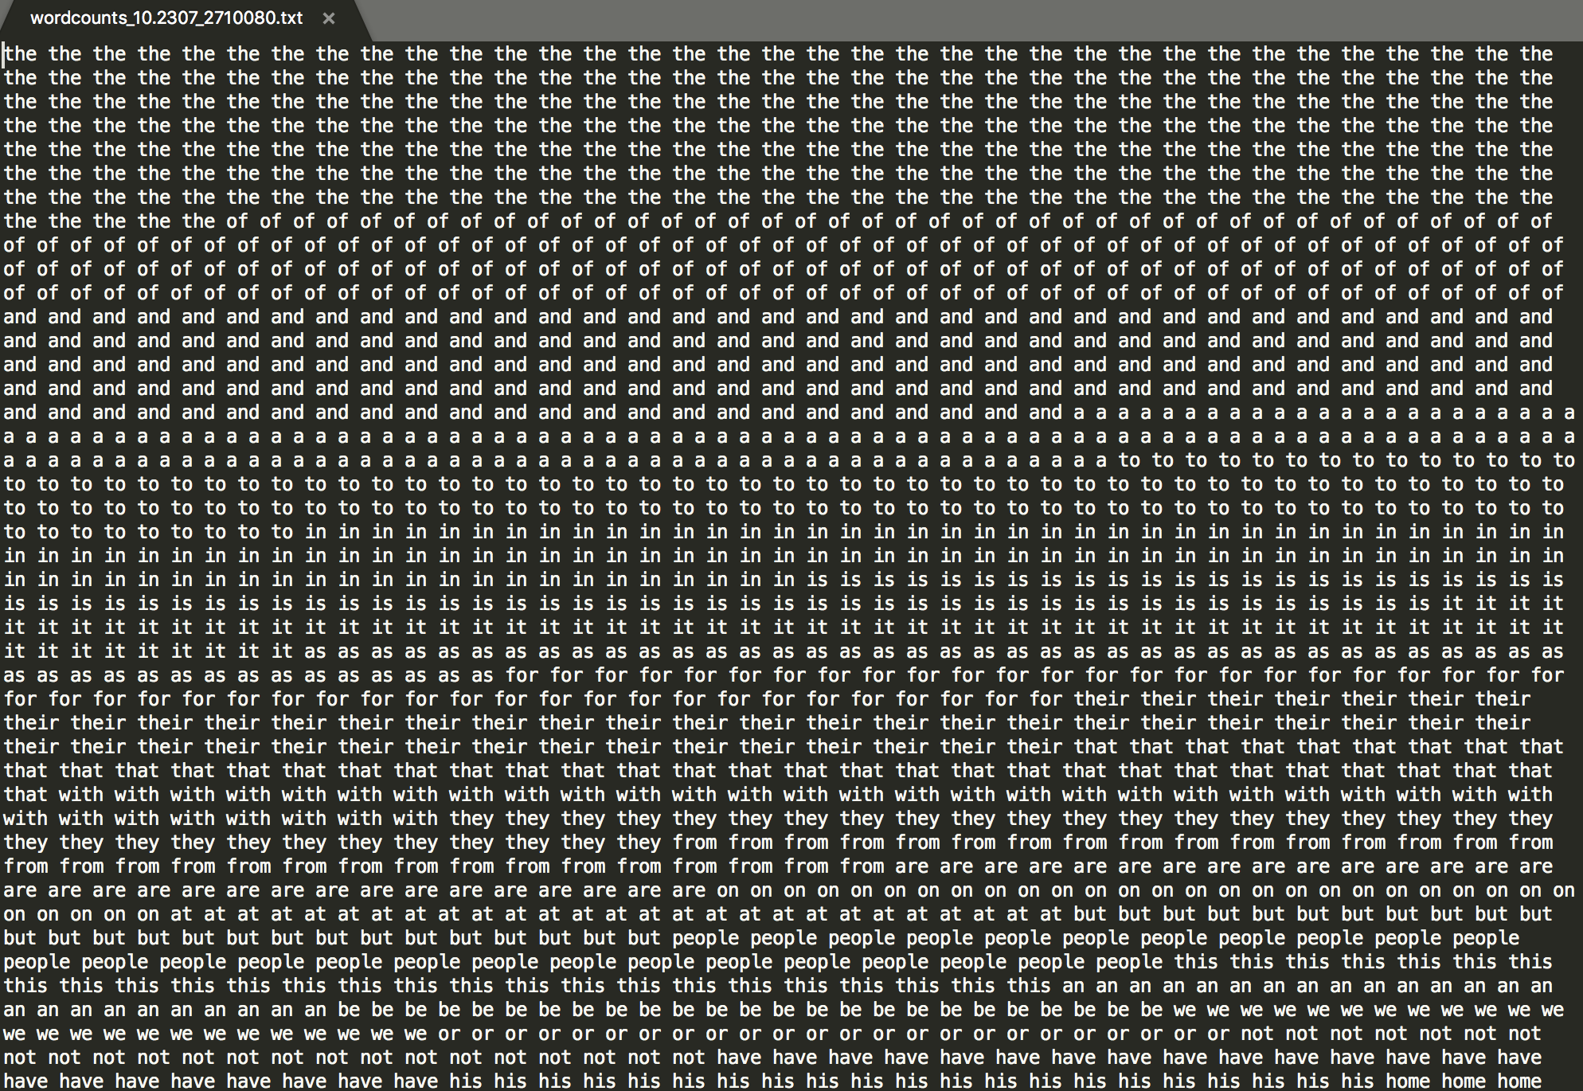
Notes:
Article from American Studies transformed into a bag of words

Slide 7
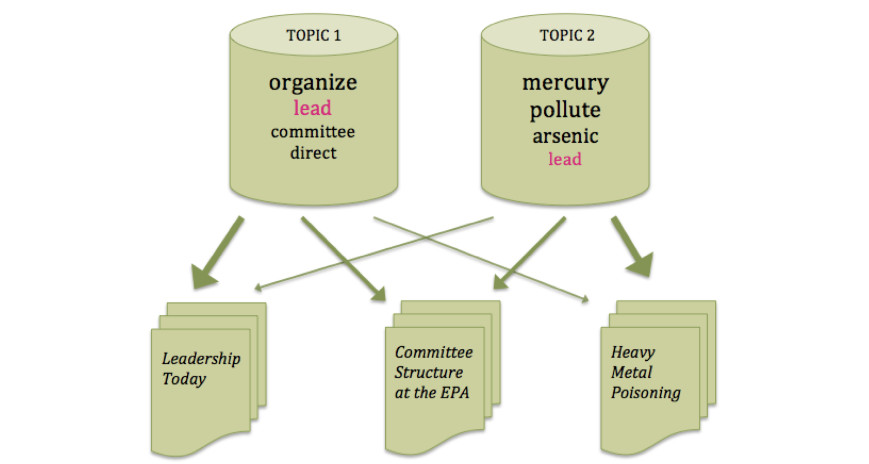
Image source: Ted Underwood, “Topic Modeling Made Just Simple Enough”

Slide 8
Sample Projects
What do the topic models highlight, suggest, or help you see?
How much assistance does the site provide for interpreting the topic models and underlying data?
Mining the Dispatch: https://dsl.richmond.edu/dispatch/
The HistoryMakers Archive: https://www.thehistorymakers.org/digital-humanities
Topics in PMLA: https://agoldst.github.io/dfr-browser/demo/
Accompanying article
Notes:
Link to PMLA article: http://journalofdigitalhumanities.org/2-1/what-can-topic-models-of-pmla-teach-us-by-ted-underwood-and-andrew-goldstone/

Slide 9
Where to find Data
JSTOR Data for Research: https://www.jstor.org/dfr/
DH Toychest: http://dhresourcesforprojectbuilding.pbworks.com/w/page/69244243/FrontPage
Project Gutenberg: https://www.gutenberg.org/

Slide 10
Practice with Topic Modeling
TOOL: Topic Modeling Tool, which uses MALLET, runs locally and works well with plain text
DOCUMENTATION: https://senderle.github.io/topic-modeling-tool/documentation/2017/01/06/quickstart.html

Slide 11
Follow-Up Tutorial
Programming Historian: https://programminghistorian.org/en/lessons/topic-modeling-and-mallet

