Slide 1
AI-BNCT
Status update

Slide 2
Original approach
“Use generative models to reproduce BNCT data and replace Geant4/Chemistry simulations”
Two possible targets:
1. Predict damage directly from initial particle conditions (mainly geometry) – doable but probably not our goal
2. Generate local transport first (Gen-AI), then predict damage
    Use StEG to generate G4/G4-DNA output: e.g., tracking quantities, DNA damage

Slide 3
Why the original data was difficult
Tracking information was incomplete for non-damaging primaries (i.e. only positive cases available)
Geometry and response variables were mixed in the same generated feature set
The number of independent primaries was small

Slide 4
Single particle voxel approach (NEW)
Transport one alpha or lithium ion through a water voxel grid
Record the particle state whenever it enters a 300nm voxel
Replay each voxel entry in Geant4-DNA to calculate damage
Join local transport and DNA damage using event and voxel IDs
Target:
- Particle + initial energy + direction + distance -> local transport and damage per voxel
- Sample local transport and damage at a requested distance.

Slide 5
Multi-step baseline models
Before using generative models, use traditional ML models to obtain baseline results
Range models – estimate maximum observed distance (regression)
Transport models – estimate transport output per voxel (local energy, eDep, steps, track length, LET, …)
Damage models – Estimate damage (SB, DSB, cDSB) probability per voxel
Initial conditions
Range check
Local transport
DNA damage in the voxel

Slide 6
Pilot dataset and models tested
Quick test. Currently have:
  10,686 recorded hit voxels
  400 independent simulated primaries
    two alpha energies and two lithium energies
  Train/test split are made by primary
  Running more.
Initial ML test results:
  Range: gradient-boosted quantile regression
  Transport: Extra Trees regression
  Damage: Extra Trees classification and count regression

Slide 7
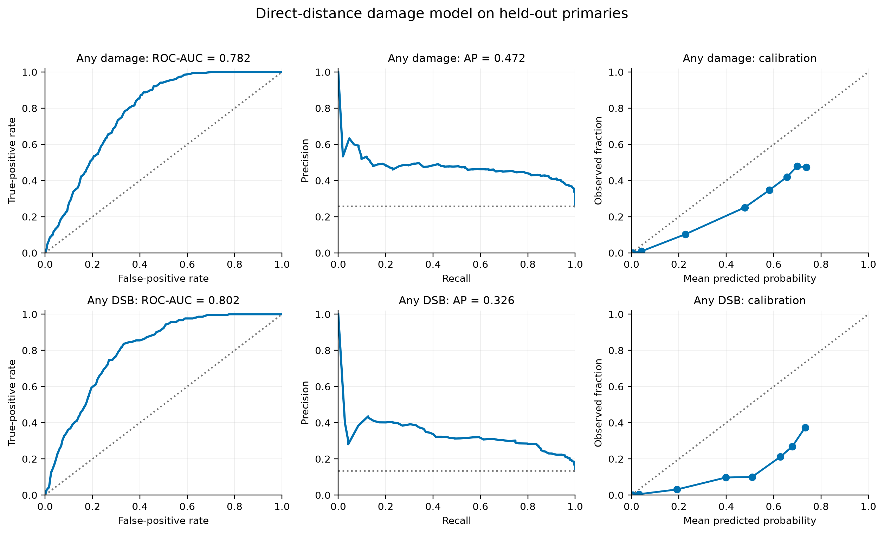
Preliminary results – Damage model
Model ranks damage risk reasonably well, but probabilities are too high and need calibration

Slide 8
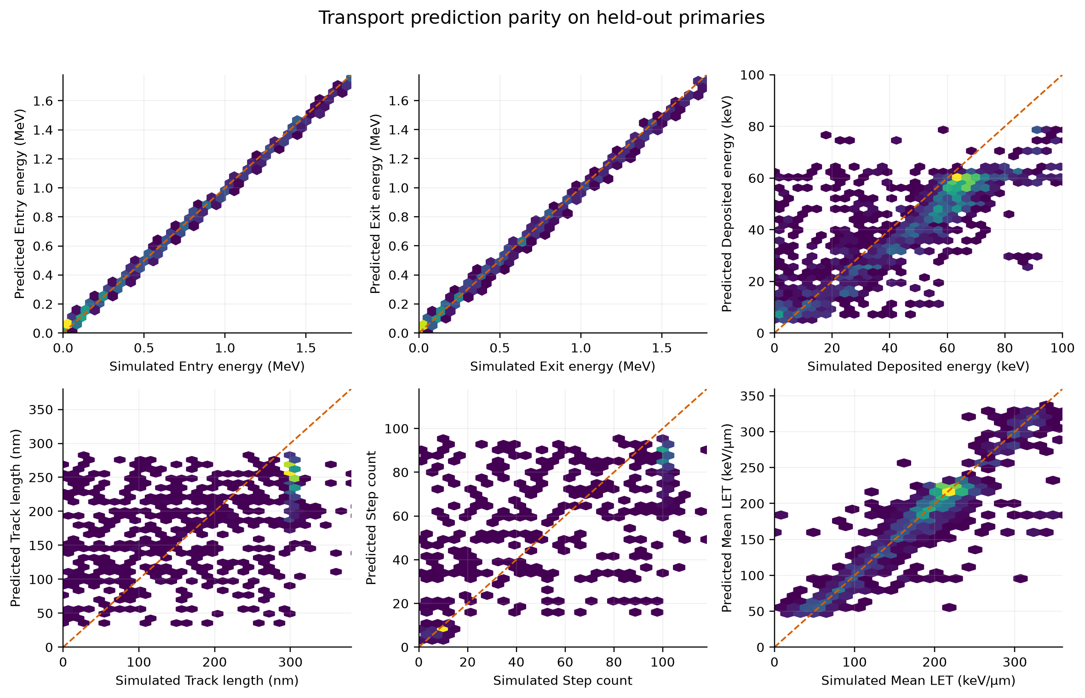
Preliminary results – Transport model
Energy is highly predictable; depositions and track structure fluctuate much more

Slide 9
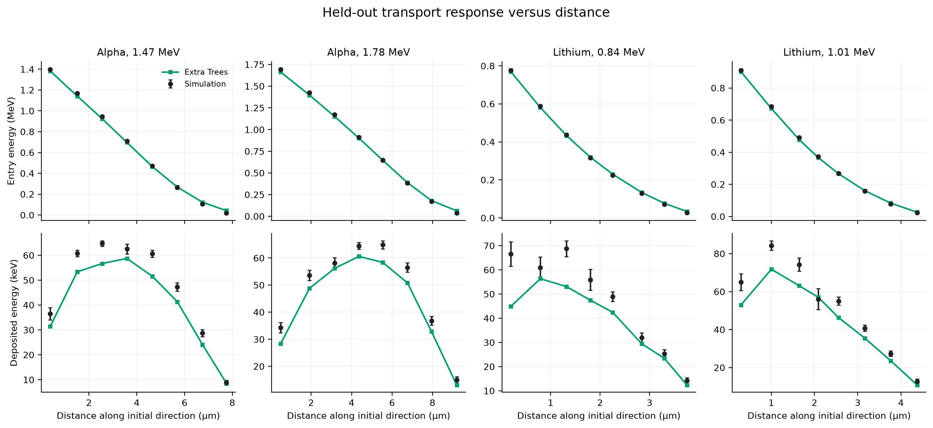
Preliminary results – Transport vs distance

Slide 10
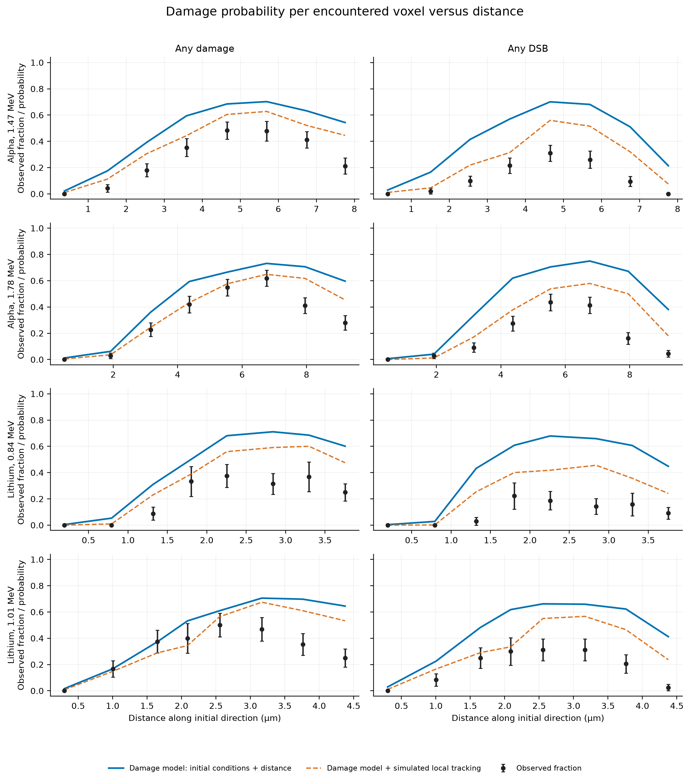
Damage vs distance
Black: Geant4-DNA observations
Blue: direct-distance damage model
Orange: damage model supplied with Geant4 local tracking

Slide 11
Next step: conditional StEG
Generate a distribution of local transport quantities at a requested distance
Pass sampled transport states into the damage model
Compare with the direct-distance baseline
Current status: training pipeline tested; generating more data

