Slide 1
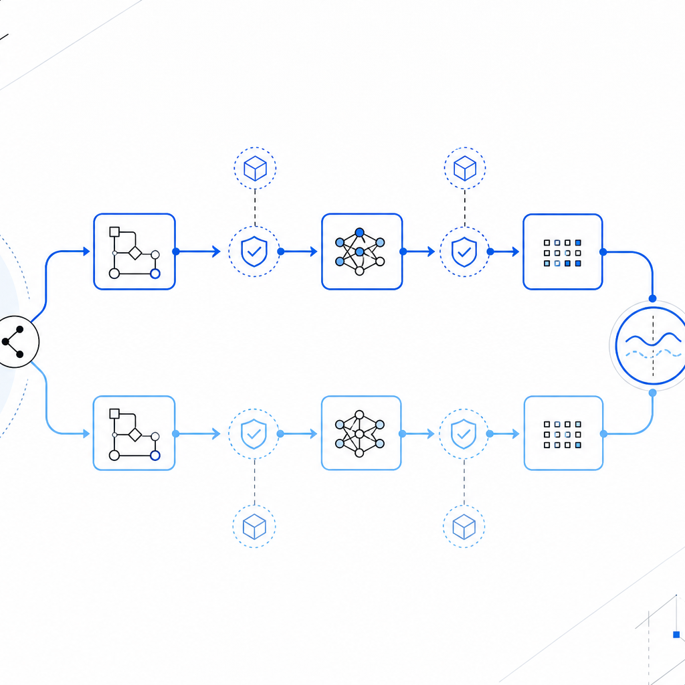
ENGINEERING METHOD
Benchmarking
workflow orchestration
A controlled before/after experiment for workflow changes
Validation harness — not the feature delivery path
01
Notes:
[Sources]
- Generated cover visual: OpenAI image generation; local file recorded in source-notes.txt
- Repository benchmark design: benchmarks/layered-tdd/README.md
[/Sources]

Slide 2
The harness wraps the workflow; it does not ship with it
NORMAL FEATURE USAGE
ORCHESTRATION VALIDATION
Request
Real feature
Workflow
Human gates + agents
Output
Verified feature
Fixture
Fresh repository
Run
Fixed playbook
Measure
Logs + evaluator
The workflow produces the feature.
The harness measures the workflow.
02
Notes:
[Sources]
- benchmarks/layered-tdd/README.md — Controlled Shape and Quick Path
[/Sources]

Slide 3
A valid comparison changes one orchestration variable
FIXTURE
TASK
EXECUTION
DECISIONS
VERIFICATION
Same commit
Same request
Same model
Same gate playbook
Same mode
ONLY VARIABLE
Workflow implementation under test
Route deviations are evidence—not comparable measurements.
03
Notes:
[Sources]
- benchmarks/layered-tdd/README.md — Fairness Checklist
[/Sources]

Slide 4
The experiment is symmetrical before and after the change
01
02
03
04
05
06
Materialize
Run ×3
Qualify
Change
Run ×3
Compare
Fresh baseline fixture
Fixed playbook
Oracle + boundary
Workflow only
Fresh candidate fixture
Successful medians
Same route • same layers • same decisions
04
Notes:
[Sources]
- benchmarks/layered-tdd/README.md — Quick Path, Fixed Gate Playbook, Fairness Checklist
[/Sources]

Slide 5
Two independent checks qualify every completed run
BEHAVIOR ORACLE
CHANGE BOUNDARY
✓
Does the feature work?
⌁
Did edits stay in scope?
Temporary reference tests
run with go test ./...
git status paths checked
against an allowlist
↓
+
↓
BOTH PASS
Comparable run
One failure → exclude from medians and report separately
05
Notes:
[Sources]
- benchmarks/layered-tdd/scripts/evaluate.py
- benchmarks/layered-tdd/oracle/internal/orders/cancellation_oracle_test.go
- benchmarks/layered-tdd/oracle/internal/httpapi/cancel_oracle_test.go
[/Sources]

Slide 6
Comparable runs form the dataset; failures remain diagnostics
COUNTED
EXCLUDED AND EXPLAINED
3 × baseline
+
3 × candidate
×
Unexpected gate
×
Revision / retry deviation
×
Provider or workflow failure
Same route + oracle pass + boundary pass
Never dilute the median with a different route.
06
Notes:
[Sources]
- benchmarks/layered-tdd/README.md — Fixed Gate Playbook and Fairness Checklist
[/Sources]

Slide 7
Example: fewer model calls, lower orchestration cost
ONE BENCHMARKED WORKFLOW CHANGE
−28.6%
model invocations
−22.3%
input tokens
3/3 → 3/3
oracle + boundary passes
07
Notes:
[Sources]
- Collected benchmark medians from state-agents-before and deterministic-state-after runs
- benchmarks/layered-tdd/scripts/compare-results.py
[/Sources]

Slide 8
REUSABLE BENCHMARK CONTRACT
Control the route.
Qualify the output.
Compare the medians.
BASELINE
↓
CANDIDATE
↓
EVIDENCE
Use the harness to validate orchestration changes—not to deliver the feature.
08
Notes:
[Sources]
- benchmarks/layered-tdd/README.md
[/Sources]

