Slide 1

Adam Kurkiewicz

Slide 2
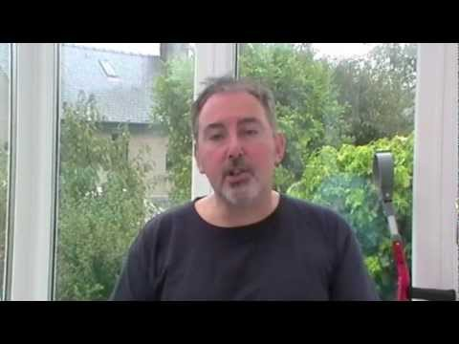
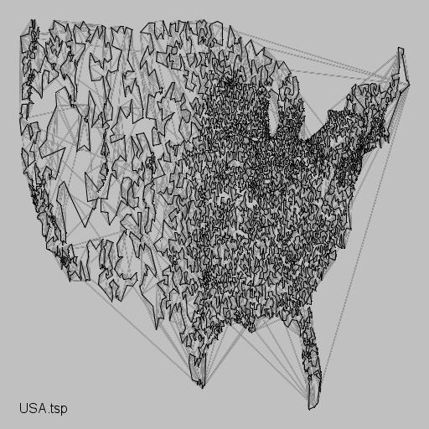
TSP Challenge

Slide 3
TSP Challenge
Impossibly Difficult Problems

Slide 4

TSP
Travelling
Salesman
Problem

Slide 5
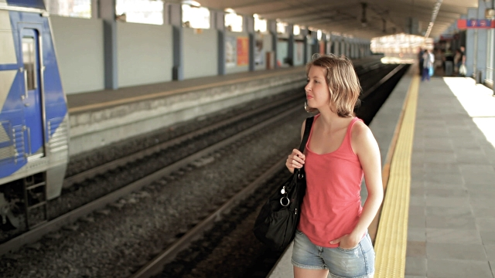
TSP
Touring my
Sister
Problem

Slide 6
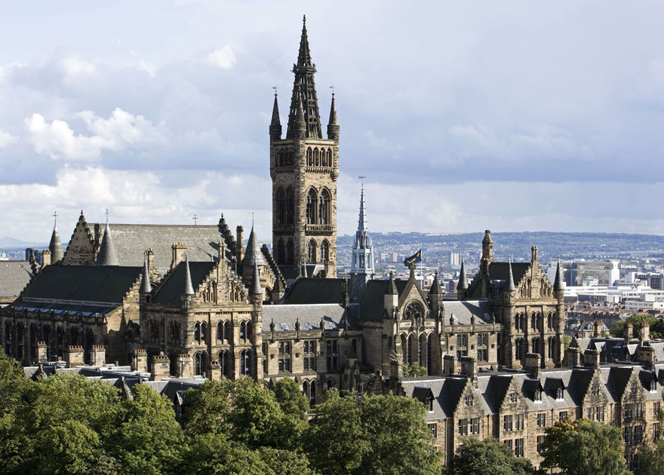

Slide 7
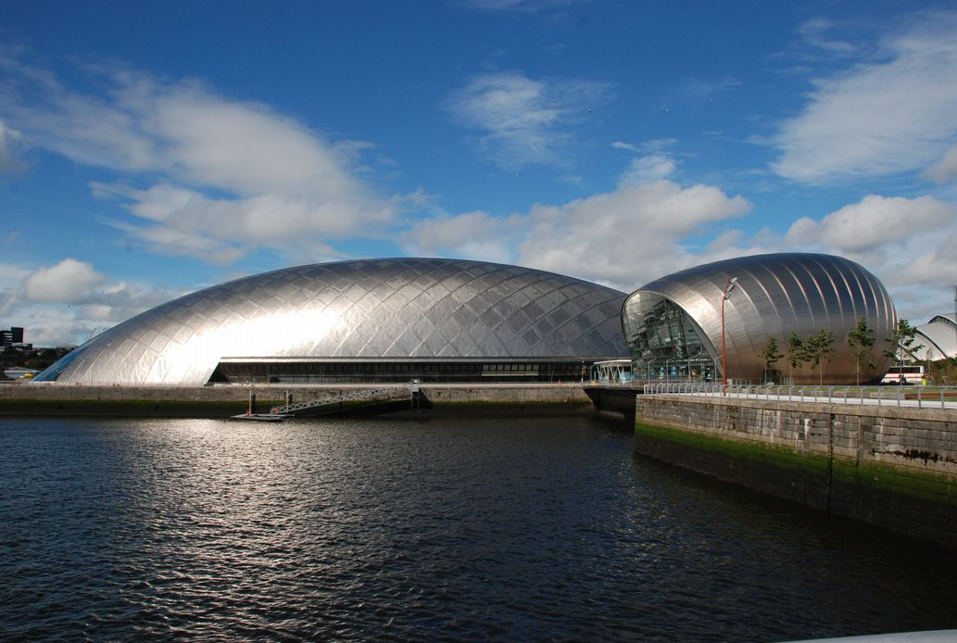

Slide 8
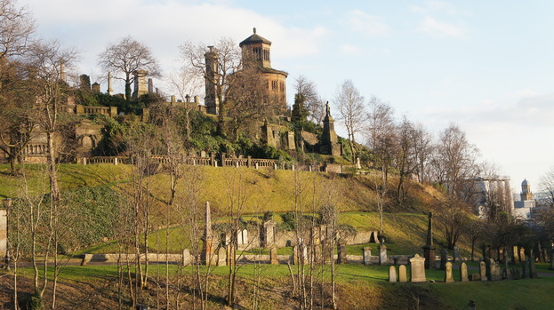

Slide 9
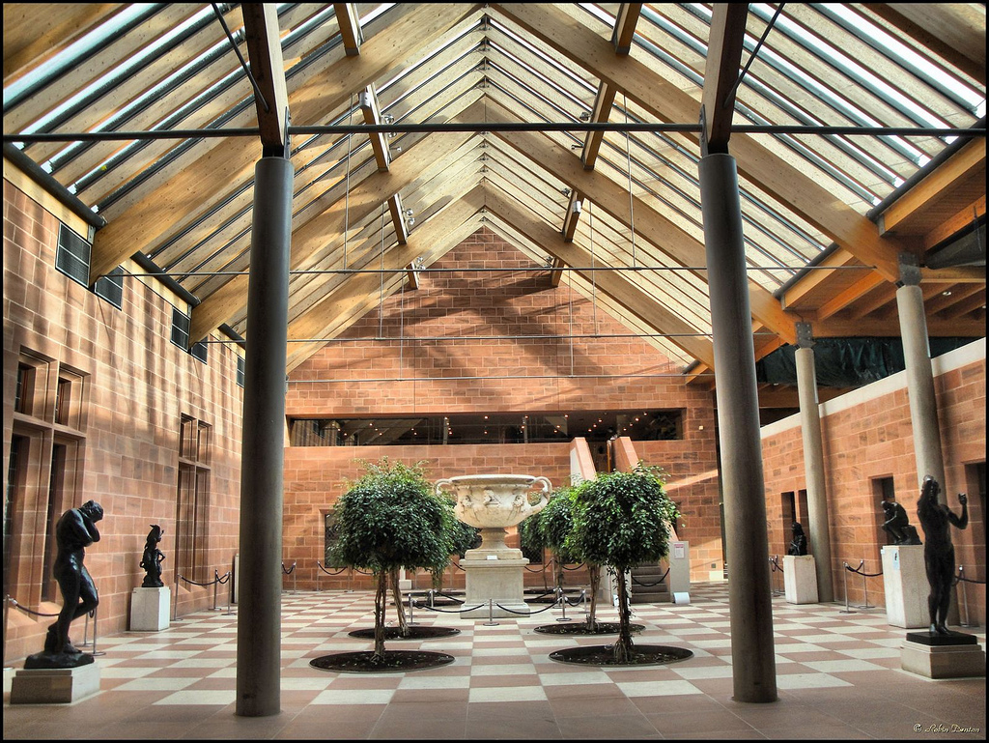

Slide 10
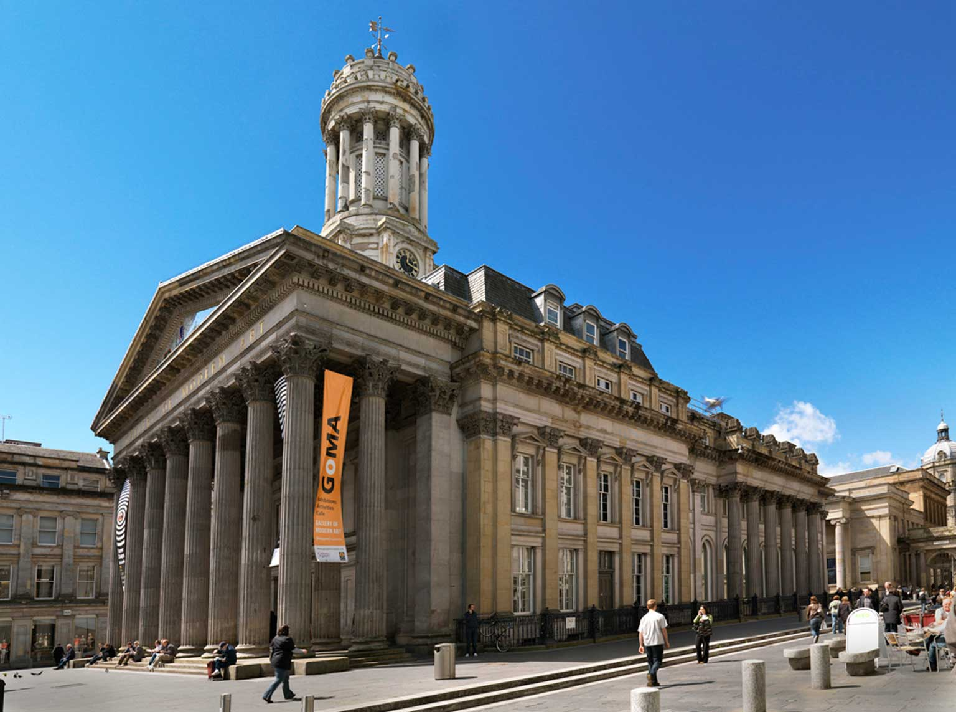

Slide 11
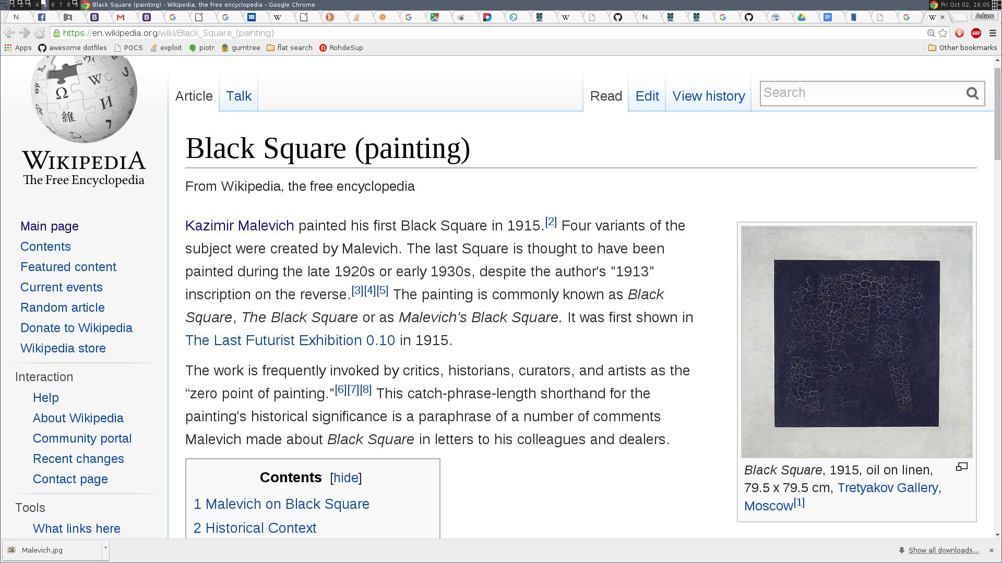
Kazimir Malevich “Black Square”

Slide 12
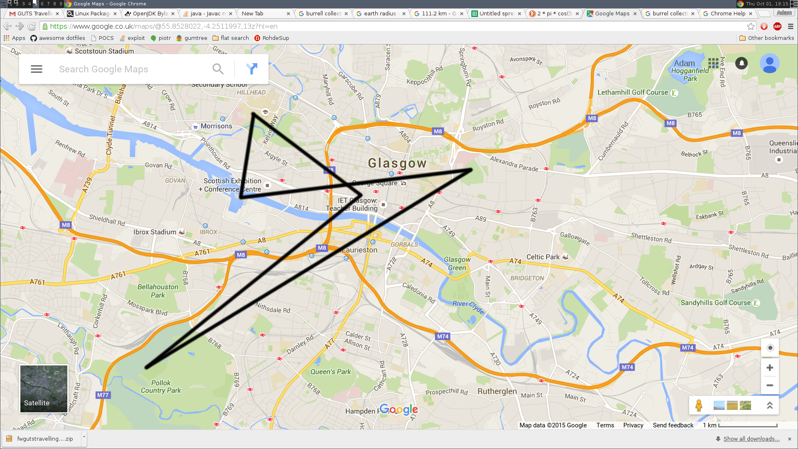
University
Necropolis
Gallery of Modern Arts
Science Centre
Burrell Collection

Slide 13
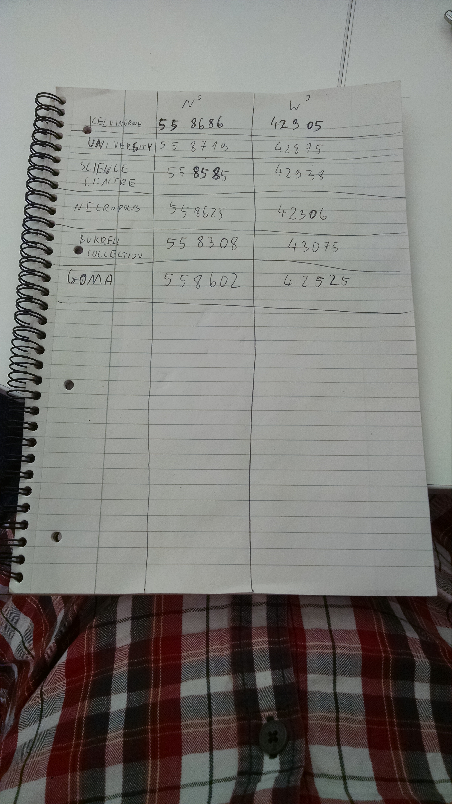

Slide 14
Glasgow University
Science Centre
Necropolis
Burrell
GOMA
The route is an index permutation

Slide 15
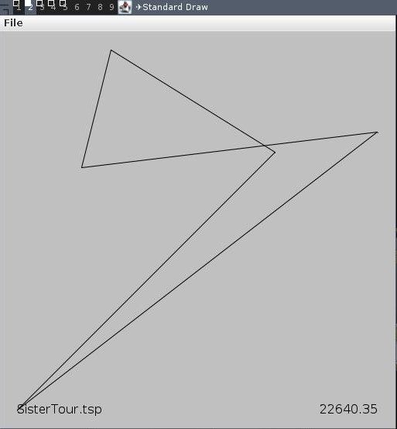
University
Necropolis
Science Centre
Gallery of Modern Arts
Burrell Collection
java Display SisterTour.tsp SisterTour.sol

Slide 16
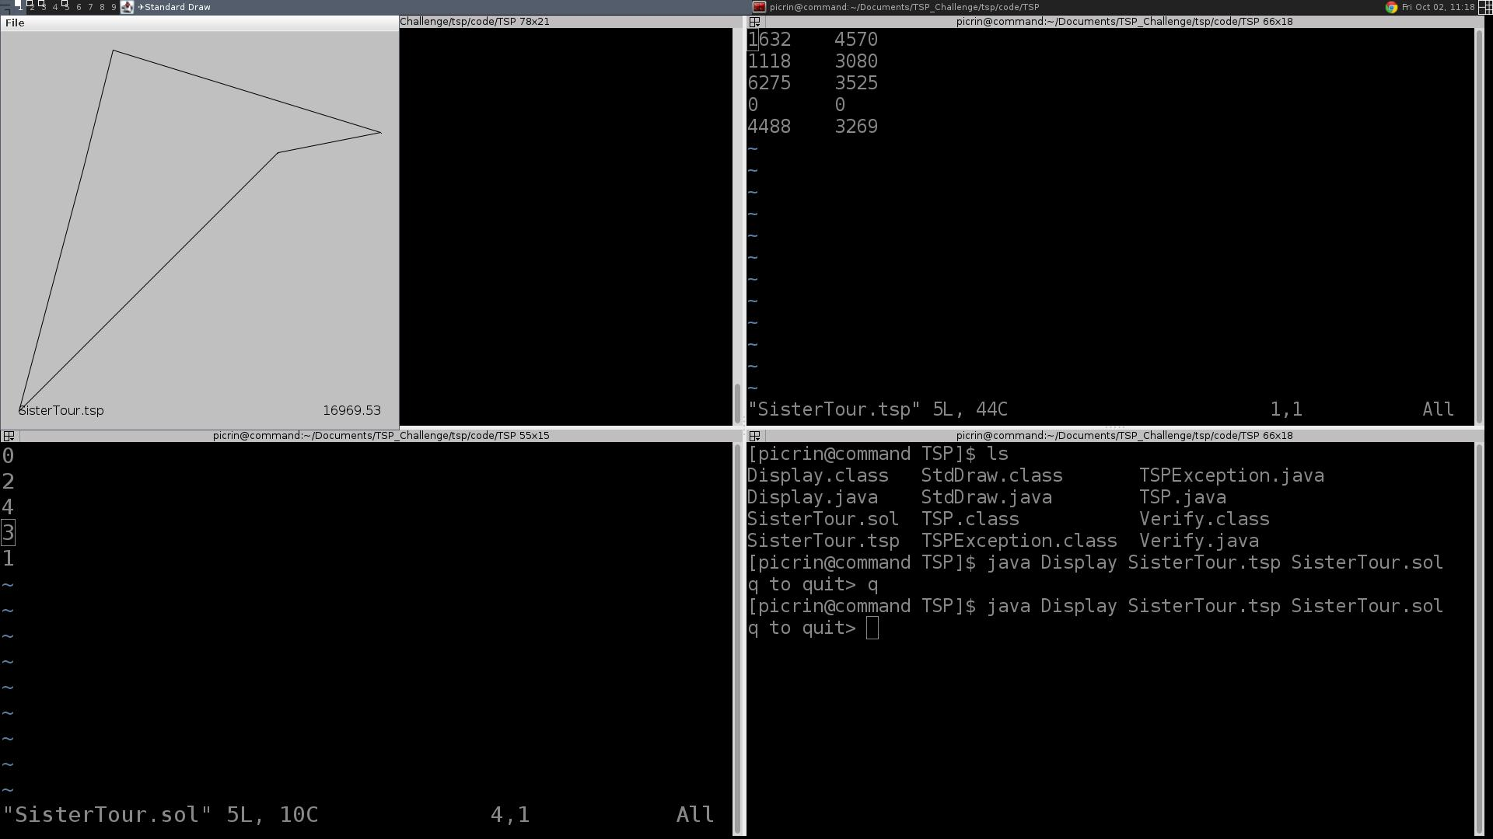
Can we do better?

Slide 17
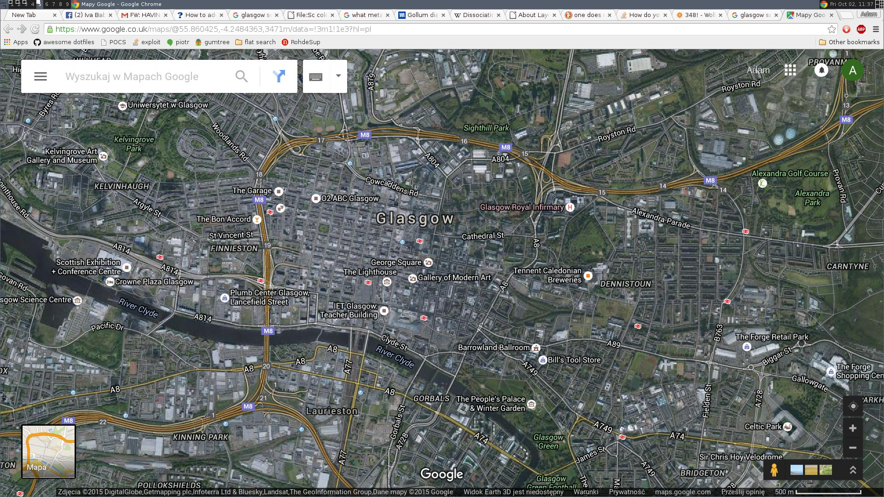
My Sister really liked glasgow
She wants to see all of it

Slide 18
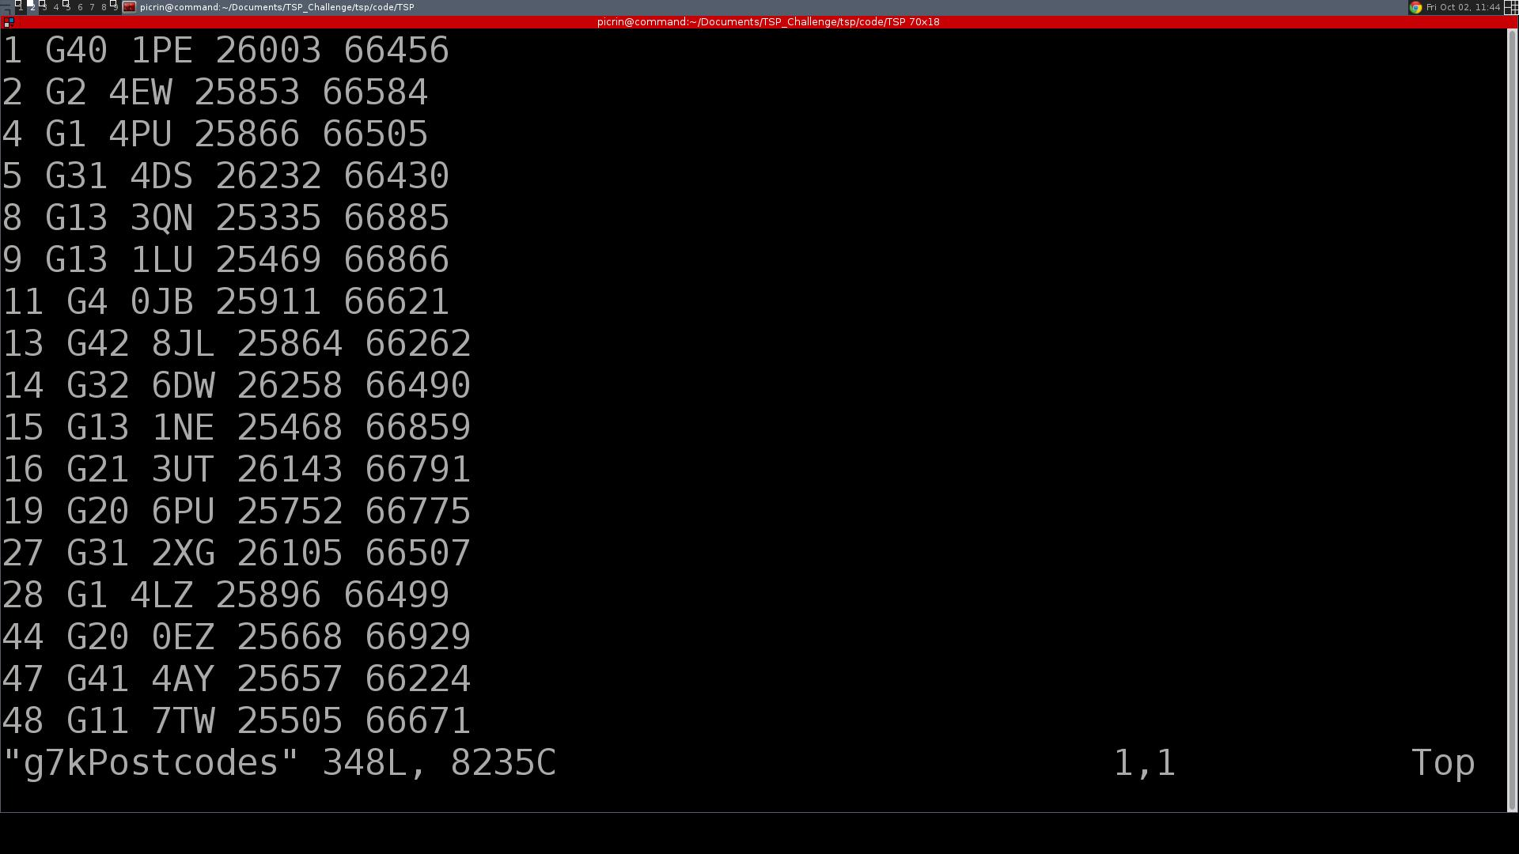
348 postcodes within 7 miles from George Square

Slide 19
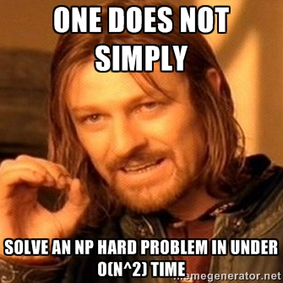

Slide 20
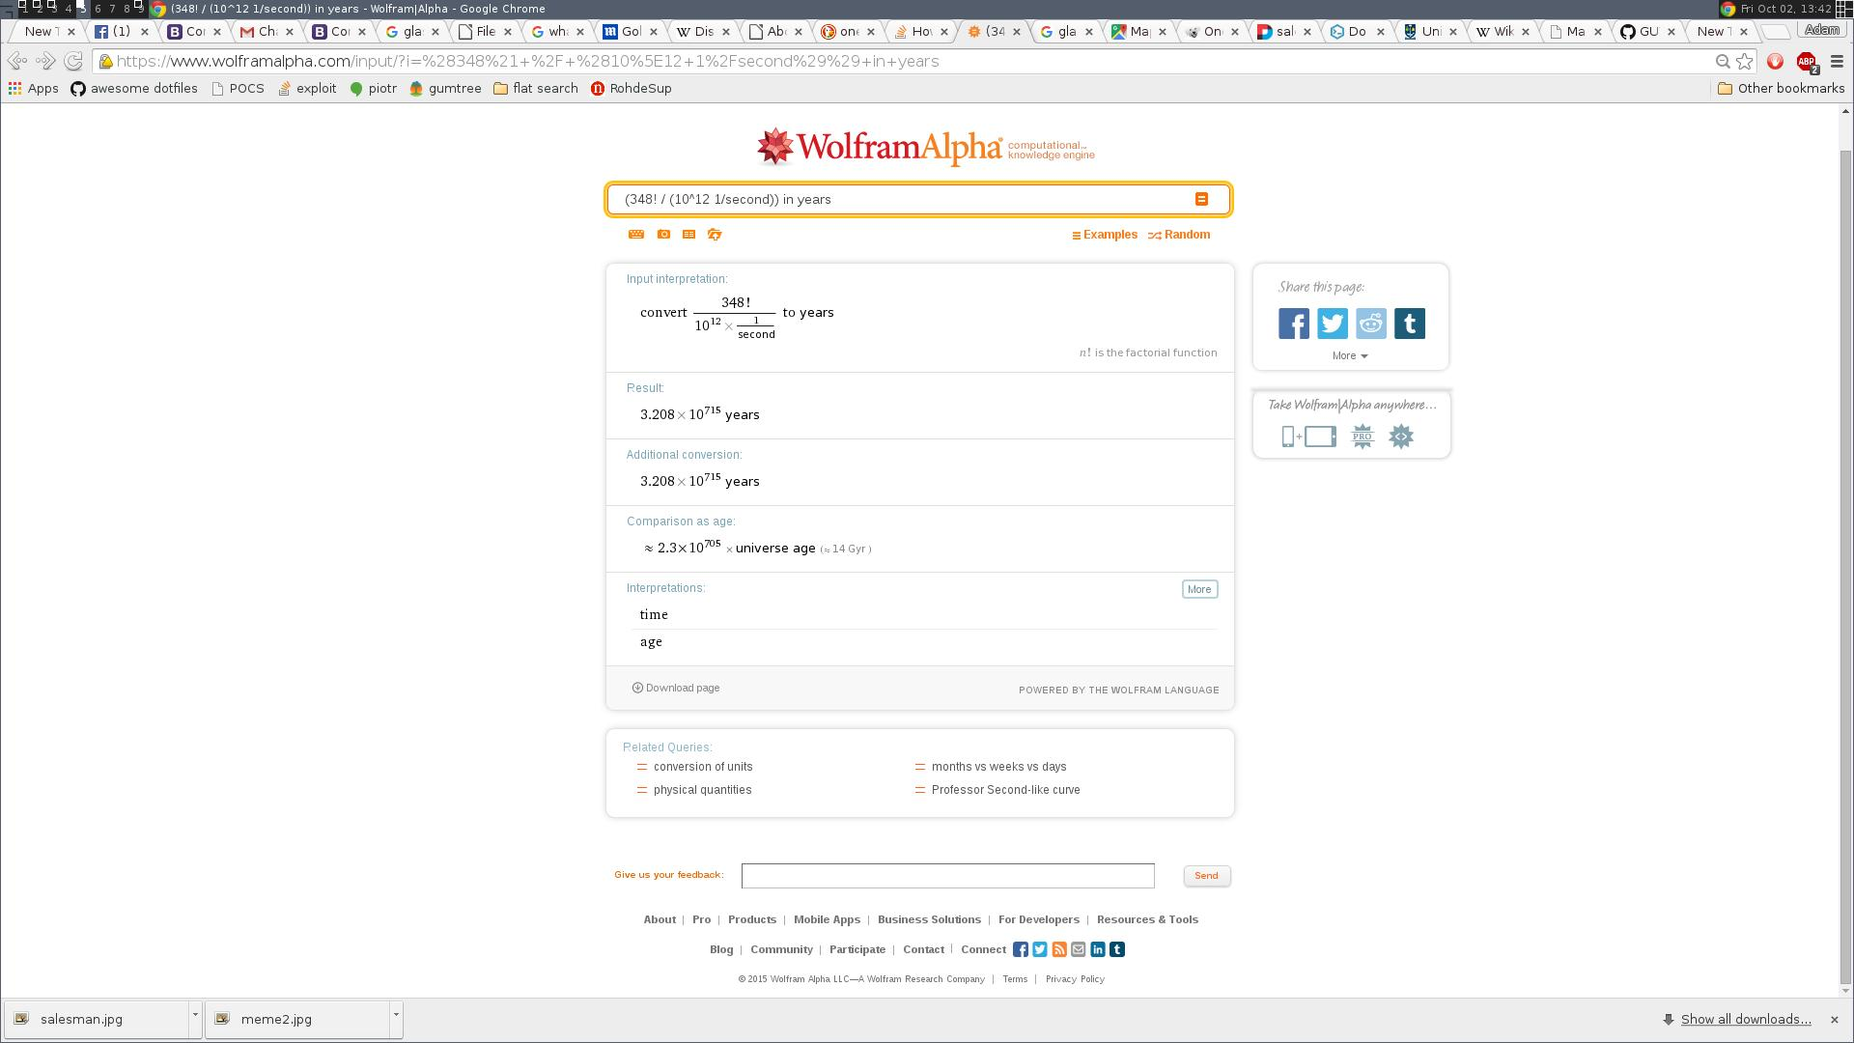

Slide 21
You don't have to solve it!
It's enough if you find a better solution than other teams.

Slide 22
You don't have to solve it!
It's enough if you find a better solution than other teams.
Extremely well studied problem. You can find a vast body of research describing good approximation algorithms.

Slide 23
You don't have to solve it!
It's enough if you find a better solution than other teams.
Extremely well studied problem. You can find a vast body of academic papers that describe good approximation algorithms.
Pat Prosser will be here on Saturday & Sunday to help you

Slide 24
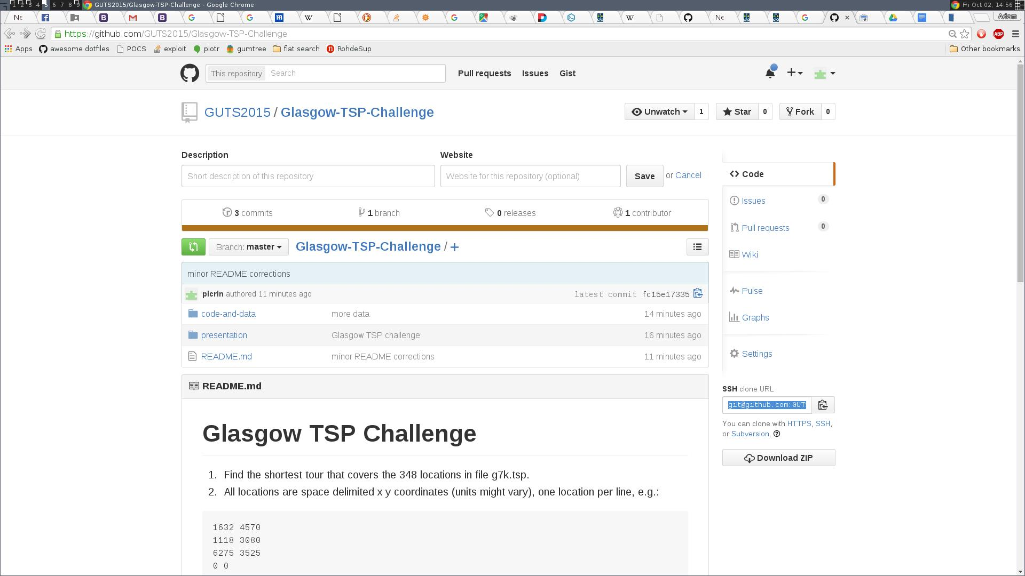
Detailed instructions on github.com/GUTS2015

