Slide 1

Extended pseudo-Voigt function for approximating the Voigt profile
T. Ida, M. Ando and H. Toraya
Volume 33 | Part 6 | December 2000 | Pages 1311–1316 |
Notes:
The formula of the pseudo-Voigt function is extended in order to improve the accuracy when approximating the Voigt profile. When the extended formula is applied for curve fitting to a Voigt profile, the accuracy of the estimated profile parameters can be improved considerably.

Slide 2
Extended pseudo-Voigt function for approximating the Voigt profile
The formula of the pseudo-Voigt function is extended in order to improve the accuracy when approximating the Voigt profile. When the extended formula is applied for curve fitting to a Voigt profile, the accuracy of the estimated profile parameters can be improved considerably.
Ida et al.
Volume 33 | Part 6 | December 2000 | Pages 1311–1316 |
Notes:
The formula of the pseudo-Voigt function expressed by a weighted sum of Gaussian and Lorentzian functions is extended by adding two other types of peak functions in order to improve the accuracy when approximating the Voigt profile. The full width at half-maximum (FWHM) values and mixing parameters of the Gaussian, the Lorentzian and the other two component functions in the extended formula can be approximated by polynomials of a parameter ρ = ΓL/(ΓG + ΓL), where ΓG and ΓL are the FWHM values of the deconvoluted Gaussian and Lorentzian functions, respectively. The maximum deviation of the extended pseudo-Voigt function from the Voigt profile is within 0.12% relative to the peak height when sixth-order polynomial expansions are used. The systematic errors of the integrated intensity ΓG and ΓL, estimated by fitting the extended formula to Voigt profiles, are typically less than 1/10 of the errors arising from the application of the original formula of the pseudo-Voigt approximation proposed by Thompson et al. [J. Appl. Cryst. (1987), 20, 79–83], while the time required for computation of the extended formula is only about 2.5 relative to the computation time required for the original formula.

Slide 3
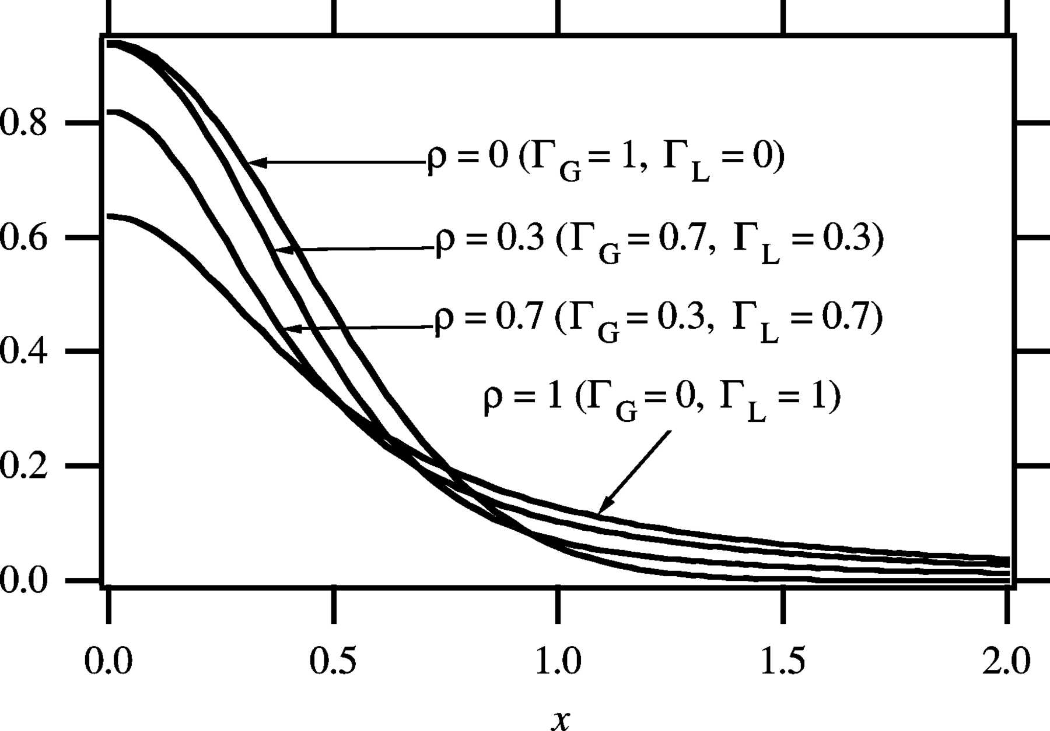
Figure 1. The Voigt profiles on variation of the Gaussian and Lorentzian FWHM values, Γ_{G} and Γ_{L}.
Ida et al.
Volume 33 | Part 6 | December 2000 | Pages 1311–1316 |
Notes:
The Voigt profiles on variation of the Gaussian and Lorentzian FWHM values, ΓG and ΓL. [Ida, T., Ando, M. and Toraya, H. (2000). J. Appl. Cryst. 33, 1311-1316. ]

Slide 4
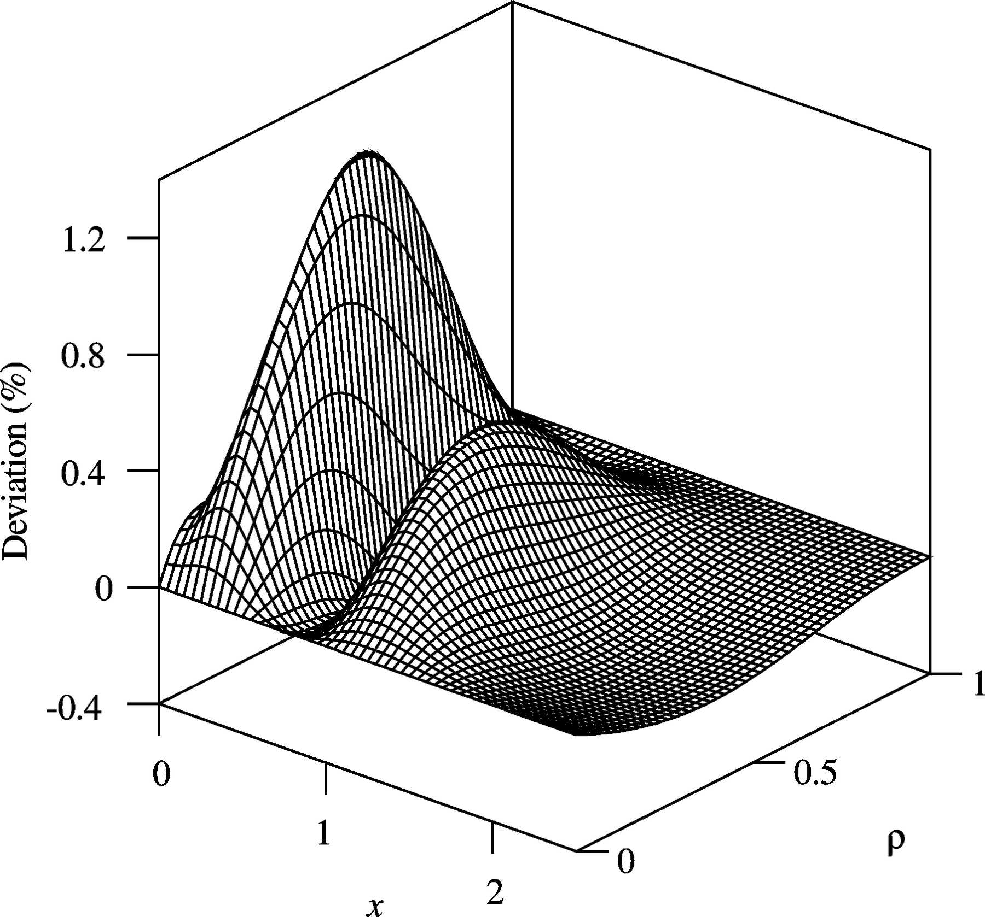
Figure 2. Three-dimensional plot of the deviation of the pseudo-Voigt function calculated by the formula proposed by Thompson et al. (1987) from the Voigt profile relative to the peak height.
Ida et al.
Volume 33 | Part 6 | December 2000 | Pages 1311–1316 |
Notes:
Three-dimensional plot of the deviation of the pseudo-Voigt function calculated by the formula proposed by Thompson et al. (1987) from the Voigt profile relative to the peak height. [Ida, T., Ando, M. and Toraya, H. (2000). J. Appl. Cryst. 33, 1311-1316. ]

Slide 5
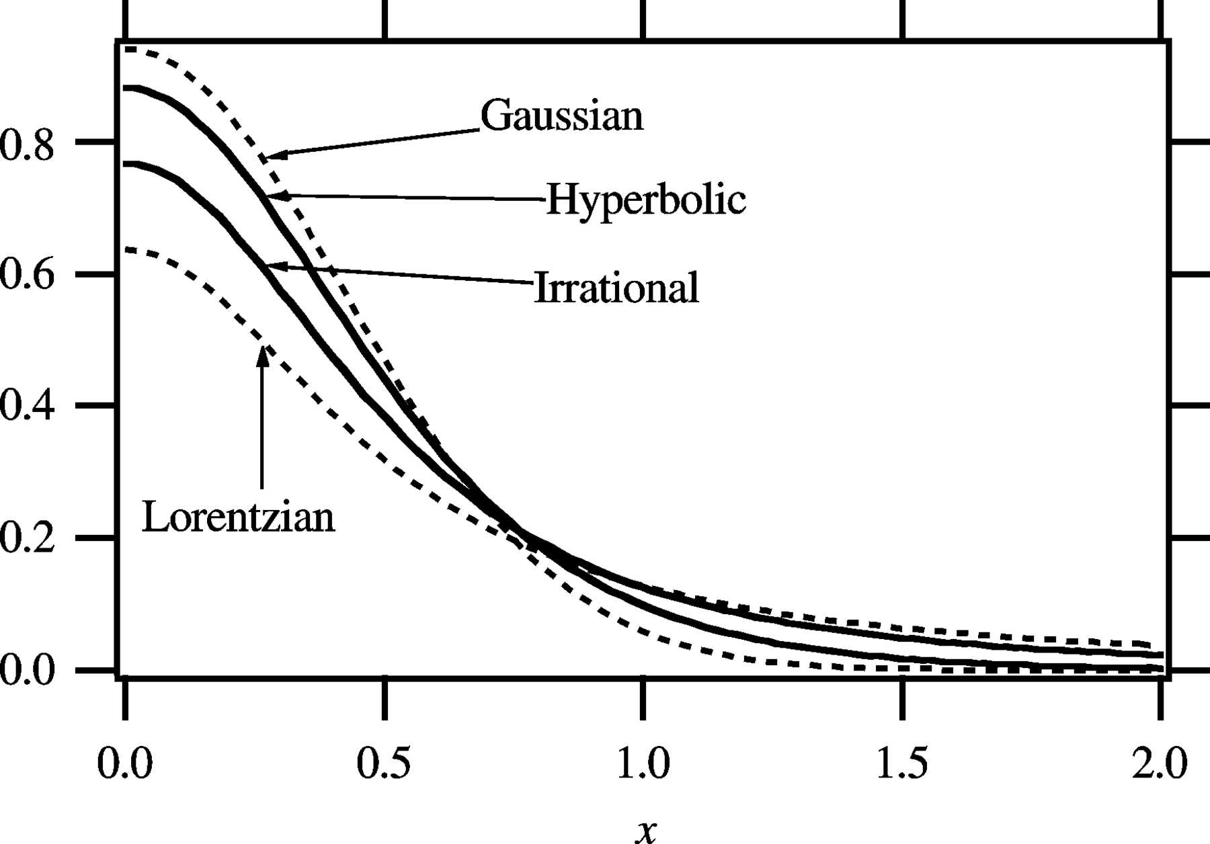
Figure 3. Profiles of the Gaussian, Lorentzian, irrational and hyperbolic functions with FWHM = 1.
Ida et al.
Volume 33 | Part 6 | December 2000 | Pages 1311–1316 |
Notes:
Profiles of the Gaussian, Lorentzian, irrational and hyperbolic functions with FWHM = 1. [Ida, T., Ando, M. and Toraya, H. (2000). J. Appl. Cryst. 33, 1311-1316. ]

Slide 6
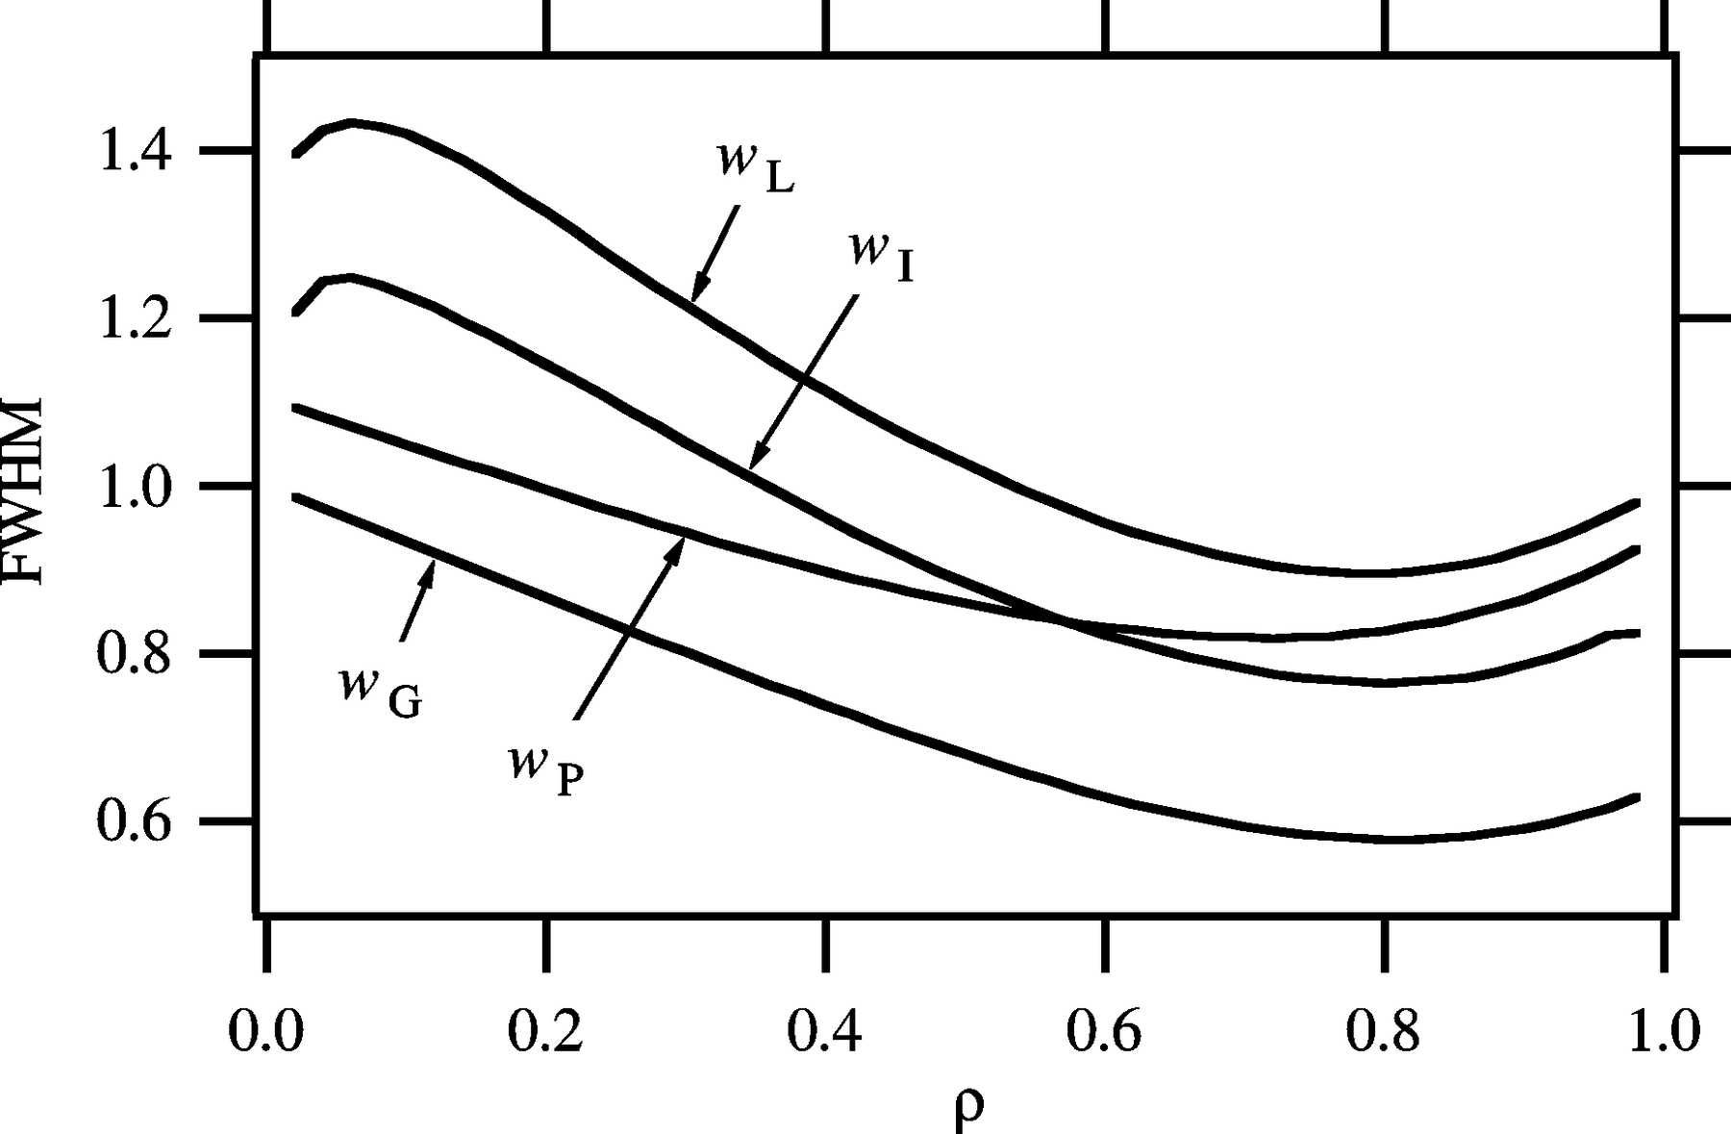
Figure 4. The optimized values of extended pseudo-Voigt parameters w_{G}, w_{L}, w_{I} and w_{P}.
Ida et al.
Volume 33 | Part 6 | December 2000 | Pages 1311–1316 |
Notes:
The optimized values of extended pseudo-Voigt parameters wG, wL, wI and wP. [Ida, T., Ando, M. and Toraya, H. (2000). J. Appl. Cryst. 33, 1311-1316. ]

Slide 7
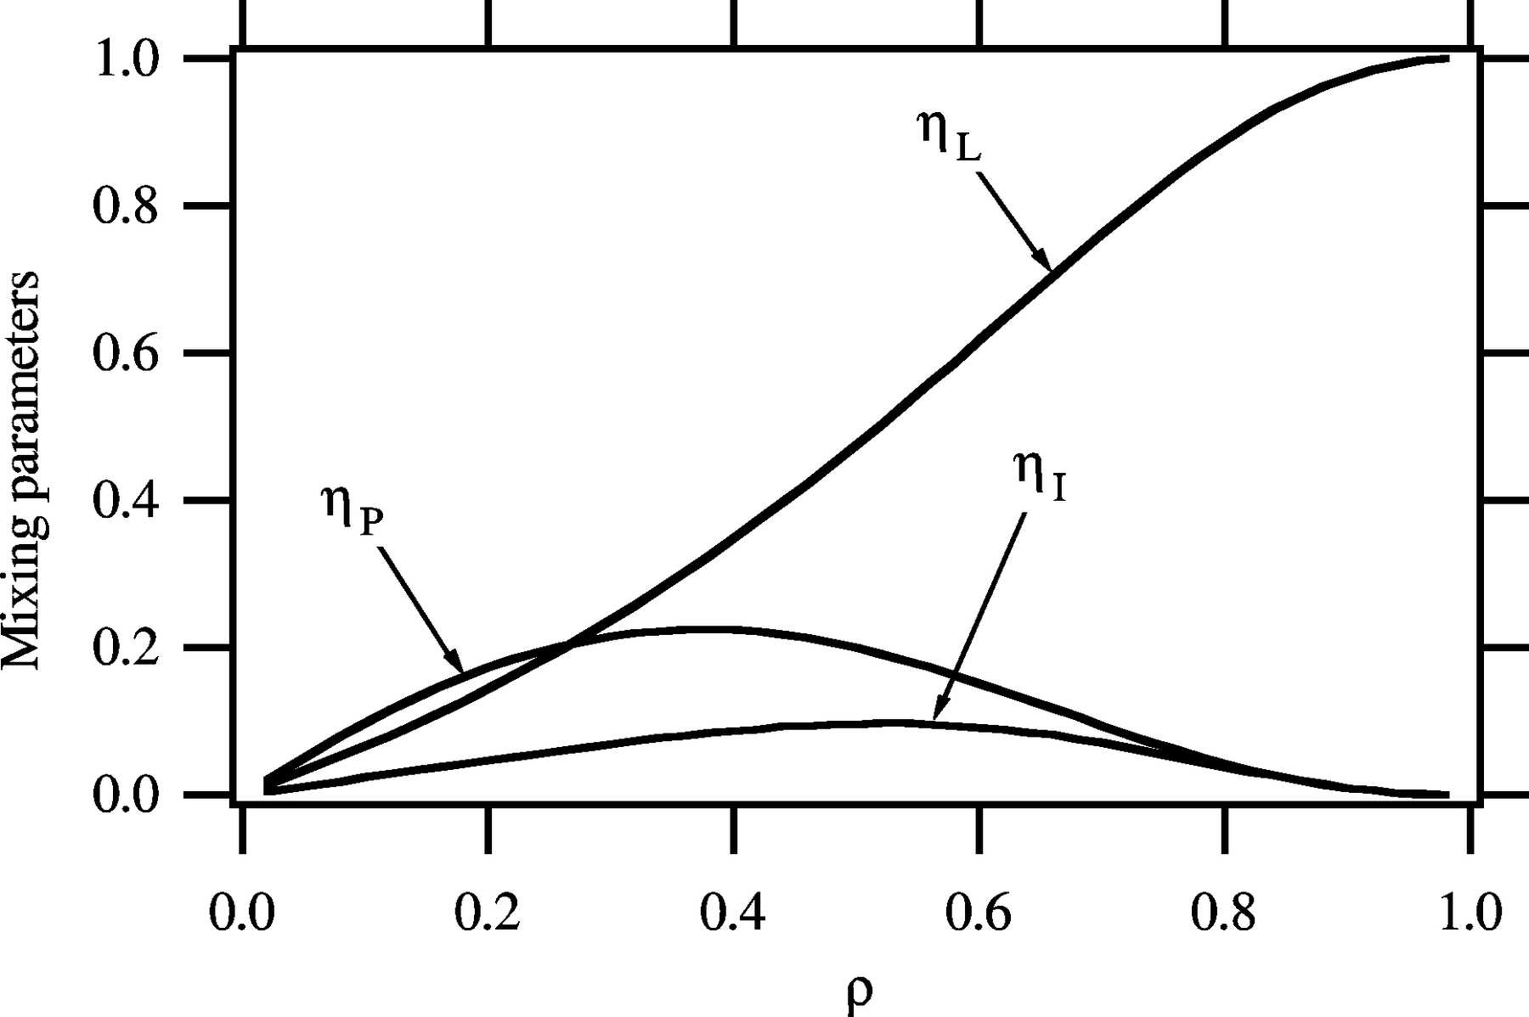
Figure 5. The optimized values of extended pseudo-Voigt parameters η_{L}, η_{I} and η_{P}.
Ida et al.
Volume 33 | Part 6 | December 2000 | Pages 1311–1316 |
Notes:
The optimized values of extended pseudo-Voigt parameters ηL, ηI and ηP. [Ida, T., Ando, M. and Toraya, H. (2000). J. Appl. Cryst. 33, 1311-1316. ]

Slide 8
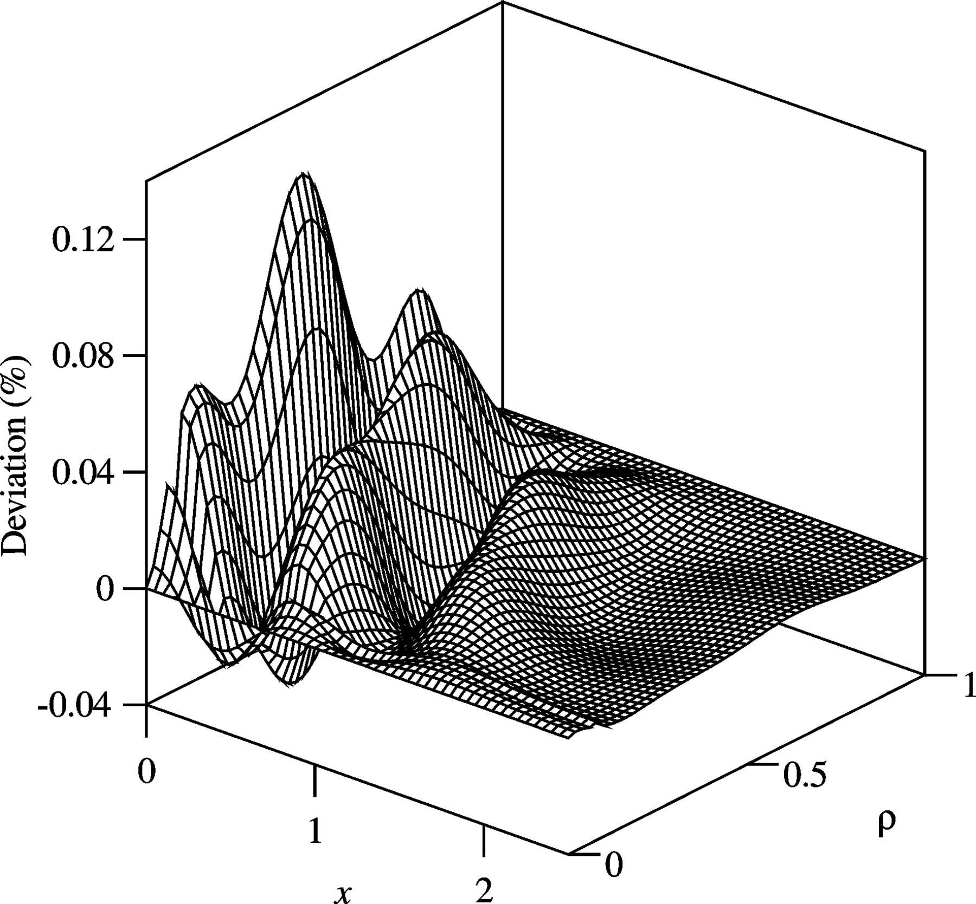
Figure 6. Three-dimensional plot of the deviation of the extended pseudo-Voigt function from the Voigt profile relative to the peak height.
Ida et al.
Volume 33 | Part 6 | December 2000 | Pages 1311–1316 |
Notes:
Three-dimensional plot of the deviation of the extended pseudo-Voigt function from the Voigt profile relative to the peak height. [Ida, T., Ando, M. and Toraya, H. (2000). J. Appl. Cryst. 33, 1311-1316. ]

Slide 9
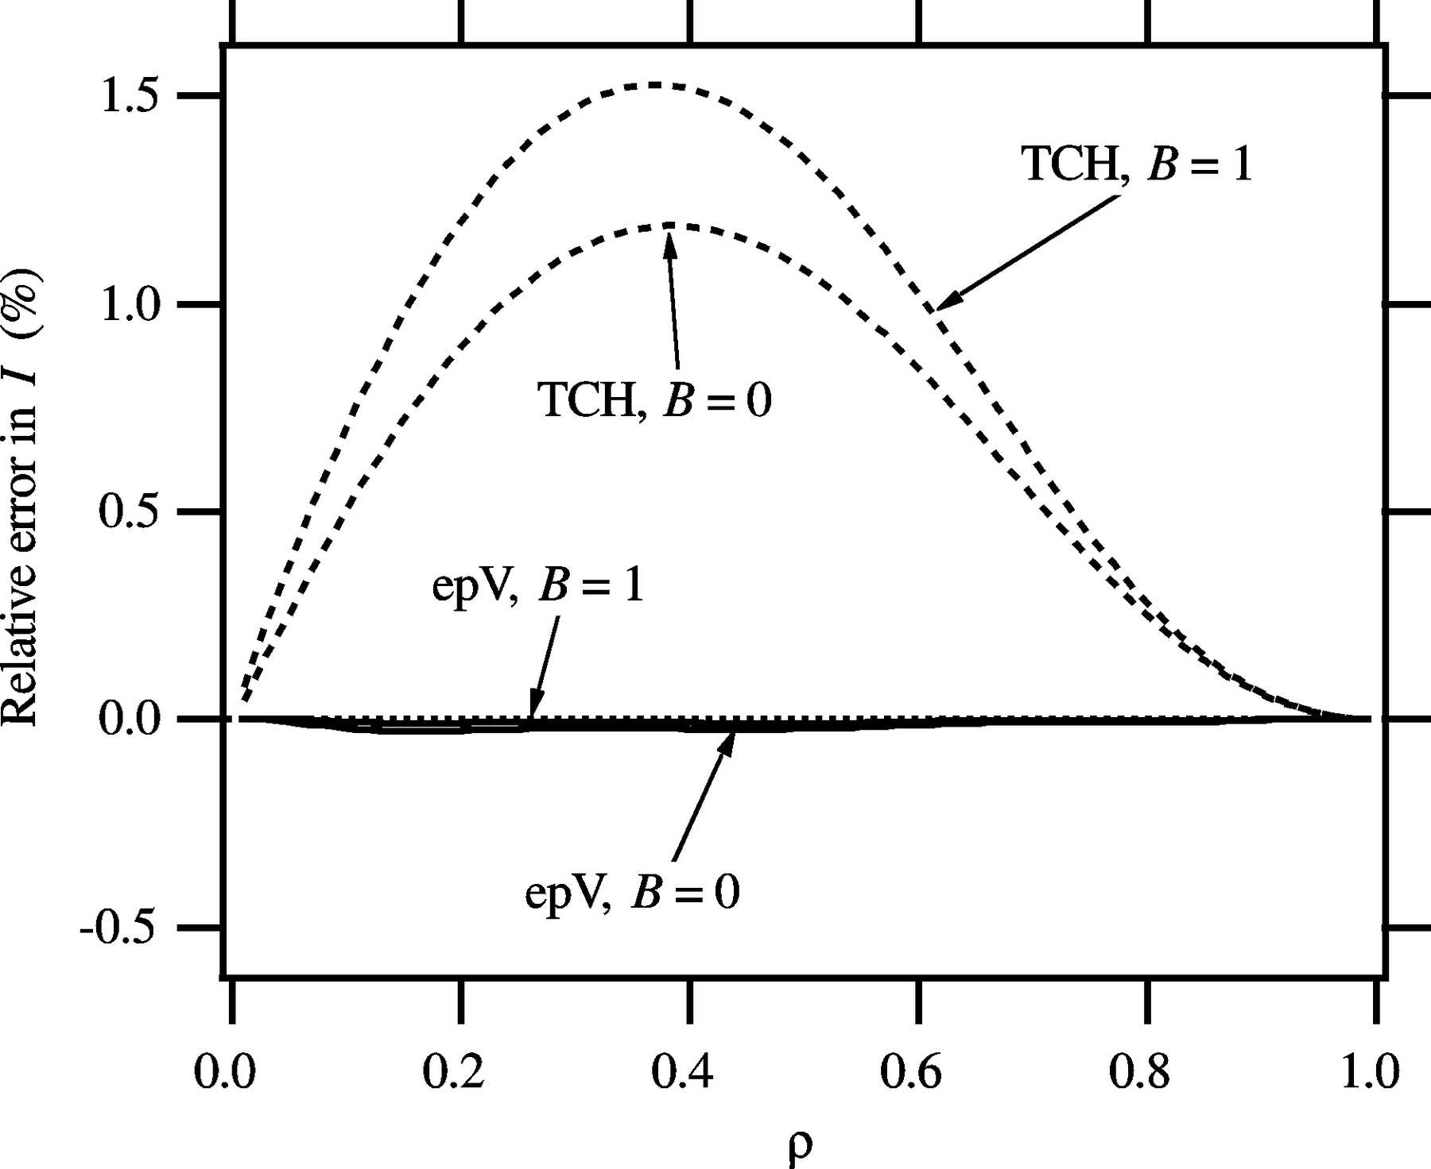
Figure 7. Errors in estimation of the integrated intensity I from Voigt profile data. The data labelled `TCH' were calculated by the formula proposed by Thompson et al. (1987), and those labelled ...
Ida et al.
Volume 33 | Part 6 | December 2000 | Pages 1311–1316 |
Notes:
Errors in estimation of the integrated intensity I from Voigt profile data. The data labelled `TCH' were calculated by the formula proposed by Thompson et al. (1987), and those labelled `epV' were calculated by the extended pseudo-Voigt function. B is the height of the background added to the Voigt profile. [Ida, T., Ando, M. and Toraya, H. (2000). J. Appl. Cryst. 33, 1311-1316. ]

Slide 10
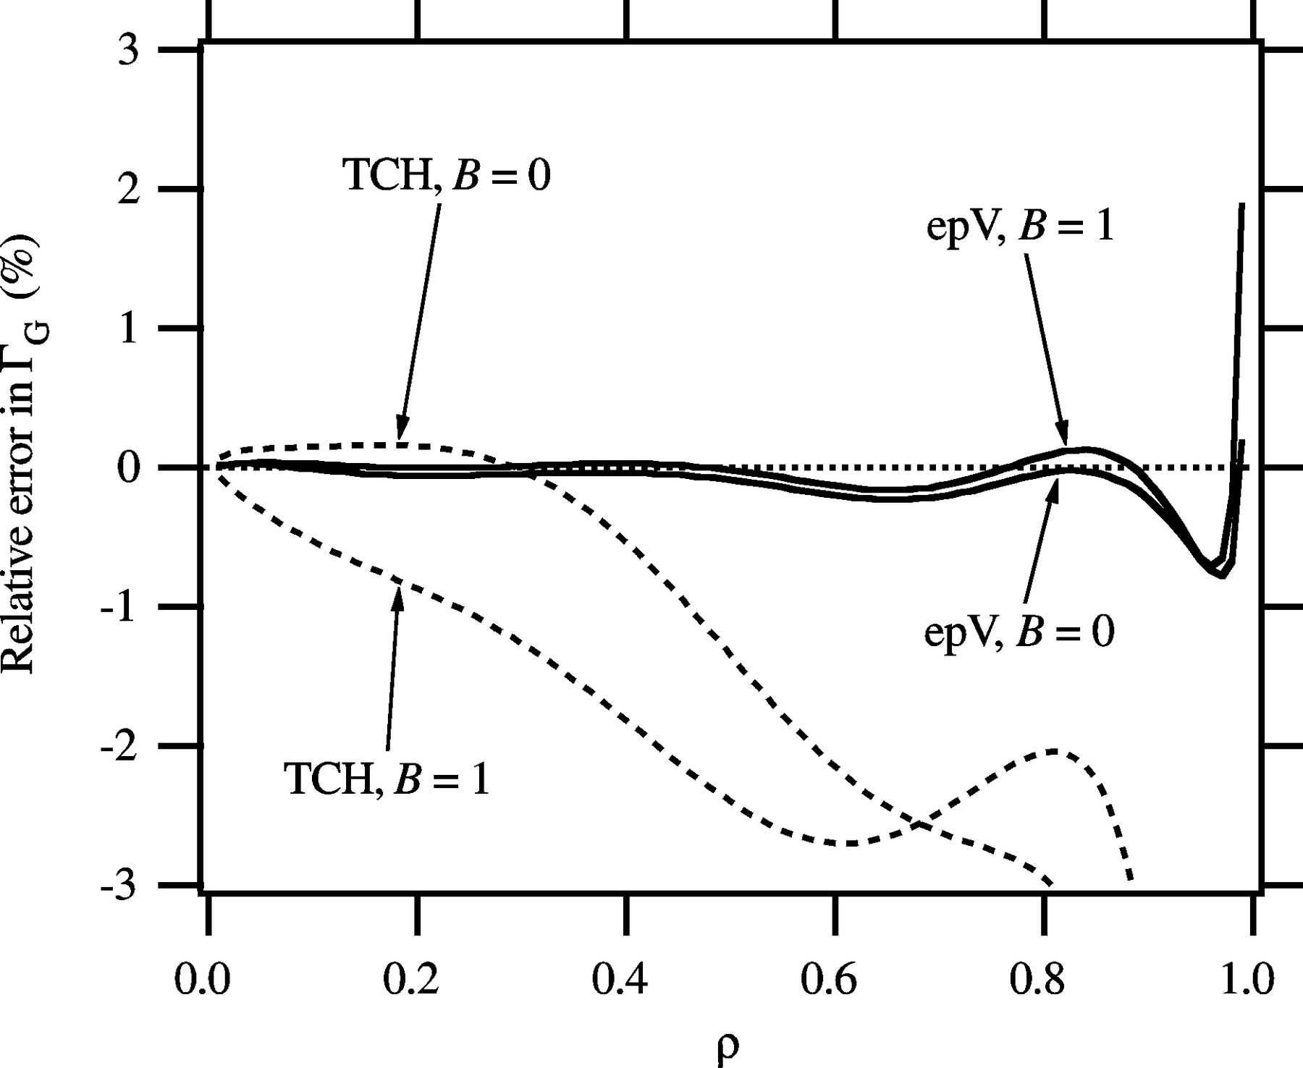
Figure 8. Errors in estimation of the Gaussian FWHM Γ_{G} from Voigt profile data.
Ida et al.
Volume 33 | Part 6 | December 2000 | Pages 1311–1316 |
Notes:
Errors in estimation of the Gaussian FWHM ΓG from Voigt profile data. [Ida, T., Ando, M. and Toraya, H. (2000). J. Appl. Cryst. 33, 1311-1316. ]

Slide 11
Figure 9. Errors in estimation of the Lorentzian FWHM Γ_{L} from Voigt profile data.
Ida et al.
Volume 33 | Part 6 | December 2000 | Pages 1311–1316 |
Notes:
Errors in estimation of the Lorentzian FWHM ΓL from Voigt profile data. [Ida, T., Ando, M. and Toraya, H. (2000). J. Appl. Cryst. 33, 1311-1316. ]

