Slide 1
TELECOM · CUSTOMER ANALYTICS
Reducing Customer Churn
$1.67M
A retention business case
annual revenue at risk
26.5% churn = $1.67M/year at risk. Here's how to win a third of it back.
Notes:
The carrier loses ~26.5% of customers a year, about $1.67M in annual recurring revenue. This readout shows who leaves, why, and the ROI of doing something about it.

Slide 2
The problem: expensive, and concentrated
26.5%
$1.67M
$74 vs $61
of customers churn each year
annual recurring revenue at risk
churned pay more than retained (monthly)
Churn isn't a rate — it's revenue, and the customers leaving are the higher-value ones. That makes keeping them worth paying for.
Notes:
Churners pay $74/mo vs $61 for those who stay — so this is expensive churn, which is exactly what makes a paid retention play pencil out.

Slide 3
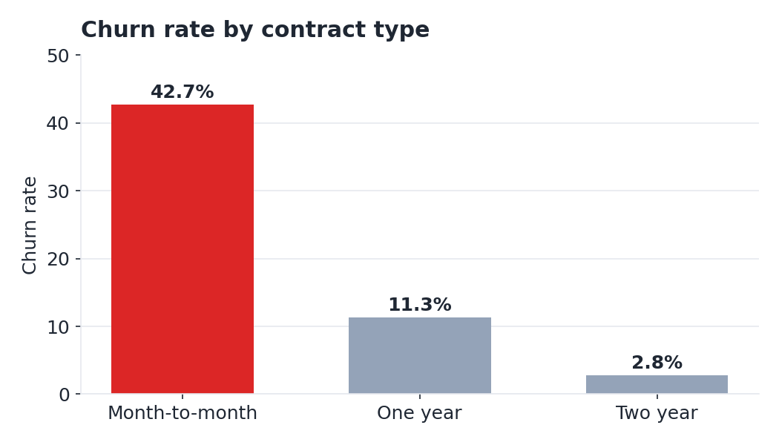
Who churns — and it's predictable
Contract is the #1 lever. month-to-month 43% vs two-year 3%
Electronic check: 45% churn the highest-risk payment method
No tech support: 42% vs 15% with it
Fiber optic: 42% elevated even after price
Notes:
Drivers are consistent and actionable: contract type dominates, followed by payment method, missing support/security add-ons, and fiber service.

Slide 4
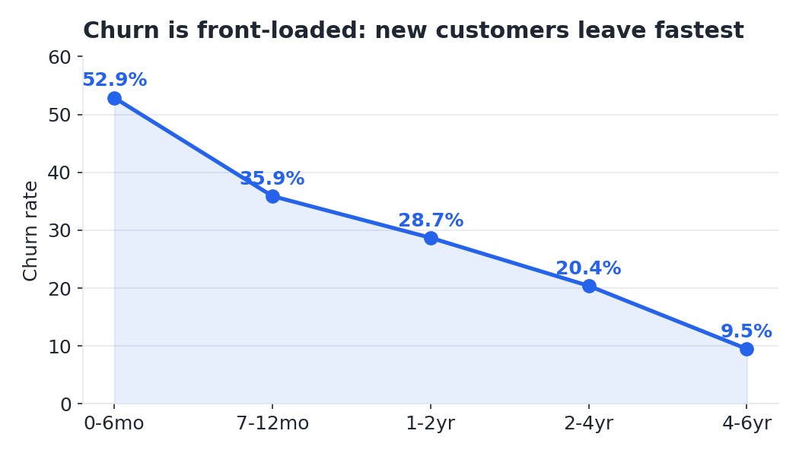
Churn is front-loaded in the first months
52.9%
of new customers churn in their first 6 months
Retention can't start at renewal — it has to start at onboarding. The first six months are where the losses happen.
Notes:
More than half of new customers leave within six months. The intervention window is onboarding, not renewal.

Slide 5
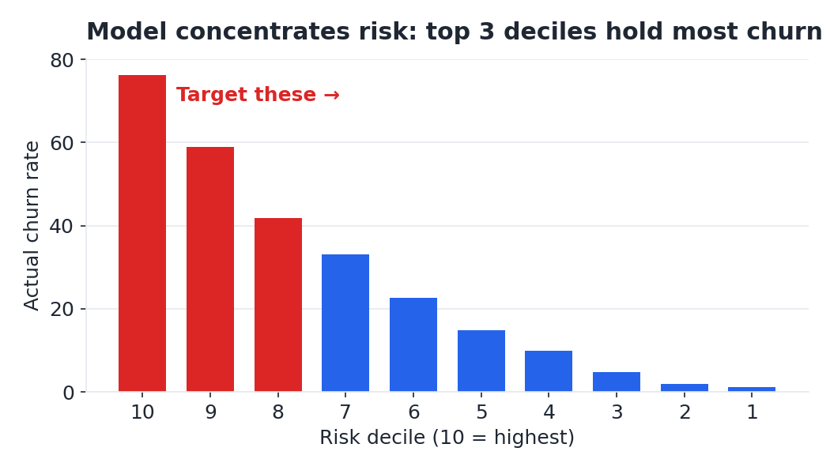
We can predict who's about to leave
0.85
67%
model AUC
of churn in top 30% risk
A logistic-regression model scores every customer, so retention budget can be aimed at the few hundred people who actually matter — not sprayed across the base.
Notes:
The model (AUC 0.85) concentrates two-thirds of churn into the top 30% of customers by risk — the basis for efficient targeting.

Slide 6
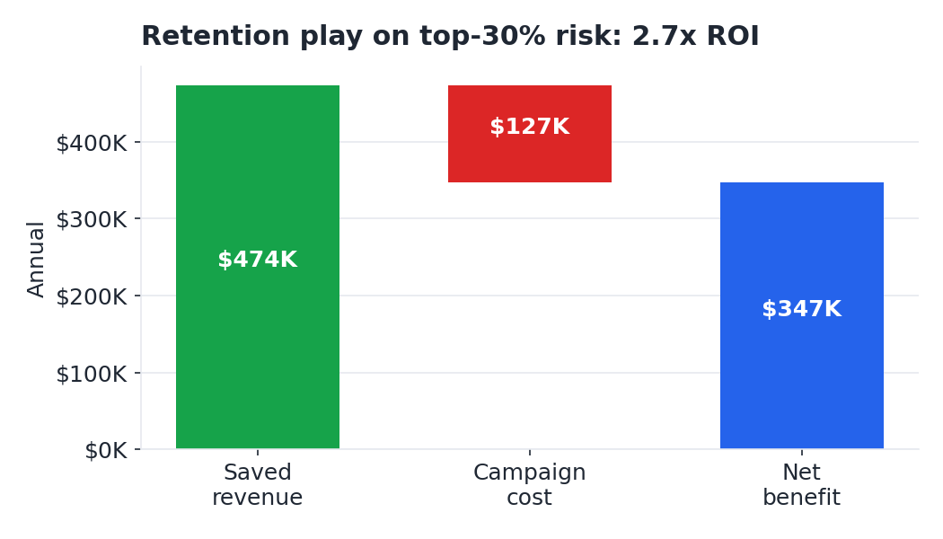
The business case: a targeted retention play
Target 2,113 highest-risk customers (top 30%)
Save ~501 of them at a 30% offer-acceptance rate
$347K net benefit / year on $127K campaign spend
2.7x ROI still positive at a 15% save rate
Notes:
Base case: $60 offer to the top 30% risk, 30% save rate → $347K net, 2.7x ROI. Sensitivity stays positive down to a 15% save rate.

Slide 7
Recommendation
1
Aim, don't spray. Run retention against the top 30% risk — 67% of churn, ~2x budget efficiency.
$347K
2
Attack contract type. Incentivize high-risk month-to-month customers onto 1–2 year terms.
net / year
3
Fix the first six months. Invest in onboarding and bundle tech support / online security (both halve churn).
2.7x
4
Move e-check payers to autopay. The single highest-churn payment method.
return on spend
Validate the save-rate assumption with a small A/B holdout before scaling.
Notes:
Four moves, one number: ~$347K net/year. Validate with an A/B holdout before full rollout.

