Slide 1
NHL Player Salaries
By: Charles Hesketh

Slide 2
Data Set - Pros
Curated from Robert Vollman http://www.hockeyabstract.com/testimonials
Several Years worth available.
Each year has more data points than the year before.
Contains “Advanced Analytics” i.e. Corsi
Dense in metrics (over 150 metrics measured)

Slide 3
Data Set - Cons
Only two years with salary.
Does not have length of contract
Does not have what year in their contact they are (1st, 2nd, 3rd,etc.)
Dense in metrics (over 150 metrics measured)
Not many observations compared to metrics (700ish)
Hyper Skewed response variable (Cap Hit).
What is Independence?

Slide 4
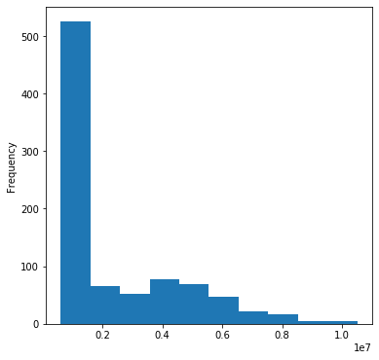
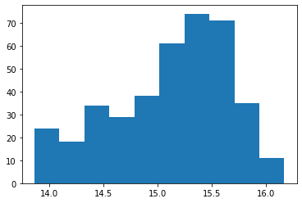
Cap Hit (Response Variable) Histogram
Response>1 million
No Restriction on Response

Slide 5
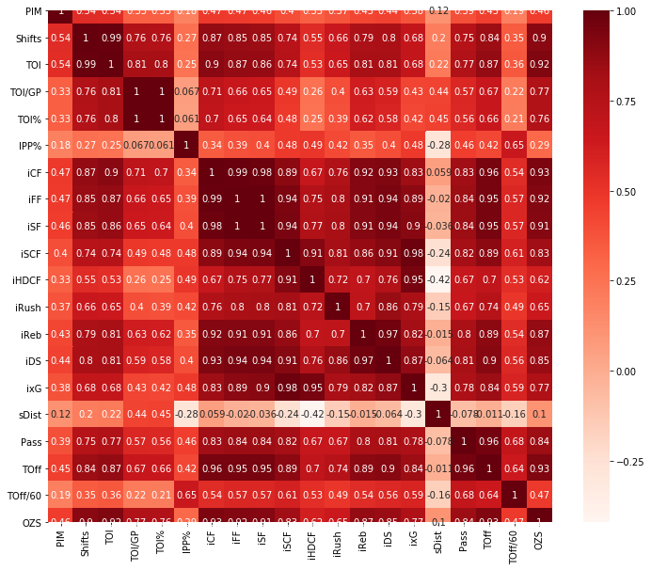
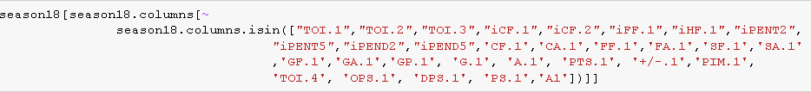
Correlation Map and Feature Reduction

Slide 6
Data Prep and Feature Selection
Remove “duplicate” columns (i.e. TOI1,TOI2,TOI3 in favor of TOI)
Remove columns with many NA’s (7 Non-Informative Columns)
Remove Rows with NA’s (About 140 rows)
Normalize all columns besides the response column
Used Backward Elimination for one set of Feature Selection
Used Lasso as another set of Feature selection
Response variable as is and Log of Response variable

Slide 7
How Models were Implemented
All manually trimmed variables used in the model w/ no transformation on Y
All manually trimmed variables used in the model w/ log(Y)
Backwards Elimination variables used in the model w/ no transformation on Y
Backwards Elimination variables used in the model w/ log(Y)
Lasso Regression variables used in the model w/ no transformation on Y
Lasso Regression variables used in the model w/ log(Y)
Bootstrap was used to create confidence intervals

Slide 8
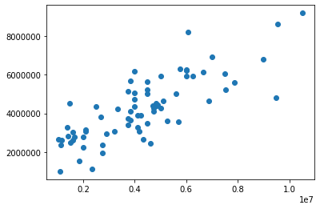
Lasso
Python Function LassoCV did not Converge after 1 million iterations.

Slide 9
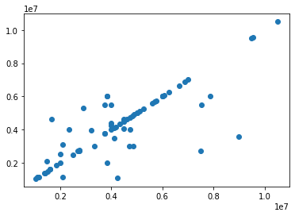
Decision Tree Regression
This produced a confidence interval of (1.8M,1.2M). Interestingly it appears it was fairly close at times, but way off at other times.

Slide 10
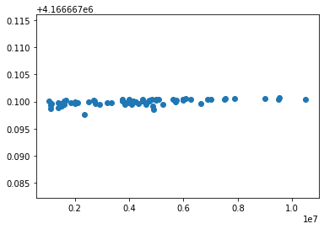
Support Vector Regression (SVR)
This gave a confidence interval of (0,0), but this obviously ran into issues… it, also, did not converge:

Slide 11
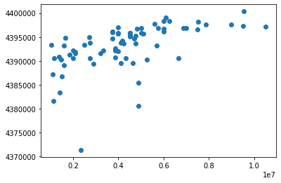
Stochastic Gradient Decent (SGD)
This gave a confidence interval of (1,874.4,35,123.7)

Slide 12
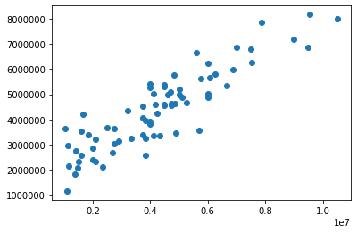
Bagging
This produced a confidence interval of (1.4M,1.8M)

Slide 13
Multi-layer perceptron (MLP) Neural Network
This took way too long to realistically use in bootstrapping. One pass would converge somewhere above 1M iterations and less then 3M iterations. This did not make it realistic and the model was not competitive so no reason to put my computer through BS.

Slide 14
Boosting
Special set up needed to run this boot strap. Results will be found in the paper.

Slide 15
PCA w/ Lasso
Don’t expect this to converge, but similarly needs special set up to do bootstrapping. Will be found in paper.

Slide 16
Best Model: SGD
SGD was clearly the winner.

Slide 17
Potential To help convergence
I am hoping to implement a log transformation on my y to help with convergence.
This was tested and proved to help LassoCV converge; however, I was having issues in python implementing exp() .
Still didn’t fix all convergence for SVR for sure and possibly others.

Slide 18
Why we aren’t getting better results
Contracts signed for this year are most indicative of results
Long term trends are not available in the data set.
Penalizing terms should be used on trending data, which is not available.
Would like to use previous contracts to predict the new contracts to be given the next year as a test.
Complexities within NHL CBA that need to be accounted for or protected against (i.e. minimum salaries and salary control measures)

