Slide 1

TRAFFIC MANAGEMENT
Indra Ganesan College Of Engineering,
Trichy
Team Members
:
Name | Register No : | Nan muthalvan ID
S. Aarthi | 811221106001 | au811221106001
M. Arockia Jenifer | 811221106003 | au811221106003
C. Thamilarasi | 811221106033 | au811221106033
S. Vellaisamy | 811221106036 | au811221106036
C. Dhinesh Babu | 811221106008 | au811221106008

Slide 2
Indra Ganesan College Of Engineering,
Trichy
Paper 1: “Traffic Management Systems”,Sanjay Kumar Sahu, Atul Basant;2021
Objective : | The establishment of apporapriate traffic flow and access into and through the Town of cottesloe,which maximises road safety and local amenity. Integration of the traffic management policy into Councils Strategic Plan.
Technique Used : | Image processing
Metrics taken : | Traffic Embeded sensor,Actuators
Limitations : | Traffic Conjecction. No means to detect traffic conjection. It requires more manpower.

Slide 3
Indra Ganesan College Of Engineering,
Trichy
Paper 2: “Traffic Management Systems”, A.Sufian, S.Javaid;2018
Objective : | The procedure from which necessary traffic management works are undertaken in a cost effective and equitable manner. To manage the movement of people and goods as efficiently and safely as possible.
Technique Used : | Wireless sensor networks.
Metrics taken : | Light Emitting Diode
Limitations : | It may be affected by external interfering magnetic field. Large temperature drift.

Slide 4
Indra Ganesan College Of Engineering,
Trichy
Paper 3: “Traffic Management Systems”, Shashank S, Kiran P;2021
Objective : | To improve the enhance road safety, enhance emergency response.
Technique Used : | Intelligence transpotation system (ITS),Infrared sensors.
Metrics taken : | Radio signal detector Light emiting diode
Limitations : | Number of accidents are more. It is less economical. It is not efficient.

Slide 5
Indra Ganesan College Of Engineering,
Trichy
Proposed Work :
Controller :
Image processing with using IOT and the sensor technique.
INPUT :
Image processing using camera with traffic light sensors.
OUTPUT :
To change the traffic light signals to control the traffics

Slide 6
Indra Ganesan College Of Engineering,
Trichy
Problems Identified From above Literature Survey:
Different System Types | Problem Indentifed
Traffic Embeded sensor , Actuators : | Traffic Conjection. It requires more manpower
Traffic sensor : | It may be affected by external interfering magnetic field. Large temperature drift
Radio signal detector Light emiting diode : | Number of accidents are more. It is less economical. It is not efficient.

Slide 7
Indra Ganesan College Of Engineering,
Trichy
Research Gap :
The First Generation Microprocessors is small memory size
slow speed instructions set limit its usefulness. Large chip size(170*200 mil) with 40 pins. More chips on decoding circuits.
Ability to address large memory space (64-K Byte) and I/O ports (256).
Ensuring immediate clearance for emergency vehicles.
Reducing operating costs with efficient traffic management processes.

Slide 8
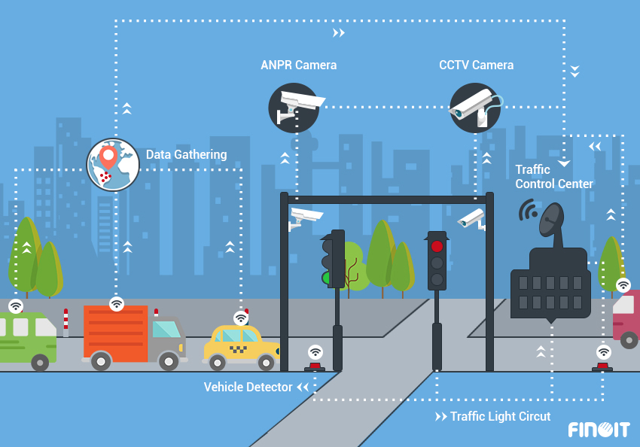
THANK YOU

