Slide 1
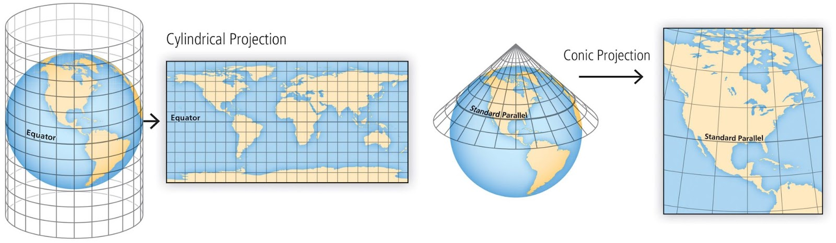
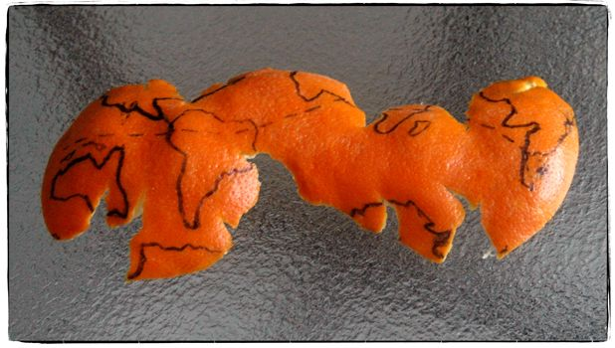
Projections
A map projection is a mathematical transformation of latitude and longitude locations on the surface of a sphere (or ellipsoid) to locations on a plane
Challenges:
Global map projections must cut the sphere somewhere
All projections of a spherical surface onto a plane distort area or shape, or both

Slide 2
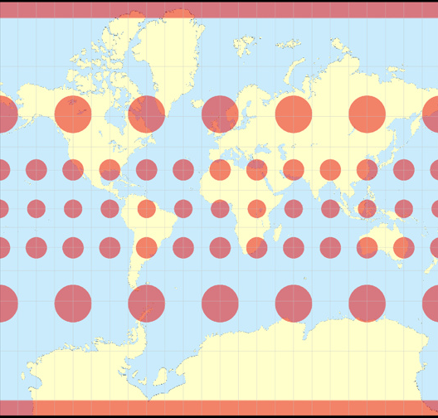
Map projections: distortions in common projections
Ideally, map projections would preserve Area and Shape, but it is impossible to do both simultaneously.
Indicatrix method: Show how equal-sized circles on Earth appear in the map projection.
Mercator
Each circle encloses the same area on Earth’s surface, but their sizes are very different in the Mercator projection.
Do not use Mercator for global maps.
Greenland is not the same size as Africa.
Mercator is fine for tropics and small mid-latitude regions (<~100 km)
Indicatrix images from Tobias Jung, https://map-projections.net

Slide 3
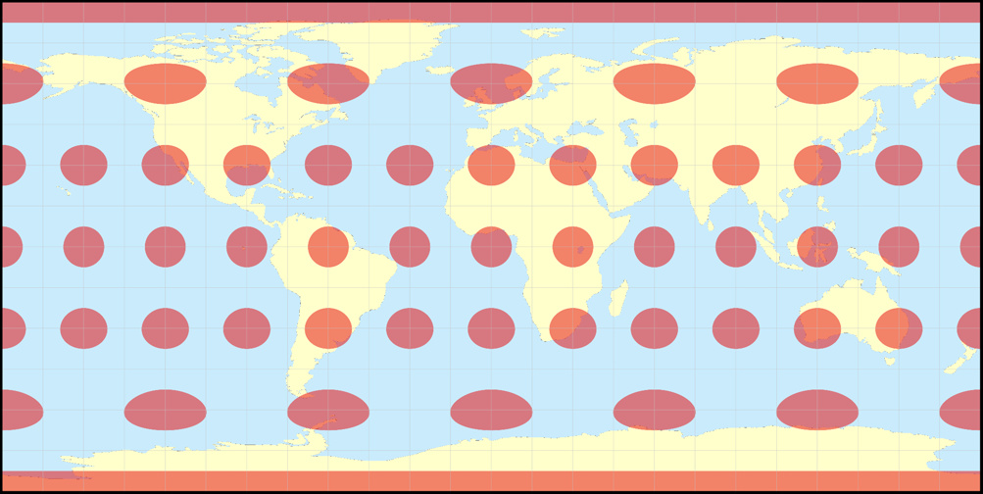
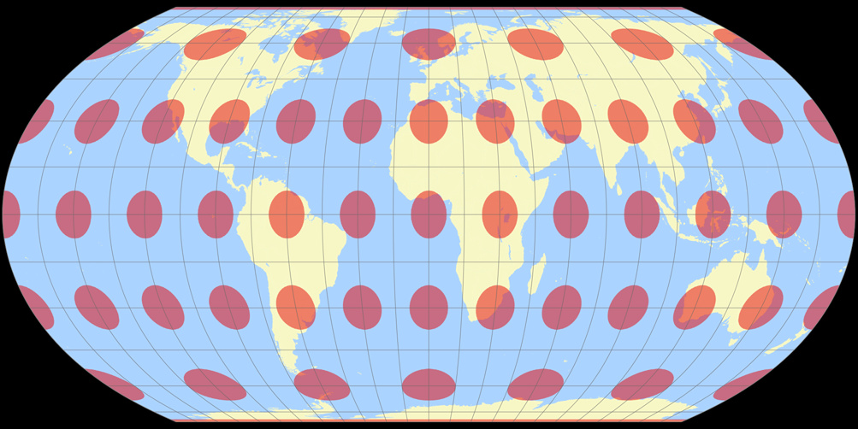
Map projections: distortions in common projections
Plate Carrée
(equal spacing for latitude and longitude)
Distorts Area and Shape
Commonly used because it is simple and maximizes the spaced used on the page.
Equal Earth
Preserves Area
Modest Shape distortion
A good choice.

Slide 4
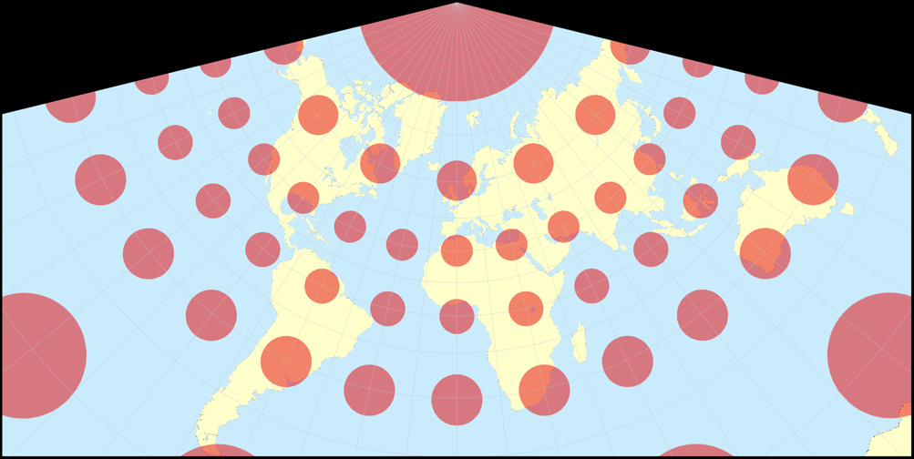
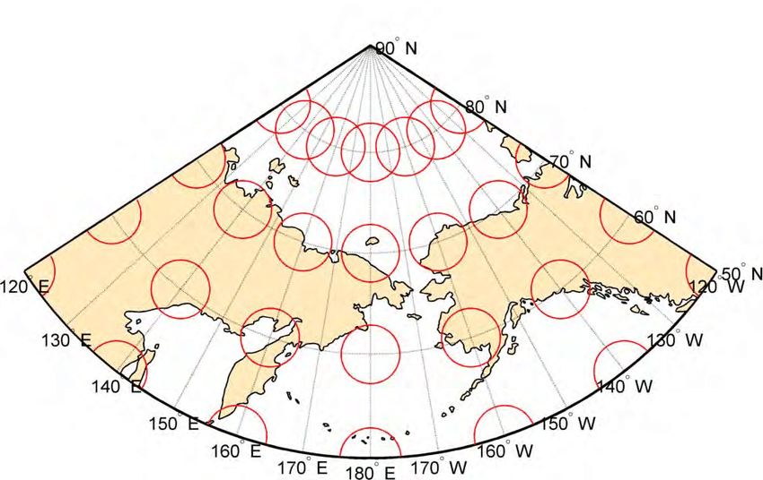
Map projections: distortions in common projections
Lambert Conformal Conic
Preserves Shape
Size distortion is acceptable for regional maps
Commonly used for
Contiguous United States (CONUS) and
North America
Size distortion is not perceptible on this regional map
Albers Equal Area
Preserves Area
Shape distortion is acceptable for regional maps
Commonly used for
Contiguous United States (CONUS) and
North America

Slide 5
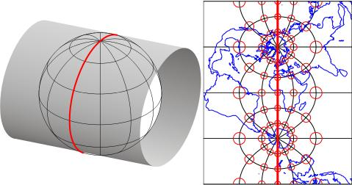
Map projections: distortions in common projections
Transverse Mercator
Preserves Shape
Size distortion is acceptable for regional maps
(≲ 500 km width)
Commonly used for state maps, topographic maps,
smaller areas

Slide 6
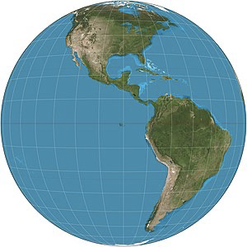
Map projections: distortions in common projections
Geostationary satellite perspective
what a camera in geostationary orbit sees
(35,786 km above the equator)
Nearside perspective
what a camera above an arbitrary point sees
Distorts size and shape, but necessary for using satellite data

Slide 7
Choosing a projection for your project
Projection Wizard provides additional recommendations for specific regions.

Slide 8
Additional guidelines for selecting regional projections
Tropics – Mercator is common, but Cylindrical Equal Area is better as the latitudes rise and is very similar to Mercator for narrow tropical bands
Polar – Stereographic is standard, but LAEA is similar over small regions and works for large areas too.
Midlatitudes – Lambert Conformal and Albers are common for regions with greater width than height. LAEA can also work well for all sizes
Tall, Thin – TM is good for narrow regions, but LAEA is similar for narrow regions and also works for wider areas too. Transverse Cylindrical Equal Area is better than TM for wider areas, but less general than LAEA. Therefore, LAEA could be recommended for a tall, narrow region at any latitude.
In short, LAEA can be used everywhere, but Cylindrical Equal Area is better for the tropics because meridians are straight lines.
LAEA = Lambert Azimuthal Equal Area

Slide 9
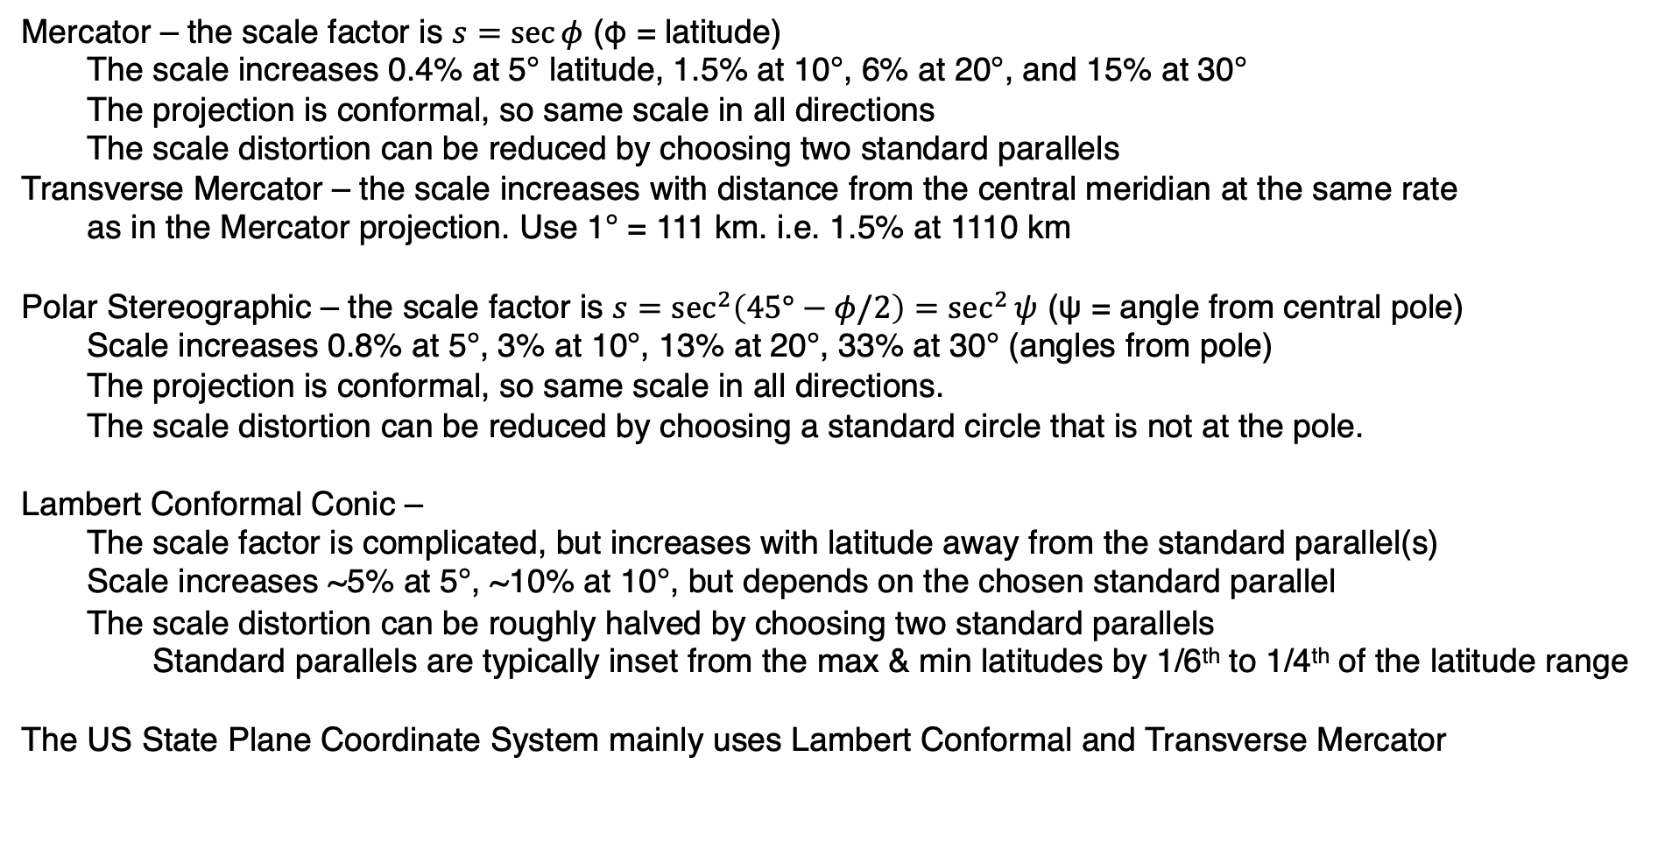
Scale factor distortion
Mercator – the scale factor is $s=\sec{φ}$ (φ = latitude)
The scale increases 0.4% at 5° latitude, 1.5% at 10°, 6% at 20°, and 15% at 30°
The projection is conformal, so same scale in all directions
The scale distortion can be reduced by choosing two standard parallels
Transverse Mercator – the scale increases with distance from the central meridian at the same rate
as in the Mercator projection. Use 1° = 111 km. i.e. 1.5% at 1110 km
Polar Stereographic – the scale factor is $s=\sec^{2}\left(45°−φ/2\right)=\sec^{2}{ψ}$ (ψ = angle from central pole)
Scale increases 0.8% at 5°, 3% at 10°, 13% at 20°, 33% at 30° (angles from pole)
The projection is conformal, so same scale in all directions.
The scale distortion can be reduced by choosing a standard circle that is not at the pole.
Lambert Conformal Conic –
The scale factor is complicated, but increases with latitude away from the standard parallel(s)
Scale increases ~5% at 5°, ~10% at 10°, but depends on the chosen standard parallel
The scale distortion can be roughly halved by choosing two standard parallels
Standard parallels are typically inset from the max & min latitudes by 1/6th to 1/4th of the latitude range
The US State Plane Coordinate System mainly uses Lambert Conformal and Transverse Mercator

