Slide 1
Silent Errors and Critical Code Review

Slide 2
Silent Errors
What are they?
Code runs completely
Generates desired output (e.g. numbers, tables or figures)
Results are wrong
More dangerous than syntax errors, because Python won’t flag them
Causes of silent errors that we have encountered in this course
Handling or ignoring missing data
Mean vs sum when aggregating over time or space
Months with different numbers of days
Weighted vs unweighted averages
Anomalies vs raw

Slide 3
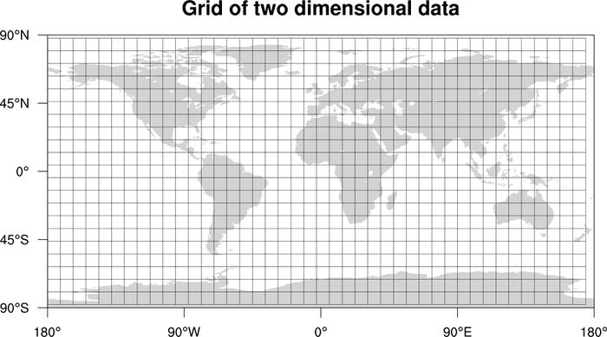
Global average from gridded data
data.mean( dim=[‘lat’,’lon’] )
Assumes that all grid cells contribute equally to average
Overweights polar grid cells, which are actually small
Biased result
Use area weighting by cos( lat )

Slide 4
Avoid silent errors with extensive sanity checks
Order of magnitude checks
Print minimum, maximum, median, fraction of data missing
Is magnitude consistent with expectation and prior studies?
Physical constraints
Some variables should never be negative (e.g. precipitation)
Seasonal cycle
Programming checks
Check units
Visualize or print intermediate steps
Compare result to simplified calculation

Slide 5
Example: Global mean sea-surface temperature with OISST data

Slide 6
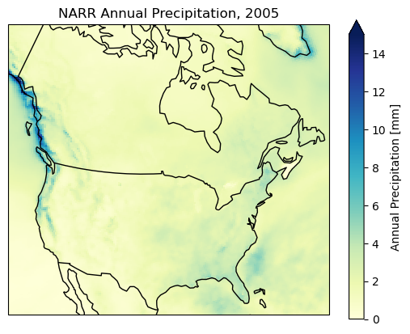
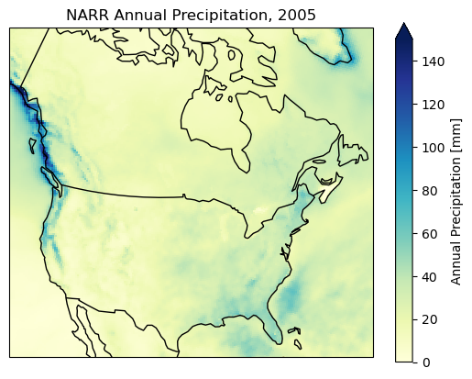
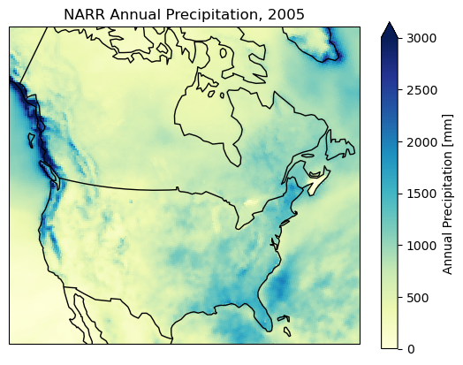
Exercise: Annual Precipitation for 2005 from NARR
You are reviewing figures produced by classmates. All three claim to show annual precipitation for 2005.
Which one do you trust more and why?
What tests would you use to increase your confidence?

Slide 7
Evaluating Generative AI
Method 2 is generated by an AI, which explains its reasoning:
“The annual precipitation is computed by summing the monthly means, which is appropriate because the data are monthly averages.”
Evaluate this justification:
What is correct or misleading?
Does it sound correct?

Slide 8
Generative AI increases the risk of silent errors
LLMs are very good at…
Writing plausible code that runs without errors
Using commands that may be unfamiliar or complex
Writing confident explanations, even when incorrect
LLMs are less good at
Knowing your dataset
Identifying necessary assumptions
Recognizing implausible results
“Vibe coding” for scientific applications is risky
Reviewing AI-generated code is essential
Treat output as a rough draft for consideration
Skepticism and critical evaluation key

Slide 9
Demands of scientific programming
Correct code is necessary, but not sufficient
Scientific programming requires
Physical reasoning
Constraints
Defensible programming choices
Good judgment
Your job is not to make plot and tables.
Your job is to decide when to trust them.

