Slide 1
MET 3220C: Meteorological Computations

Slide 2
What is computer programming?
Programs tell a computer what to do
e.g. inputs, outputs, user interface, user interaction
programs contain machine code (binary 0’s and 1’s) that the hardware (CPU, GPU) can understand
Programming languages (e.g. Python, Matlab, R, Java, Fortran, C++, Swift…)
provide notation for computer instructions that people can read and write (with training)
Interpreters and Compilers translate programming languages into machine code
Programming Language
Interpreter or Compiler
Machine Code
function multiply(x, y):
return x * y
result = multiply( 3, 5 )
001101000111
110101010111
000011010101
101111101110

Slide 3
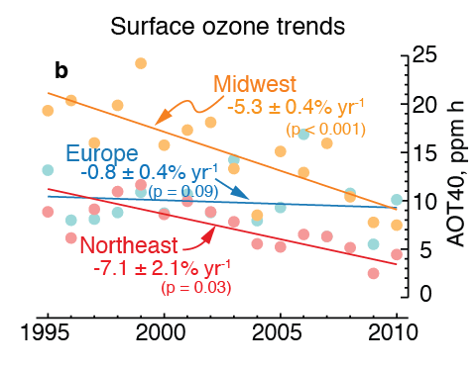
What is Python for?
General programming, automating tasks, interactive websites
Analyzing and visualizing datasets
Numerical modeling and simulation
Many, many mathematical functions built in (unlike C++, Java, Fortran)
Ideal for interactive analysis, but slower than compiled languages (e.g. Fortran, C++) for very large tasks
Ship NOx emissions

Slide 4
Why Python rather than Matlab, Fortran, Java, etc.?
Python is free and open-source software, meaning that anyone can use and modify it at no cost
Easy to learn and powerful
Used in many science and technology fields
Many pre-existing, free modules for advanced tasks like mapping, statistics, machine learning
Interfaces well with web and databases
In-demand by employers

