Slide 1
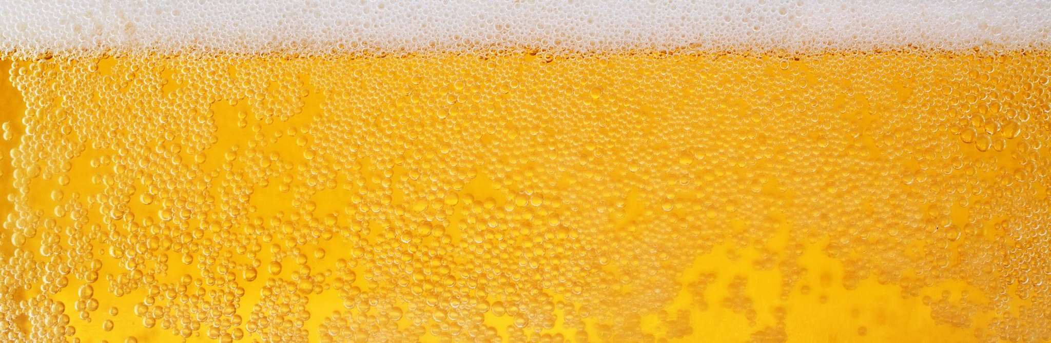
DDS Project 1: Beer/Brewery Analysis
by Dane Holmes & Milan Patel

Slide 2
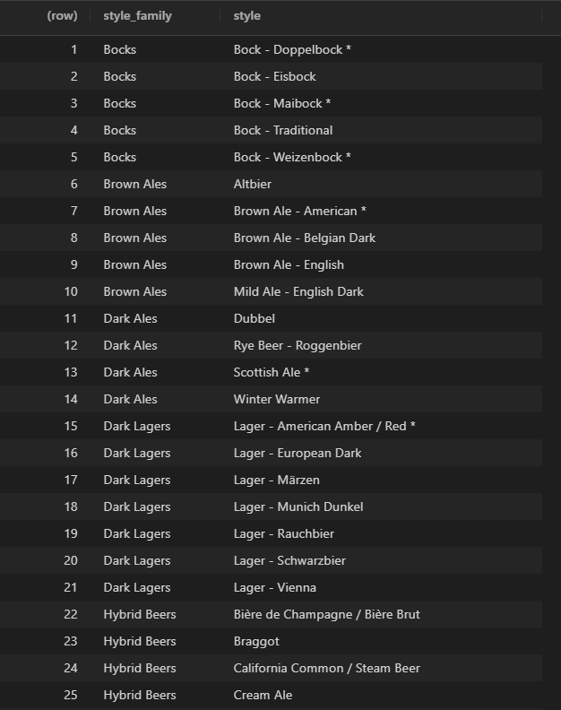
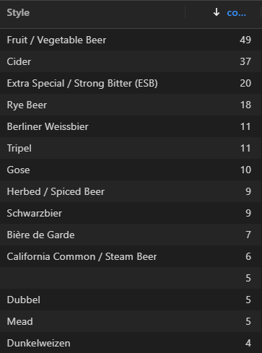

Clean Data
Beer Advocate – Beer Styles
Using an outside source to group beers into more manageable style groups allowed for better and less busy plots.
Web Scraping with rvest
“Other” Category (Top 15)
ABV & IBU Categories
https://www.beeradvocate.com/beer/styles/

Slide 3
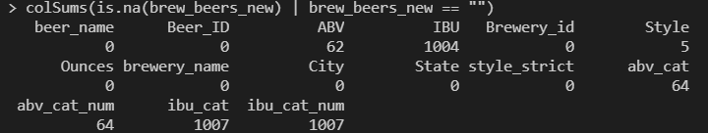
Missing Values
ABV and IBU will have to be filtered each time they are used in a plot or data frame.
If they were to be filtered beforehand, a significant number of lines would be removed if IBU or ABV were not needed.

Slide 4
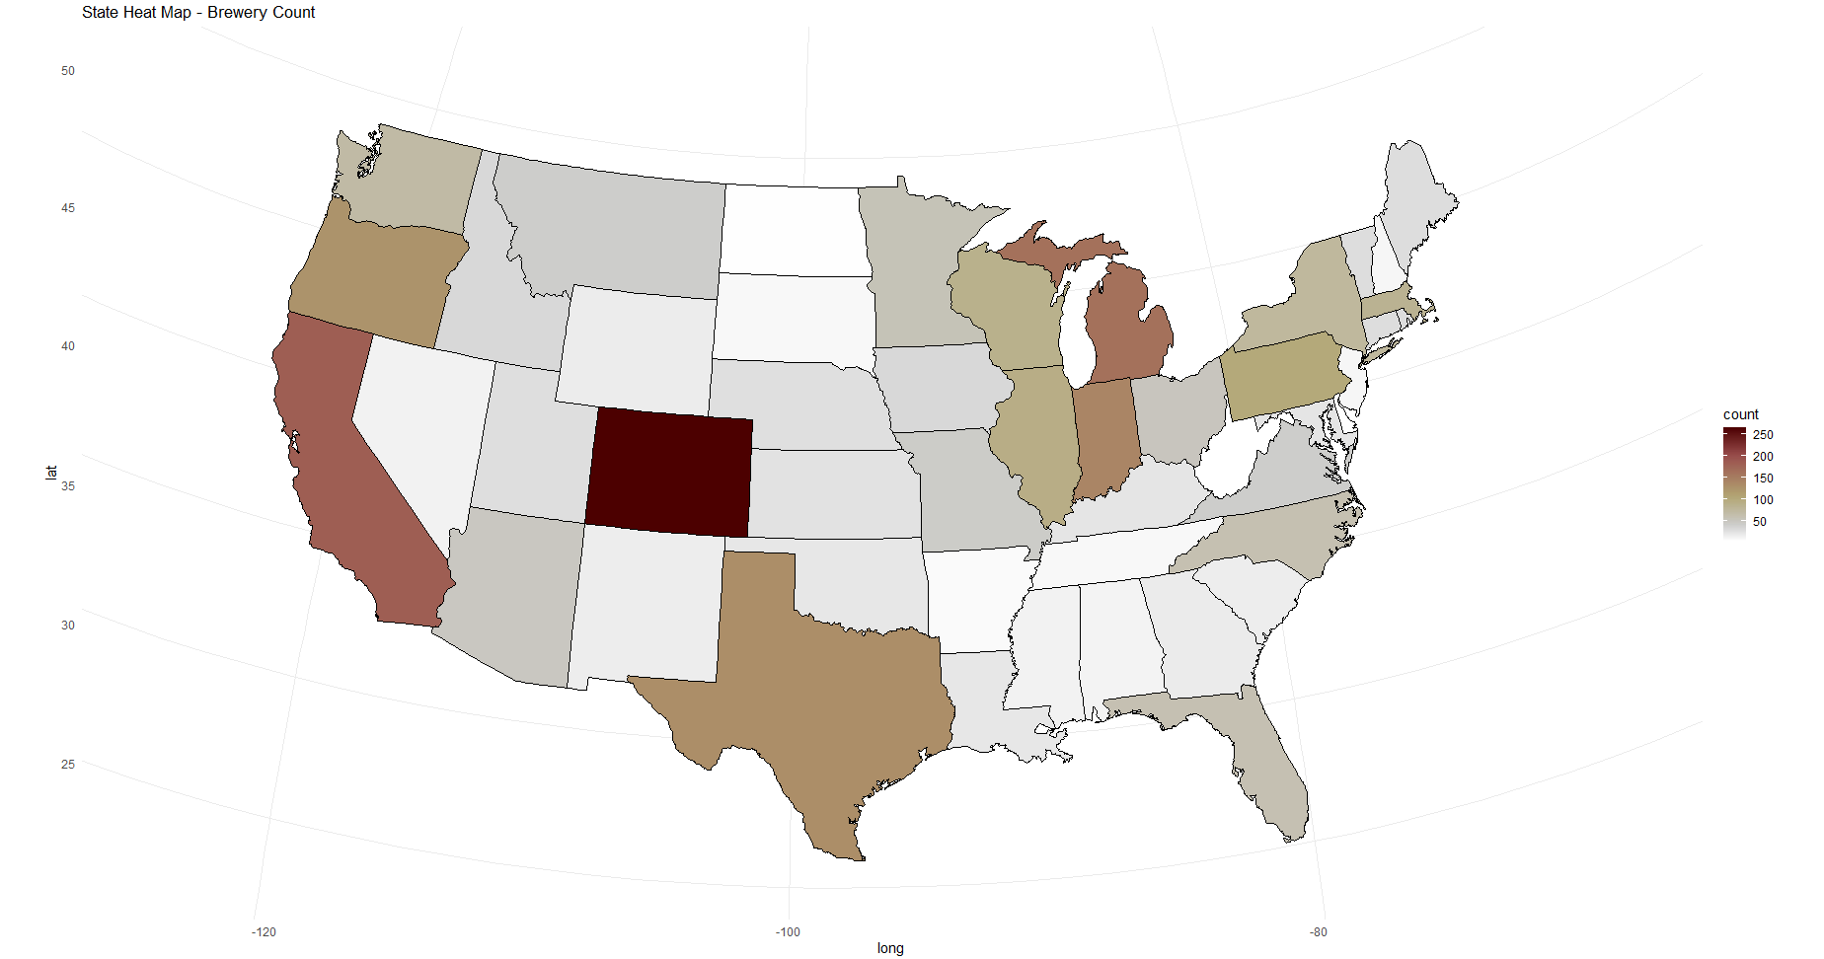
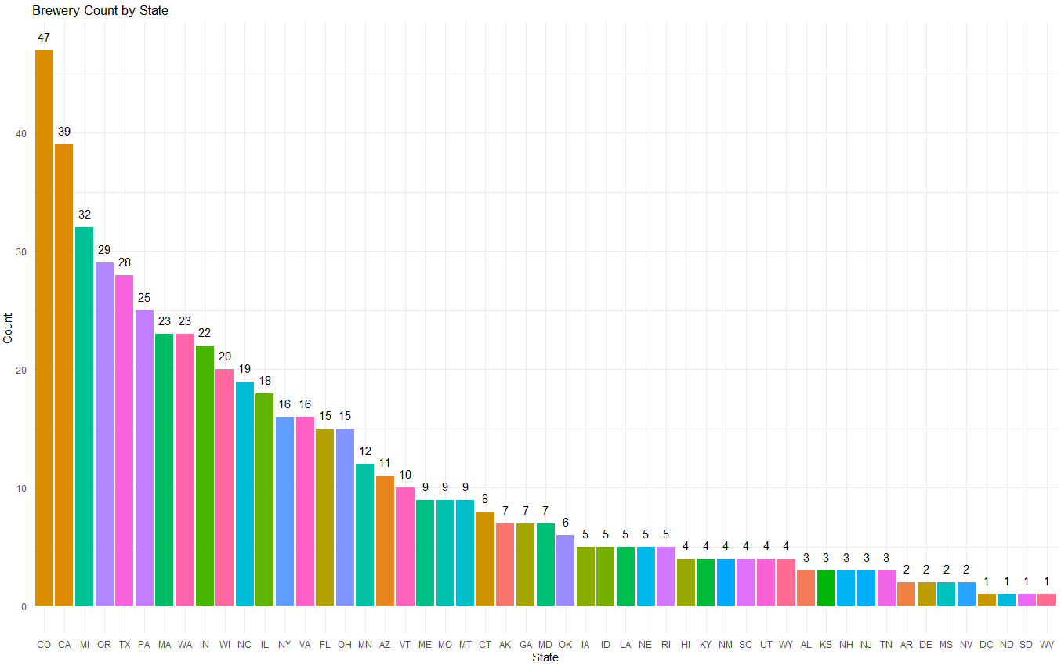
Beers by State

Slide 5
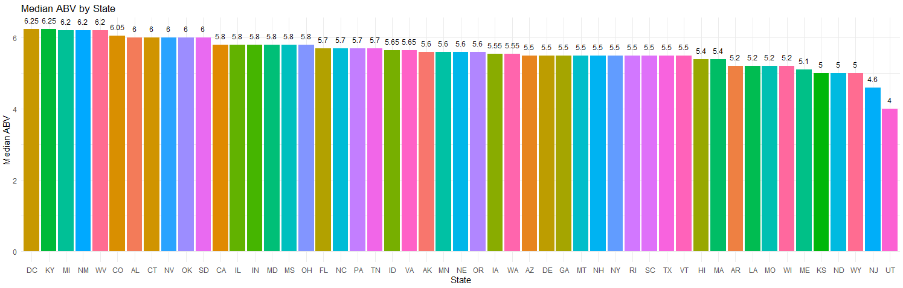
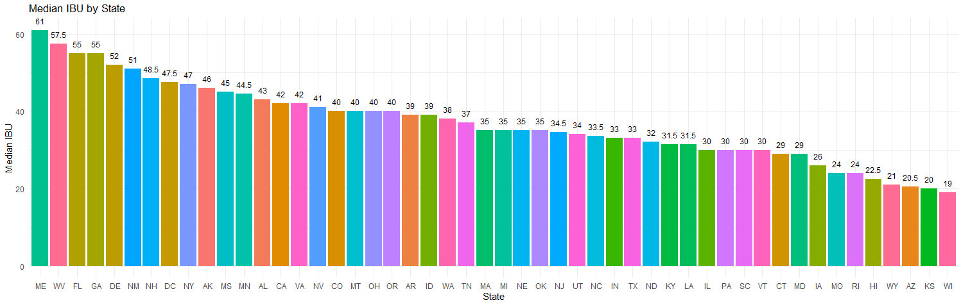
Median ABV/IBU by State

Slide 6
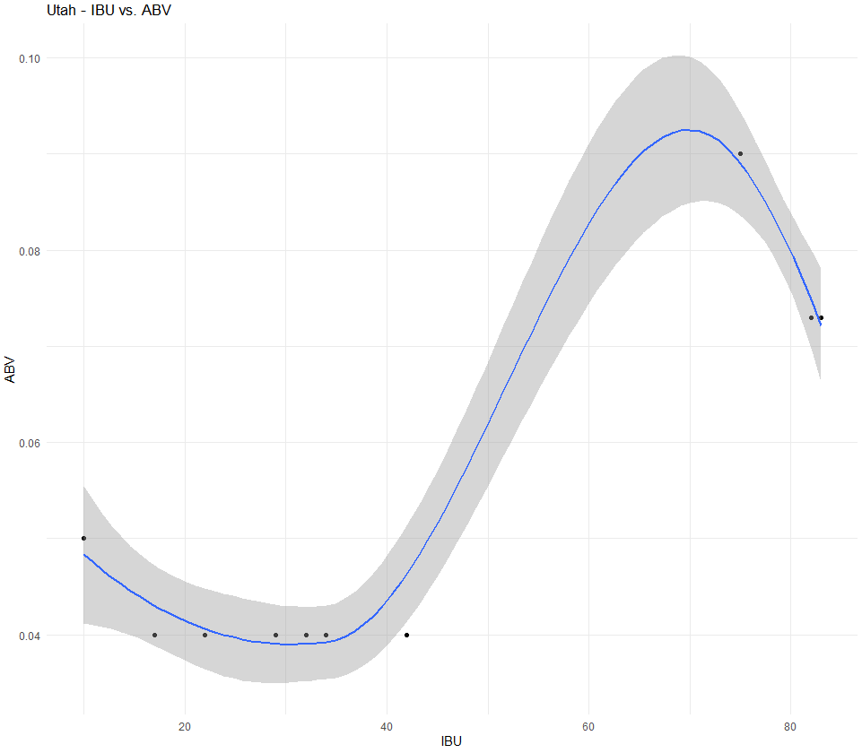
Utah ABV/IBU
Utah has a negative correlation for IBU vs. ABV.
On November 1, 2019, Utah alcohol laws were updated once again. This time it was in favor of higher alcohol beer in grocery stores and convenience stores. Previously, Utah law only allowed these locations to sell retail beer with alcohol content up to 4% alcohol by volume. The new law allows for retail beer up to 5% ABV. Beer with higher than 5% ABV will continue to be sold in state-run liquor stores just as it was before.
From - Utah.com

Slide 7
Max ABV/IBU State
ABV
Colorado – 12.8 %
IBU
Oregon - 138

Slide 8
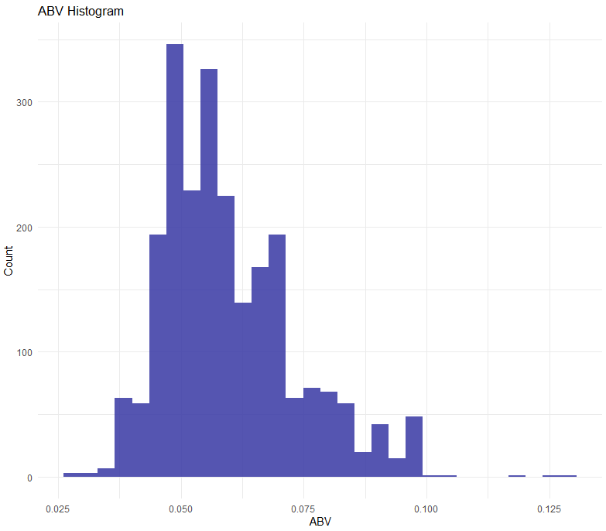
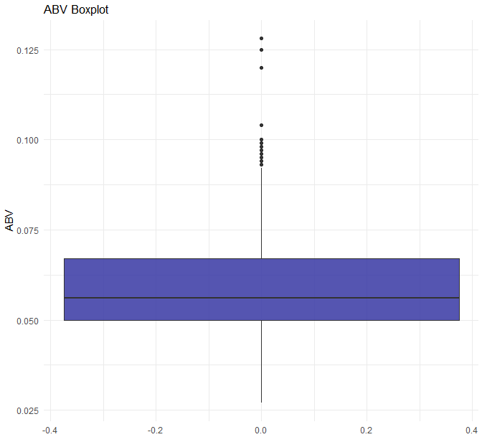
ABV Summary
While ABV has a large range, the 50% of beers fall between 5.0% and 6.7%
Its distribution is close to normal but is slightly right skewed.
We decided to remove “Scotty K NA” from the dataset because it’s ABV was so significantly less than any other beer we considered it an outlier.

Slide 9
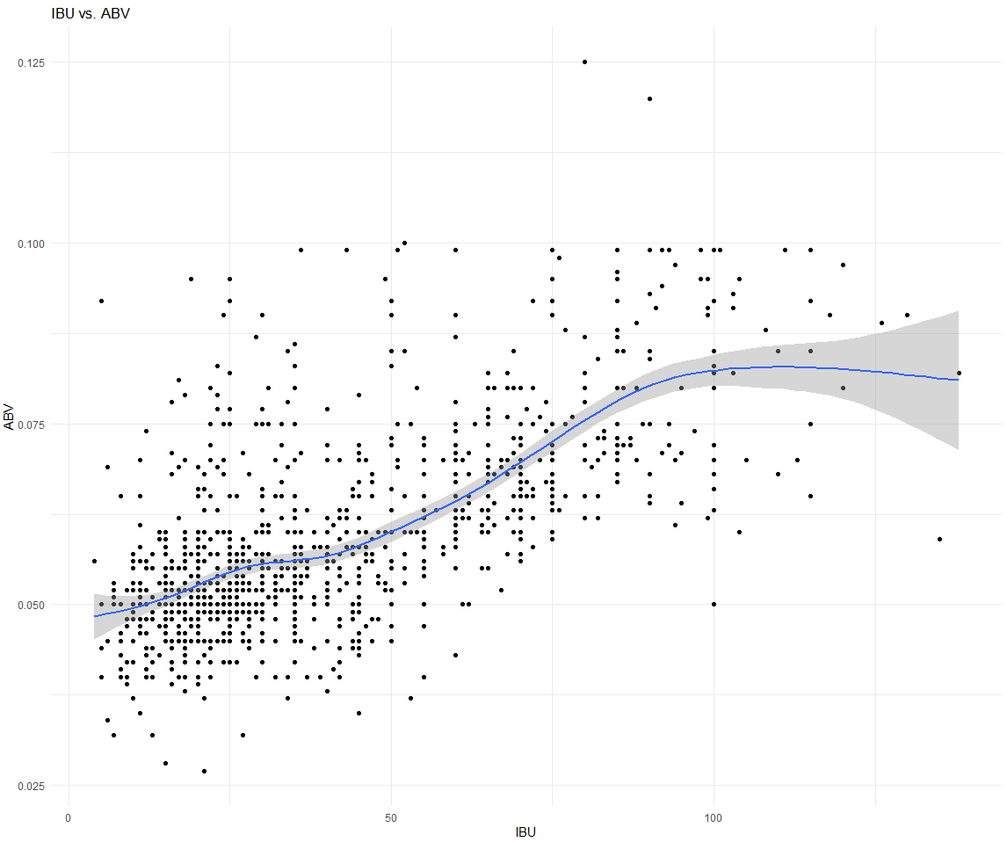
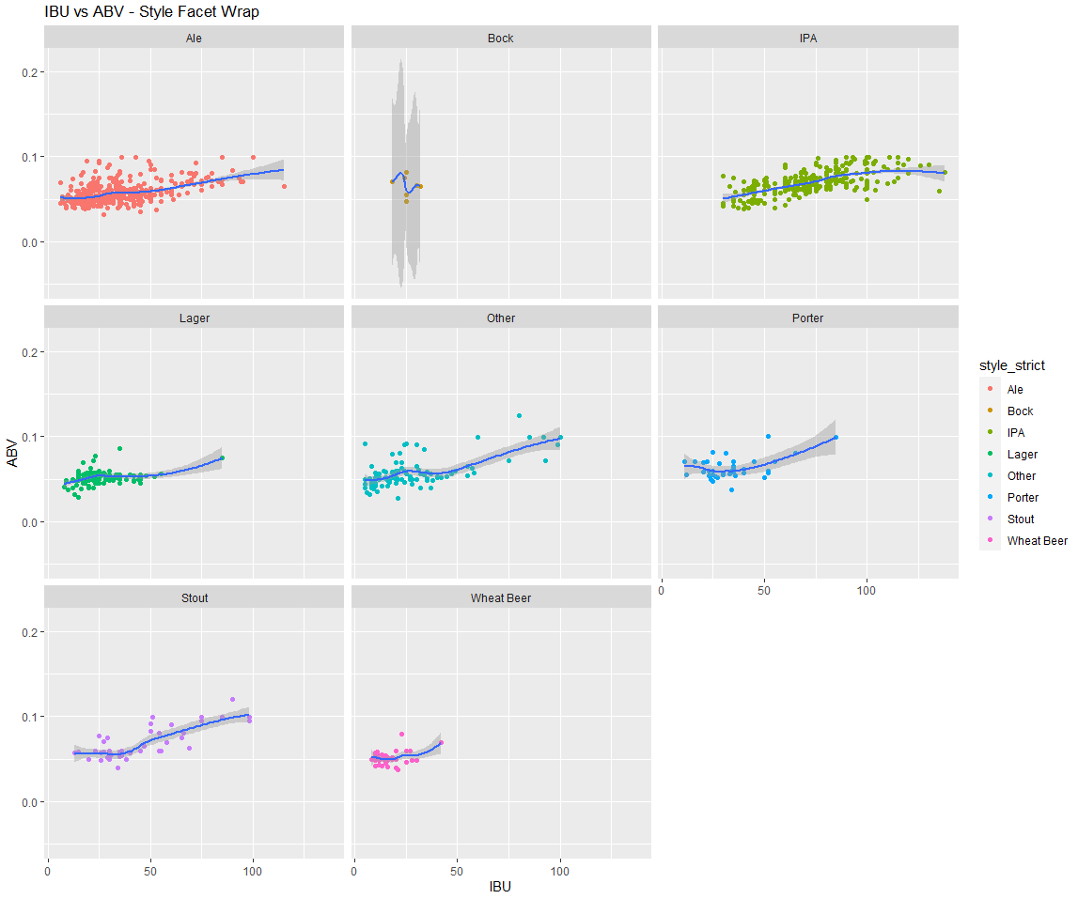
IBU vs. ABV Relationship
IBU and ABV have a very positive correlation that weakens at the lower and upper limits of IBU.
Excluding Bock due to lack of data, the relationship is maintained throughout the various styles.

Slide 10
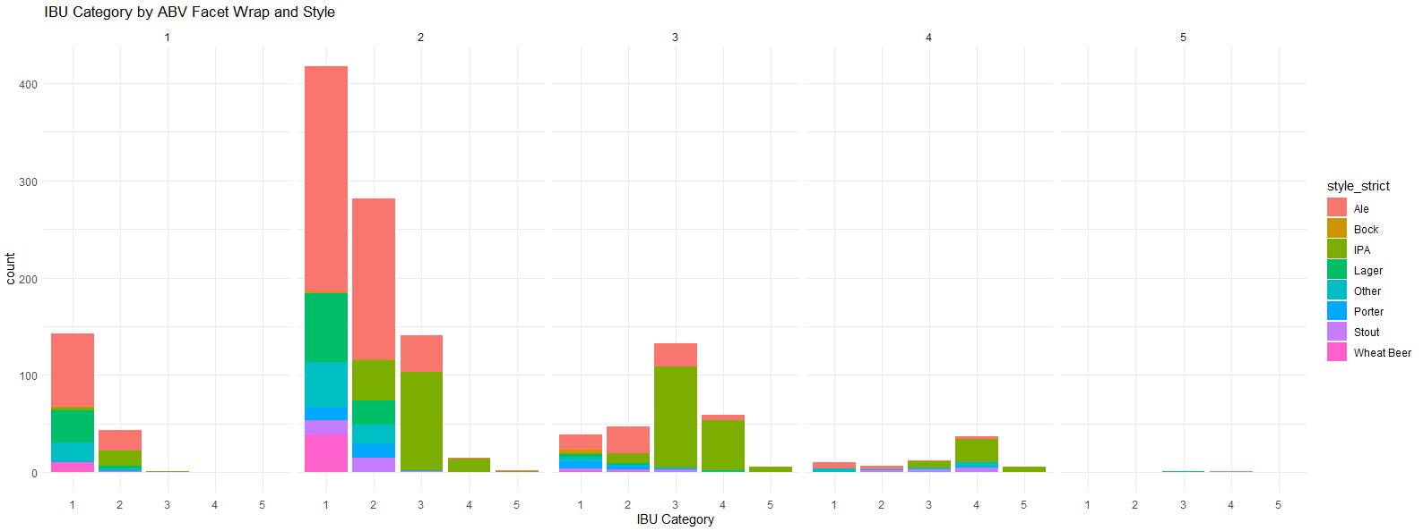
IBU Category vs ABV Category
At the lower categories of ABV, there are far less high IBU beers.
At category 3 and up is weighted more towards high IBU beers.

Slide 11
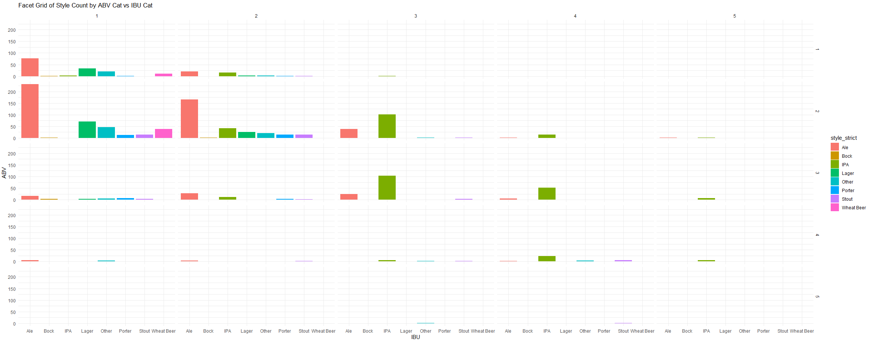
IBU Category vs ABV Category
(cont.)

Slide 12
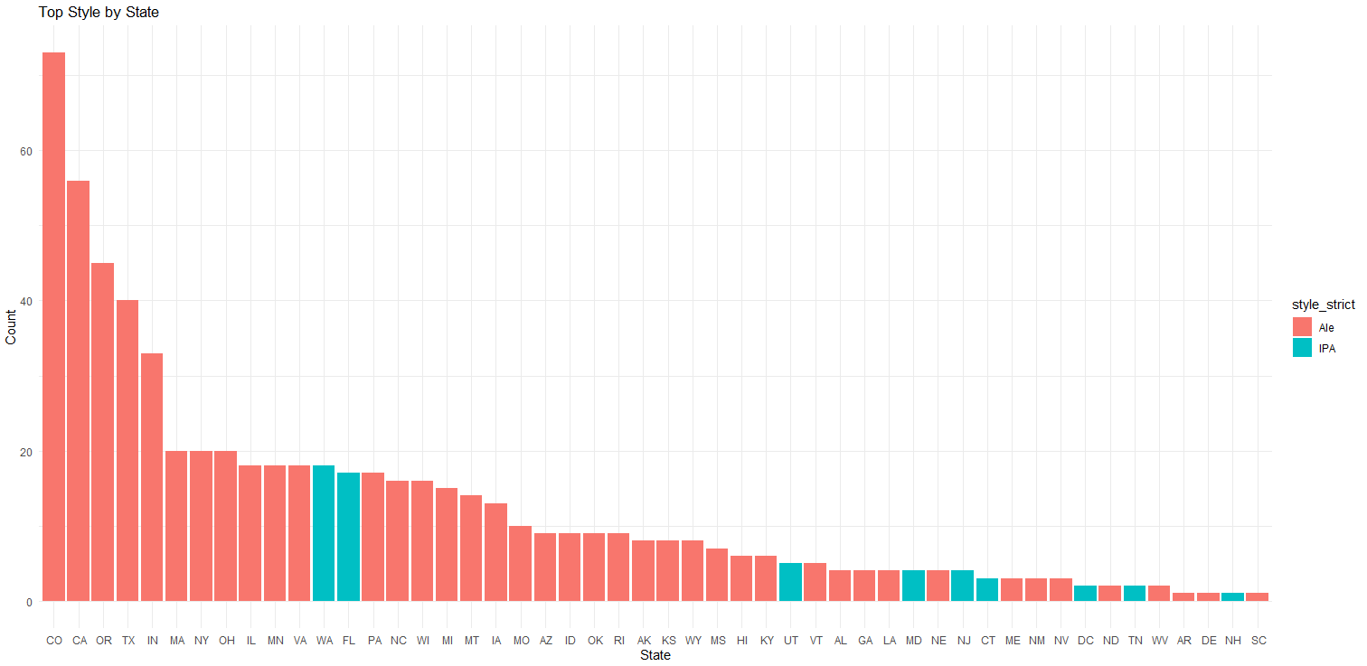
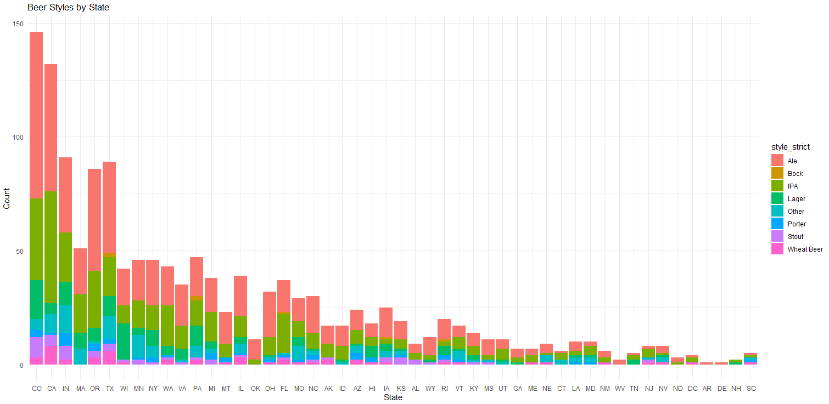
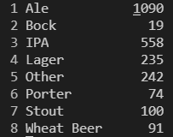
Beer Styles by State

Slide 13
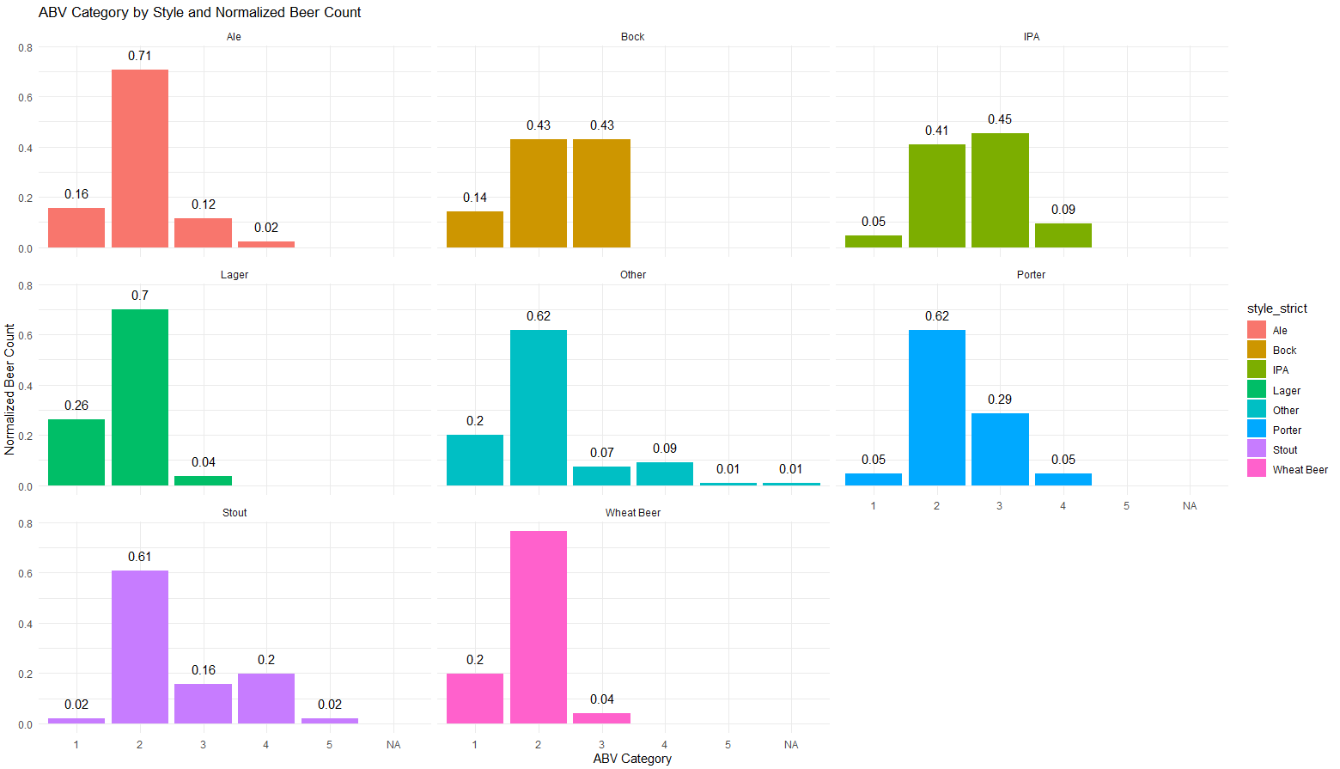
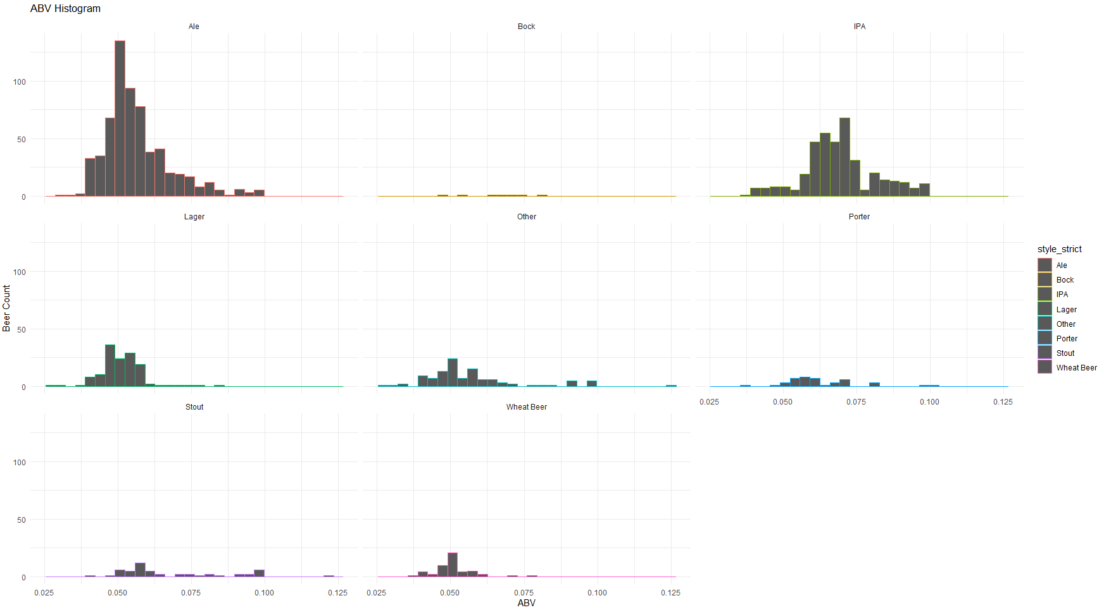
ABV Category with Normalized Counts
Ale’s account for significantly more of the total beer count.
For this reason, we normalized the count when comparing the distribution between ABV Categories.

