Slide 1
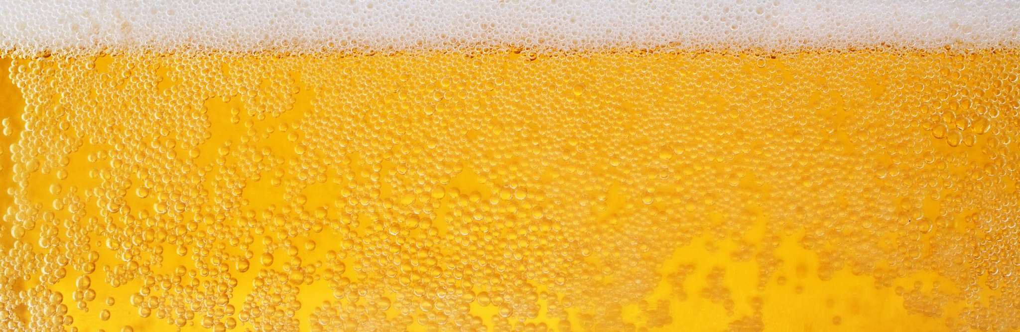
DDS Project 1: Executive Beer Analysis
by Dane Holmes

Slide 2
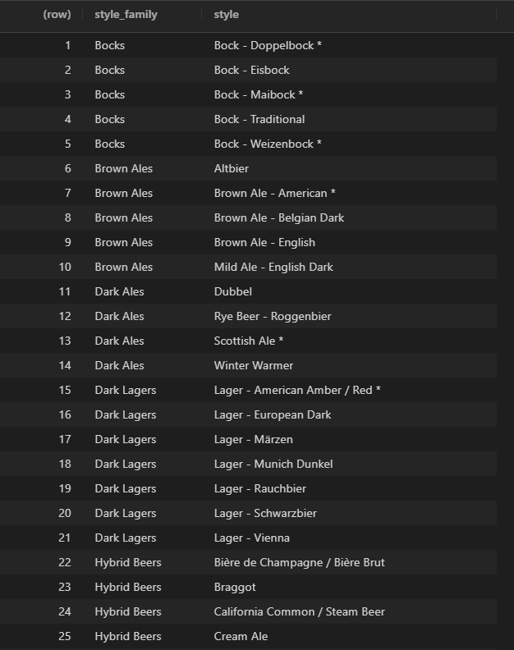
Clean Data
Beer Advocate – Beer Styles
Using an independent outside source to group beers into more manageable style groups allowed for better and less busy plots.
We decided to remove “Scotty K NA” from the dataset because it’s ABV was so significantly less than any other beer we considered it an outlier.
https://www.beeradvocate.com/beer/styles/

Slide 3
Missing Values
Missing Values
ABV | IBU
62 | 1004
All lines with missing beer names were removed.
ABV and IBU will have to be filtered each time they are used in a plot or data frame.
If they were to be filtered beforehand, a significant number of lines would be removed if IBU or ABV were not needed.

Slide 4
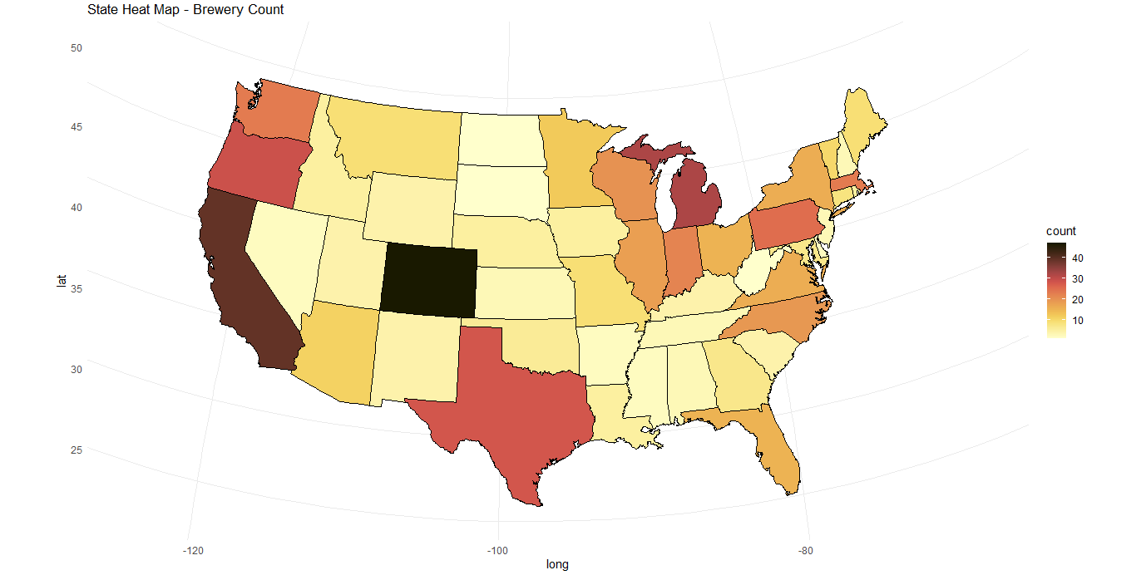
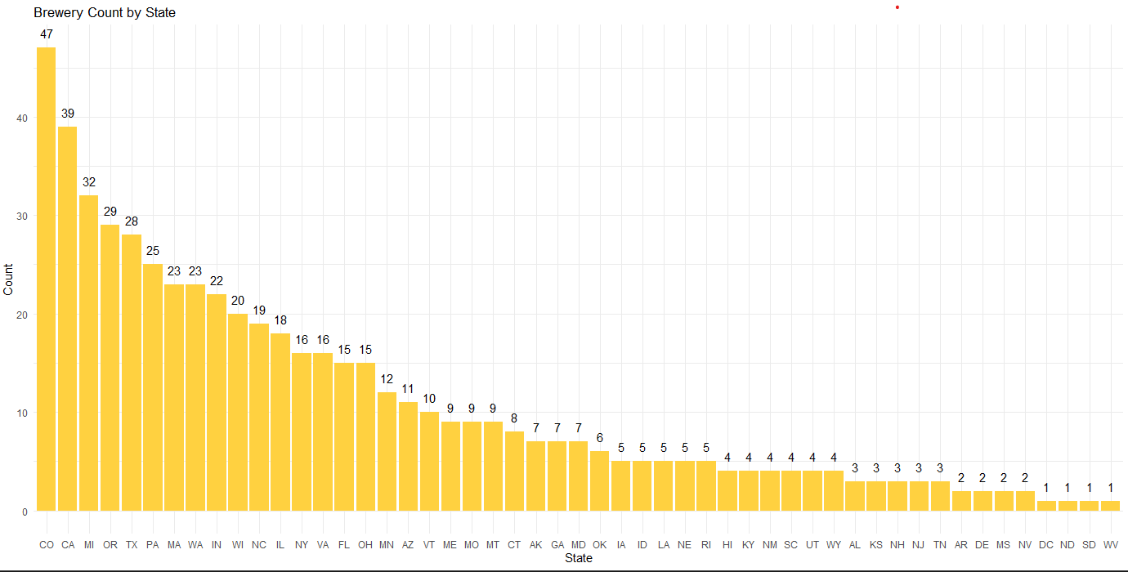
Breweries by State

Slide 5
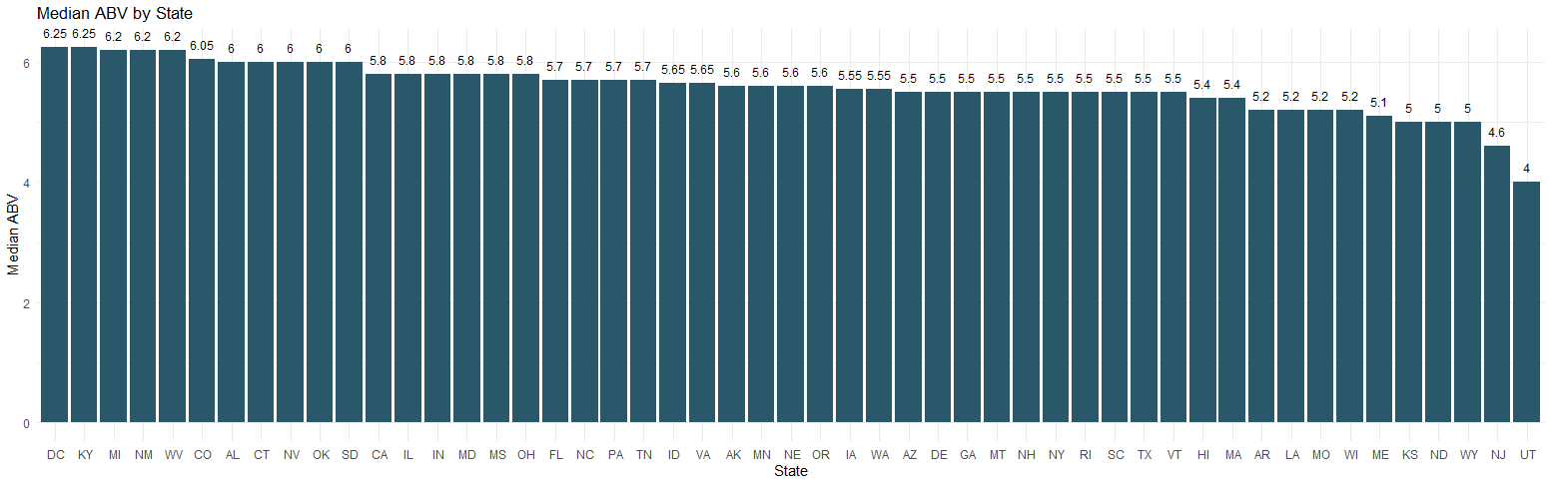
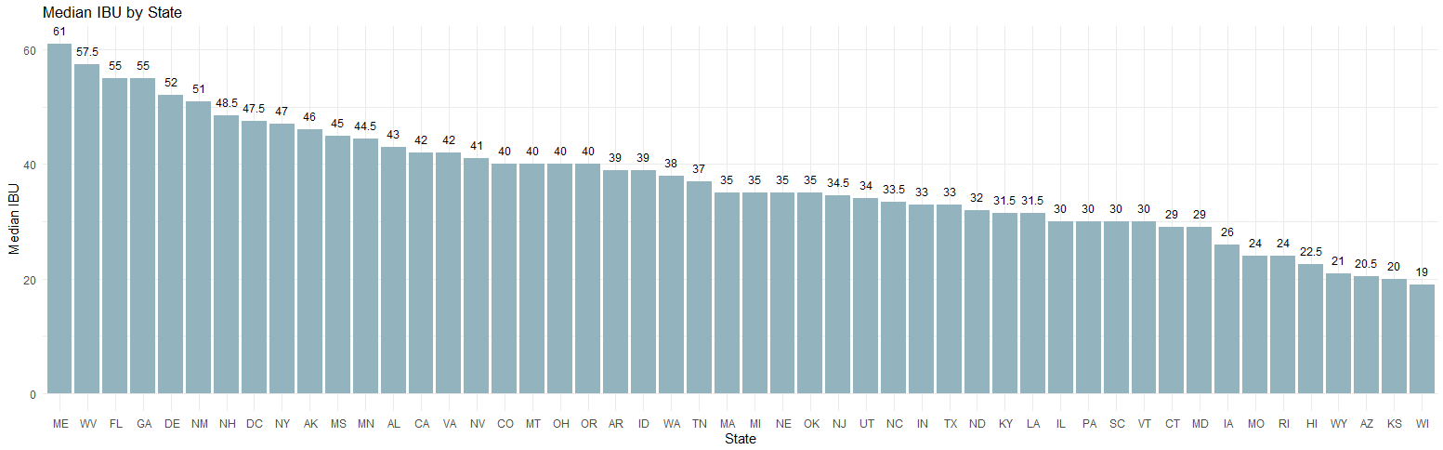
Median ABV/IBU by State

Slide 6
Max ABV/IBU State
ABV
Colorado – 12.8 %
IBU
Oregon - 138

Slide 7
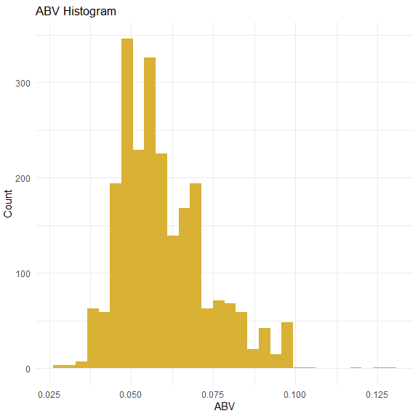
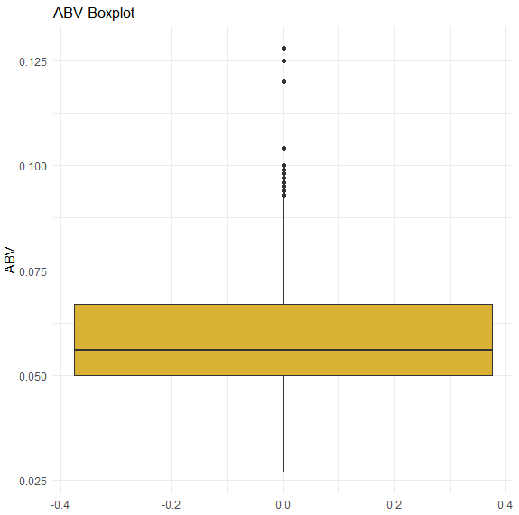
ABV Summary
While ABV has a large range, the 50% of beers fall between 5.0% and 6.7% Its distribution is close to normal but is slightly right skewed.
Summary Statistics
Min | 0.027
1st Qu. | 0.05
Median | 0.056
Mean | 0.0598
3rd Qu. | 0.067
Max | 0.128

Slide 8
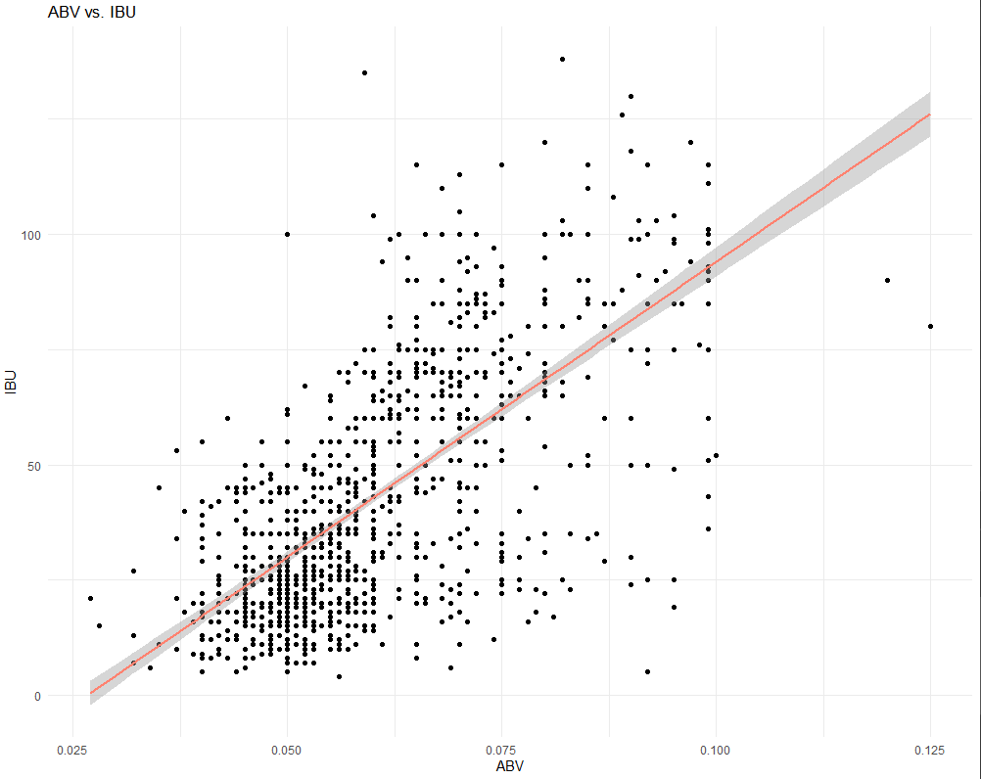
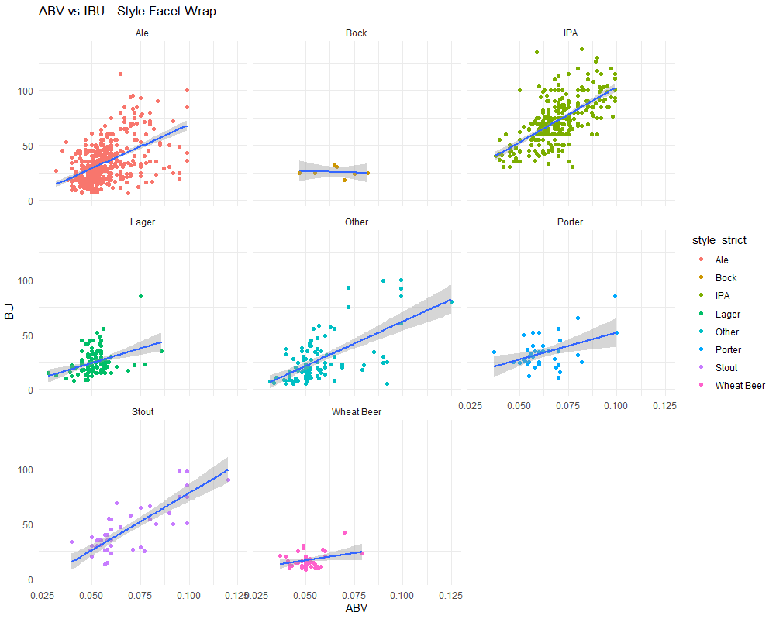
IBU vs. ABV Relationship
IBU and ABV have a very positive correlation that weakens at the lower and upper limits of IBU.
Excluding Bock due to lack of data, the relationship is maintained throughout the various styles.

Slide 9
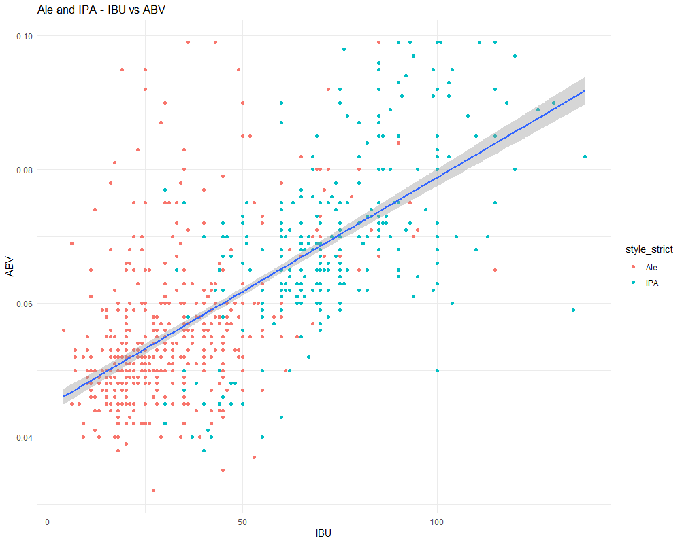
IBU vs. ABV Relationship (Ales & IPAs)
The same linear relationship is present. However, we see Ales appear to be mostly on the low end… while IPAs appear on the high end. Using the KNN model to predict style, we were able to achieve an Accuracy: 87% Sensitivity: 90% Specificity: 81%
KNN-7

Slide 10
IBU vs. ABV Relationship (Ales & IPAs)
continued…
Threshold
IBU | 50
ABV | 0.06
Lower Range | Count | Percent
Ale | 416 | 93%
IPA | 31 | 7%
When setting an upper and lower ABV/IBU limit based on a visual analysis of the previous chart, we find our assumption to be true.
Upper Range | Count | Percent
Ale | 79 | 20%
IPA | 314 | 80%

Slide 11
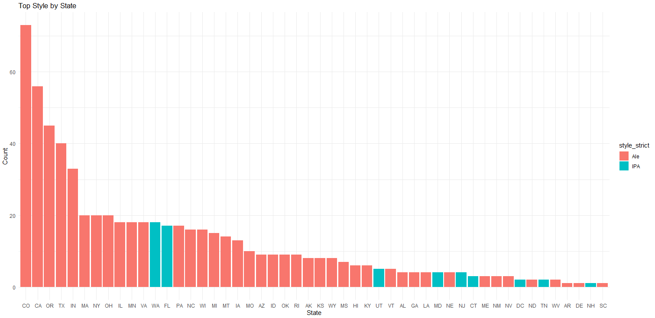
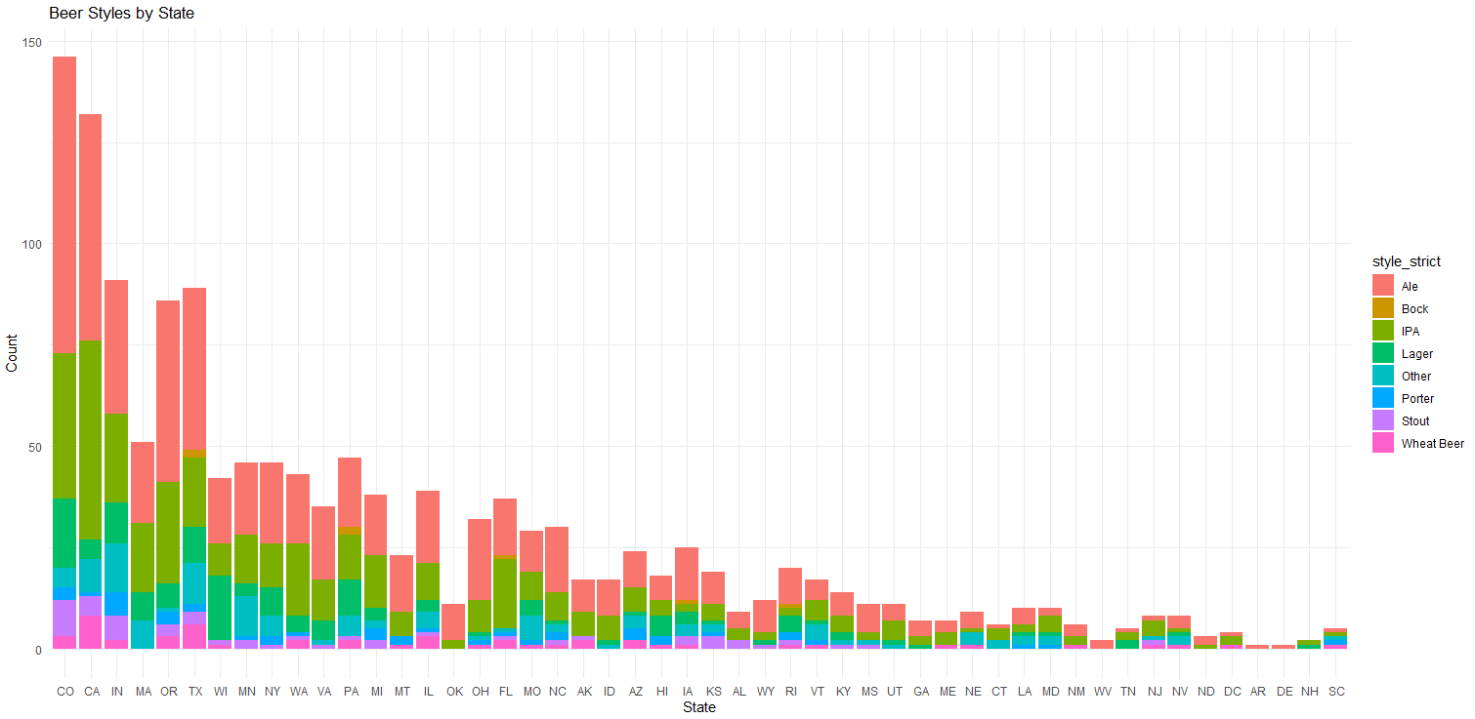
Beer Styles by State
Style | Count
Ale | 1,090
IPA | 558
Other | 242
Lager | 235
Stout | 100
Wheat Beer | 91
Porter | 74
Bock | 19

Slide 12
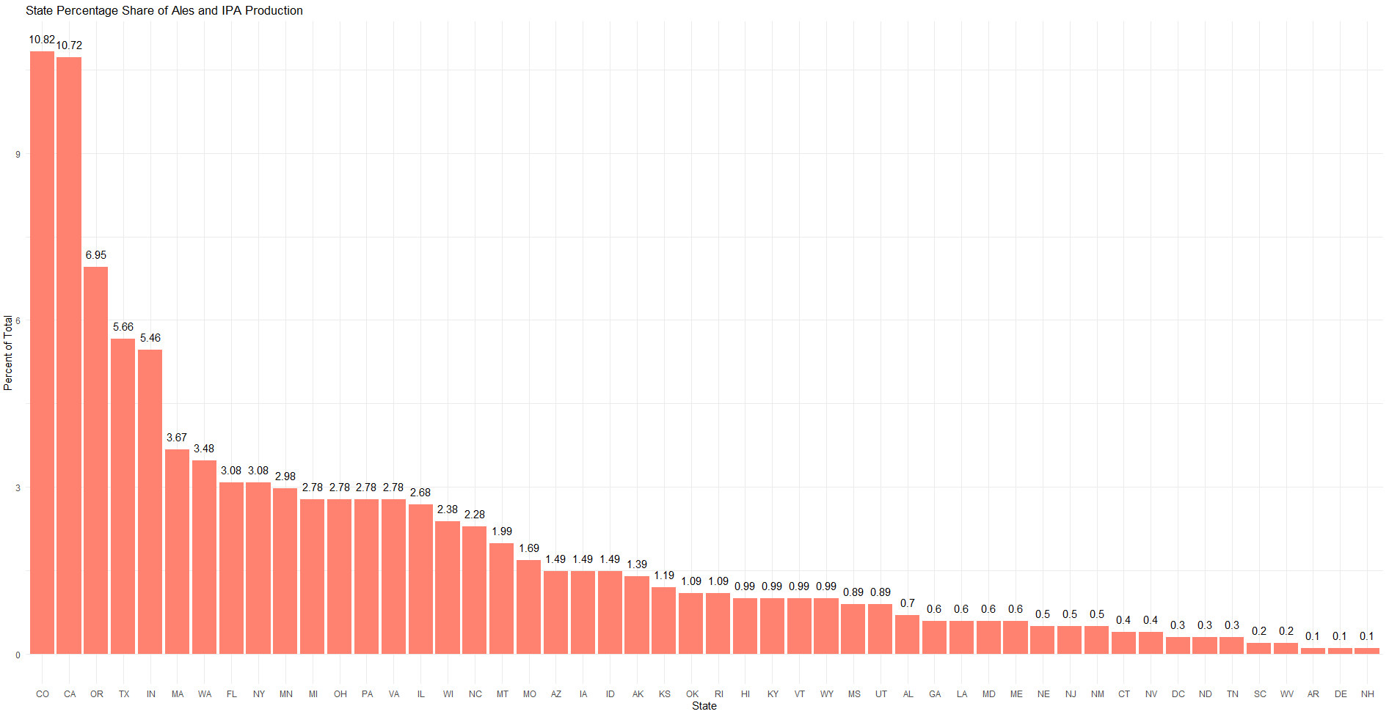
IBU vs. ABV Relationship (Ales & IPAs)
continued…

Slide 13
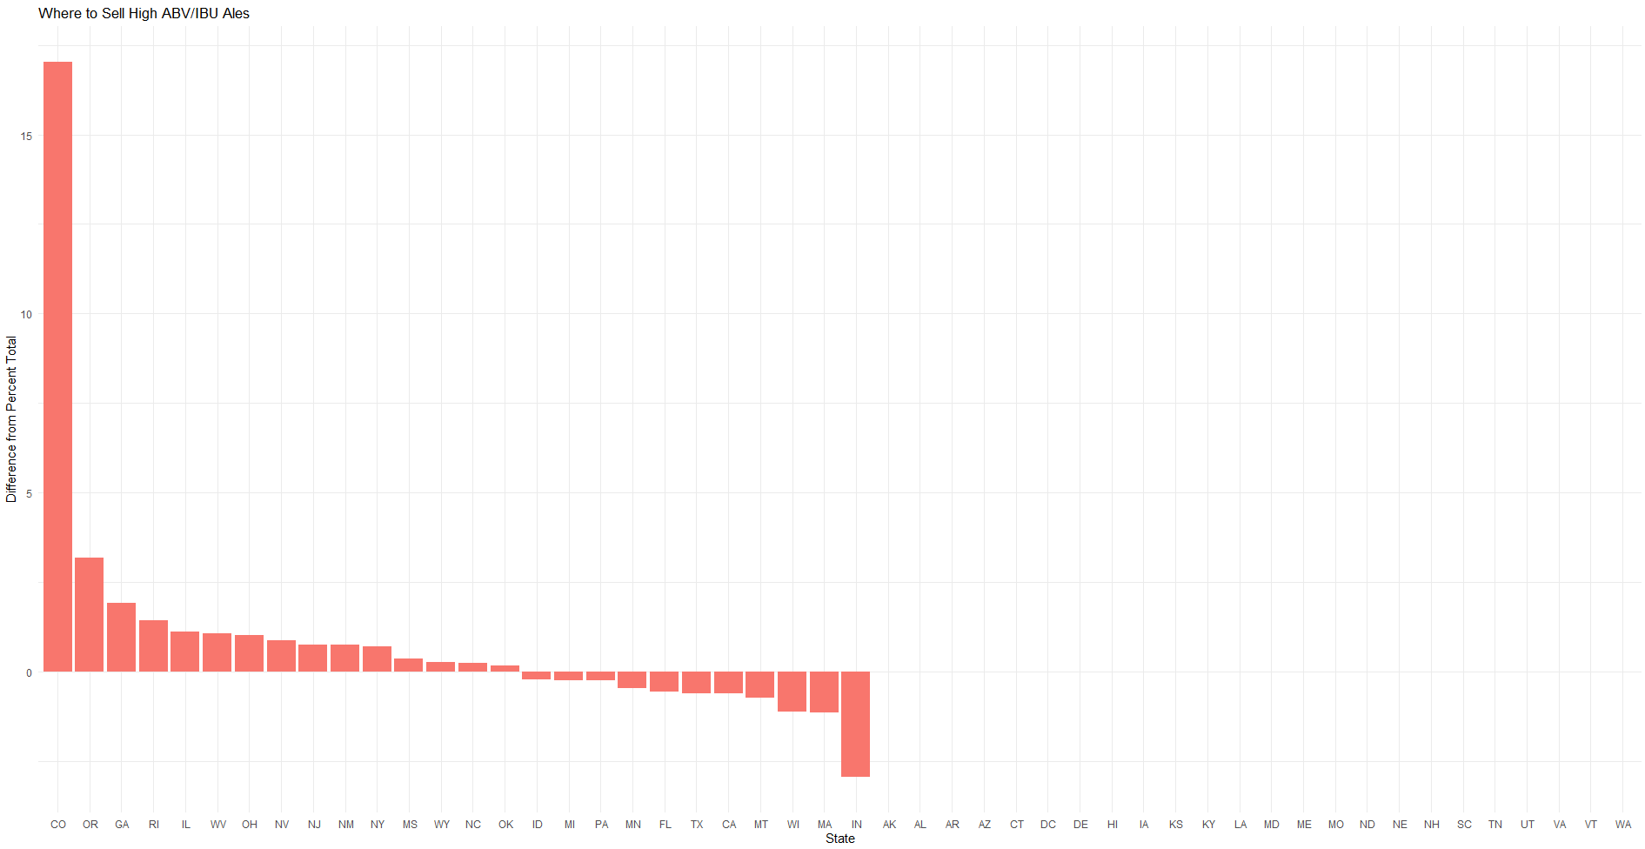
IBU vs. ABV Relationship (Ales & IPAs)
Where to sell…
Positive is better

Slide 14
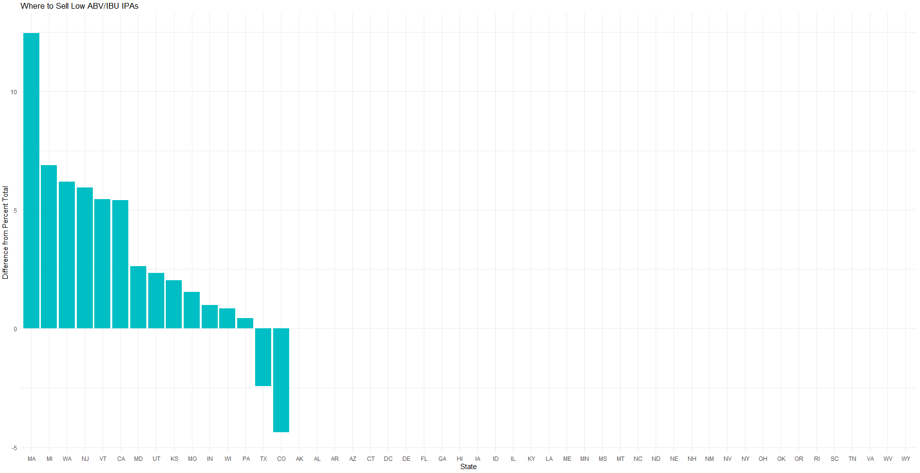
IBU vs. ABV Relationship (Ales & IPAs)
Where to sell…
Positive is better

Slide 15
Conclusion & Questions
Thank you for the opportunity to present.

