Slide 1

Doing Data Science
Live Session: Unit 10
Dane Holmes

Slide 2
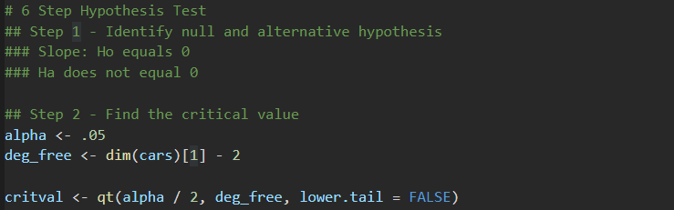
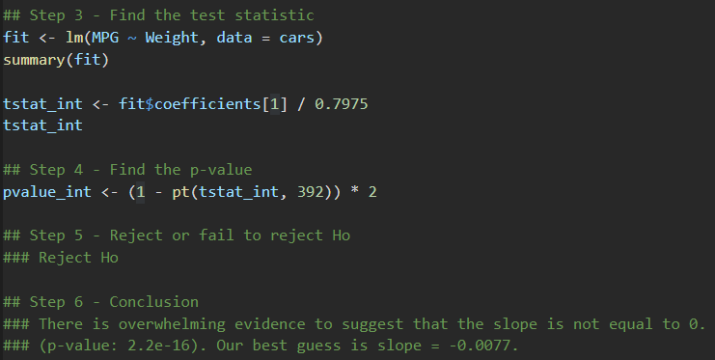

Part 1
6 Step Hypothesis Test
Critval = 1.966034
tstat_int = 58.02313
pvalue_int = 2e-16

Slide 3
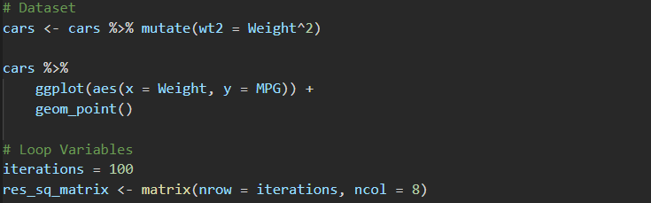
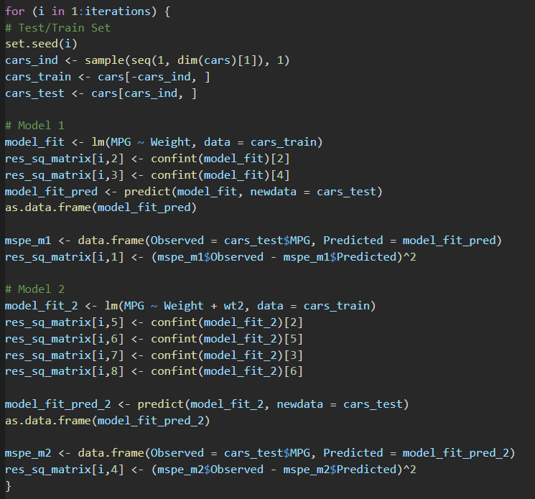
Part 2

Slide 4
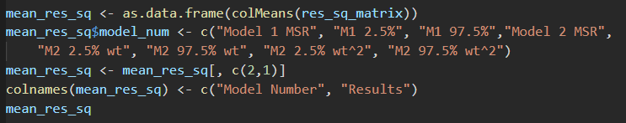
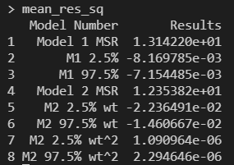
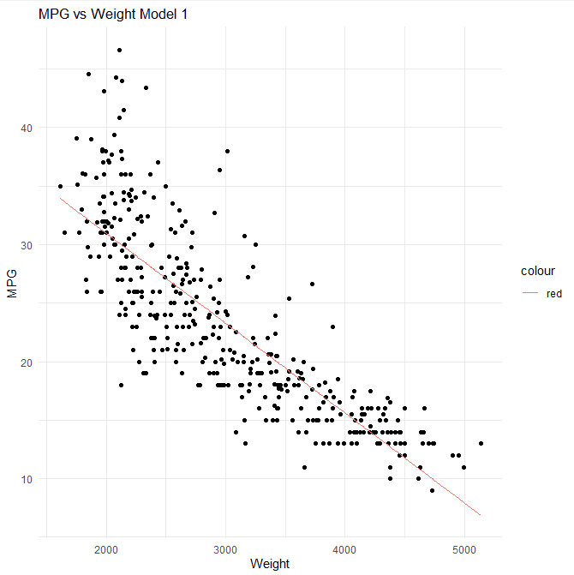
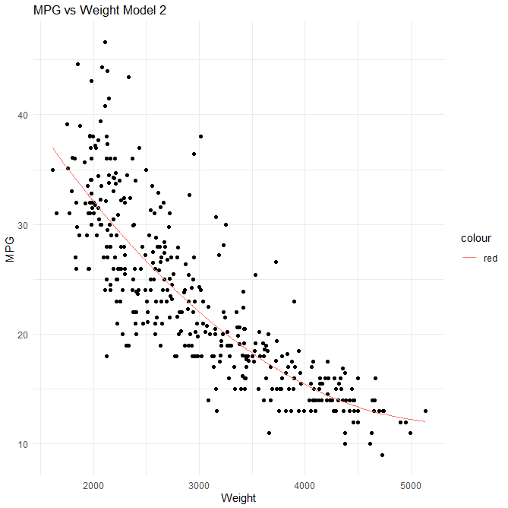

Part 2
cont.
Model 2 has a lower Mean Squared Residual of 12.35382
Using Model 2 to for our prediction…
Mean MPG = 32.12897

Slide 5
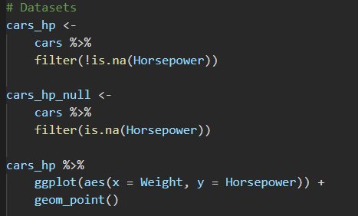
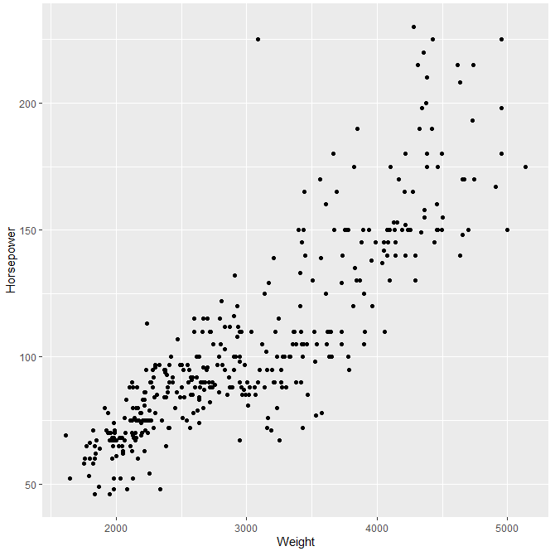
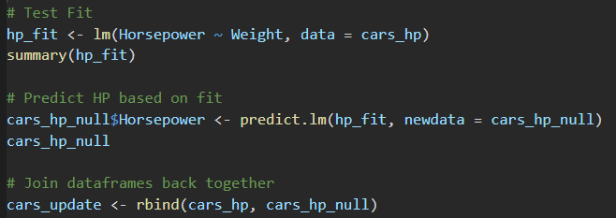
Part 3

Slide 6
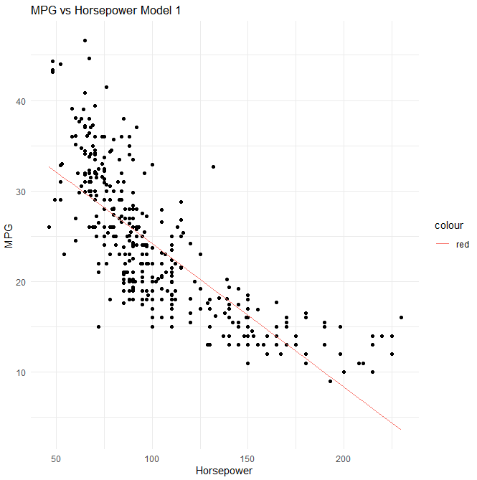
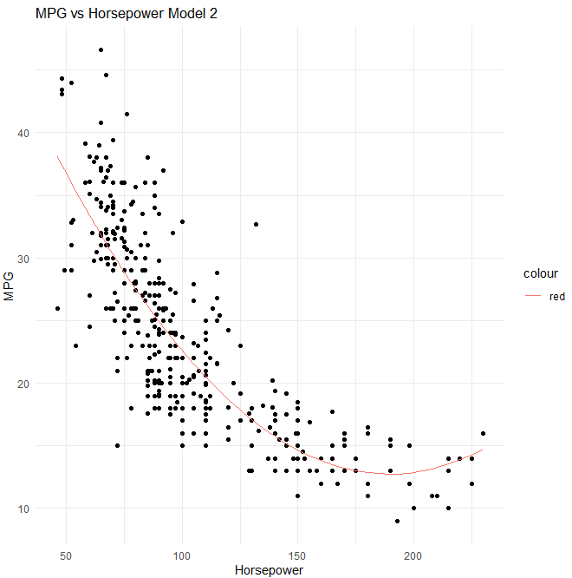
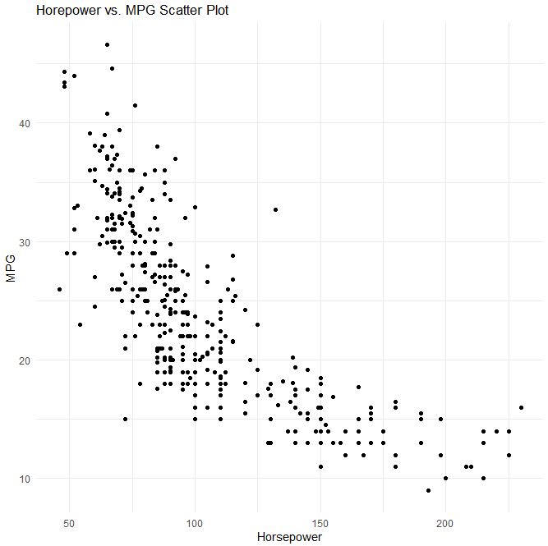



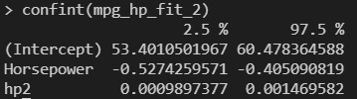
Part 3
cont.
Model 2 produces a better fit.
The data does not provide any cars over 230 hp. Therefore, our prediction is extrapolation.
Model 2 predicts an MPG of 17.22886 given a Horsepower of 250.

Slide 7
. Takeaways and/or Questions
I found the application of a squared model to be much more tedious than for a normal linear model.
Are there any functions that allow you to choose this instead of having to add the squared column to the data.frame.
Interpreting confidence intervals for exponential fits was confusing to me.
How do you interpret the confidence intervals for wt and wt^2?

